Slide 1
PGR Student Introduction to
TurnitinUK OriginalityCheck Software
http://www.turnitinuk.com
Last updated January 2015

Slide 2
Examples of Plagiarism
According to Cottrell (2008) this could be:
  Summarising a text using virtually the same words that have been used (eg in journals, classes, texts, websites etc..)
  Using but not acknowledging the ideas of others (eg theories etc..).
  Re-writing authors’ work in your own words but not giving them credit.
    Cottrell, S. (2008) The Study Skills Handbook, 3rd edn. Basingstoke: Palgrave Macmillan.

Slide 3
Plagiarism
“Even when you change (some) words or sentences you have ‘borrowed’ or put them in a different order, the result is still plagiarism.” Stella Cottrell (2008, p.128)
… When you write in your own words they are unique to you….
… So the sentences that students use in an essay should not match the sentences in other essays or online sources…

Slide 4
TurnitinUK
Electronic originality checking service
Global leader
Used in “nearly 100%” of UK Universities (including UU)
Checks your writing against a range of online sources
Checks your writing against bank of student assignments

Slide 5
“Healthy” Text Matches 1
References
  References at end of assignment can be excluded but both in text and sub-text references can match.
Quotations
  Can be excluded but what percentage is allowable? Are they correctly constructed/referenced? DOUBLE QUOTATION MARKS
Definitions
  You might be using use standard definitions but should these be in the form of quotes?
  Which sources of definitions are acceptable? e.g. SHOULD YOU USE WIKIPEDIA?
Standard terms
  Scientific, engineering, medical, philosophical, psychological, educational, sociological management-related, etc.
  E.g. Names of procedures

Slide 6
“Healthy” Text Matches 2
Names of Official Organisations
  Public, national & international bodies etc.
Report titles
  Titles of official reports referred to in text.
Required Headings & Sub-headings
  If you have given a standard format for the assignment to follow the title & subsection headings may match with those of others.
STUDENT SELF TEST:
Could I have written this any other way?
Is there someone I should acknowledge?
n.b. It would be extremely rare for a submission to return a 0% report

Slide 7
Student Introduction to
TurnitinUK
These instructions show you how to:
Register for the service
Upload and re-upload a chapter
View the originality report
Open an Internet browser and go to the following website address:
http://www.turnitinuk.com

Slide 8
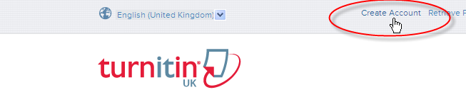
Creating a Student Account (step 1)
To use the system you must first sign up at the TurnitinUK website: http://www.turnitinuk.com : click Create Account at the top of the window .

Slide 9
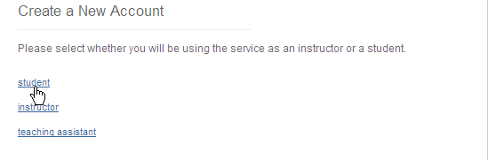
Creating a Student Account (step 2)
(Scroll Down) Under Create a New Account click Student

Slide 10
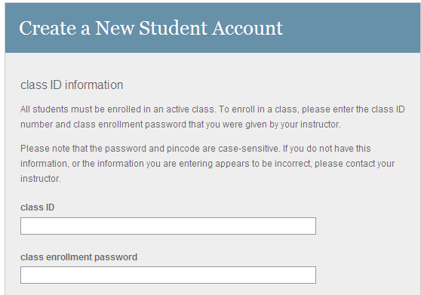
Creating a Student Account (step 3)
class ID and password (sent to you by your supervisor) scroll down to continue.
All sections with a red asterisk * must be completed.

Slide 11
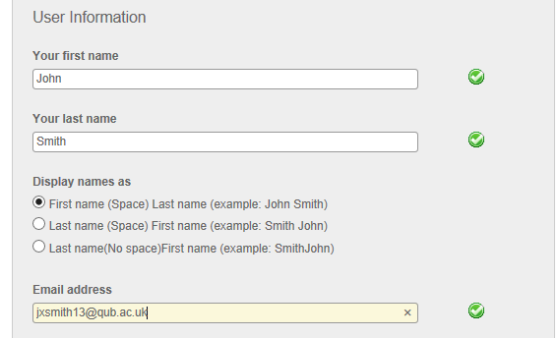
Creating a Student Account (step 4)
Please enter First Name, Surname (as used at enrolment) and your QUB email address -> scroll down to continue.

Slide 12
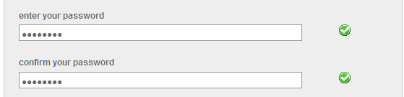
Creating a Student Account (step 5)
Enter a password* and then confirm it. Make sure you use a password you will remember!! -> scroll down to continue.
*Passwords must include at least one Number and one Letter and be between 6 and 12 characters (it is also case sensitive).

Slide 13
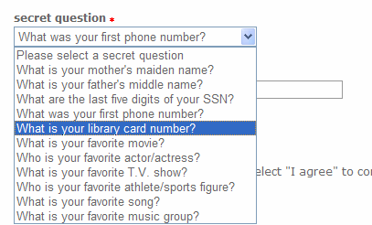
Creating a Student Account (step 6)
Select a secret question from the drop down menu.
Type the answer to this question in the box ‘question answer’ -> scroll down to continue.

Slide 14
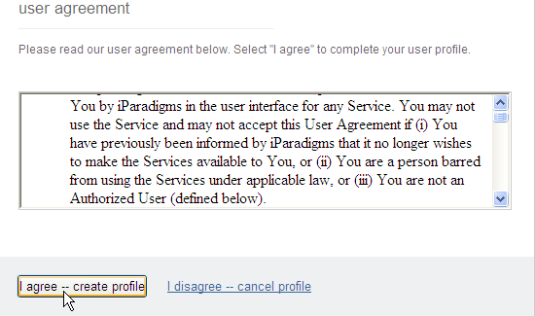
Creating a Student Account (step 7)
Read the user agreement displayed -> you will be asked to click on I agree -- create profile link.

Slide 15
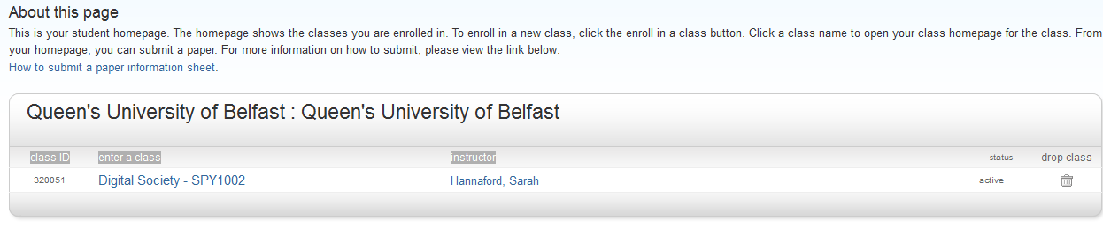
Creating a Student Account (finish)
You have now completed creating your student account.
You will now be directed to your student homepage (see image below).

Slide 16
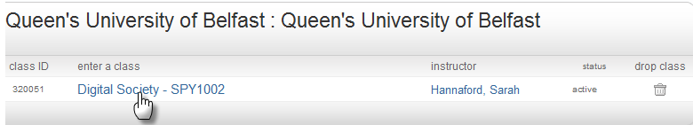
Submitting a Chapter/paper
To submit a paper you must first enter the class homepage by clicking on the class name on your homepage (underneath enter a class).

Slide 17
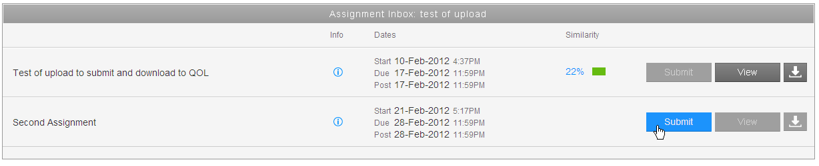

Submitting a Chapter/paper
Click on the blue submit button next to the desired chapter heading in your class portfolio.
Please note when the assignment is closed to submissions the submit button will be coloured grey.
Information about the assignment can be found at

Slide 18
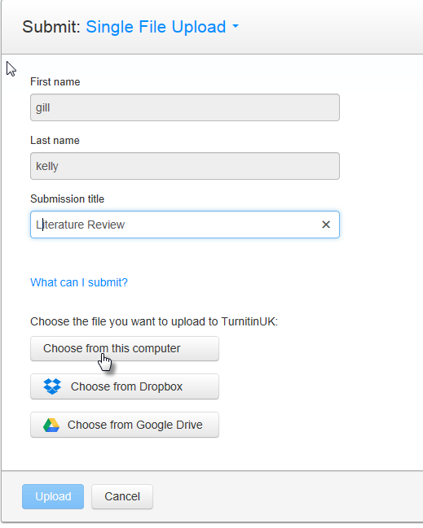
Submitting a Chapter/paper
Select ‘single file upload’ from the drop down menu
Enter a title for the chapter (your name will be automatically inserted)
Click the Browse… button to locate your chapter on the PC for upload to the system

Slide 19
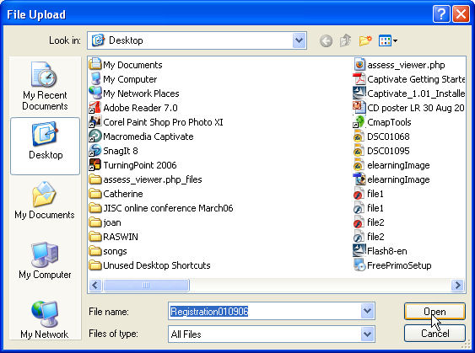
Submitting a Chapter/paper
From the File Upload window locate your document -> click Open.

Slide 20
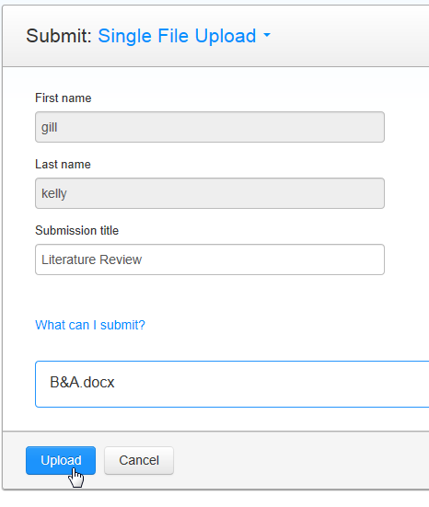
Submitting a Chapter/paper
The path to your file will appear beside the Browse… button -> click submit.
The system will tell you if your file is uploaded successfully and if so, you will taken to the preview screen

Slide 21
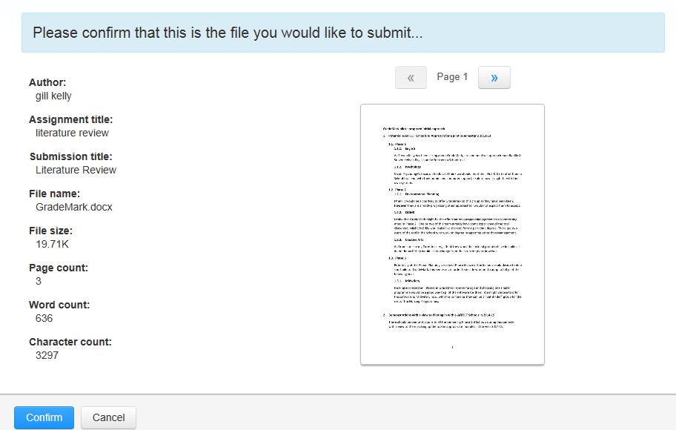
Submitting a Chapter/paper
The text of your assignment will be displayed in a window for you to check. If it is the correct file -> click Confirm.
If this is not the correct file click on Cancel and select a different (correct) file.

Slide 22
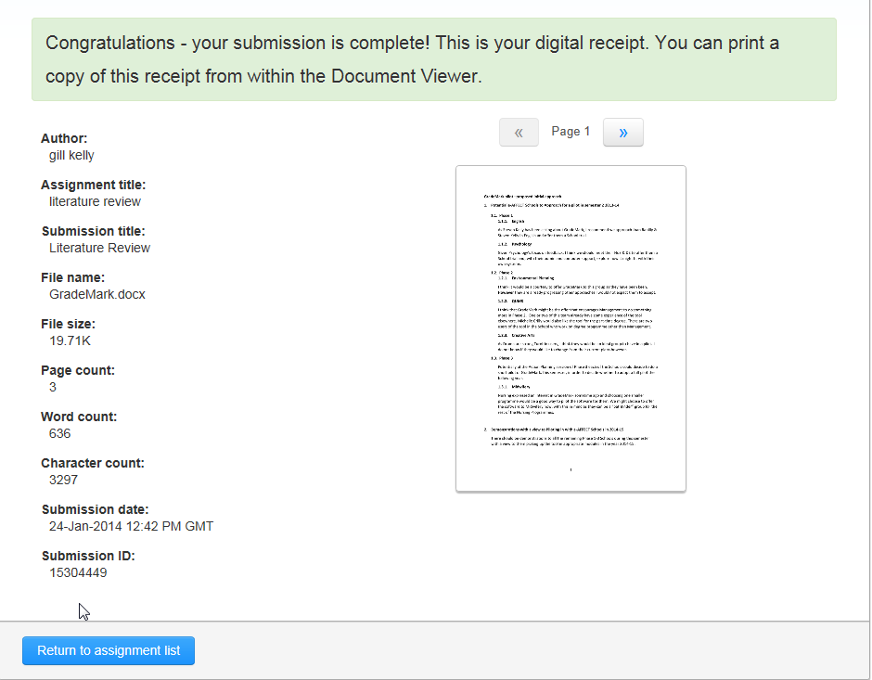
Submitting a Chapter/paper
You will then see a digital receipt showing that you have submitted the assignment to TurnitinUK.
To return to the class page -> click ‘Return to assignment list’
An email will also be sent to you confirming the submission.

Slide 23
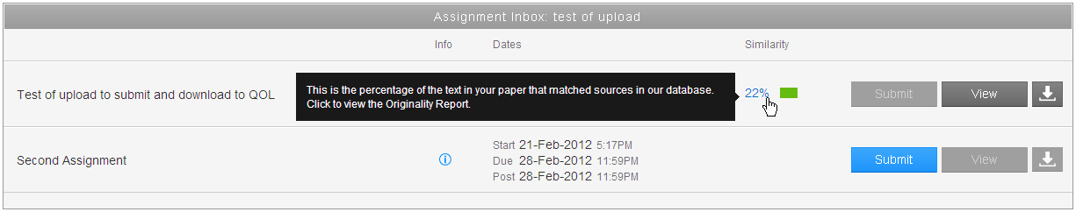
Viewing your submissions
You can view your submissions and their associated originality reports on your class homepage.
Only you and the lecturer can see your submission.
Your homepage will look similar to below:
To view the originality report click on the coloured rectangle, which may take several hours to appear depending upon the document size (the percentage in the brackets is the level of matched text).
To view your document submission click on view.

Slide 24
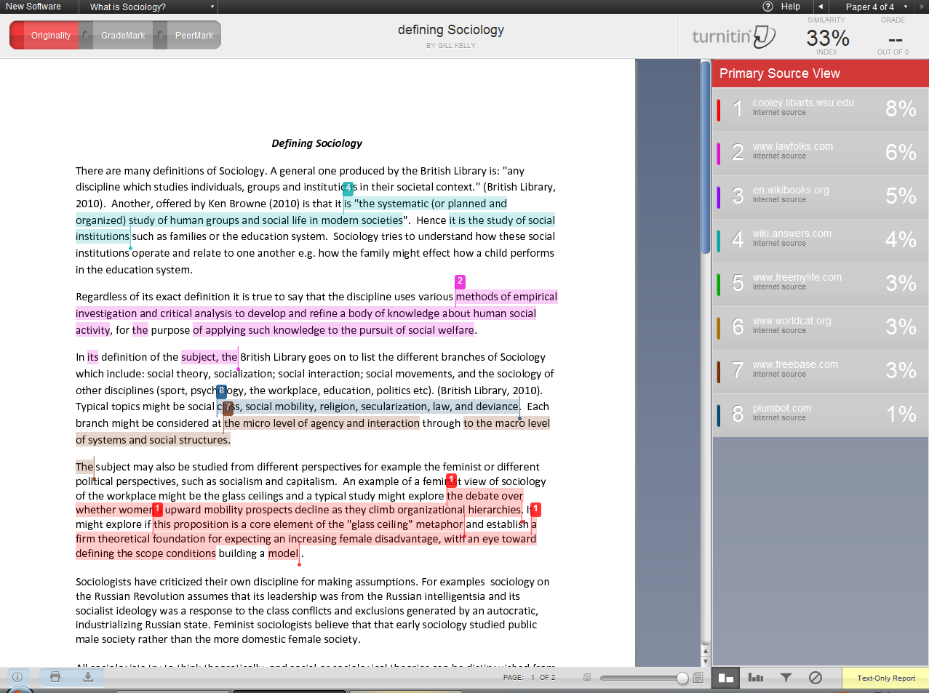
Viewing an originality report
3
Your chapter is displayed on the left.
To view the matching material in detail, click on the match itself or the corresponding link in the right hand window and the content is shown above the match.
The overall percentage of matched text is displayed at the top of the report.
You can choose to include/exclude quotations and bibliography in the comparison.
1
2
2
4

Slide 25
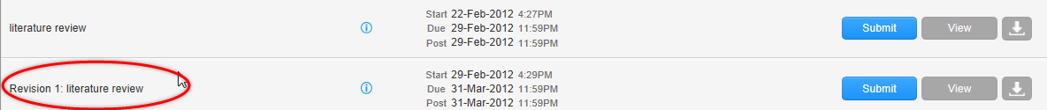
Viewing your submissions
Once you have reviewed your originality report you can submit one further draft of your chapter which will not be compared to the first. This submission opportunity will show as a revision of the original chapter.
The originality should normally be produced within 1-2 hours but allow up to 24 hours for the originality report to appear.

