Slide 1
Student Introduction to TurnitinUK OriginalityCheck Software
www.turnitinuk.com
Last updated July 2016

Slide 2
Examples of Plagiarism
According to Cottrell (2008) this could be:
Summarising a text using virtually the same words that have been used (eg in journals, classes, texts, websites etc..)
Using but not acknowledging the ideas of others (eg theories etc..).
Re-writing authors’ work in your own words but not giving them credit.
Cottrell, S. (2008) The Study Skills Handbook, 3rd edn. Basingstoke: Palgrave Macmillan.

Slide 3
Plagiarism
“Even when you change (some) words or sentences you have ‘borrowed’ or put them in a different order, the result is still plagiarism.” Stella Cottrell (2008, p.128)
… When you write in your own words they are unique to you….
… So the words students use in an essay should not match the words in other essays…

Slide 4
TurnitinUK
Electronic originality checking service
Global leader
Used in “nearly 100%” of UK Universities (including UU) & ROI
Checks your assignments against a range of online sources
Checks your assignments against other student assignments

Slide 5
Taking a look at Turnitin
www.turnitinuk.com
A live explanation of the originality report

Slide 6
“Healthy” Text Matches 1
References
References at end of assignment can be excluded but both in text and sub-text references can match.
Quotations
Can be excluded but what percentage is allowable? Are they correctly constructed/referenced? DOUBLE QUOTATION MARKS
Definitions
You might be using use standard definitions but should these be in the form of quotes?
Which sources of definitions are acceptable? e.g. SHOULD YOU USE WIKIPEDIA?
Standard terms
Scientific, engineering, medical, philosophical, psychological, educational, sociological management-related, etc.
E.g. Names of procedures

Slide 7
“Healthy” Text Matches 2
Names of Official Organisations
Public, national & international bodies etc.
Report titles
Titles of official reports referred to in text.
Required Headings & Sub-headings
If you have given a standard format for the assignment to follow the title & subsection headings may match with those of others.
STUDENT SELF TEST:
Could I have written this any other way?
Is there someone I should acknowledge?
n.b. It would be extremely rare for a submission to return a 0% report

Slide 8
Student Introduction to TurnitinUK
These instructions show you how to:
Register for the service
Register for a class/module
Upload and re-upload an assignment
View the originality report
Open an Internet browser and go to the following website address:
http://www.turnitinuk.com

Slide 9
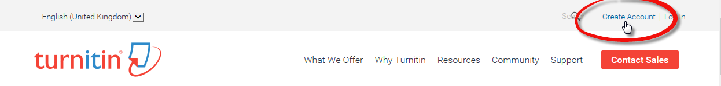
Creating a Student Account (step 1)
To use the system you must first sign up at the TurnitinUK website: http://www.turnitinuk.com . Check that the language is English (United Kingdom)
Click Create Account at the top of the window

Slide 10
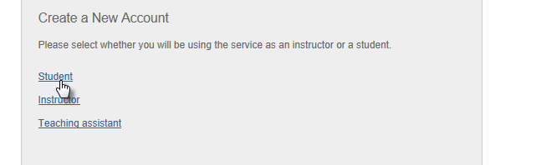
Creating a Student Account (step 2)
Under create a new account click student (scroll down if necessary)

Slide 11
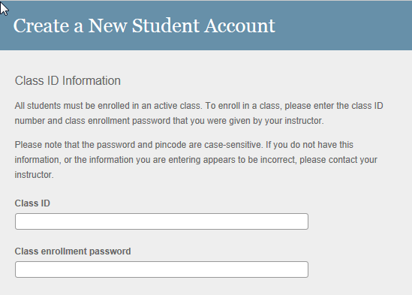
Creating a Student Account (step 3)
class ID and password (sent to you by email from your lecturer) scroll down to continue.
All sections with a red asterisk * must be completed.

Slide 12
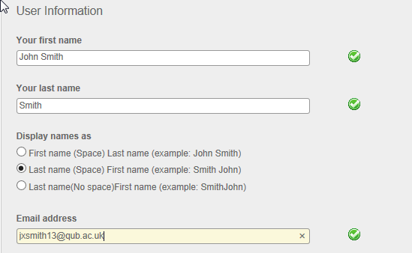
Creating a Student Account (step 4)
Please enter First Name, Surname (as used at enrolment) and your QUB email address -> scroll down to continue.
Notes:
Please note the following programmes English, Politics, all GAP programmes, Social Work have used the student number in the surname field. These slides will need to be amended to reflect that.

Slide 13
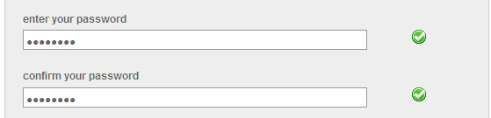
Creating a Student Account (step 5)
Enter a password* and then confirm it. Make sure you use a password you will remember!! -> scroll down to continue.
*Passwords must include at least one Number and one Letter and be between 6 and 12 characters (it is also case sensitive).

Slide 14
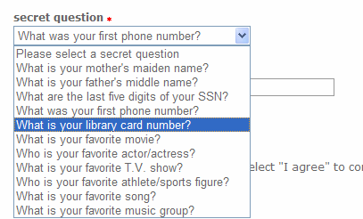
Creating a Student Account (step 6)
Select a secret question from the drop down menu.
Type the answer to this question in the box ‘question answer’ -> scroll down to continue.

Slide 15
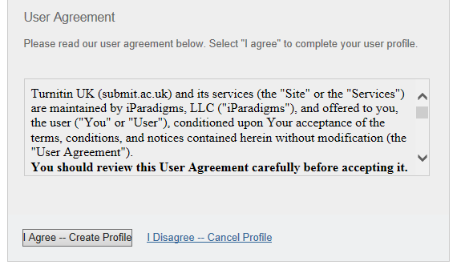
Creating a Student Account (step 7)
Read the user agreement displayed -> you will be asked to click on I Agree -- Create Profile link.

Slide 16
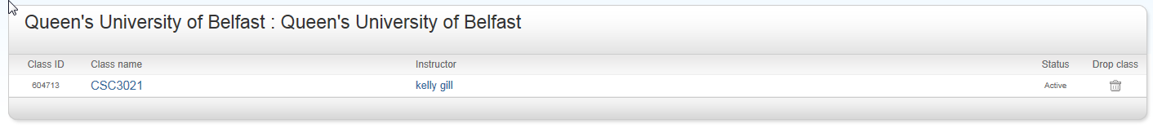
Creating a Student Account (finish)
You have now completed creating your student account.
You will now be directed to your student homepage (see image below).

Slide 17
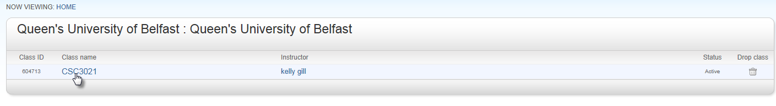
Submitting a paper
To submit an assignment you must first enter the class homepage by clicking on the class name on your homepage (underneath enter a class).

Slide 18
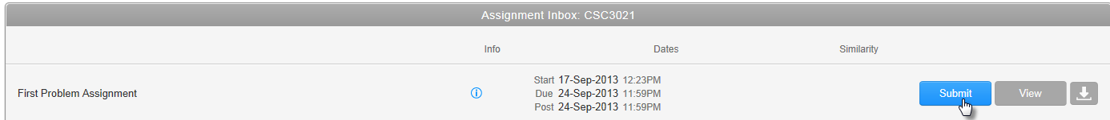

Submitting a paper
Click on the blue submit button next to the desired assignment in your class homepage.
Please note when the assignment is closed to submissions the submit button will be coloured grey.
Information about the assignment can be found at

Slide 19
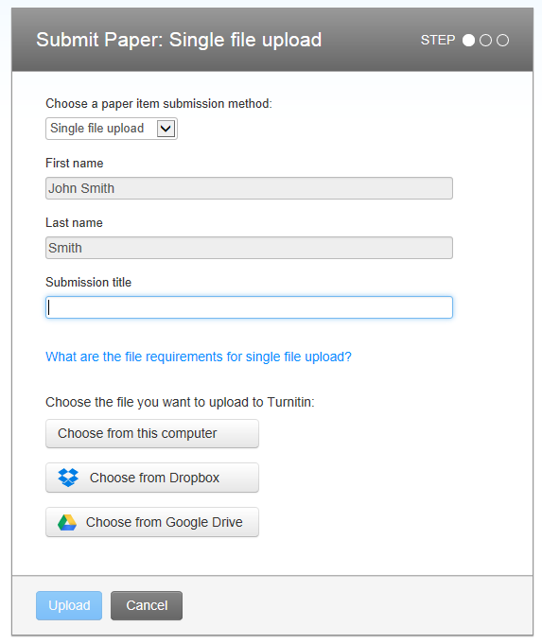
Submitting a paper
Select ‘single file upload’ from the drop down menu
Enter a title for the assignment (your name will be automatically inserted)
Click the Choose from this computer… button to locate your assignment on the PC for upload to the system

Slide 20
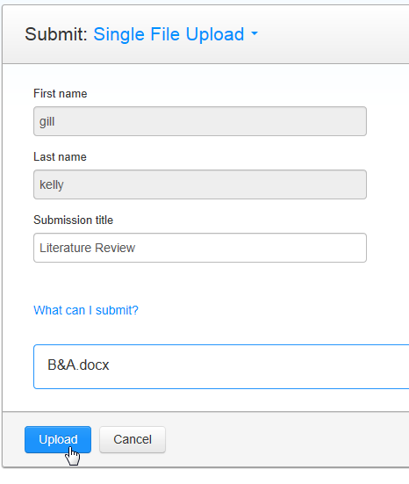
Submitting a paper
Your file name will appear in the upload window-> click the Upload button.
The system will tell you if your file is uploaded successfully and if so, you will taken to the preview screen

Slide 21
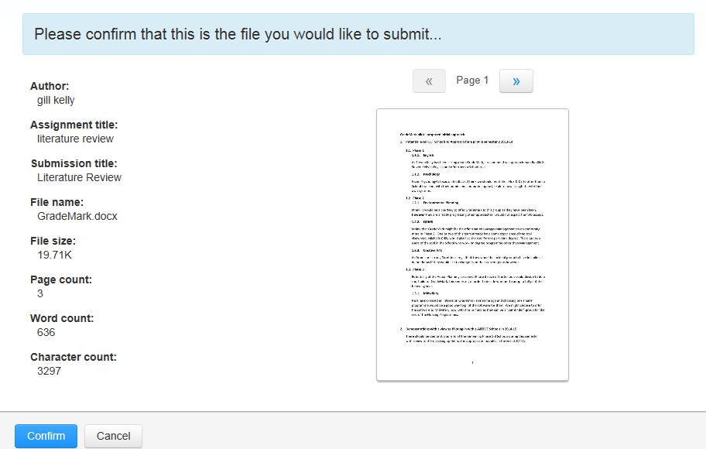
Submitting a paper
The text of your assignment will be displayed in a window for you to check. If it is the correct file -> click Submit Paper.
If this is not the correct file click on cancel and browse to select a different (correct) file.

Slide 22
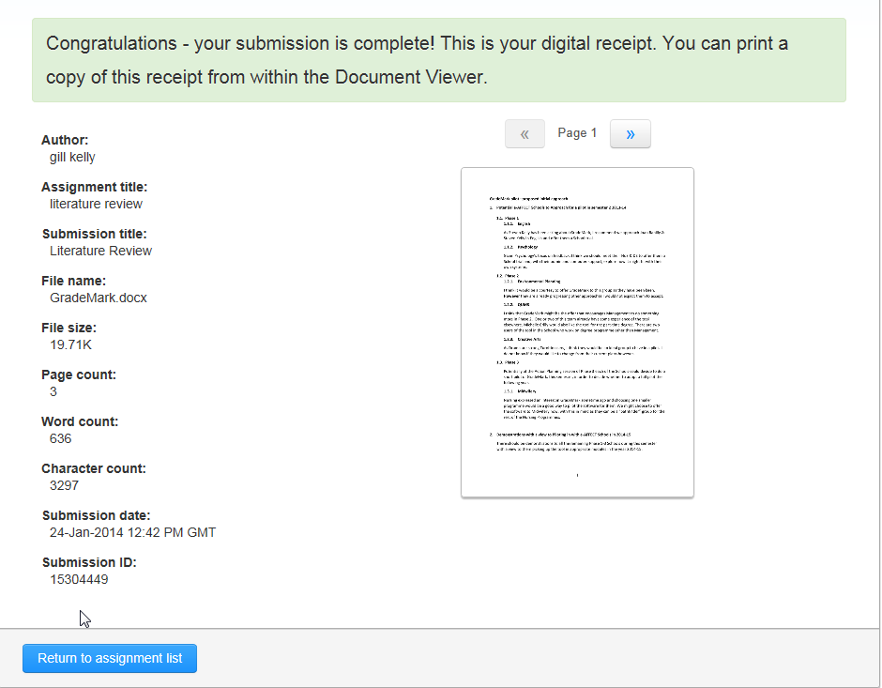
Submitting a paper
You will then see a digital receipt showing that you have submitted the assignment to TurnitinUK.
To return to the class page -> click ‘Return to assignment list’
An email will also be sent to you confirming the submission.

Slide 23
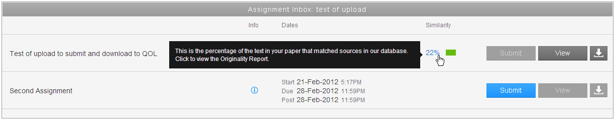
Viewing your submissions
You can view your submissions and their associated originality reports on your class homepage.
Only you and the lecturer can see your submission.
Your homepage will look similar to below:
To view the originality report click on the coloured rectangle (the percentage in the brackets is the level of matched text).
To view your essay submission click on view.

Slide 24
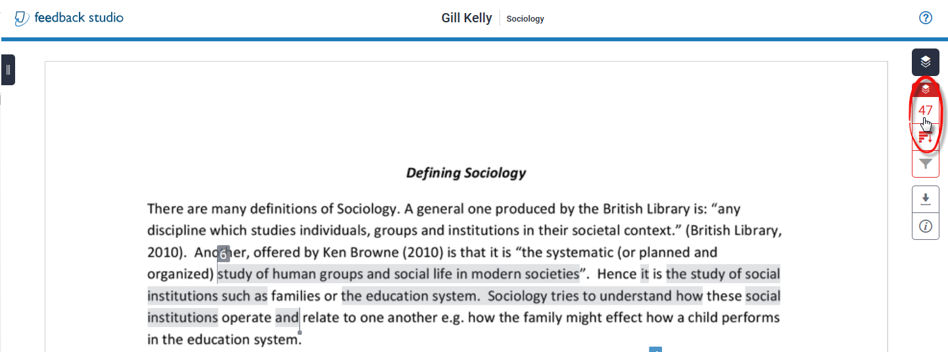
Viewing an originality report
You will see your assignment with individual matches to external sources shaded in colour a tool bar on the right will allow you to explore the report further
Click on the red number towards the top right corner to see details of the text in your essay which matches external sources.

Slide 25
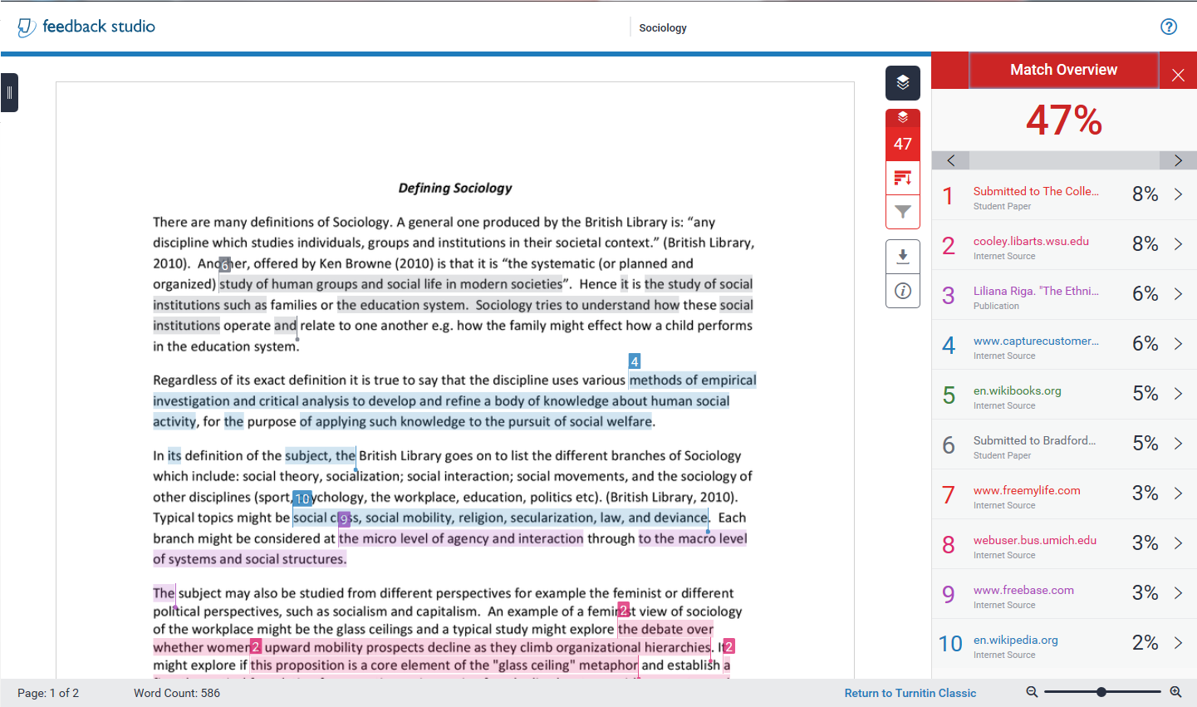
Viewing an originality report – match overview
The overall percentage of matched text is displayed towards the top of the report.
To view the matching material in detail, click on the match itself or the corresponding link in the right hand window and the content is shown above the match.
1
2
2

Slide 26
Viewing your submissions
Once you have reviewed your originality report you can submit further drafts of your assignment and see further originality reports (Provided these permissions have been granted by your tutor).
Each originality report will be updated 24 hours after the new submission.
COMPARISONS WITH OTHER STUDENT REPORTS WILL NOT BE MADE UNTIL AFTER THE DEADLINE – WHEN TWO STUDENTS COPY THE SAME MATERIAL IT SHOWS AS A MATCH BETWEEN THOSE STUDENTS

Slide 27
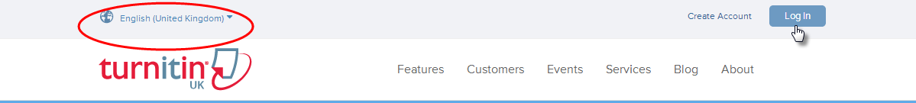
Logging in subsequently
On the TurnitinUK homepage (www.turnitinuk.com) Ensure that the Languages are set to English (United Kingdom)
-> Click the Log in button
Type your email and password
(your QUB email address and the password you chose when creating your profile into the password field )
Click Log
Don’t forget if you need to reset your password the Surname field in the system contains your student number NOT your Surname

