Slide 1
Revolutionary Ireland
Dr Andrew Holmes
a.holmes@qub.ac.uk

Slide 2
Overview
I. Understanding eighteenth-century Ireland
II. Politics and religion, 1690-1776
III. Revolutions – American, French … and Irish?

Slide 3
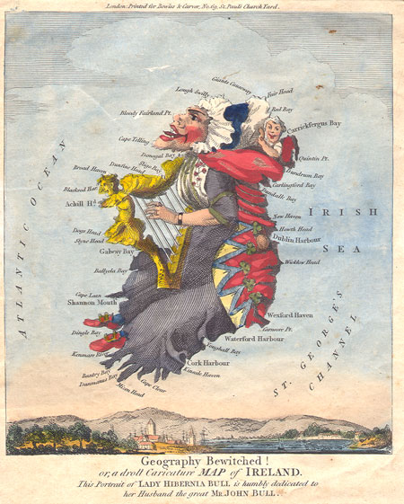
I. Understanding eighteenth-century Ireland
1. Polarization & the ‘hidden Ireland’
2. The Anglo-Irish elite
  Descendants of migrants: c12, c16, & c17
  Church of Ireland
  Land and politics: the Irish Parliament
3. Kingdom or colony?
4. A European society?
  ancien régime
  Confessional state and penal laws
  Deference and paternalism

Slide 4
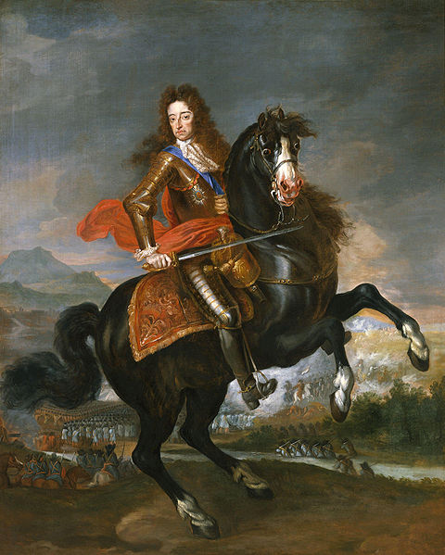
II. Politics and religion, 1690-1776
1. The ‘Glorious’ Revolution in Ireland
James II (1685-88): Irish policy and protestant fears
Williamite War
  Derry, the Boyne, Aughrim
  William vs. Irish protestants
  Treaty of Limerick (1691) and the penal laws
Status and subordination of the Irish Parliament

Slide 5
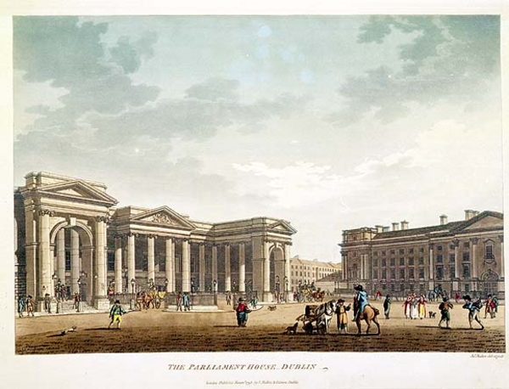
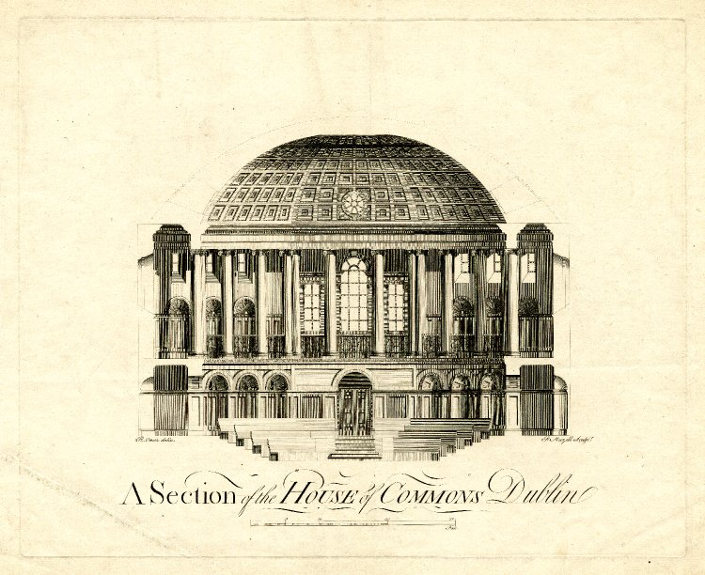
II. Politics and religion, 1690-1776
2. ‘The Protestant Ascendancy’
c. 15% of population - Church of Ireland, land
Virtual monopoly on power and public office
Yet … growing concern about British domination
Emergence of Irish patriotism – a separate kingdom with a separate parliament
Mobilisation, c. 1750 to 1776

Slide 6
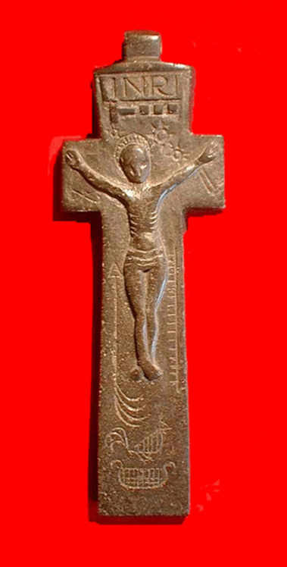
II. Politics and religion, 1690-1776
3. Catholics and the penal laws – c. 75% population
Penal laws, c. 1695 to 1728
  Why? Power, security, greed, revenge, conversion, ‘the done thing’?
  What impact did the penal laws have? Enforcement, variations, type of society
  Catholics and politics
    Jacobitism: variety of forms and grievances – loss of credibility after 1745
    Agrarian protest: Whiteboys (1760s)
    Emergence of the Catholic Question in Britain and Ireland from 1750s

Slide 7
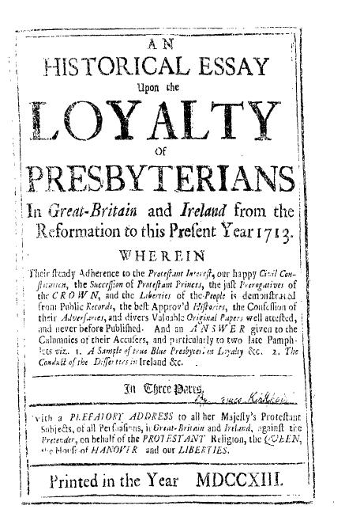
II. Politics and religion, 1690-1776
4. Presbyterians – c. 10% population
Growth and consolidation in Ulster, 1613-1690
Unimpeachable loyalty during the Williamite Revolution: regium donum
Confessional state and legal restrictions – Sacramental Test
Commerce and the Enlightenment – ‘classical republicanism’
Emigration to American and agrarian protest

Slide 8
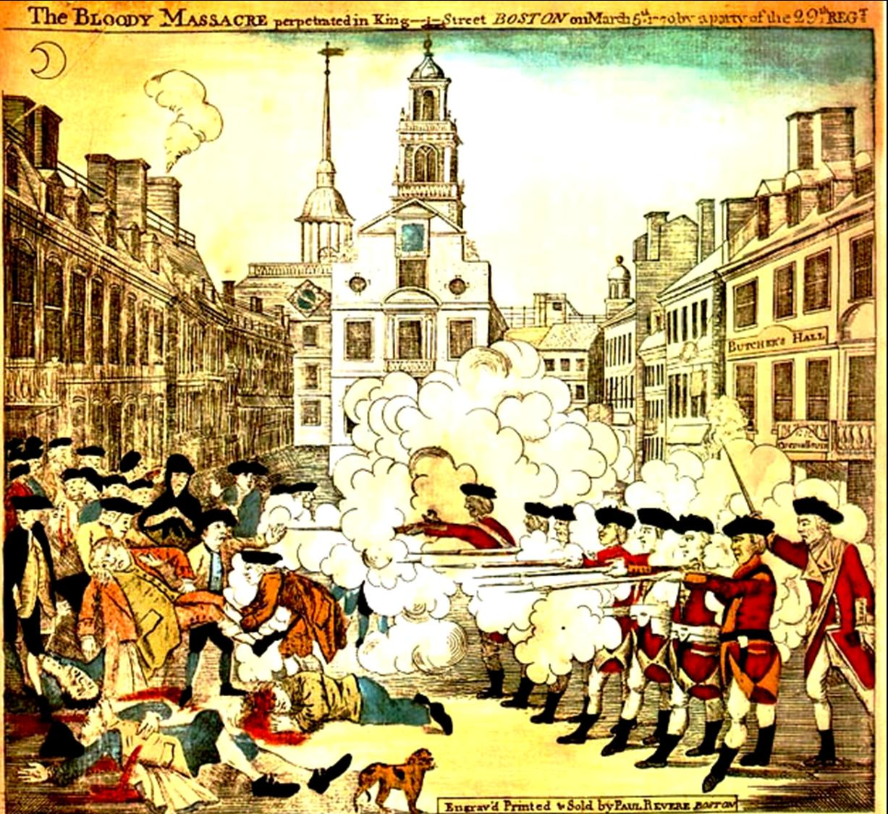
III. Revolutions – American, French … and Irish?
1. The American Revolution
Post 1763: tightening of control and taxation
Greater colonial rights rather than independence: ‘the rights of Englishmen’
4 July 1776: Declaration of Independence
1775-81: military struggle and alliance with France

Slide 9
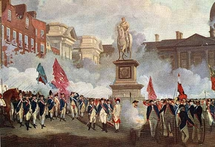
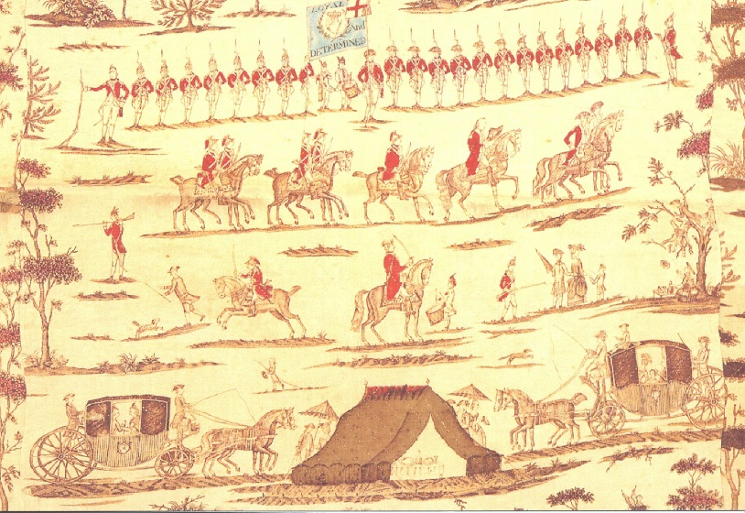
III. Revolutions – American, French … and Irish?
2. The American Revolution and Ireland
Recession, threat of invasion, example of America
Formation and spread of the Volunteers
  60,000 by May 1782
  Development of popular politics, especially amongst Ulster Presbyterians
Success and decline
  End of trade restrictions (1779)
  Dismantling of the penal laws – Catholic relief for Catholic recruits
  Legislative independence (1782)
  Reaction and the ‘Protestant Ascendancy’

Slide 10
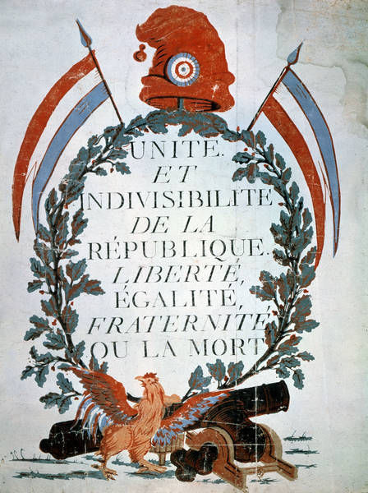
III. Revolutions – American, French … and Irish?
3. What was the French Revolution?
14 July 1789: fall of the Bastille
1792-3: execution of Louis XVI and declaration of a republic
1793: Jacobin coup & the ‘terror’
1794: Jacobins overthrown by the Directory – Napoleon by 1800
War between Britain and France, 1793-1815

Slide 11
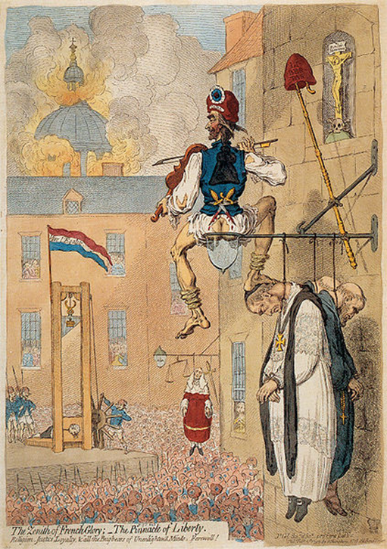
III. Revolutions – American, French … and Irish?
4. Irish reactions
The ‘Protestant Ascendancy’ – from welcome to opposition
Edmund Burke, Reflections on the Revolution in France (1790)
Irish Catholic elite: loyalty and ‘the French disease’
Presbyterians: reform … and radicalism

Slide 12
III. Revolutions – American, French … and Irish?
‘Declarations and resolutions of the Society of United Irishmen of Belfast, October 1791’
First, Resolved, That the weight of English influence in the Government of this country is so great, as to require a cordial union among ALL THE PEOPLE OF IRELAND, to maintain that balance which is essential to the preservation of our liberties, and the extension of our commerce.
Second, That the sole constitutional mode by which this influence can be opposed, is by a complete and radical reform of the representation of the people in Parliament.
Third, That no reform is practicable, efficacious, or just, which shall not include Irishmen of every religious persuasion.

Slide 13
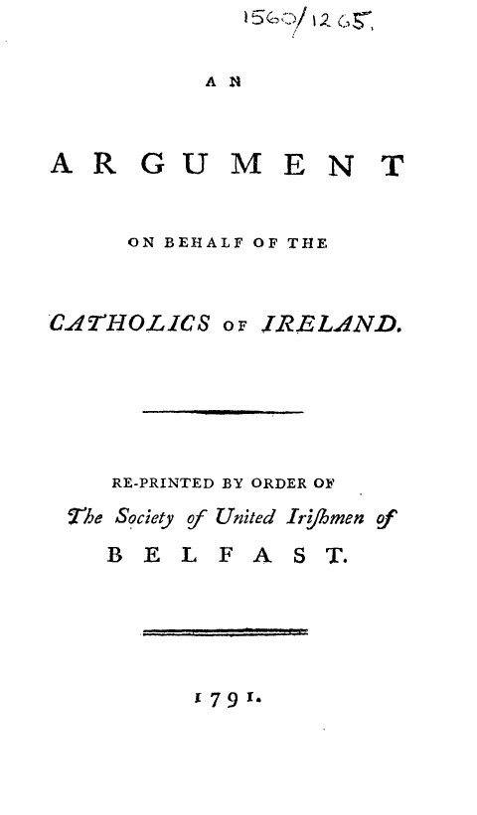
III. Revolutions – American, French … and Irish?
5. The Catholic Question, 1789-95
Radicalisation of the Catholic Committee and links with the United Irishmen
Wolfe Tone, Argument on the behalf of the Catholics of Ireland (1791)
Catholic Relief & Militia Acts (1793) and the Fitzwilliam episode (Feb. 1795)
Popular Catholic politics – Defenders

Slide 14
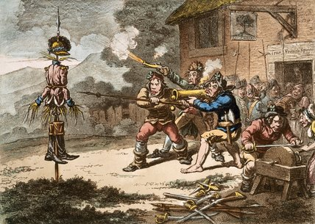
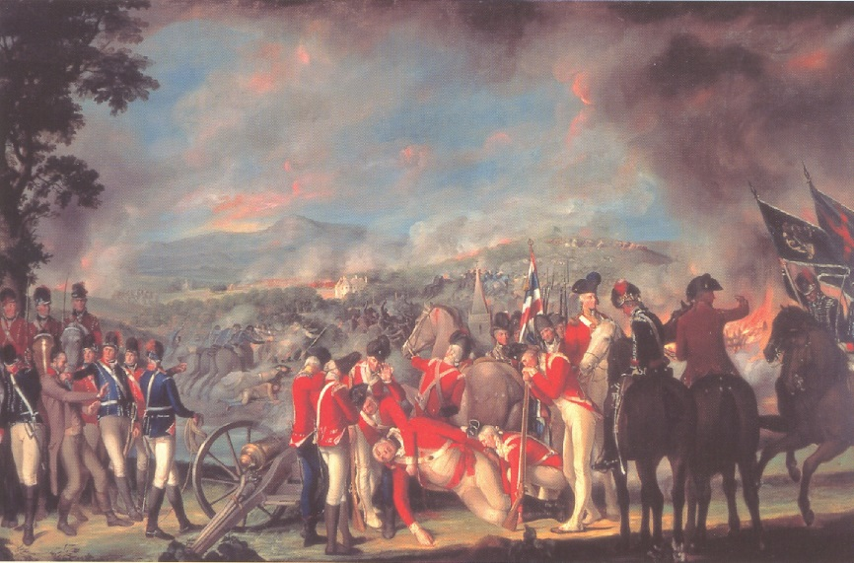
III. Revolutions – American, French … and Irish?
6. Transformation and rebellion, 1795-8
United Irishmen c. 1795: from a political movement to a revolutionary republican conspiracy
1798 Rebellion – a disaster: Peasant uprising? A civil war? A religious war? An assertion of republican and Enlightened ideals?
Non-rebels
  Defence & counter-insurgency
  Catholic Church
  Popular protestant loyalism – Orange Order 1795
The Act of Union (1800)

Slide 15
Reflections
1798 was a complex event in which a variety of tensions came to the fore – ‘Catholic disaffection, Presbyterian radicalism, anti-English patriotism, agrarian discontent, middle-class liberalism, loyalist anxiety, popular sectarianism’ (Ian McBride)
‘Because the republicans attempted to be all things to all people, subsequent generations have been free to interpret them as they wish.’ (Nancy Curtin)
The danger of anachronism
The importance of historical method

Slide 16
Reading
S.J. Connolly, Divided kingdom: Ireland, 1630-1800 (Oxford, 2008)
M.J. Powell, ‘Ireland: radicalism, rebellion and union’, in H. T. Dickinson, (ed.), A companion to eighteenth-century Britain (Oxford, 2006), 414-28
Pieter Tesch, ‘Presbyterian radicalism’, in David Dickson, Daire Keogh, and Kevin Whelan (eds), The United Irishmen: republicanism, radicalism, and rebellion (Dublin, 1993), 33-48

