Slide 1


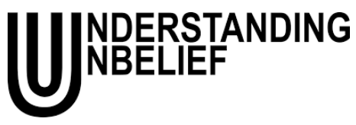
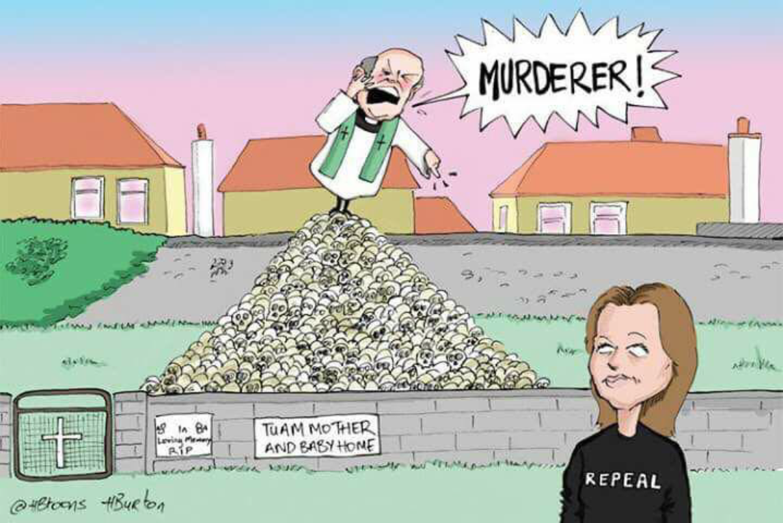
Unholy Catholic Ireland
Hugh Turpin
Morality and the Rejection of Catholicism in the Contemporary Republic

Slide 2
Contents
Background: Irish Secularisation
Survey Data: Moralised Ex-Catholicism
Fieldwork: The Social Dynamics of the Moral Taint
Conclusion

Slide 3
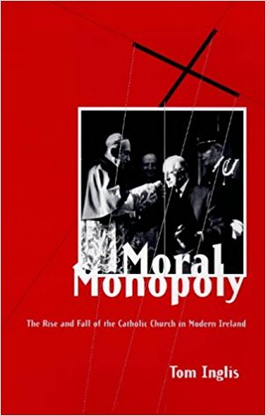
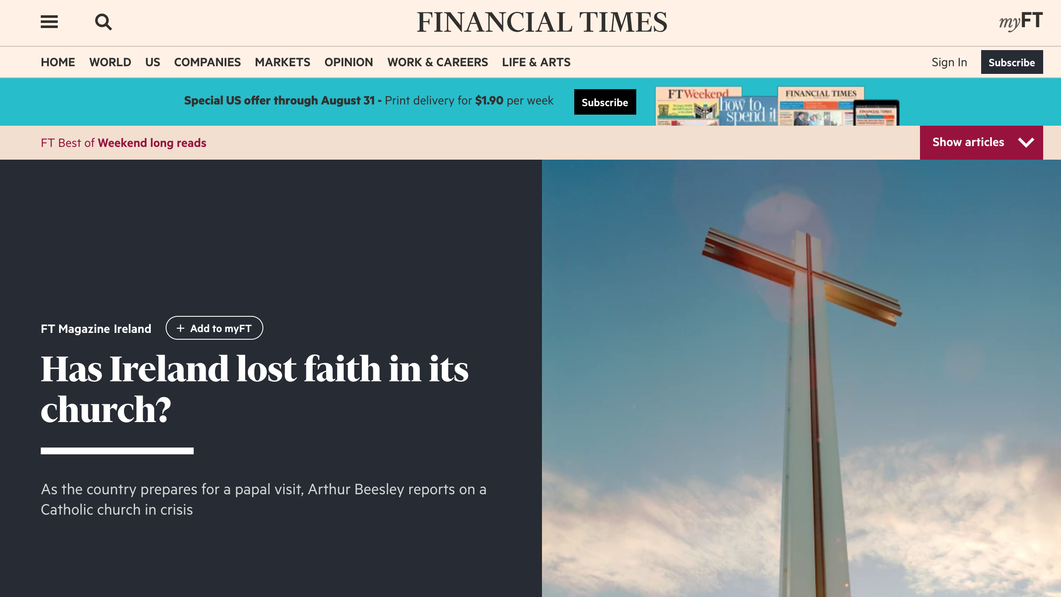
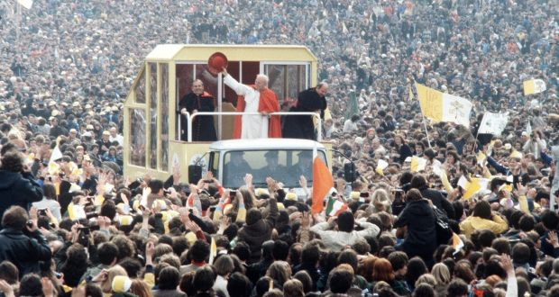
1.1. Irish Secularisation
Still relatively pious ‘on paper’, but from the 1990s onwards practice especially decreases. Church loses social & moral influence. 2000s see emergence of ex-Catholic ‘nones’.
ROI: Western European ‘pious outlier’
Inglis (1998): ‘Good Irish people’ and their Catholic ‘habitus’

Slide 4
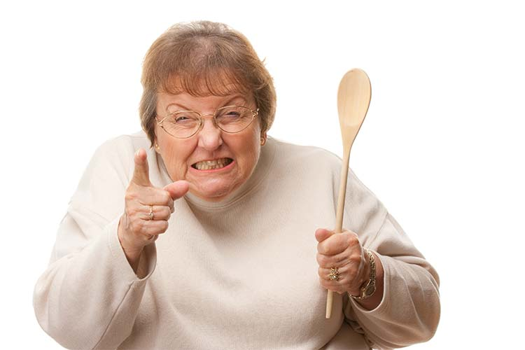
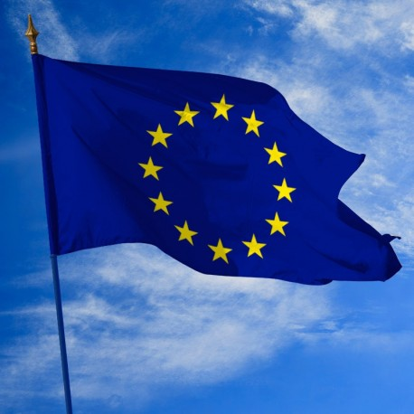
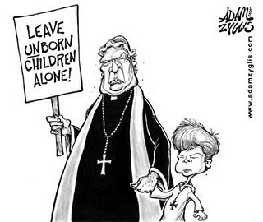

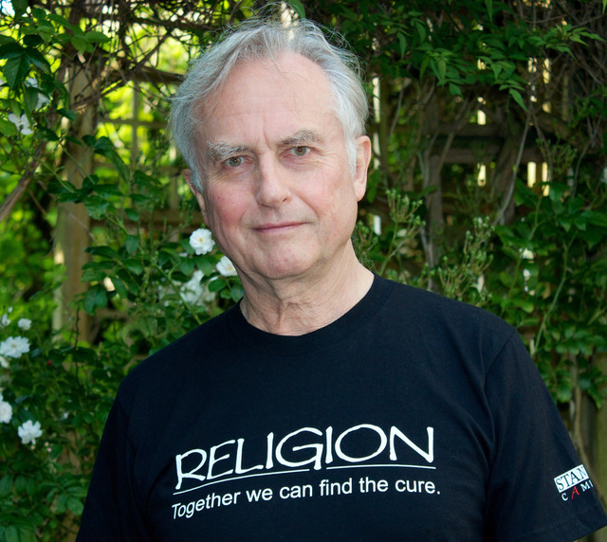
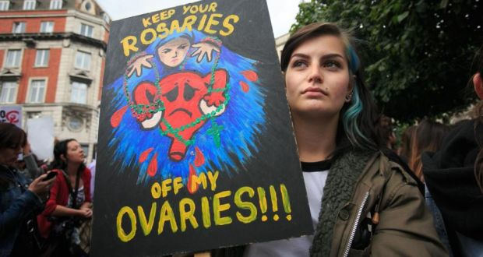
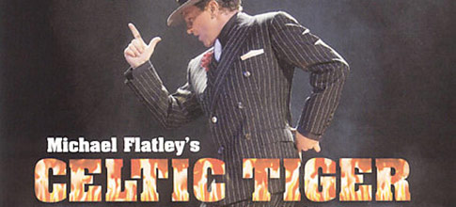
1.2. The Weakening of the Church
Catholic Church Scandals: Dominate media from 1990s onwards; often portrayed as the ‘coup de grace’ .
Causal Overdetermination: new media and comunications, changing gender roles, moral tensions, Vatican II, educational changes, new global movements, economic prosperity, etc., etc.

Slide 5
1.3. Current Sociological Consensus: Cultural Catholicism consolidated
‘…high levels of belief and identification as a religious person, coupled with the decreases in attendance and confidence in the Catholic Church, indicate that, for Catholics in Ireland, religion [is] becoming private and personal’ (Ó Féich & O’Connell, 2015: 243)
‘Pious Variant’
‘Fuzzy Variant’
e.g. ‘Believing without belonging’ (Davie, 1994)
e.g. ‘Fuzzy Fidelity’ (e.g. Voas, 2009)
Notes:
Various Problems:
- What is a privatised religion anyway? Can it be transmitted? Is it stable? Is it exaggerated in surveys?
-Other sociological interpretations: ‘cultural religion’ as a transient, superficial ‘verbal shell’ (e.g. Voas, 2009; Demerath II, 2000) or hollowed-out ethno-marker (Pew, 2017).
-Very harmonious description of social change. Where’s the conflict? (contrast: Ribberik et al, 2014)
-Rapid post-2000s growth in outright unbelief/religious rejection ignored in this picture (e.g. Census 2016; WinGallup 2013).
-Has the impact of scandal been underestimated by the sociologists? What might that impact be?

Slide 6
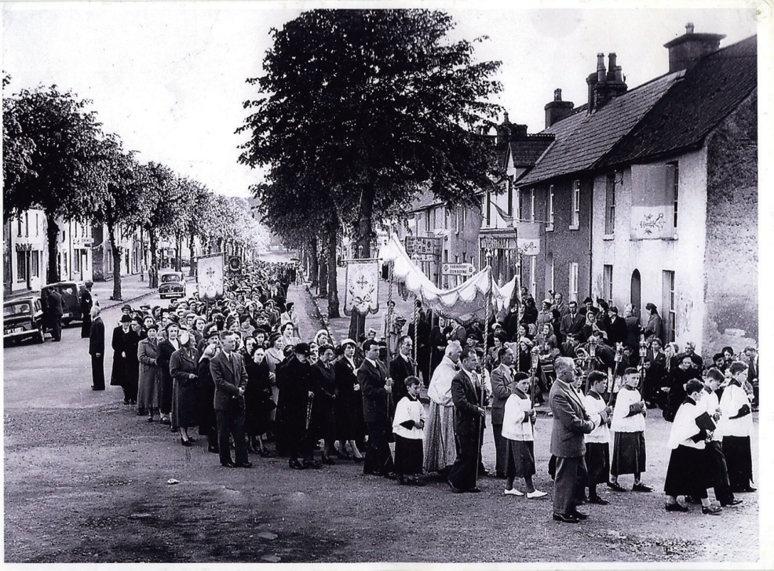

Problems for Pious ‘Privatised’ Variant
Problems for Fuzzy ‘Cultural’ Variant
How static is Irish fuzzy fidelity (is it like Danish Lutheranism)?
2008 ESS data: ROI had highest popular approval of religion in Western Europe, but Irish non-religious had strongest anti-religious sentiment (Ribberink et al, 2013).
‘Nones’ fastest growing group (Census, 2016; ESS, 2016), and ‘Convinced atheism’ growing faster in the ROI than anywhere barring Vietnam (WinGallup, 2013).
Cognitive anthropological work suggests transmission of religious beliefs and social identities greatly enhanced by ‘embodied’ proof (i.e. ‘Credibility Enhancing Displays’ - Henrich, 2009)
Creates problems for notion of intergenerationally stable ‘privatised’ religiosity

Slide 7
Static, harmonious, conflict-free image.
How stable and transmissible is ‘privatised’ or ‘cultural’ religion?
What about growing non-religion and ex-Catholicism?
And how might the clerical abuse factor relate to this, if at all?
Notes:
Various Problems:
- What is a privatised religion anyway? Can it be transmitted? Is it stable? Is it exaggerated in surveys?
-Other sociological interpretations: ‘cultural religion’ as a transient, superficial ‘verbal shell’ (e.g. Voas, 2009; Demerath II, 2000) or hollowed-out ethno-marker (Pew, 2017).
-Very harmonious description of social change. Where’s the conflict? (contrast: Ribberik et al, 2014)
-Rapid post-2000s growth in outright unbelief/religious rejection ignored in this picture (e.g. Census 2016; WinGallup 2013).
-Has the impact of scandal been underestimated by the sociologists? What might that impact be?

Slide 8
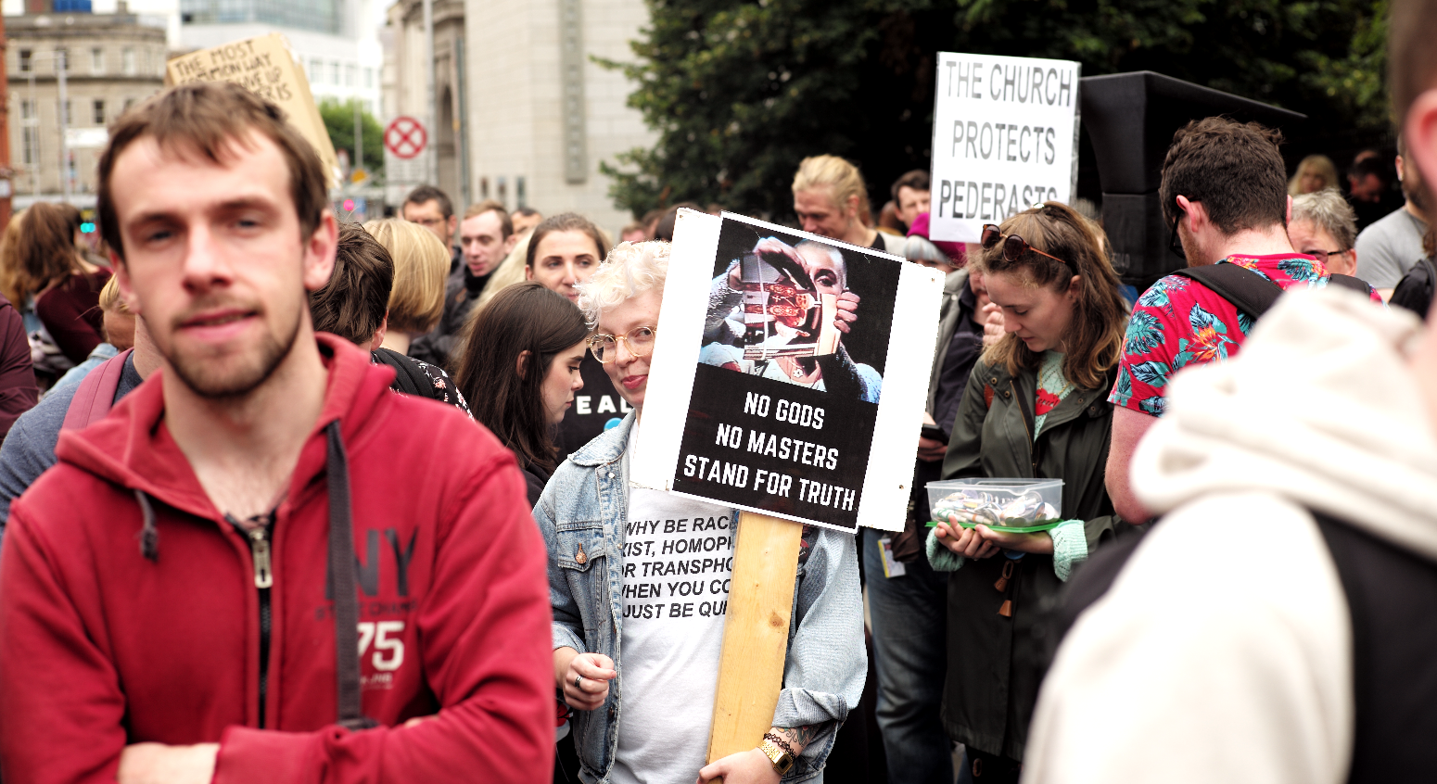
2. Survey Data: Moralised Ex-Catholicism
Sample: N=248 baptised Irish Catholics.
Nationally representative for age, gender, urban/rural habitation, SES.
Conducted online via Qualtrics.
Sample recruited by Qualtrics Panels.

Slide 9
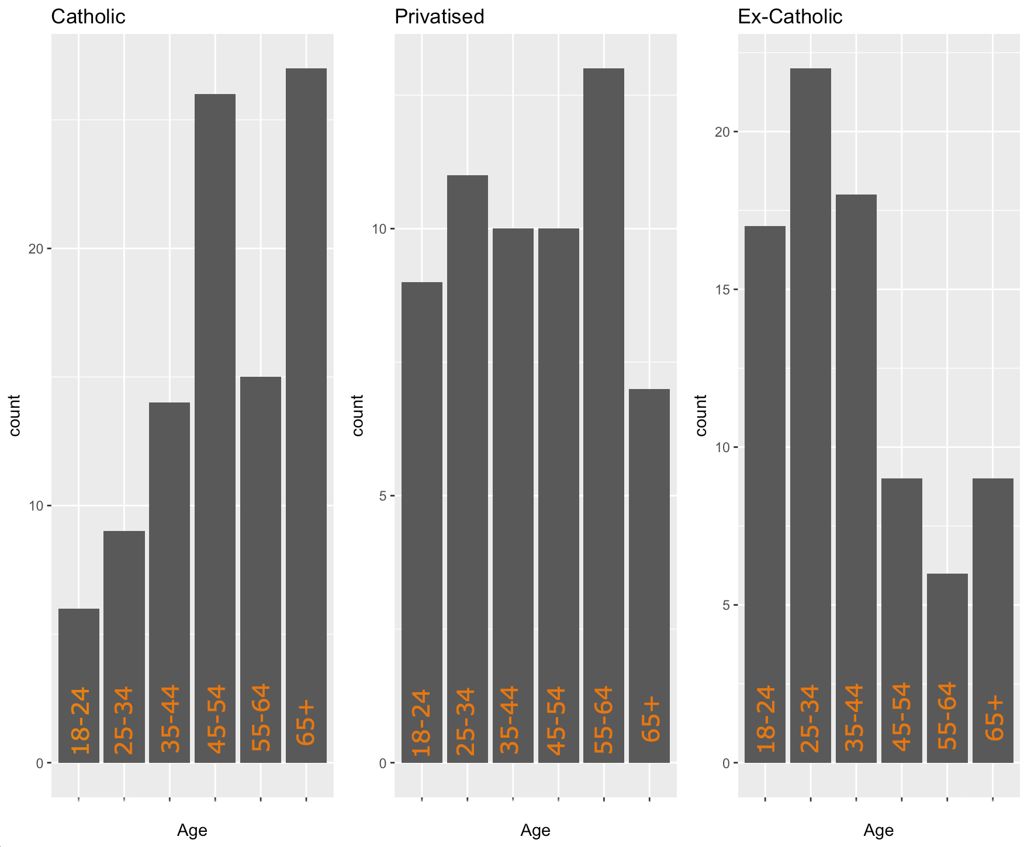
2.1. Catholics, Privatised Catholics, and Ex-Catholics
Catholics: Reject neither Church teachings nor Catholic identity (N=96)
Privatised Catholics: Reject Church teachings but not Catholic identity (N= 59)
Ex-Catholics: Reject both Church teachings and Catholic Identity (N=81)
Age is a strong predictor. Ex-Catholics also more progressive, lower level of domestic religious exposure, much more atheistic.

Slide 10
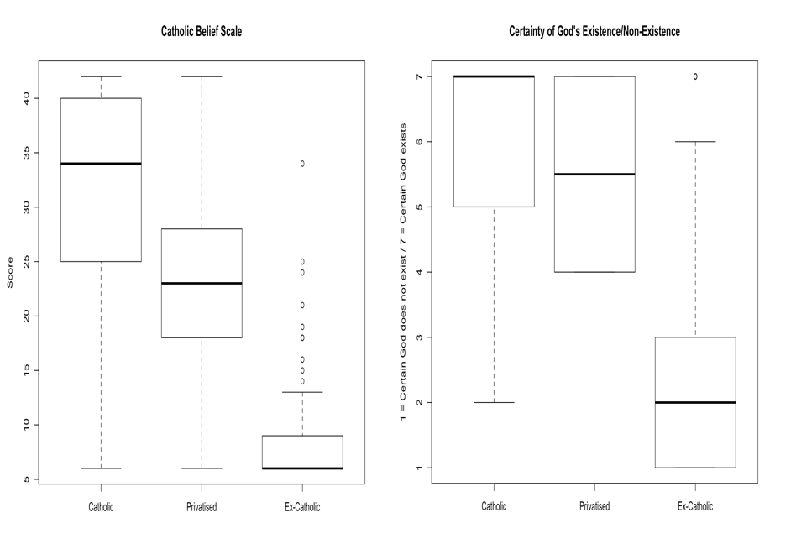
2.2. How atheistic are ex-Catholics?
Ex-Catholics outright reject Catholic beliefs
Unspecified theism seems linked to retention of Catholic identity
Is this ‘new default’ or transient - perhaps even troubled - compromise?

Slide 11
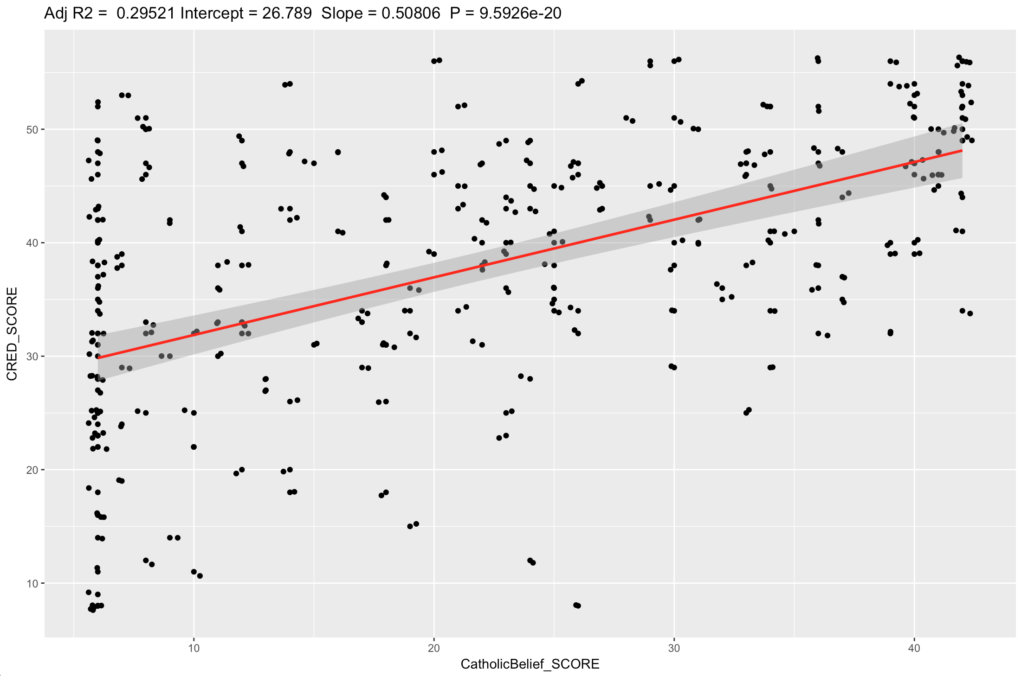
2.3. One Underlying Factor: CREDs
Multiple Regression on orthodox Catholic belief (Age, Gender, SES, Urb/Rural, Progressivism, CREDs): (f(6,244), p<.001, R² = .342)
Modified parental CRED Scale (Lanman & Buhrmester, 2016) easily most significant predictor (β = .428, t(250) = 6.89, p < .001).
Similar story for strength of social identification with Catholicism (highly correlated): e.g. if you’re not orthodox, you tend not to care too much about being Catholic.

Slide 12
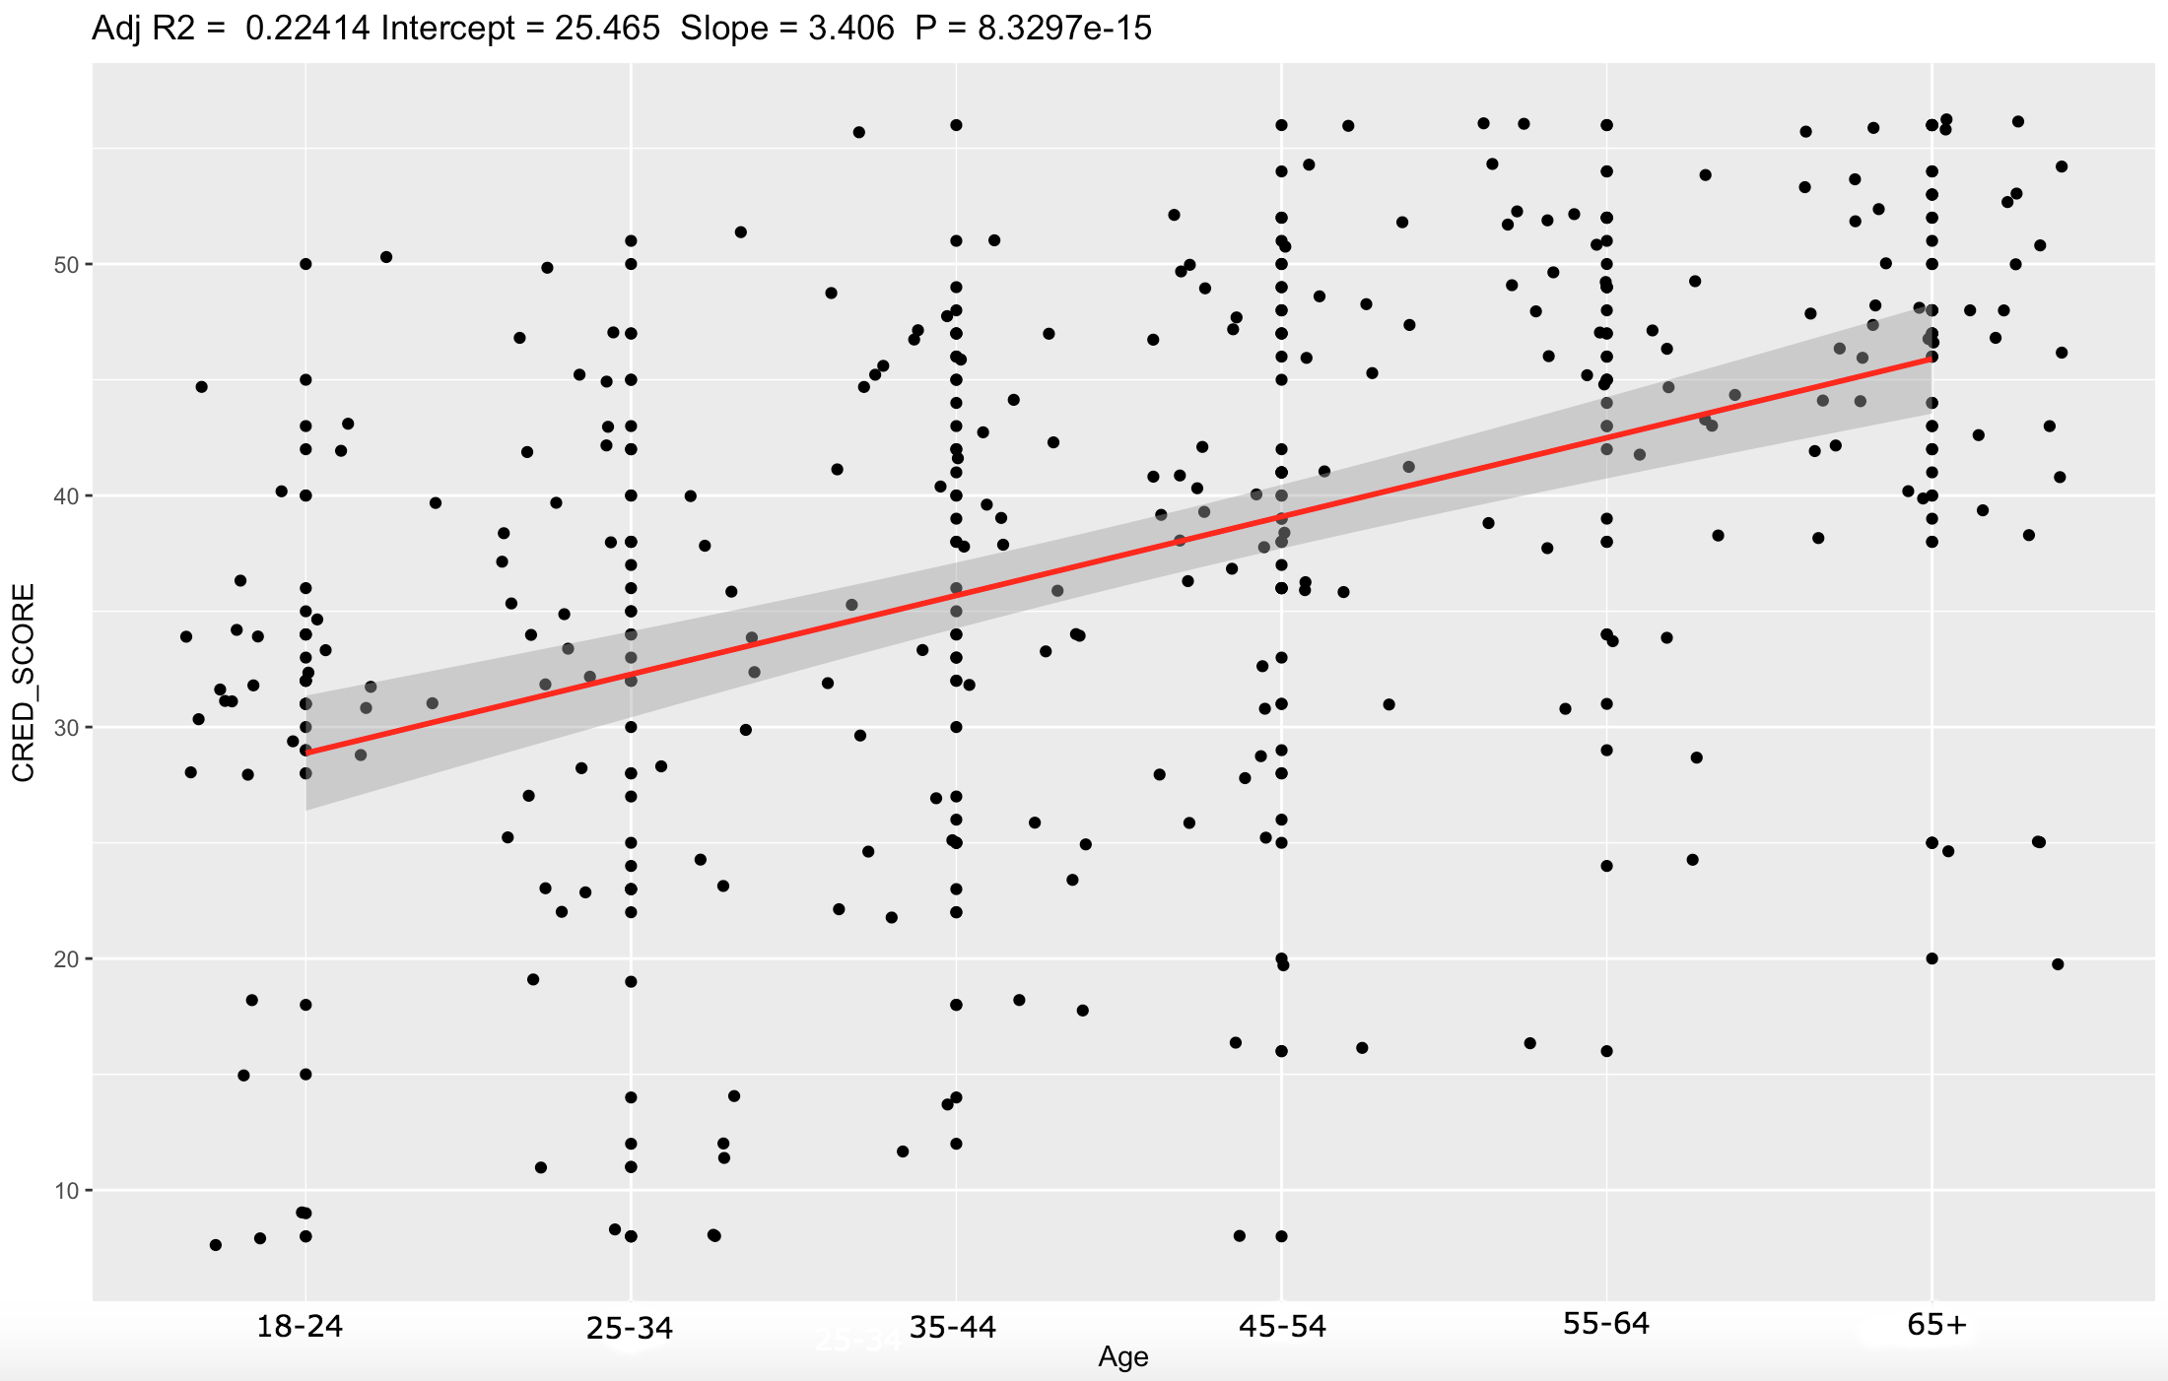
2.4. ‘CRED Depletion’: The Threadbare Canopy?
Can be interpreted as a decline in CREDs. Age (β = .451, t(250) = 7.97, p < .001) best predictor of CRED exposure
Each generation perceives its parents to have been less influenced in their behavior by Catholicism
But this does not simply leave behind an apathy about the Church
Catholicism ‘privatises’ from the 80s/90s onwards. The need to look like a ‘good Irish Catholic’ loses importance but the ethnic tie remains.

Slide 13
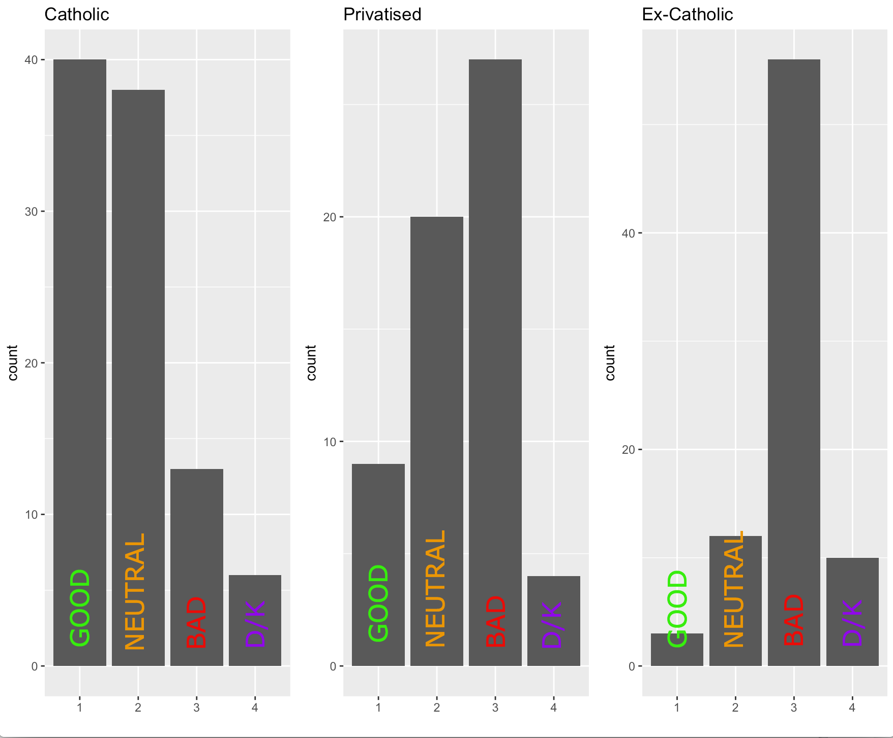
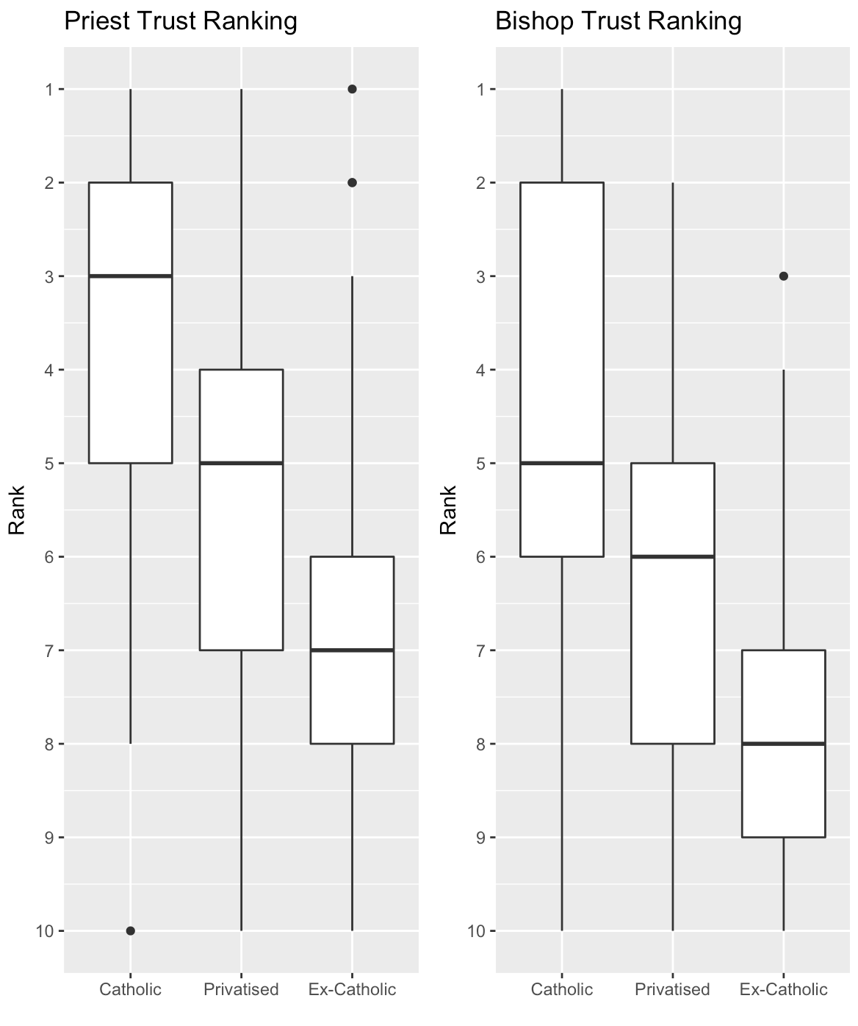
2.4. The Moral Dimension of Ex-Catholicism
Large numbers perceive Church to have been a negative influence on Irish society. Particular consensus among ex-Catholics.
Ex-Catholics show extreme distrust of clergy.

Slide 14
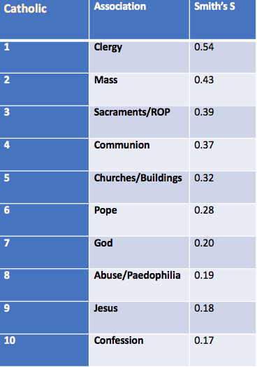
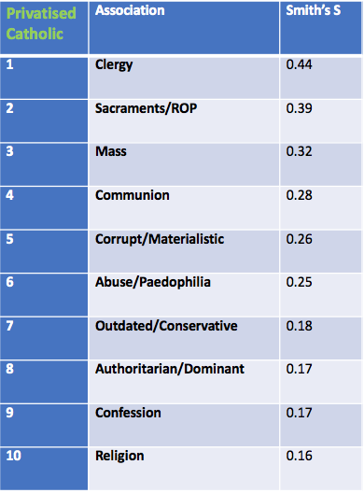
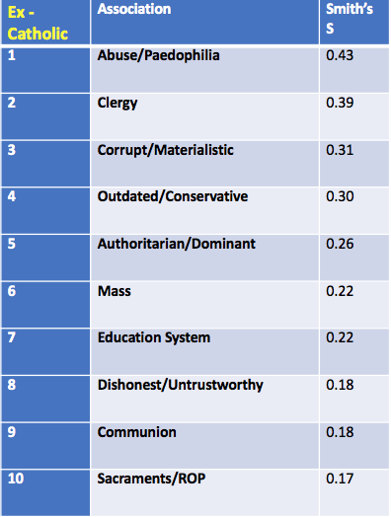
2.5. Free-List Associations: ‘Irish Catholic Church’
Rejection linked to 1) moral conservativism, and 2) fundamentally immoral conduct.
Direct causal claims cannot be made; background factors (age, CREDs, etc) suggest not simply ‘shocked withdrawal’
Furthermore, one can reject the Church and remain a nominal, de-institutionalised, or even atheistic Catholic. What lies behind the further step of outright disaffiliation?

Slide 15
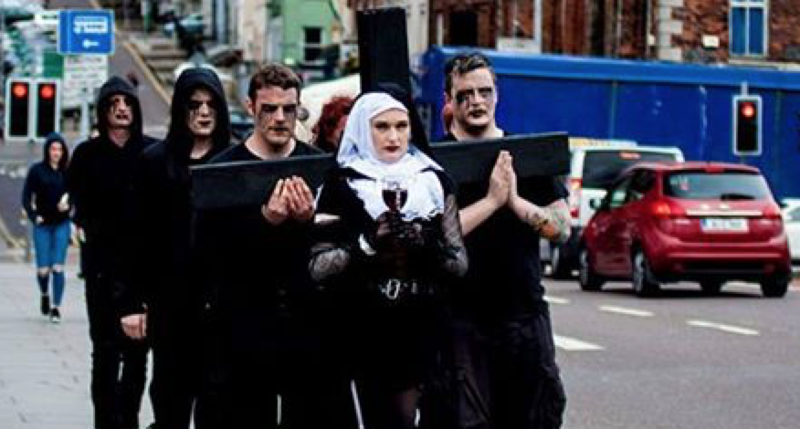
3. Fieldwork: The Social Dynamics of the Moral Taint
Field sites: two Dublin parishes (one middle class, one working class)
Semi-structured interviews (N=28) with religious, non-religious & culturally religious informants, as well as clergy and secular activists
Attendance at religious and secular gatherings
Digital ethnography, particularly among online secularist groups

Slide 16
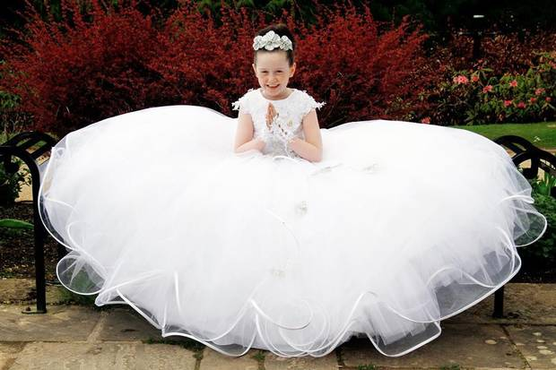
3.1. Cultural Catholicism: the Ethic of Harmony
Belief flexible, unfixed, private. Unbelief, should it occur, sometimes presented as dark, personal insight
Should not necessarily be allowed to cause tension by interfering with social obligations
The ‘ethic of harmony’ is a binding ethic: the national, local or familial group comes first - issues of belief are secondary (within reason)(e.g. Haidt, 2006)
‘I’d like to think that there is some sort of a release of this energy or electricity from a dead corpse into the…into oblivion or the universe or whatever, and then maybe we are just re-entered, like a data bank or thrown back into the star making machine that turns out all these stars in the centre of the galaxy but it’s unfortunate…to believe that we are just food for crows…that’s the way it is…
I baptised them because I had to...[there would have been] holy war, a jihad...not by the Catholic priests, but I mean the woman I was married to...there is no arguing with these people…it’s a tradition that is expected and has to be respected, you have no argument against that…’
(Eamonn, cultural Catholic/unbeliever?, 45)

Slide 17
3.2. Ex-Catholicism: the Ethic of Authenticity
Emphasis on ‘authentic belief’; derogation of action not motivated by this factor
Cultural Catholicism as ‘unwoken’ or self-deceptive unbelief (at least as regards Catholic religious representations)
The ‘ethic of authenticity’ is an individualising ethic: social harmony or pragmatism subordinated to individual self-determination
‘Yesterday my sister Baptised her second child. I am disgusted. I´m sure it was the first time she has been in a church since the baptism of her first child, before that, her wedding.
I'm sure the real reason is to fit in, or to please my older family members (mum and her siblings), not that they would have asked her to do it. Maybe because she’s not sure about what to believe. Maybe she wants to be able to get the kids into a school more easily.
The reason is definitely not because she believes .. although she would argue that it is, to defend her actions.’

Slide 18
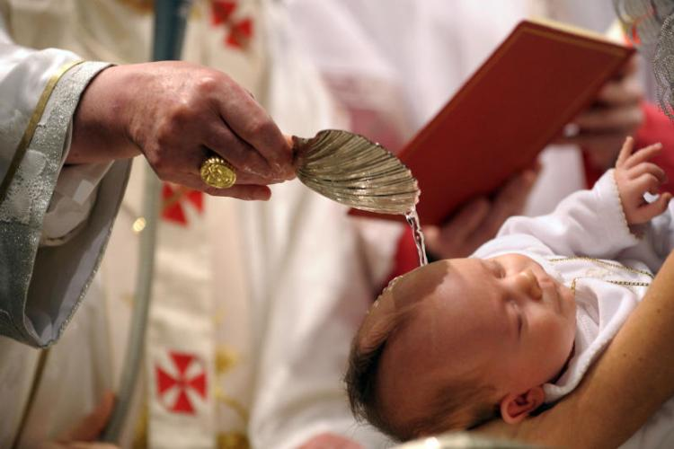

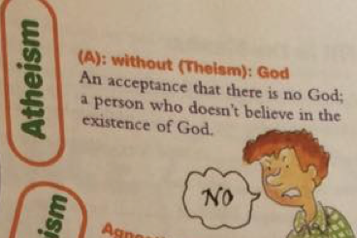
3.3. Exacerbating Factor: The Cultural Catholic Arrangement Lingering influence in return for identity and in-group solidarity
Church & Society: Inversion of Dominance
Cost of Compromise: Lingering Influence
“They’re against everything really – except for molesting little boys!”
Notes:
Ethnic affiliation; social rituals of collective Irish identity
Inglis’ take - people increasingly ignore Church, deciding for themselves what their Catholicism means
Scandals strengthen this (not a quote from Inglis)
Most people don’t care about these costs, but those that do care very much. Problem: how to convert others?

Slide 19
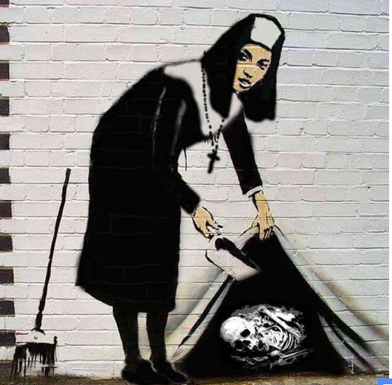
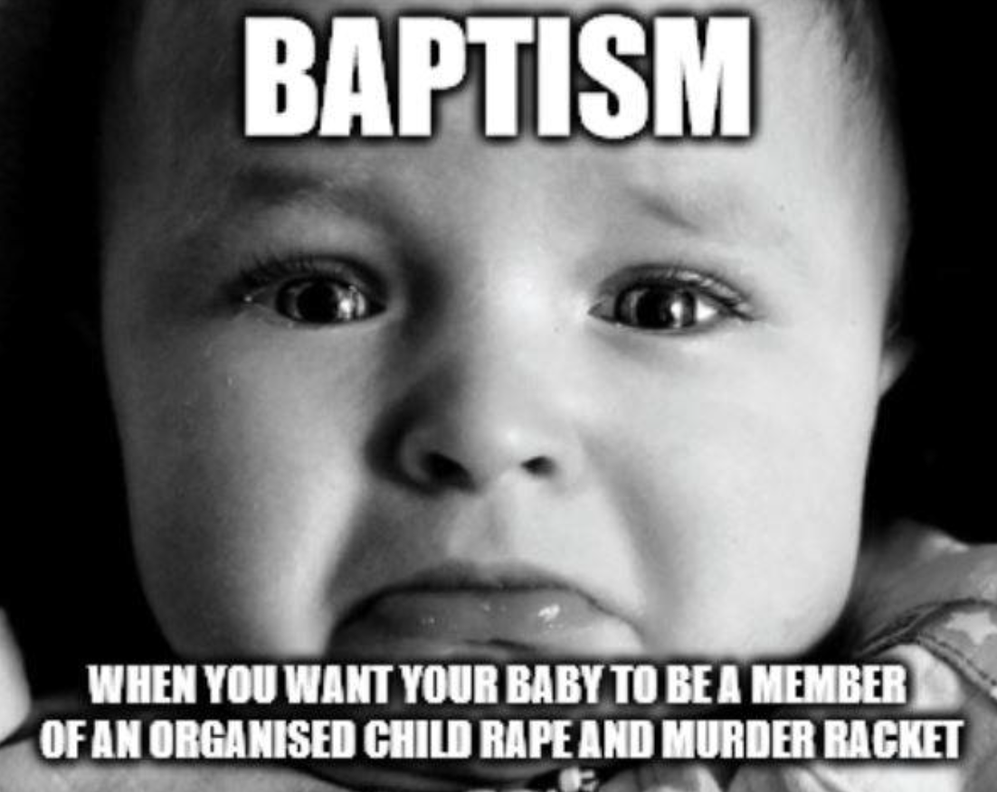
3.4. Scandal: Cultural Catholicism as Complicity
Church portrayed as a source of harm, eliciting anger and disgust
Connection to Catholicism is a form of complicity with the Church’s crimes - especially if unmotivated by orthodox belief (i.e. it is then ‘inauthentic’ or ‘bouncy castle’ Catholicism)
The Infernal Alliance: this ‘lazy’ or ‘mindless’ complicity constructed as impeding progress and keeping a harm-causing, immoral institution in power
‘I was complaining to a group of friends and one of them said, “Well, what’s the harm?¨
Well, lets see, what is the harm?
Ignoring the whole Paedophilia.. Magdalen laundries, homophobia, sexism, crusades, Inquisition, cover ups and scandals question, there is a very large community who believe the Church should have no hand in education, health care or politics.
Even people I know who are like my sister believe it should be separate. So surely baptising your child is a vote to keep the reigns in the hands of the Church?’

Slide 20
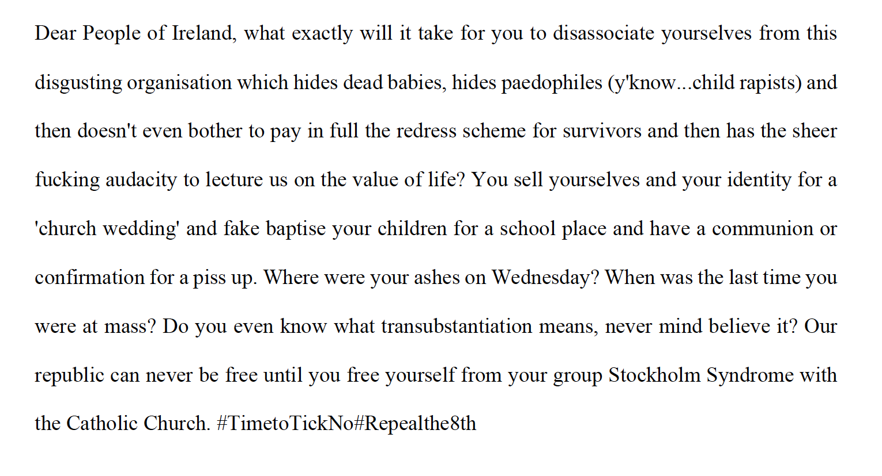
3.5. The Moral-Psychological Affordances of Scandal
Psychologists suggest moral judgement is primarily driven by swift emotional responses. Moral reasoning is post-hoc, and often relates to convincing third parties (e.g. Haidt & Joseph, 2007; Tooby & Cosmides, 2010)
Purity/Degradation
Harm/Care
Fairness/Cheating

Slide 21
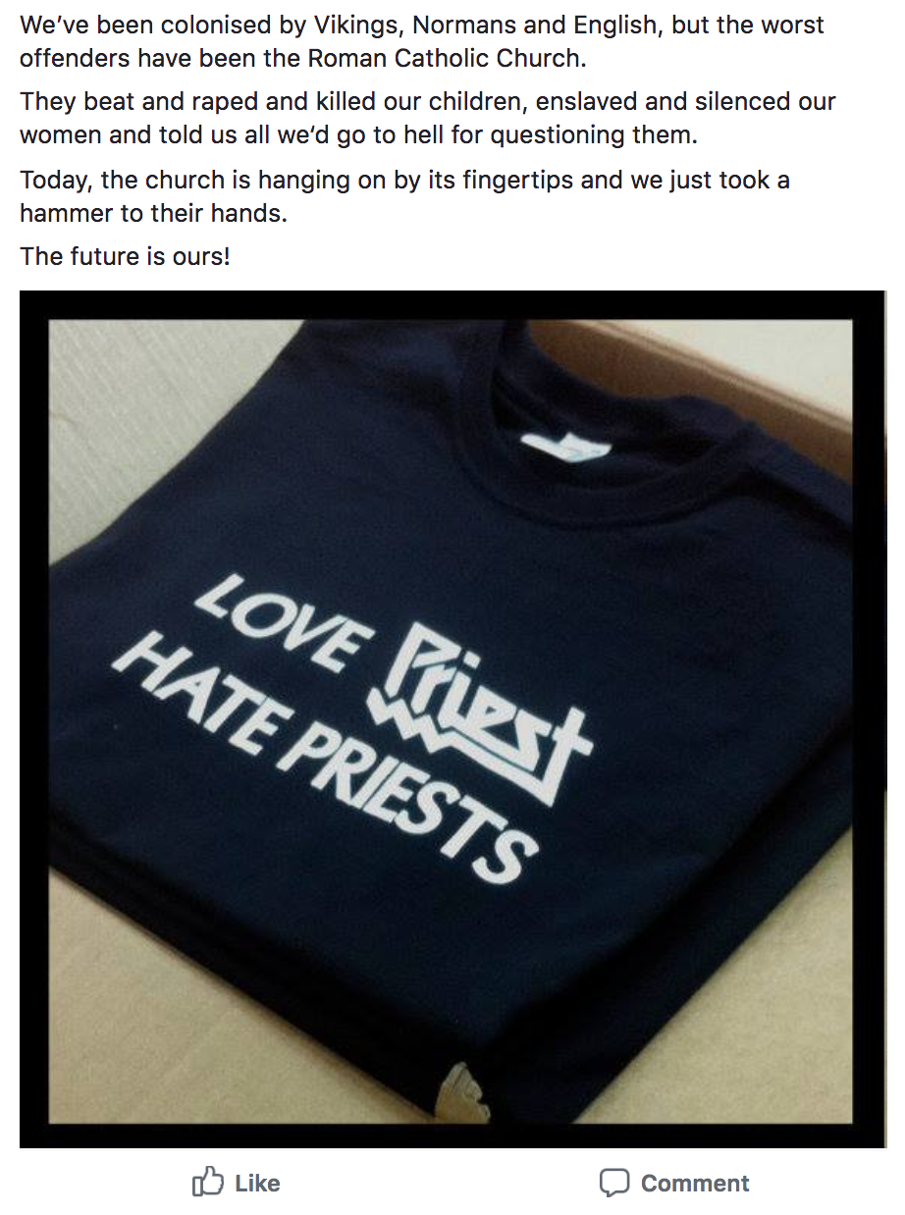
3.6. If the schema fits…
Anthropologists of morality emphasise the role of ‘schema’ or ‘definitions of the situation’ in transmitting new normative stances (e.g. Keane, 2015)
The moral affordances of clerical abuse fit into an existing schema around Irishness: liberation from external oppression, and the dream of long-withheld freedom
This creates a catchy moral narrative around disaffiliation, repositioning it as a viable alternative to the cultural Catholic ‘default’, which gets drawn into conscious awareness

Slide 22
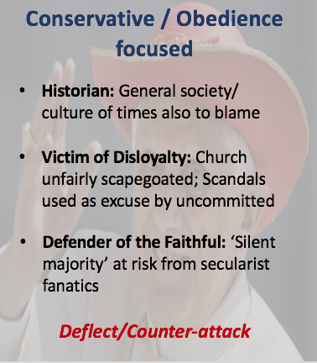
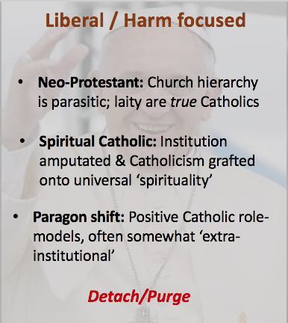
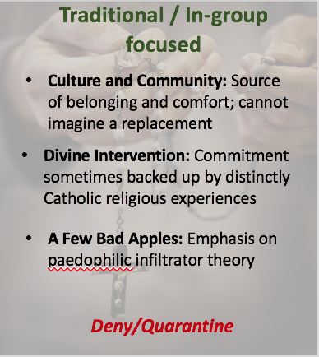
3.7. The Other Side: Taint Strategies and Devout Fragmentation
In contrast, devout Catholicism increasingly requires self-conscious justification. Moral intuitions - e.g. shame, loyalty, disgust, obedience, anger - pull in different directions; various conflicting stances emerge:
Notes:
Could mention progressivism (more ‘binding’ vs more ‘individualised’ MFs) / causal factors from survey

Slide 23
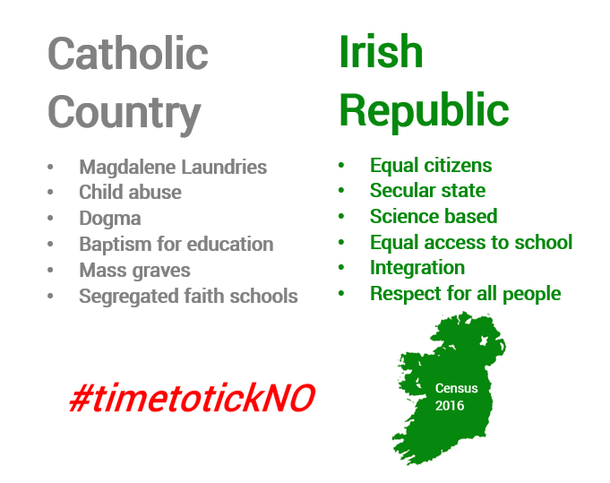
3.8. The Great Awakening? The Cultural Catholic Default in Play
‘After the 2011 census when I entered myself as Catholic and subsequently realised that I had just put this down because I felt I had to, as though honouring some strange sense of conscription…I don't want to be a number in their favour that can be employed in service of agendas I vehemently disagree with. And I'm really not a Catholic.’
(Diane, 33)

Slide 24
4. Conclusion: A New Way to Be a Good (and Secular) Irish Person
The scandals entered the vacuum of an increasingly habitual, tenuous, but institutionally entrenched Catholicism.
They gave rise to a new, catchy moral narrative: liberation from a repressive, abusive past, made urgent by lingering Church influence.
This draws the existing default - cultural Catholicism - into scrutiny, and weakens the ethno-religious bond.
It allows unbelief that may previously often have been tacit or unarticulated to become part of a public normative stance.
This stance is perhaps unusual in that it is as much a rejection of habitual, inertial religious affiliation as devout religiosity (quite different to, for example, US ‘nones’)
The current ROI is thus defined both by rapid depletion of religious CREDs, and the presence of a particularly cognitively-catchy and moralized non-religious alternative.
The degree to which this stance may come to displace default cultural religion will depend, among other factors, on the degree to which the Church continues to appear as a threat to secular values and ambitions.
Notes:
This narrative is cognitively catchy - it appeals to the moral ‘taste buds’ (Haidt & Kesebir, 2010) and spreads easily to third parties (Tooby & Cosmides, 2010)
Ex-Catholic interviewees and respondents (and many others) exhibited strong consensus around it

