Slide 1

Northern Ireland: A History of confliCT
Prof Peter Gray, Institute of Irish Studies, QUB

Slide 2
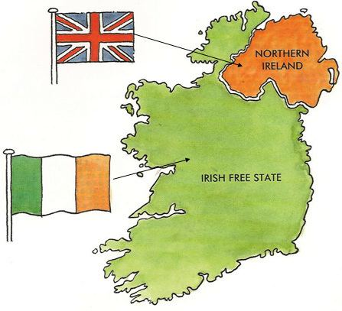
Ireland Partitioned, 1920
1801-1920 all of Ireland was part of the United Kingdom of Great Britain and Ireland (UK)
1920 Government of Ireland Act partitions Ireland into two states
Six north-eastern counties become ‘Northern Ireland’ – a self-governing ‘province’ within the United Kingdom (UK) with capital at Belfast
Twenty-six southern counties become in 1921 an independent state as the ‘Irish Free State’ - renamed ‘Republic of Ireland’ in 1949 - with capital at Dublin
‘Irish Border’ created – 310 miles / 499km separating the two Irelands

Slide 3
Lecture Outline
Why was Ireland partitioned? Roots in colonialism, religious division, rise of rival nationalisms
How was Ireland partitioned? Response to ‘Irish Revolution’ and Ulster Unionist mobilisation; British geopolitics; a contested boundary
What was ‘Northern Ireland’? Legacy of ethno-national division and violence; devolved powers and responsibilities; ‘The Orange State’?
Could NI have been reformed? The failure of ‘Liberal Unionism’ and the crisis of Civil Rights in the 1960s
Collapse into violence: outbreak and intensification of ‘The Troubles’; suspension of NI self-government 1972

Slide 4
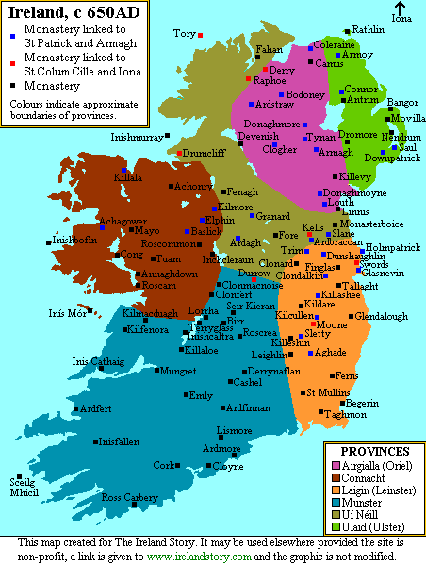
Early Medieval Ireland
Ireland converted to Christianity (5th Century, with allegiance to Roman church) – Saint Patrick its ‘apostle’ and patron saint – monastic system
Gaelic (Irish) speaking island – high level of cultural unity; shared Gaelic culture with western Scottish isles / highlands
Politically divided into small kingdoms (túath) /provinces but with a nominal ‘high king’ of Ireland by 10th century. Pastoral clan society; slavery; regulated by ‘Brehon laws’
Some urban development around ports following Viking (Scandinavian) invasions from 9th century (Dublin, Limerick, Waterford etc)
Legacies: ideal of ‘Irish Gaelic Civilisation’ – ‘Isle of Saints and Scholars’ appeals to later generations
Ireland in early medieval period (c.650)

Slide 5
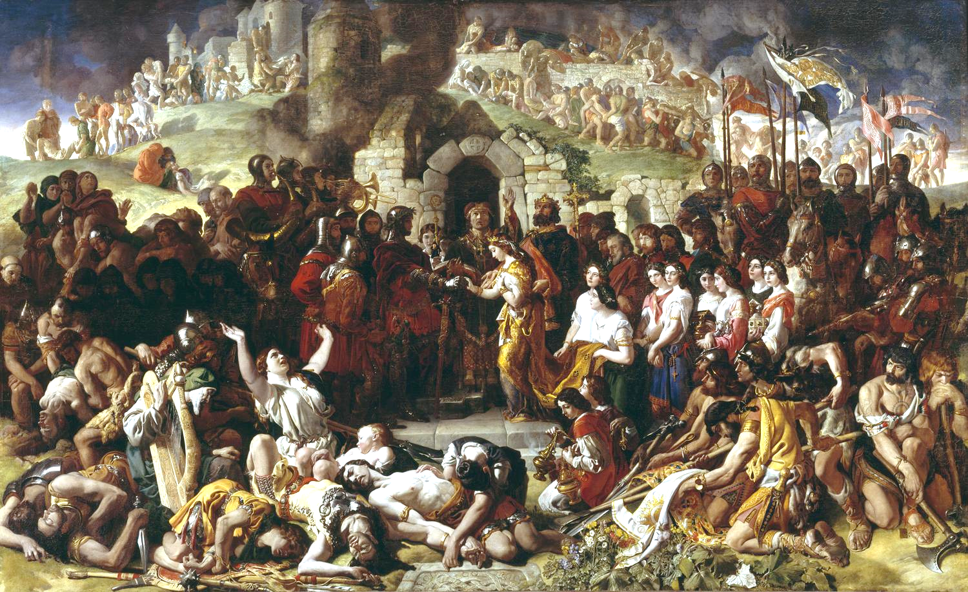
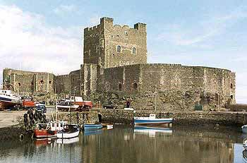
The Medieval Colony of Ireland c.1170-1534
Invasion and partial colonisation of Ireland by Kingdom of England 1171 (following incursion 1170 by Baron Richard ‘Strongbow’ de Clare)
Part of Norman expansion across Europe (Normandy, England, Scotland, Naples, Sicily)
Settlement of eastern coastal districts by English/Welsh settlers brings feudalism and English language; west and north remains Gaelic and Irish-speaking
Dublin emerges as political capital of Ireland; seat of English royal power at Dublin Castle
Settlers become knows as the ‘Old English’ of ‘The Pale’; but some Hibernicisation of settlers beyond the Pale (De Burgo/Burkes, Fitzgeralds, Butlers)
Statutes of Kilkenny (1366) seek to prevent intermarriage in English colony; subordinate Gaelic law/language; maintain cultural divide in ‘Pale’ – only partial success
‘The Marriage of Strongbow and Aoife’ by Daniel Maclise (1854)
Carrickfergus Castle, Co. Antrim (1177-1217). Seat of English power in east Ulster until 18th century.

Slide 6
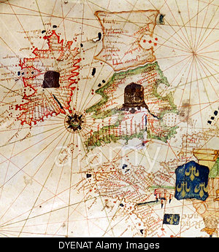
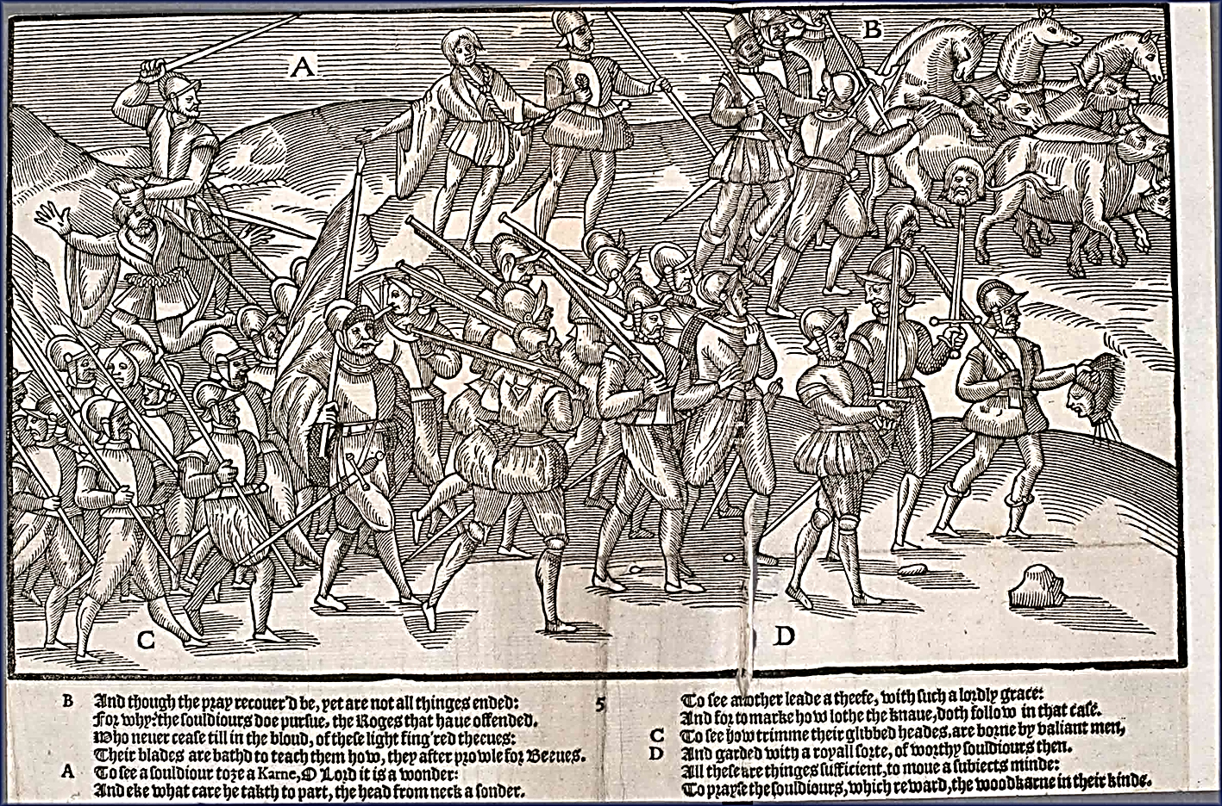
English Tudor Conquest and Reformation
Full conquest and political subordination of Ireland by Tudor English kingdom in series of initiatives and wars from 1534 to 1603 (from Henry VIII to James I)
King Henry VIII of England proclaimed ‘King of Ireland’ 1541
Context of Atlantic colonial expansion of England/Britain
English Protestant Reformation from 1530s exported to Ireland – mostly fails, but is made the Established Church of Ireland (Episcopalian) – to 1869
Protestantism imposed on Ireland from 1560s; but strong resistance from both natives and ‘old English’ settlers who mostly adhere to Catholicism
‘New English’ Protestant settlers hostile to both native and ‘Old English’ Catholics
Ireland drawn into European Wars of Religion (Spanish Armada, 1588)
Ireland and England, from 1528 map
English army campaigning in Ireland (John Derrick, 1581)
Notes:
Early modern developments complicated these relationships
1) Gradual reconquest of Ireland in 70 years after 1534 as Tudor state grew in power; and Atlantic grew in political importance – part of western colonial expansion.
2) Key difference from 12thC: Reformation - a failure in Ireland. Protestantism inevitably identified with expansion of British political power at time of growth of Tudor power in Ireland. The later C16th and early C17th series of wars and confiscations - the destruction of Gaelic power (especially in its stronghold in Ulster by 1603), & creation of a strong colonial administration. Accompanied by rhetoric of ‘civility’ - dehumanizing ‘natives’ and legitimizing conquest - a mode of thinking which proved suitable for export as the empire grew.
Not entirely uniform – ‘Old English’ settlers remained Catholic but mostly loyal to state – but begins process of h political and social subordination of Irish Catholics, especially as Protestant ‘New English’ settlers seek to differentiate themselves from natives.

Slide 7
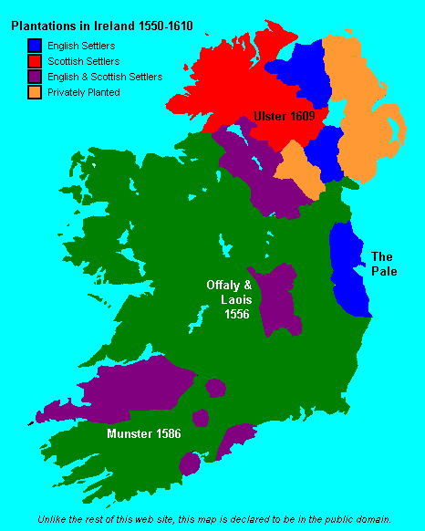
The Plantation of Ulster, 1609
Rebellion of Gaelic Irish lords of Ulster under Hugh O’Neill 1594; supported by Spain as a Catholic crusade
Defeated at Kinsale 1603 and their lands confiscated by crown after ‘Flight of the Earls’ in 1607; depopulation
Ulster Plantation by English (Anglican) and Scottish (Presbyterian) settlers from 1609: land ownership allocated to British soldiers and ‘adventurers’ / London companies
Mass migration of settlers from lowland Scotland/northern England. ‘Informal’ plantations of counties Antrim and Down by Scots. Continues to 1690s
British settlers predominantly Protestants and speakers of English language/Scots dialects
Most natives remain Catholic and Irish-speaking; pushed to west or on to poorer land in north
Irish Catholic rebellions in 1641-49 and 1689-91 defeated: political power monopolised by landowning minority (‘the Protestant Ascendancy’) until late 19th Century
Memory of rebellions and their suppression important for historical narratives of both Protestant and Catholic communities
Plantations in 16th-17th Century Ireland. Those in the Midlands (1550s) and Munster (1580s) mostly failed in the face of rebellions.

Slide 8
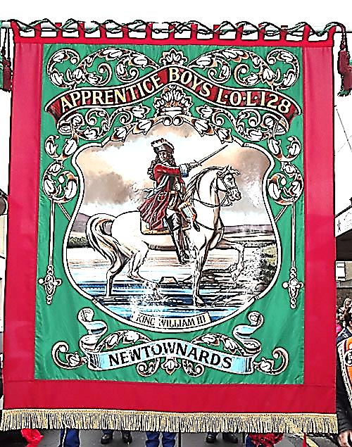
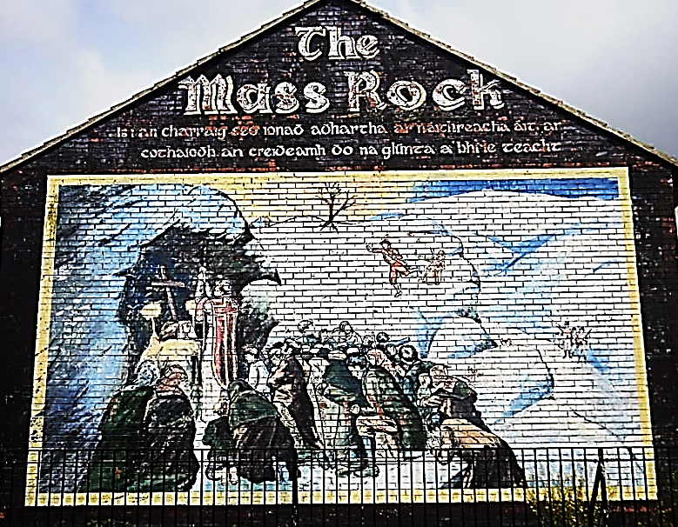
The legacies of the Boyne (1690)
‘War of the Three Kingdoms’ or ‘Glorious Revolution’ (1688-91)
Victory of Protestant King William III ‘of Orange’ at Battle of the Boyne, 1690 (part of wider European war)
Further land confiscations: c.90% of Irish land Protestant-owned by 1700
‘Penal Laws’ passed restricting Catholic (and some Presbyterian) economic, religious, educational and political rights
Most penal laws lifted 1780s-90s, but political ones remain to 1829
Parallel memories – ‘penal era’ or ‘golden age’ of 18th Century
Failed attempt by United Irish movement to create a non-sectarian Irish identity in 1790s – abortive revolution of 1798
Left: Orange banner of King William (1990s); below: Belfast wall mural of penal ‘mass rock’ (1990s, based on 1900s print)
Notes:
Last gt Cath-native rebellion - in support of James II and with Fr aid 1688 - suppression after Battle of Boyne 1690 (commemorations central to mythhistory of Ulster Protestants) - flight of remnants of milit elite to Europe; further wave of confiscations
Reinforced by Penal laws which excluded RCs from pol. power, and imposed consid. relig and econ. disabilities. Yet the penal system failed (if it was ever thus intended) to induce mass conversions - Catholicism remained the religion of more than 3/4 of the population, and the Cath. Ch. re-emerged from the persecution of the eC18 as an object of particular veneration. Towards the end of the century all but the political disabilities were abandoned by the state - but the Protestant confessional character of the state continued to remind Caths of their inferior status and the alien nature of their landlords.

Slide 9
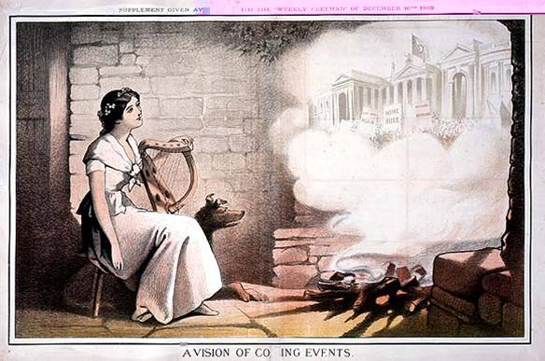
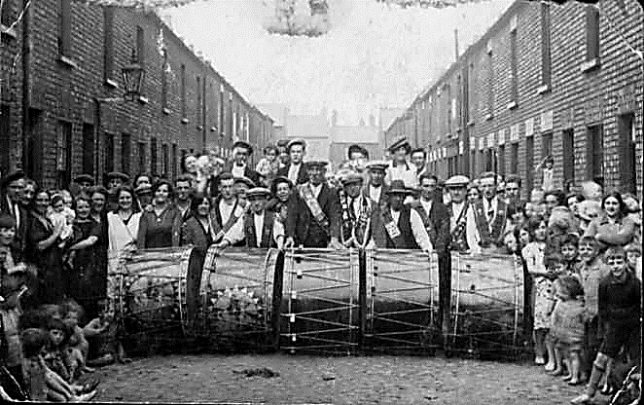
Nationalism and Unionism
1800 Act of Union integrates Ireland politically into United Kingdom of Great Britain and Ireland (UK); direct British rule of Ireland
In 19th Century, most Irish Catholics support Irish self-government (‘Repeal’/‘Home Rule’) but with some link to UK (Nationalists) – to be attained by constitutional agitation
More radical nationalists /‘Fenians’ seek totally independent Republic through revolution (Republicans)
Most Irish Protestants become Unionists (seeking to maintain political union with UK). Mobilise through Orange Order (est. 1795) named after King William III of Orange.
Pro-‘Home Rule’ cartoon, 1890s
Orange Order band, Belfast, early 20thC

Slide 10
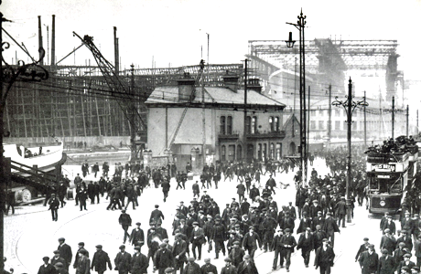
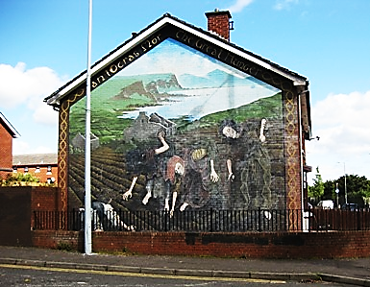
Uneven Economic Development
North-east Ulster has industrial revolution
Belfast centre of world-leading linen textiles and engineering industries
Harland and Wolff Shipyard (est. 1861) – construction of ‘Titanic’ 1910-12
Protestant middle and working classes associate economic prosperity with Union
South and west of Ireland marked by slower economic growth or stagnation
Great Famine 1845-50 sees 1/8 of population die
Mass emigration (c.8m over 19th century)
Post-famine economy remains dependent on agriculture and food processing
Nationalists tend to blame Union for damaging Irish economy

Slide 11
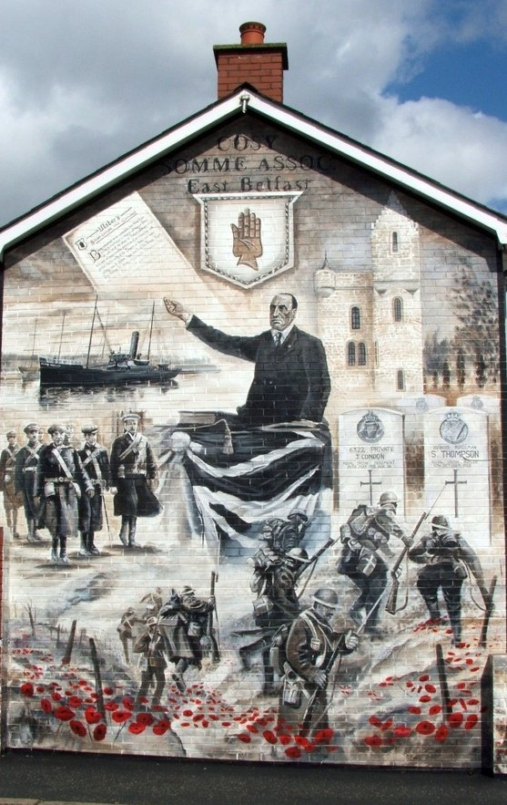
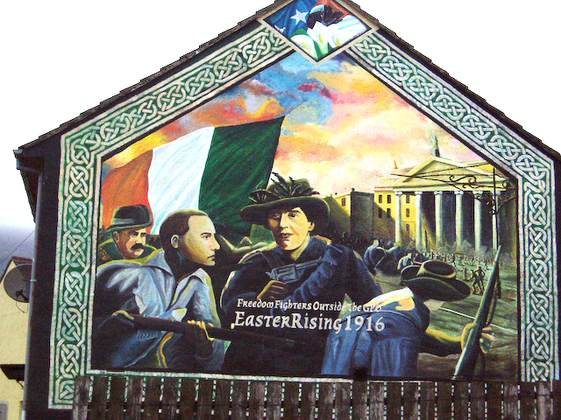
War and Revolution in Ireland 1912-21
1912 British Liberal Govt allied to Irish Nationalists proposes Home Rule Bill for Ireland
‘Ulster Crisis’ 1912-14 sees Unionism mobilise in defence of UK link; paramilitary Ulster Volunteer Force (UVF)
First World War (1914-18) sees radicalisation of Irish Nationalism: 1916 Rising in Dublin led by revolutionary IRB
Unionist ‘Blood sacrifice’ myth – Battle of the Somme 1916
1918 Election sees Ireland split between Sinn Fein party (seeking total independence) and Ulster Unionists
Irish War of Independence led by Sinn Fein party and IRA, 1919-21 forces British Govt to negotiate – Anglo-Irish Treaty 1921
Loyalist Historical Mural of 1912-14 mobilisation under Edward Carson and First World War
Belfast Republican Mural of ‘Easter Rising’ in Dublin, 1916

Slide 12
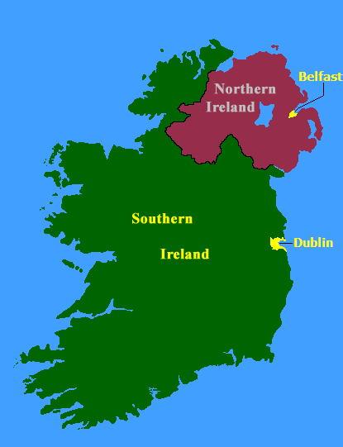
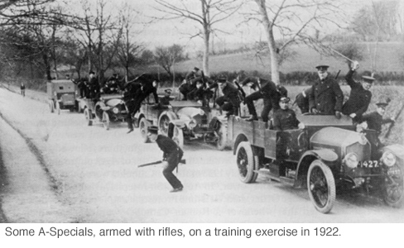
Partition and Northern Ireland, 1920-22
Ireland partitioned by 1920 Government of Ireland Act
6 North-eastern counties become ‘Northern Ireland’ with Protestant majority
26 southern counties known as ‘Southern Ireland’ (1920-1), Irish Free State (1921-37), Éire (1937-49), Republic of Ireland (1949-)
Northern Ireland a self-governing ‘province’ within UK, with a devolved parliament and a regional government in Belfast
Partition of Ireland an attempt by Britain to ‘solve the Irish problem’ by territorial division between ethno-national communities – could it succeed?
Compare with other ‘end of empire’ partitions: India (1947); Palestine (1947-8); Cyprus (1974)

Slide 13
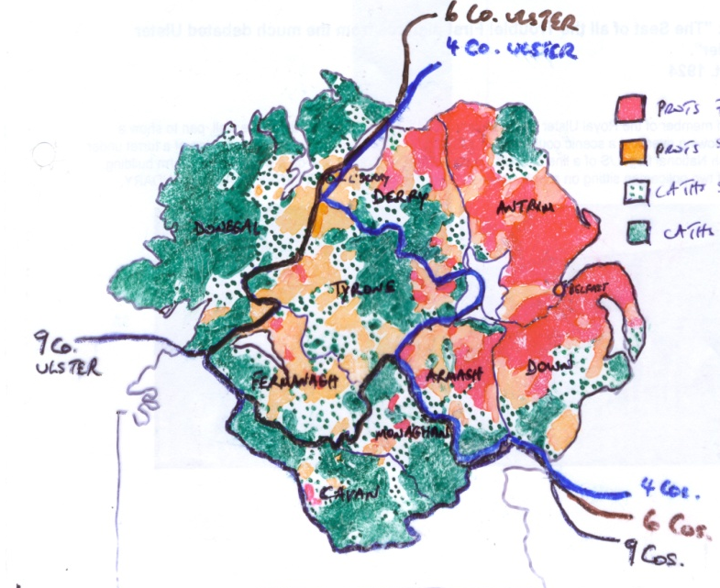
Partitioning Ireland: Border drawing
Complex religious demography of Ulster
4, 6 or 9 county area – debated from 1913/14?
GOIA 1920 rejects local plebiscites / county option (c.f. Silesia, Schleswig-Holstein, Saarland)
UK Government preferred 9 counties (c.54% Protestant); Unionist leader James Craig insisted on 6 (c.70% Protestant)
2 of 6 counties (Tyrone, Fermanagh) had Catholic/Nationalist majorities; border city of Londonderry also Catholic majority
Large and hostile minority (c.30% Catholic) left inside Northern Ireland; smaller Protestant minority (c.10%) left in ‘Southern Ireland’/IFS
Boundary Commission of 1925 recommends only very minor changes – abandoned
No repartition since 1920
Prot 75-100%
Prot 50-75%
Prot 25-50%
Prot 0-25%

Slide 14
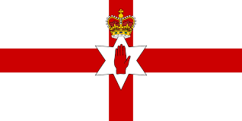
The Government of Northern Ireland (1921-72)
Flag of Northern Ireland (‘Ulster Banner’) 1924-72
GOIA 1920 grants NI legislative and executive devolution as a ‘Province’ within UK
Supported by Ulster Unionists as guarantee of partition – but meant acceptance of ‘Home Rule’ for NI – contradiction?
NI Parliament: 52 MPs in Commons elected by Proportional Representation (STV); 24 Senators elected by Commons
NI Parliament to have devolved control over internal affairs, including policing, education, economic development
‘Imperial’ or ‘reserved’ affairs reserved to Westminster (NI remains in UK) – including war/peace, currency and trade
NI to have symbolic Governor General, but no federal relationship with Westminster
Hope that NI and S Irish Parliaments would co-operate in ‘Council of Ireland’ and possibly reunite voluntarily

Slide 15
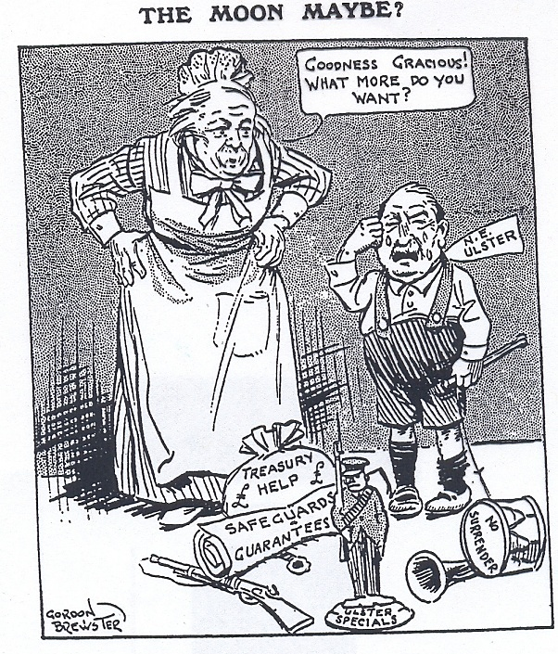
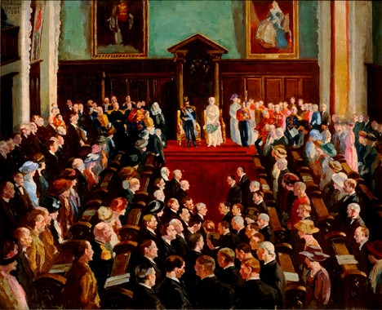
State Building: Craig in Government
James Craig PM of NI 1921-1940; created Viscount Craigavon 1927
NI Parliament elections May 1921: 40 Ulster Unionist, 6 Nationalist Party, 6 Sinn Fein – permanent Unionist control to 1972
NI Parliament opened at Belfast City Hall by King George V, June 1921 (boycotted by nationalist parties)
Devolved powers transferred to NI Govt in course of 1921
Irish Weekly Independent, Nov. 1921
John Lavery: Opening of NI Parliament, 1921

Slide 16
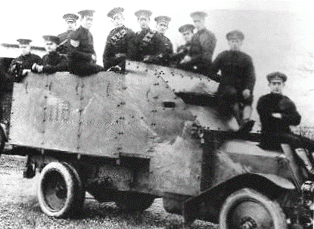
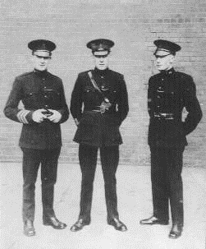
The ‘First Troubles’ and Security Policy
Northern Ireland born in violence – ‘Troubles’ of 1920-22
Irish War of Independence (1919-21) and Irish Civil War (1922-3) affects north; also sectarian violence in Belfast and Derry and ‘Border War’ (1920-22) – 455 killed in Belfast alone
Ulster Special Constabulary (B-Specials) formed late 1920 as state security force for NI – exclusively Protestant armed part-time militia based on old UVF
Special Powers Act (NI) introduced 1922 giving coercive powers to NI Govt (retained to 1970s)
Royal Ulster Constabulary (RUC) introduced 1922– an armed regular police force (some Catholic members, but mostly ex-RIC members from south – little N. Catholic recruitment)
New state stabilised by 1923; IRA marginalised; but NI retains security apparatus and distrust of Catholic minority
B-Specials c.1922
RUC Officers, mid-1920s

Slide 17
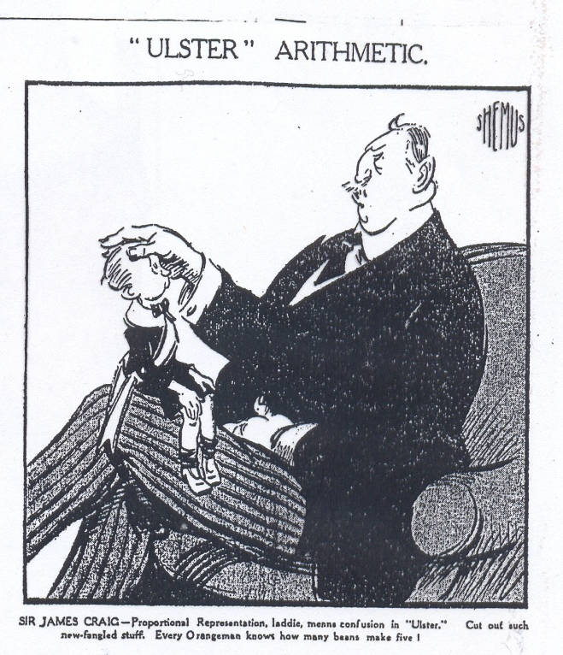
Local Government and Education
Problem of ‘disloyal’ (i.e. Irish Nationalist) control of western local authorities – suspended by NI Govt 1922
NI Local Govt Act 1922 abolishes Proportional Representation (PR) in local govt and redraws electoral boundaries (‘gerrymandering’)
Restores western County Fermanagh, Tyrone and Derry city councils to Ulster Unionist control
British Govt fails to intervene to uphold GOIA ‘safeguard’ of PR - only restored in local government elections 1973
1923 Education Act prepared by Liberal-Unionist Lord Londonderry: seeks equitable treatment of Catholic education in a non-denominational system
Opposed by churches (Protestant and Catholic) and by Orange Order; Lord Londonderry resigns 1926
Legislation amended to favour Protestant schools and guarantee interests of Protestant churches 1925, 1930
‘Proportional Representation, laddie, means confusion to ‘Ulster’. Cut out such new-fangled stuff. Every Orangeman knows how many beans make five!’
‘“Ulster” Arithmetic’ – Shemus, Weekly Freeman, 22 Sept. 1922

Slide 18
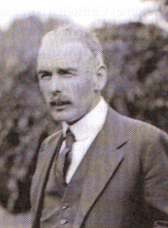
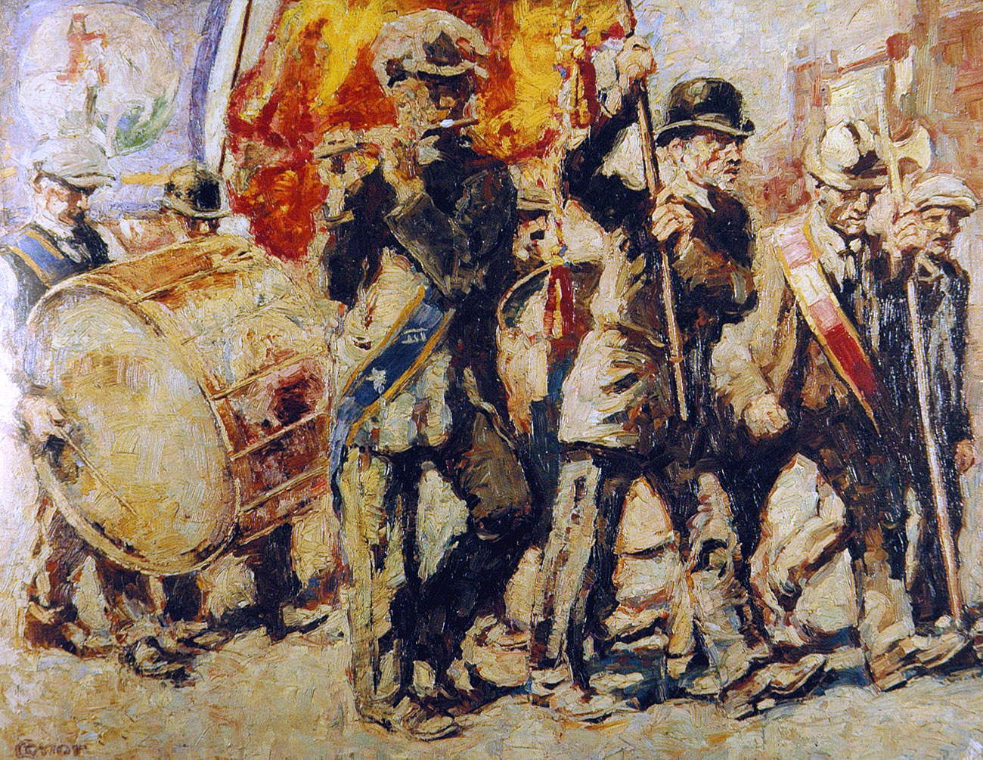
A discriminatory state
Richard Dawson Bates at Home Affairs: had ‘Such a prejudice against Catholics that he made it clear to his permanent Secretary that he did not want his most juvenile clerk or typist, if a Papist, assigned for duty to his ministry.’
Bates lifts ban on RUC membership of Orange Order 1923
Close relationship of Orange Order and the Ulster Unionist Party – a cross-class vertical alignment (OO has seats on Ulster Unionist Council)
Unionist hegemony dependent on continuity of internal and external threats – religious and political
PR abolished for Stormont elections 1928
Continuing Catholic (Nationalist Party and SF) boycott of state institutions until 1925 and again after 1932
Richard Dawson Bates, NI Interior Minister, 1921-43
William Conor, ‘The Twelfth’ (1920)

Slide 19
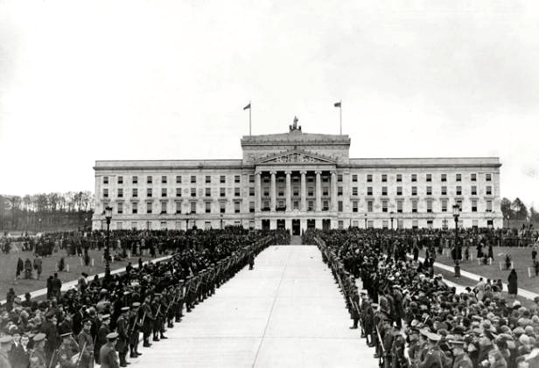
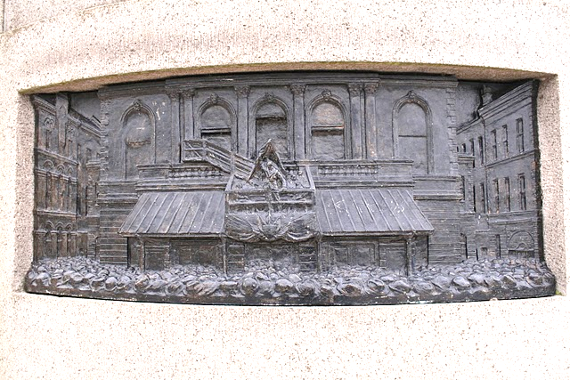
Stormont
Parliament Buildings, Stormont, opened as permanent home of NI Parliament, 1932
Sir Arnold Thornley, architect
Funded by UK Treasury
Statue of Sir Edward Carson added, 1932
Carson has state funeral in Belfast, 1935 (St Anne’s Cathedral)
Context: Severe economic recession and high unemployment (1932 Outdoor Relief Riots)
Major sectarian rioting 1935
Opening of Stormont, 1932
Carson statue, detail

Slide 20
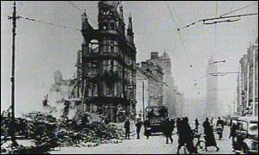
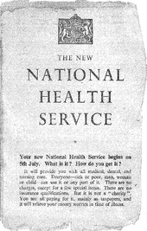
Legacy of World War 2
Revival in heavy industry 1940s and
economic restructuring
Revived sense of common ‘Britishness’ with GB due to shared war experience (Belfast Blitz 1941) and NI war effort
1949 Ireland Act guarantees NI’s constitutional status
Welfare State come to NI after 1945 - Stormont follows UK Labour measures ‘Step by Step’ (paid for by UK Treasury)
National Assistance, Family Allowances, Non-contributory Pensions; National Health Service introduced 1948
NI Education Act 1947; NI Housing Trust established 1945
Belfast after 1941 Blitz

Slide 21
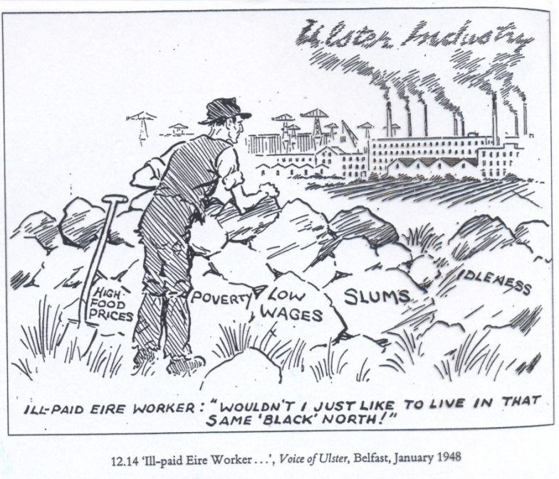
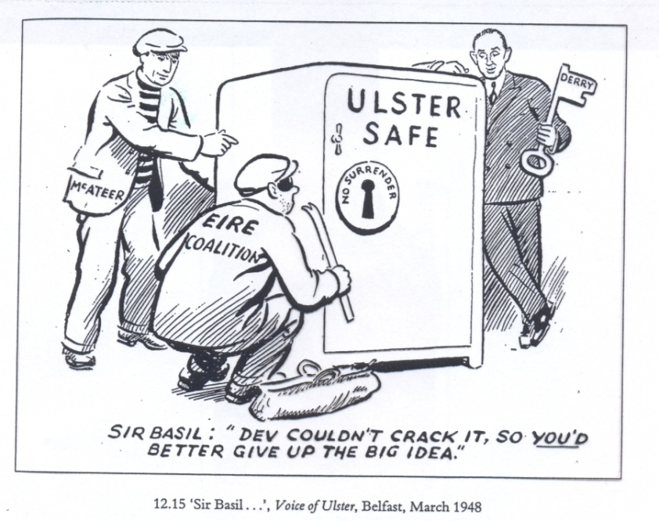
Consequences of welfarism for NI
Welfare reforms popular with Protestant and Catholic working classes
Raises social expectations
Promotes development of Catholic professional middle class (access to secondary and higher education)
Sharpens social differences between north and south of Ireland
Slows emigration from NI – encourages growth in Catholic share of population (had risen to 37% by 1971)
Ties Stormont financially more firmly to Westminster
BUT: not accompanied by political reform
PM of NI Lord Brookeborough (1943-63) retains ban on Catholic members of UUP
IRA campaigns 1939-40, 1956-62 keep tensions high
Lost opportunity for reconciliation after WW2?

Slide 22
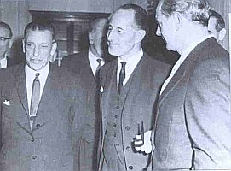
O’Neill’s ‘Liberal Unionism’ 1963-9
Response to economic decline late 50s-early 60s and growing Labour movement (NI Labour Party gets 26% of votes 1962)
Captain Terence O’Neill appointed PM of NI 1963
Technocratic approach to socio-economic development: 1964 Wilson Report on NI economy
Seeks multinational investment (FDI) in new industries
Rapprochement with Sean Lemass (PM of Republic of Ireland) 1965 – trade talks
Liberal Unionist attitude towards Catholic institutions and symbols
Sought working relationship with Harold Wilson’s Labour govt in GB (1964-70)
Was it possible to reform NI?
Sean Lemass and Terence O’Neill meet at Stormont, 1965

Slide 23
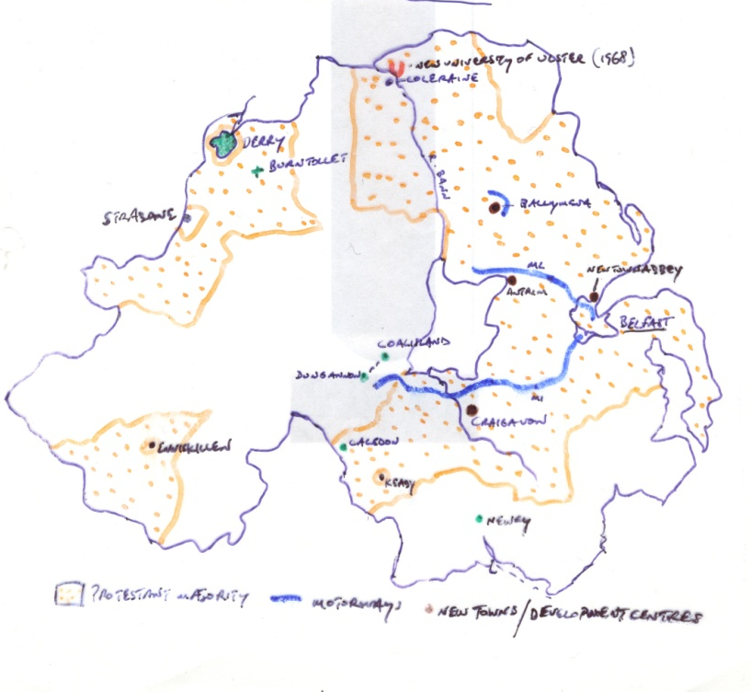
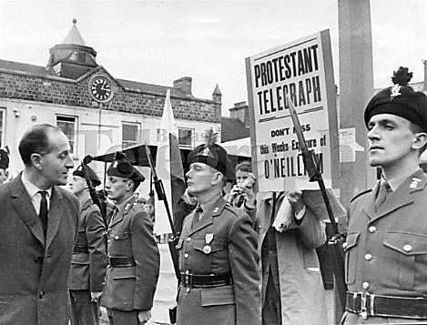
Limitations of O’Neillism
Initial political success – 1965 Stormont elections: UUP vote rises to 60%; NI Labour slips
Limits of planned economy (Craigavon new city); Continued decline of textiles and shipbuilding
Disproportionate development in East Ulster; New University controversy 1968
Catholic political and social expectations not met
No political/security reforms before 1969
Polarisation over 1916 commemorations in 1966 / UVF paramilitary revival and violence
Unhappiness of UUP colleagues (William Craig) and Orange Order towards reforms – anti-O’Neill feeling grows
Loyalist protest against O’Neill, 1966

Slide 24
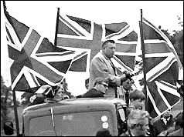
The rise of Rev. Ian Paisley
Evangelical clergyman (Baptist background)
Founds Free Presbyterian Church 1950s
Opposed ‘ecumenism’ in religion and politics
Member of ‘Ulster Protestant Action’ from late 1950s: Published Protestant Telegraph
Provokes riots over display of tricolour on Divis St, 1964; and demonstrates vs Presbyterian General Assembly, 1966
Protests against Lemass visit 1965
Imprisoned for public order offences 1966, 1969
Leads ‘O’Neill must go’ campaign 1968-9
Nearly defeats O’Neill in Bannside election 1969
Founds Democratic Unionist Party (DUP) 1971
Paisley electioneering for the Protestant Unionist Party, 1970

Slide 25
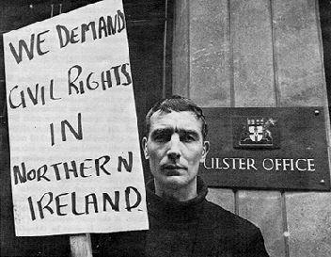
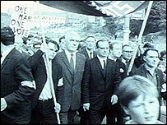
The rise of the Civil Rights Movement
Initial focus west of River Bann, 1963-4, On housing and local govt employment and franchise – discrimination against Catholics
Initial focus on lobbying for change. Support from Campaign for Democracy in Ulster (British Labour Party group)
Support from Gerry Fitt, Republican Labour/SDLP MP for W. Belfast 1966-83
Fails to get NI issues debated at Westminster

Slide 26
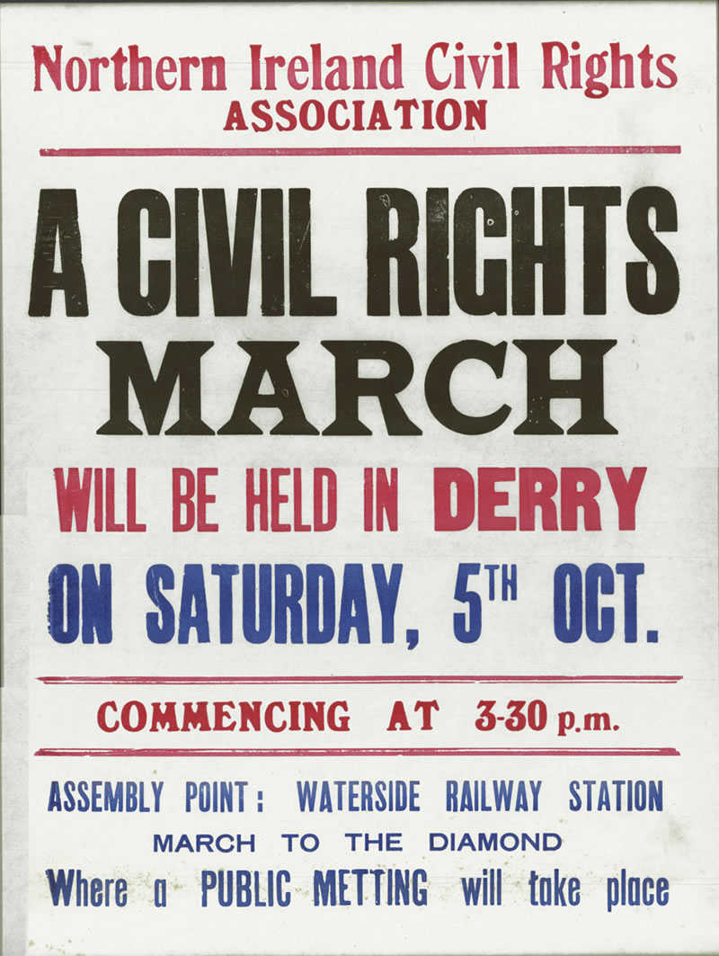
NICRA
NI Civil Rights Association formed Feb. 1967
Loose coalition of Lobby Groups, Liberals, Republicans, NILP, TUs, NI Communist Party, Nationalists
Support from IRA under leftist leadership of Cathal Goulding
Aims:
universal adult suffrage in local government elections (‘one man one vote’)
the end to 'gerrymandered' electoral boundaries
the allocation of public housing on the basis of need (points system)
repeal of the Special Powers Act; the disbanding of the B-Specials (USC)
the end to religious discrimination in employment
a system to deal with complaints of discrimination.

Slide 27
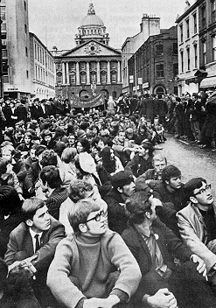
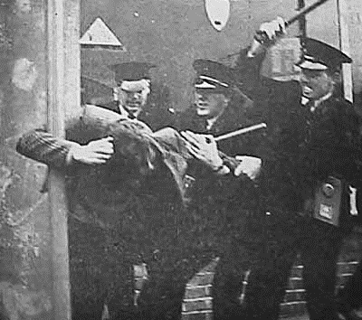
NICRA activities
Modelled on M.L. King’s US Black Civil Rights movement
Student activism – ‘People’s Democracy’ 1968 (QUB): look to European and US student radicalism
Housing occupations – Caledon June 1968
Demonstrations:
Coalisland-Dungannon march Aug. 1968
Provokes Loyalist counter-marches
Derry March 5 Oct. 1968; banned and Protestors batoned by RUC; followed by riots
Filmed and broadcast by RTE tv crew – ‘first day of the Troubles’?
QUB students in Civil Rights protest, 1968
RUC attack 5 Oct march

Slide 28
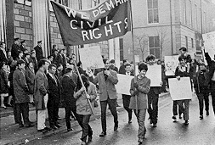
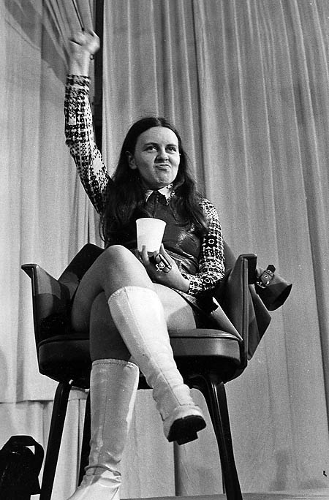
Consequences
15,000 in demonstration in Derry Nov. 1968
UK, Irish and World attention focused on NI
O’Neill comes under external pressure to introduce reforms
Growing tensions between moderates (John Hume) and radicals (PD/Republicans) in NICRA
Nov 1968 O’Neill offers moderate reforms and NICRA calls truce
Radical Peoples Democracy demands more – march to Derry Jan. 1969 attacked by Paisleyite mob at Burntollet
PD leader Bernadette Devlin elected ‘Unity’ MP 1969
Moderates form Social Democratic and Labour Party (SDLP) 1970 – Gerry Fitt, Paddy Devlin, John Hume

Slide 29
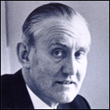
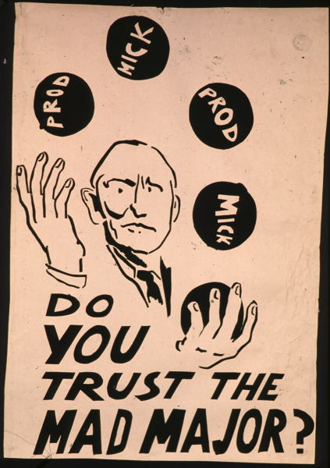
Unionist fragmentation 1969
Ian Paisley’s ‘O’Neill must go’ campaign gains popularity among many Unionists
Stormont elections Feb. 1969: 1/3 UUP ‘Anti-O’Neill’
Ulster Volunteer Force (UVF, founded 1966) bomb NI electricity and water installations March-April 1969 (later also Dublin) – escalate tensions
28 April 1969 O’Neill resigns and is replaced as PM by Major James Chichester-Clark
James Chichester-Clark, 5th PM of NI (1969-71)
PD Poster 1969

Slide 30
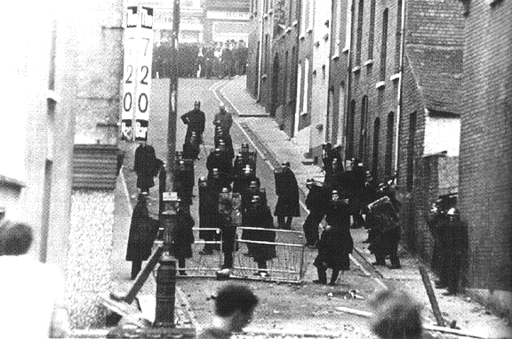
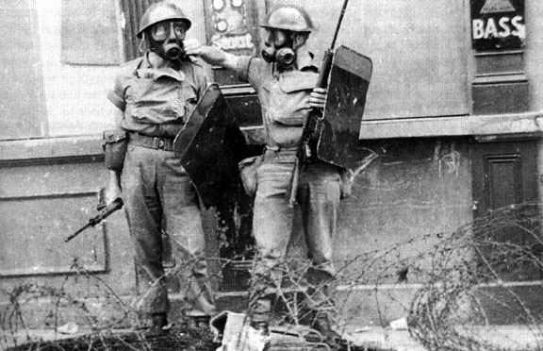
August 1969
Extreme tensions and disturbances over ‘marching season’ in July-August: NI Govt mobilises B-Specials under Special Powers Act, 15 July
Apprentice Boys march in Derry 12 August provokes rioting: ‘Battle of the Bogside’ 12-14 August
Sectarian rioting spreads to Belfast 13 August (7 deaths in city 14-15 Aug): Bombay Street burnings
Stormont requests military aid to RUC: 15 August Wilson govt deploys British Army in Belfast and Derry as peacekeepers
Establishment of ‘peace lines’
Home Secretary James Callaghan visits Derry and promises reforms and official inquiry (Aug., Oct. 1969)
Stormont shares control of security in NI with British army
Photographs of ‘Battle of the Bogside’, Aug. 1969
British troops deployed in Belfast 1969

Slide 31
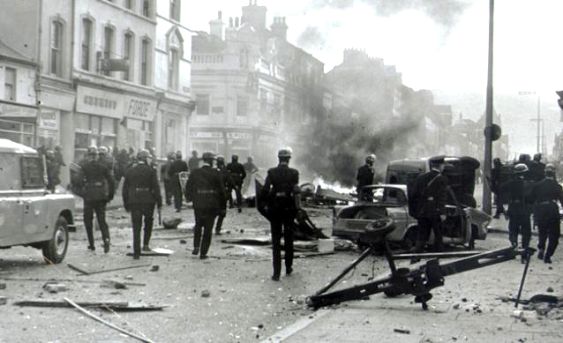
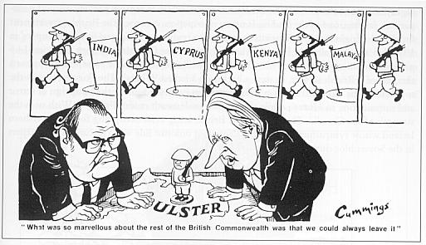
Continuing security crisis 1969-71
Loyalist paramilitary backlash vs reforms (UVF and Ulster Defence Association (UDA), est. 1971)
IRA revival as self-declared ‘defenders’ of Catholic areas and imports arms
Continuing sectarian rioting and attacks : 16 ‘Troubles’ deaths 1969, 26 in 1970, 171 in 1971
Start of bombing campaigns by paramilitaries
Edward Heath’s Conservative govt in GB (June 1970-Feb 1974) more assertive on security policy in NI
UK military leadership saw NI in ‘colonial’ terms (experience in Kenya, Malaya, Cyprus, Aden 1950s-60s)
Stormont ministers lobbied for army to be given more aggressive role vs insurgency, especially Brian Faulkner (PM of NI 1971-2)
‘Falls Curfew’ imposed by British Army July 1970
Aftermath of Shankill riot, 1969
Daily Express cartoon, Mar. 1971

Slide 32
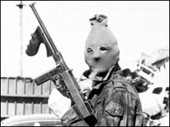

IRA revival and split
Marxist turn of IRA in 1960s under Dublin leadership of Cathal Goulding
Opposed by conservative militants such as Sean MacStíofáin and Ruairí Ó Brádaigh
IRA splits Dec 1969 into Marxist ‘Officials’ and militarist ‘Provisionals’/PIRA (also Sinn Fein splits early 1970)
Provisionals expand in NI 1970 – adopt terrorist techniques developed by PLO etc
First British soldier killed by IRA Feb. 1971 – shift to offensive strategy (‘armed struggle’) in pursuit of British withdrawal and United Ireland
Official IRA gunman, 1972
PIRA funeral 1971

Slide 33


Internment
Previously used 1940s and 1956-62 (NI Special Powers Act but also in ROI)
Used against Republican suspects from 9 August 1971 (not at first against Loyalists)
Arrests by Army, using RUC lists: 342 detained (1971-75: 1,981 in total)
Use of illegal interrogation techniques (‘torture’) on some suspects (cases in ECHR)
Mass alienation and protests across Catholic community: campaign of civil disobedience including SDLP/NICRA
Followed by massive escalation of IRA attacks in second half of 1971
Long Kesh internment camp
Derry after a riot, early 1970s

Slide 34


‘Bloody Sunday’
NICRA march against Internment in Derry 30 Jan. 1972
13 Catholic civilians killed by Army
Official inquiry by Lord Widgery claims most were involved in violence – subsequently discredited (Saville Inquiry report, 2010)
Propaganda coup for PIRA
Riots in Dublin – British Embassy burnt, upsurge of support for PIRA in USA and Europe
Followed by boost to PIRA recruitment and further escalation of violence
1972 bloodiest year of ‘Troubles’ (479 deaths)
Bloody Sunday press photo
Irish Times 5.2.72

Slide 35


The fall of Stormont 1972
British Govt blames Stormont for political crisis and demands surrender of all security powers – refused by PM Brian Faulkner
30 March 1972 NI Parliament and Government prorogued under NI (Temporary Provisions) Act
Mass protests from Unionists and upsurge in Loyalist violence
Direct Rule by UK introduced under Secretary of State for NI William Whitelaw (Con) at NI Office – with some short breaks lasts to 1998
Vanguard Unionist Party protest against suspension of Stormont, March 1972 (BT)
Ian Paisley protests against suspension of Stormont, 1972

Slide 36


Conclusion
By mid-1972 ‘The Troubles’ at peak:
NI in full-scale communal violence – daily atrocities
Mobilisation of PIRA (and later INLA) campaign to end partition and British rule
Mobilisation of Loyalist paramilitary groups (UVF, UDA) to resist this and restore Protestant majority rule in NI
Compromise of British claim to be ‘peacekeepers’ and honest brokers in NI – counterproductive security policy
Start of internationalisation of NI conflict
External and internal political pressure for ‘political settlement’ in NI (1973-4; 1982-3; 1985; 1993-4, 1997-8))
Mutual alienation of religious-national communities and parties in NI – political stalemate to 1990s
Conditions set for ‘long war’ by IRA (to 1994/1997)
Failure of NI Devolved State Experiment of 1920 – but what would replace it?
A conflict with specific short-term causes, but rooted in deep historical structures
British Army in Belfast, 1971
Tarring and feathering an ‘informer’, 1971

