Slide 1
Early Modern Ireland: The 1641 Rebellion
Irish Studies Summer School
Queen’s University Belfast
Monday 1 July 2-3.30
Dr Ian Campbell

Slide 2
Seventeenth-Century Ireland: radical change in politics, society, and culture
From a Bi-Cultural Society to a Society characterised by a dominant and sub-ordinate culture (plus multiple areas of intersection)?
Gaelic Ireland
English Ireland
Protestant Ireland?
Catholic Ireland?

Slide 3
Seventeenth-Century Ireland: Principle Events
Flight of the Earls (1607): End of independent Gaelic lordship.
Ulster Plantation, the Wars of the Three Kingdoms, Restoration, Glorious Revolution.
Dissolution of Irish Catholic Elite; Foundation of Protestant Ascendancy.
Was dismantling that Protestant Ascendency the main thing going on in nineteenth-century Ireland?

Slide 4
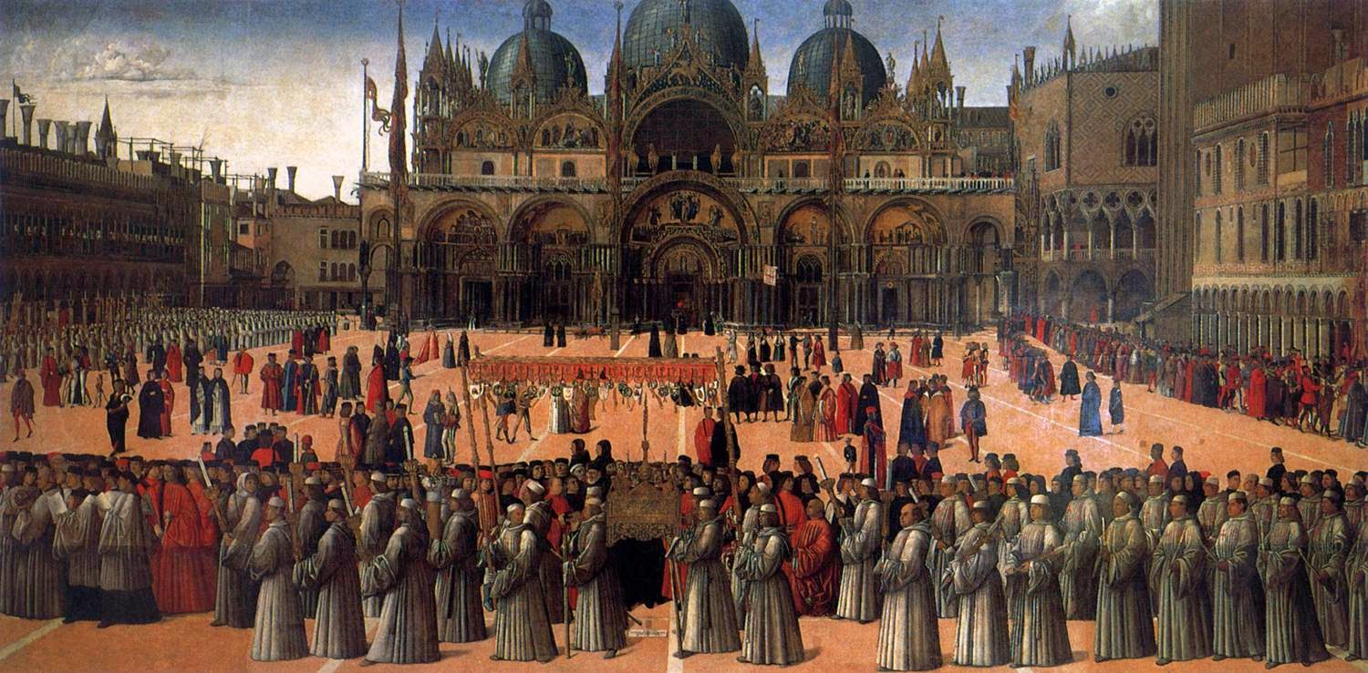
Religion in Early Modern Europe: What was it and how did it work?
Lots of very religious people about?
A religious culture. (Corpus Christi procession, St Marks, Venice)

Slide 5
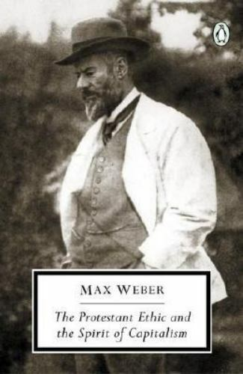
Christianity and the State in Europe
Christianity anti-Modern?
Weber – Special relationship between Calvinism and Modernity.
Heinz Schilling – Confessionalisation Thesis
Intense enforcement of rules in religious, social, and economic life
Generated obedience and the thickening of state power.

Slide 6
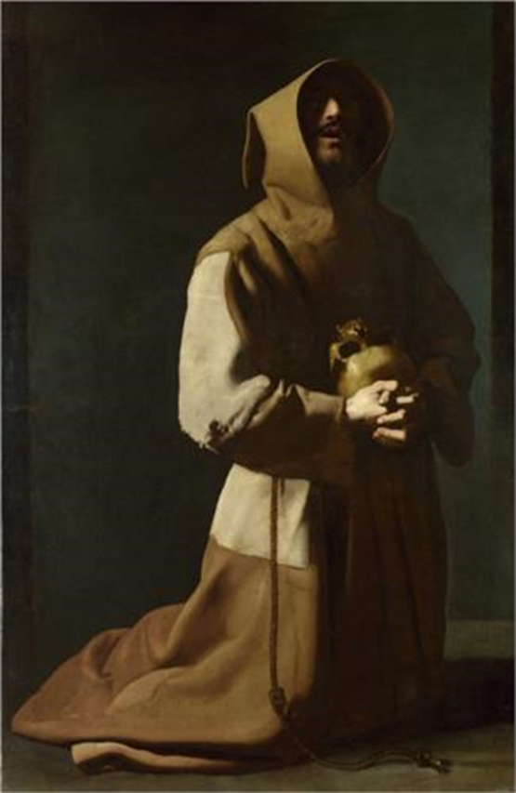
What does this mean about Seventeenth-Century Culture?
Discussion of everything important – the family, war, commerce, kingship – took place using religious language and concepts
Many Christians thought God had left them quite a big natural space in which to use their God-given reason, building laws and states free of his direct intervention.
These Christians reluctant to try and impose faith (a supernatural thing) by force (a natural thing).
But religious militants brought the supernatural very far in …

Slide 7
Religious Warfare in Early Modern Europe
Knights’ War (1522), Peasants’ War (1524-5), Schmalkaldic Wars (1546-7, 1552-5), Wars of Kappel (1529, 1531).
French Wars of Religion (1562-1598), Dutch Revolt (began 1566)
Thirty Years War (1618-1648)
War of the Three Kingdoms (1638-1652)

Slide 8
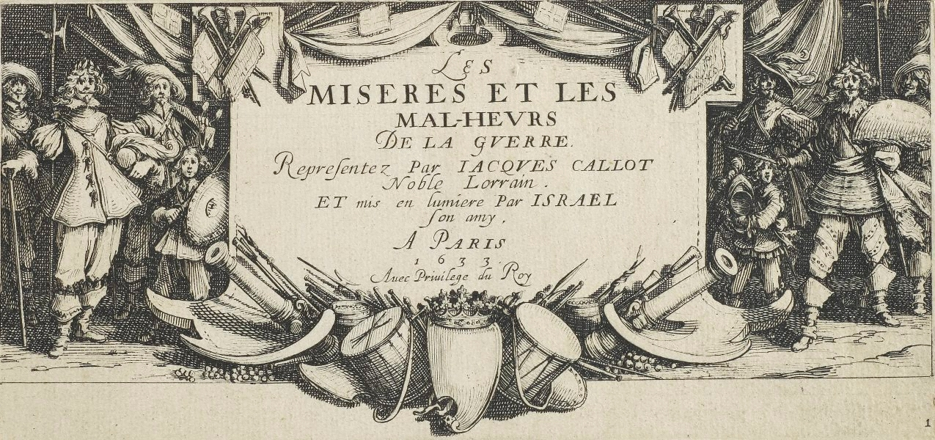
Jacque Callot’s Depiction of War – French army in Lorraine, 1633

Slide 9
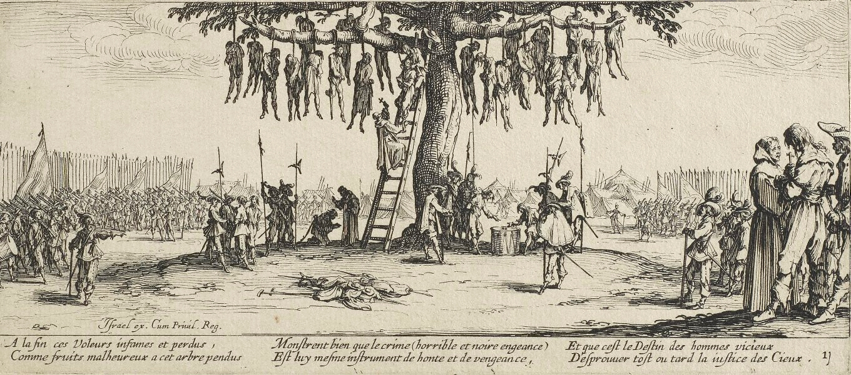
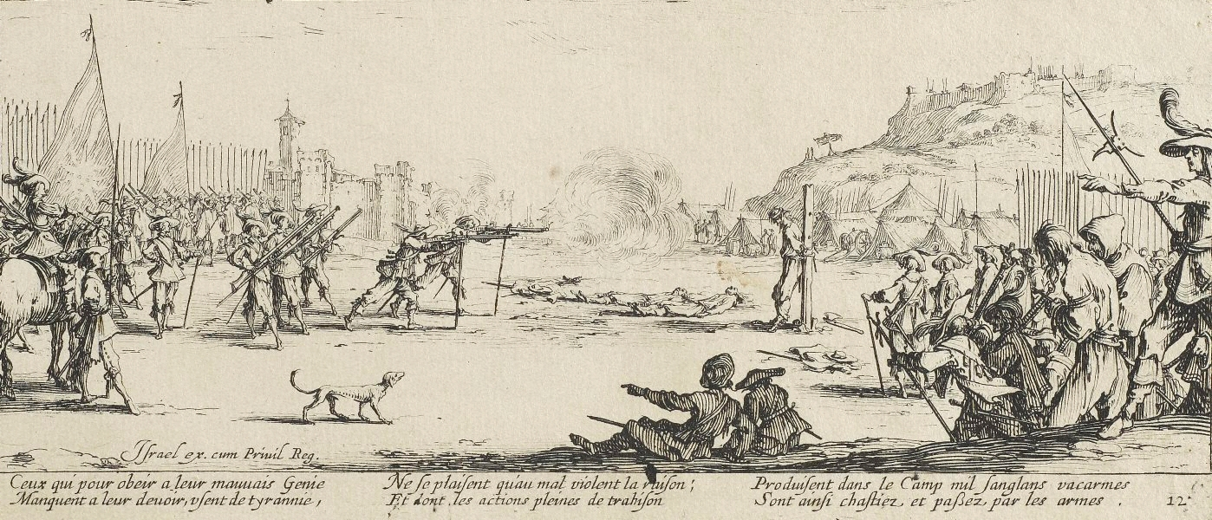
Part of the French (Catholic) intervention against the Habsburgs (Catholic)

Slide 10
What is a Religious War?
Hordes of Fanatics flinging themselves at each other, mindlessly?
If so, no religious wars anywhere in early modern Europe.
Or is it something else?

Slide 11
Irish and English in Medieval Ireland
‘English’ ‘Invasion’ of Ireland, 1169-1172 (Papal bull Laudabiliter, 1155).
Burkes, Butlers, and Fitzgeralds, rather than O’Neills, O’Donnells, and MacCarthys…
Kings of England claimed to be Lords of Ireland from 1172 to 1541 – king’s subjects and the king’s enemies.
Extension of feudal norms of Western Europe to Ireland
1541- The Irish Parliament declared Henry VIII king of Ireland. English law now theoretically available to all Irishmen.

Slide 12
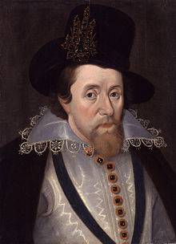
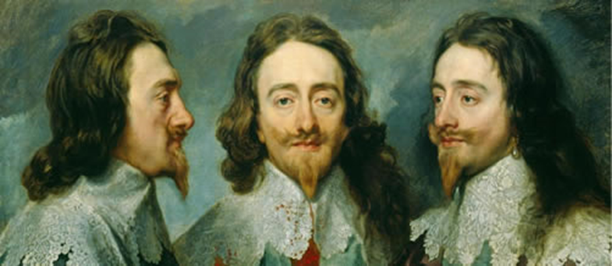
The Stuart Multiple Monarchy
3 Stuart Kingdoms since the accession of James VI/I of Scotland to the kingdoms of Ireland and England 1603
Scotland and England: Protestant
Ireland: Catholic
The ecclesiastical policies of King Charles I

Slide 13
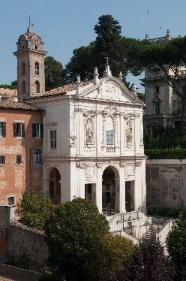
Ireland’s Catholics: Toleration under Stuart Monarchy an Impractical Hope?
Up to the 1640s Ireland’s Catholic gentry and nobility still intact.
Could they find a way of living with their Protestant monarchs?
Protestant kings and Catholic universities?

Slide 14
Two Anti-Stuart Revolutionary Careers
Philip O’Sullivan Beare (1590-1636) – arrives in Spain aged 12 as a refugee – educated northern Spain at a college for poor Irish noblemen – 1610s Conry’s revolutionary group in Madrid – Duel/Assassination attempt English ‘spy’ Madrid 1618 – naval officer – Historiae Catholicae Iberniae Compedium (Lisbon, 1621).
Florence Conry, Franciscan Archbishop of Tuam (1560-1629) – family of Gaelic poets – educated Salamanca – complained of Old English bias – Accompanied Spanish force to kinsale 1601 – advised on appointment of colonels to Irish regiments – 1607, Flight of the Earls – Conry met the earls and escorted them to Rome – author of catechisms in Irish and theology in Latin.

Slide 15
Their Anti-Stuart Revolutionary Ideology
The twelfth-century conquest of Ireland by king Henry II was an unjust war of aggression; Laudabiliter was invalid.
Since then, the English governed the Ireland for the good of a colonial faction, not for the good of the whole people.
This constitutes an attack on the Irish kingdom.
The Irish kingdom is an artificial person, with the same right of self defence as any human.
Under natural law, the Irish kingdom has the right to defend itself against English tyranny and English tyrants.
Spain should help to free the Irish by invading Ireland and destroying English government there.

Slide 16
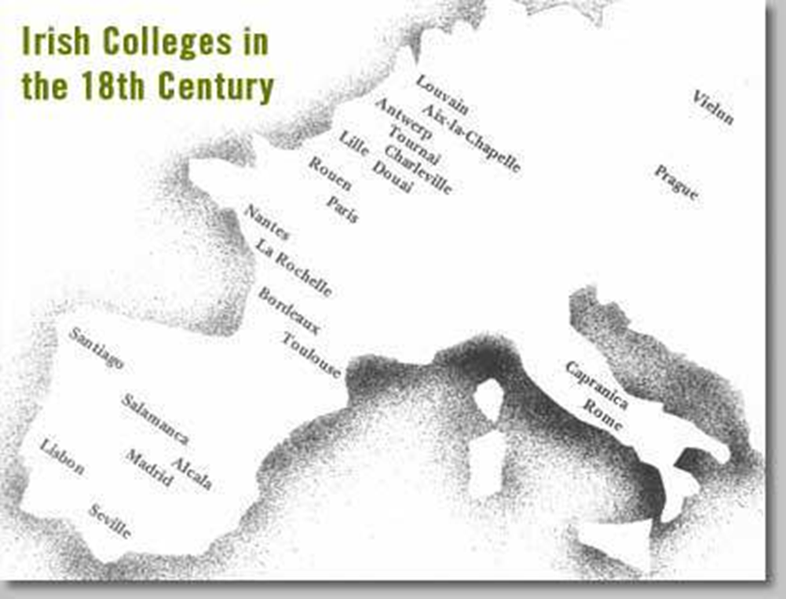
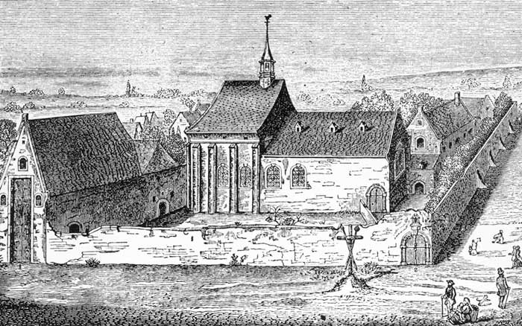
Colleges for the Education of Irish Catholic Clergy founded over the course of the Seventeenth Century
Some of these colleges predominantly English-Irish.
Foundation of Louvain procured by Archbishop Florence Conry, 1607 – predominantly Gaelic Irish.

Slide 17
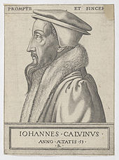
Divisions within British and Irish Protestantism: The Problem of Calvinism
Distinctive Theology:
  Wickedness and Powerlessness of Humanity; Sovereignty of God.
Distinctive Liturgy:
  Preaching and psalm-singing rather than sacraments
Distinctive Ecclesiology:
  Church to be governed by councils rather than bishops.

Slide 18
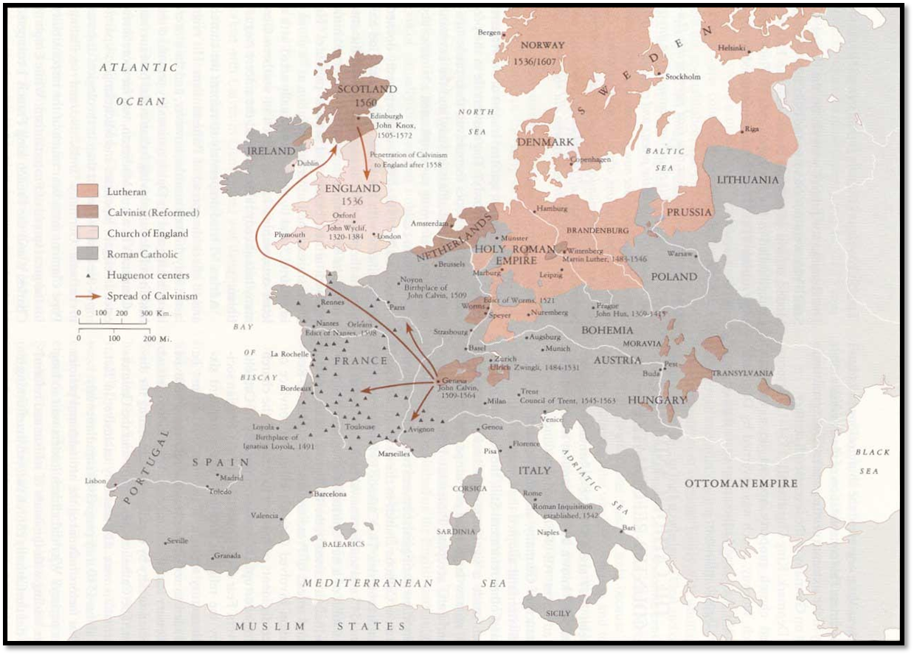
Calvinist Europe

Slide 19
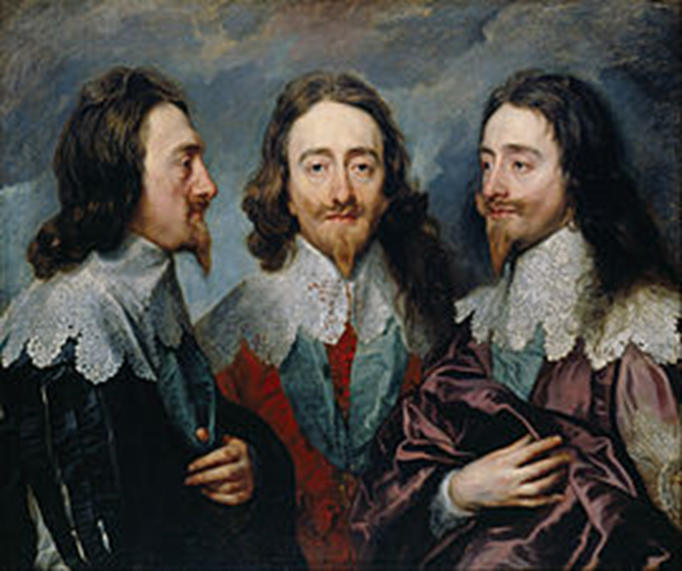
King Charles I and his Calvinist Subjects
Ruled Ireland, Scotland, and England 1625-1649
Wished to impose an episcopal church government on his Calvinist subjects in Scotland and Ireland

Slide 20
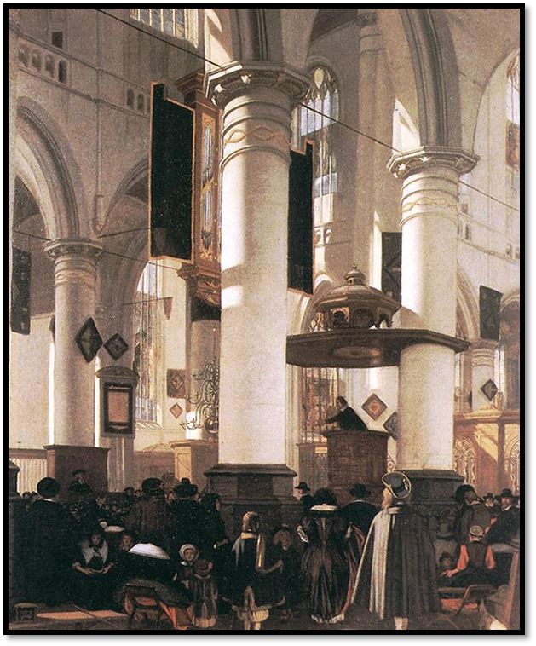
European Calvinists needed a Theology of Resistance and Revolution

Slide 21
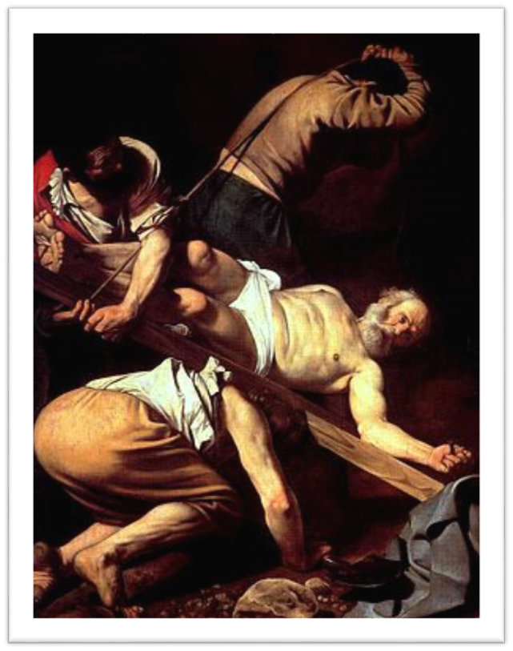
Problem: The Bible - especially the New Testament - told Christians to Obey
‘Let every soul be subject unto the higher powers. For there is no power but of God: the powers that be are ordained of God. Whosever therefore resisteth the power, resisteth the ordinance of God: and they that resist shall receive to themselves damnation’ St Paul, Epistle to the Romans, Chap. 13, Verses 1-2.

Slide 22
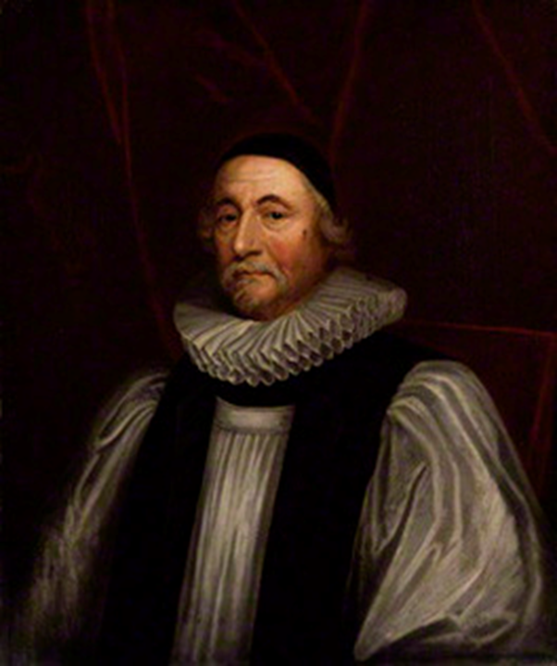
For Many British and Irish Protestants, The King was never to be Resisted
Archbishop James Ussher of Armagh
God gives every individual the power/right to kill in self defence.
But God gave the power/right to execute only to kings

Slide 23
Thought Experiment!
You are a Calvinist minister in Scotland in 1638
Your King Charles I is out to destroy British Protestantism
God must want you to oppose this tyranny – What is God saying to you in these words?
‘Let every soul be subject unto the higher powers. For there is no power but of God: the powers that be are ordained of God. Whosever therefore resisteth the power, resisteth the ordinance of God: and they that resist shall receive to themselves damnation’

Slide 24
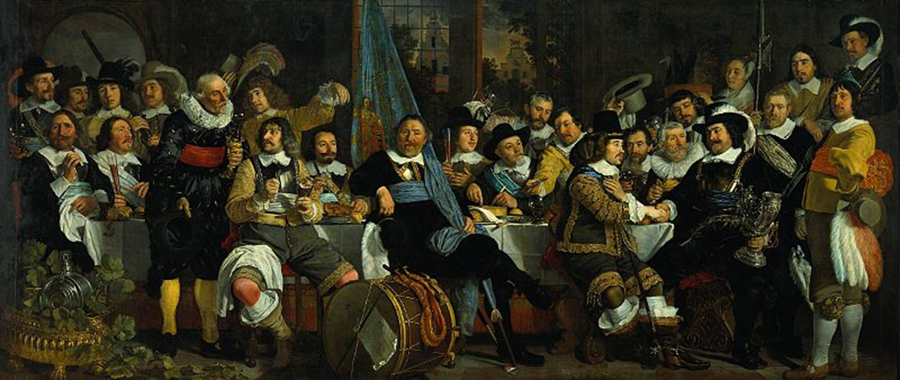
Powers
It is not just the king’s power that comes straight from God.
The powers of Inferior Magistrates come from God too.
Inferior Magistrates are obliged to defend their subjects against royal tyranny.
These Calvinists saw divine rights all around them … Quite different to Catholics

Slide 25
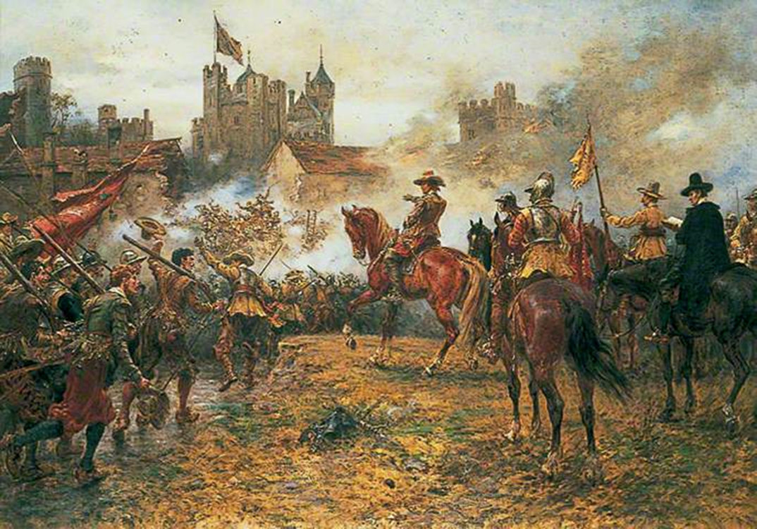
The Wars of the Three Kingdoms, 1638-1652
1638: Scotland Rebels
1641: Ireland Rebels: a baronial revolt becomes a religiously inflected peasant revolt. Catholic nobles set up a provisional government to restore order, and start negotiating with the king for toleration.
1642: English Parliament Rebels
1649: King Charles I Executed.
1649-1652: English Parliament make war in Ireland. Total defeat of the Irish Royalists (including Catholics, Episcopal Protestants, and Presbyterians).
England: 3.7% loss of population
Scotland: 6% loss of population
Ireland: 41% loss of population

Slide 26
These were the crucial religio-political dynamics that dominated the rest of the century
Could Episcopal Protestants in England tolerate Presbyterian church government in Scotland and Ulster? Ultimately, yes.
Could Episcopal Protestants and Presbyterians tolerate a Catholic elite in Ireland? Ultimately, no.

Slide 27
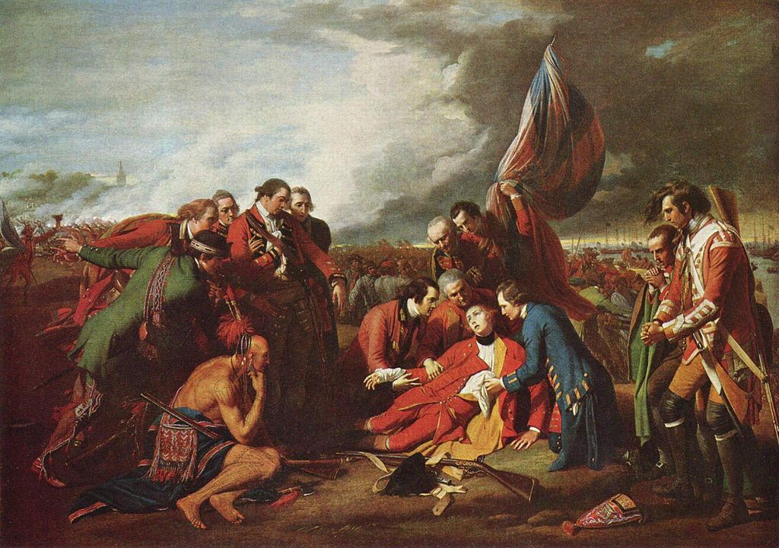
Settlement of the Irish and Scottish Questions meant power of the British state massively increased: Foundation of British Empire in the North Atlantic
Death of General Wolfe at 1759 battle of Quebec during Seven Years War. Painted by Benjamin West, 1770.

Slide 28
Discussion
What is a religious war? (what people say, and what people really think?)
Are religious wars fought only to force other people into your religion or confession?
Are wars fought in defence of your own religion or confession religious wars?
Peter Wilson on the Thirty Years War: a war fought about the constitution of the Holy Roman Empire, of which religious rights were an important part.

Slide 29
Primary Source for the Popular Revolt and Mass Killing
The 1641 Depositions:
  The 1641 Depositions contain information dealing with events from Oct 1641 to May 1642. Lords Justice in Dublin commissioned 8 Protestant clergymen, in December 1641, to take evidence related to robberies and murders. Witnesses encouraged to describe what they saw and what they heard others saw.
  This material was augmented in 1652: High Court of Justice set up by Cromwellians undertook fresh examinations of witnesses, with a view to trying Irish rebels.
Best example of how to approach the 1641 Depositions: Hilary Simms, ‘Violence in County Armagh, 1641’, in Brian Mac Cuarta (ed.), Ulster 1641: Aspects of the Rising (Belfast, 1993), pp. 123-138.

Slide 30
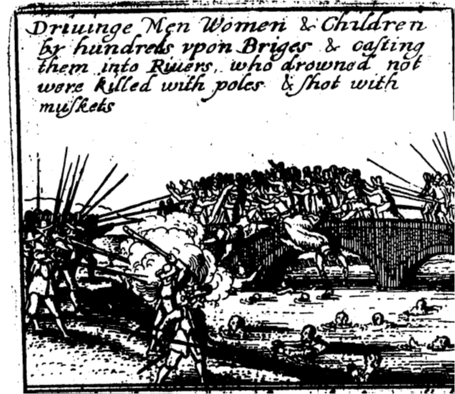
The Case of County Armagh
Rebellion began in Armagh; Worst massacres happened in Armagh.
Eyewitness accounts of:
  Mid-November 1641, mass drowning at Portadown; Perhaps same time, mass burning at Shewie; May 1642, Massacre as Irish withdraw from Armagh; December 1641-January 1642, massacre of Sir Phelim O’Neill’s own Protestant tenants at Kinnard.
Substantial hearsay evidence for:
  Drownings near Loughall and bridge of Corr near Tynan; massacre of Armagh settlers in Tyrone.
Various accounts of individual murders.
Number of murders in Armagh between October 1641 and May 1642 admitting only eyewitness testimony: 527.
Number of murders admitting hearsay evidence: 1259.
William Smyth estimates a settler population of 130,000 people in Ulster by 1641.

Slide 31
1641 in Parliamentarian Propaganda
Sir John Temple, The Irish Rebellion (London, 1646).
  The Irish Catholics planned a general massacre from the start.
  They murdered 300,000 British Protestants in cold blood from 1641 to 1643.

Slide 32
The Butcher’s Bill?
William Smyth, Map-making, Landscapes and Memory: A Geography of Colonial and Early Modern Ireland c. 1530-1750 (Cork, 2006), pp. 160-1
  Estimates about 4,200 settlers reported killed in the 1641 Depositions (not clear on hearsay, eyewitness, etc).
Irish killed in reprisals? No Depositions for them …
Demographic disaster in Ireland, 1641-1654:
  Total Population 1641 of 1.8 million.
  Total Population loss, 1641-1654 of 600,000 (33%)
  If evenly distributed, 109,080 Protestants and 490,920 Catholics killed by war, pestilence, and famine.

