Slide 1
The oral history of a post-industrial city Professor Sean O’Connell

Slide 2
‘Martin, there was seventeen of them - two sets of twins. And their father, the only time he worked was when he took his trousers off at night.’

Slide 3
MRS RAFFERTY (1904-2003)
Mrs R: I don’t bother with them either. The people from Ardoyne are not the same. Sure, they call us imports.
Madge: We’re the imports…. That's 63 years like, and you’re an import, you know?
Mrs R: They called us imports. No, they're not the same - the people in North Queen Street are all very friendly…

Slide 4
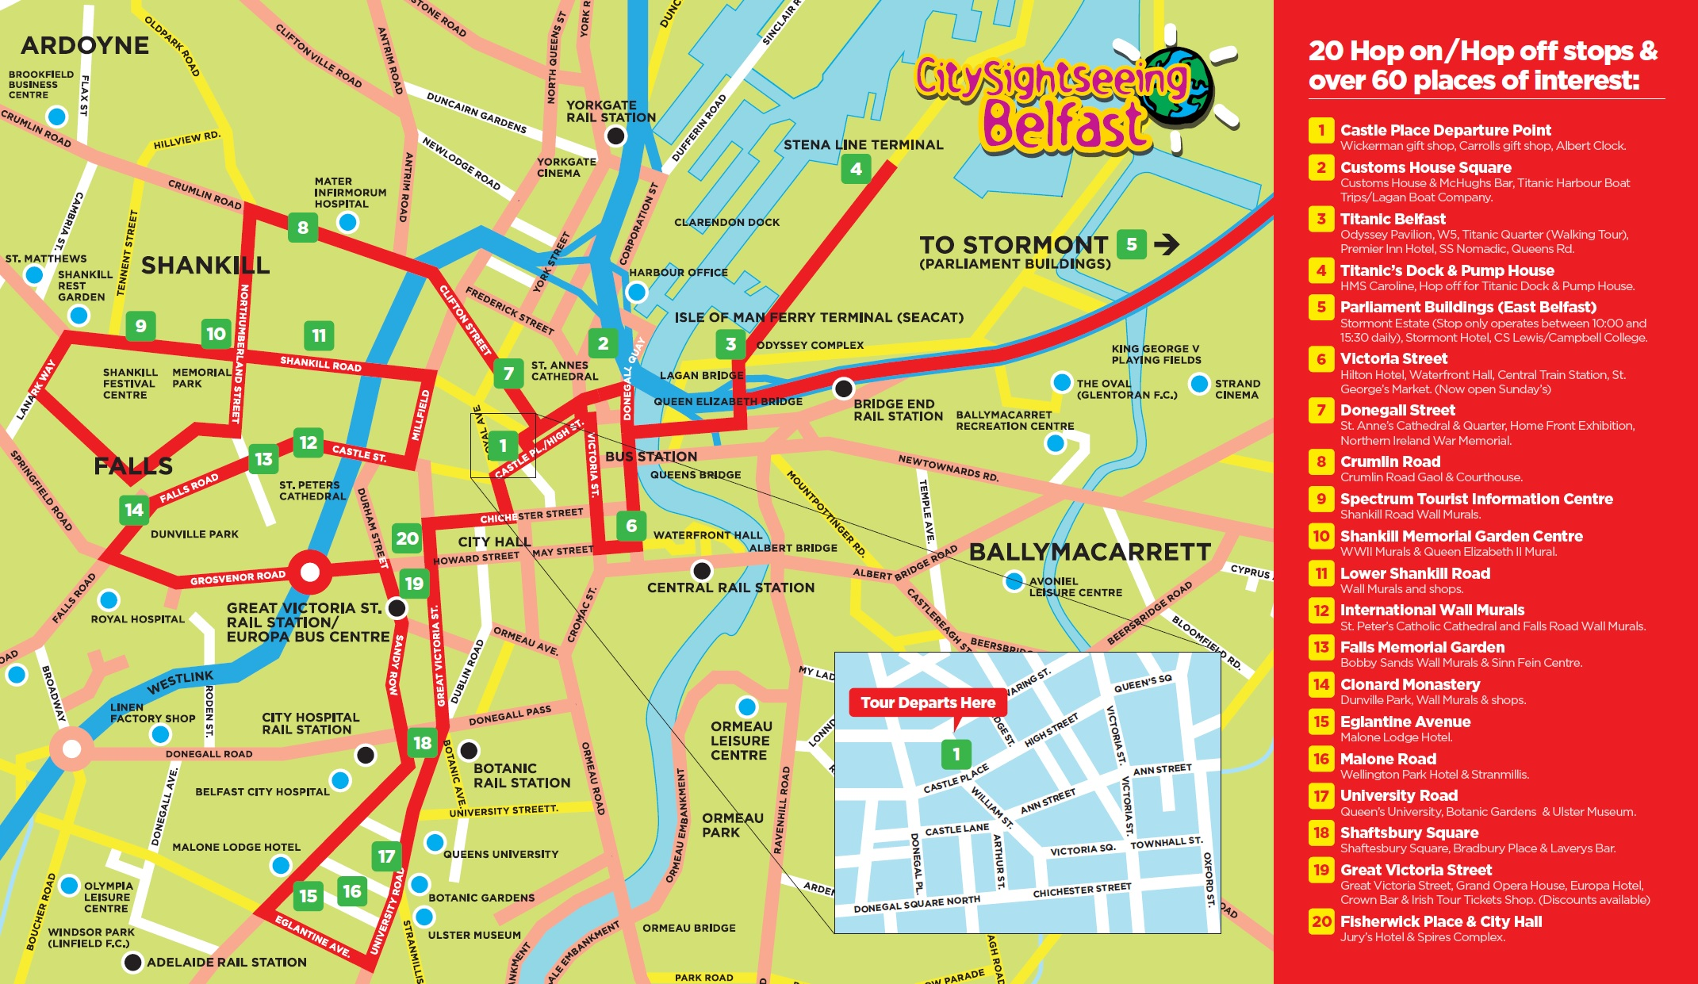

Slide 5
Belfast modernist redevelopment: troubles with a lower case ‘t’ ’
Divis Flats, Falls Road

Slide 6
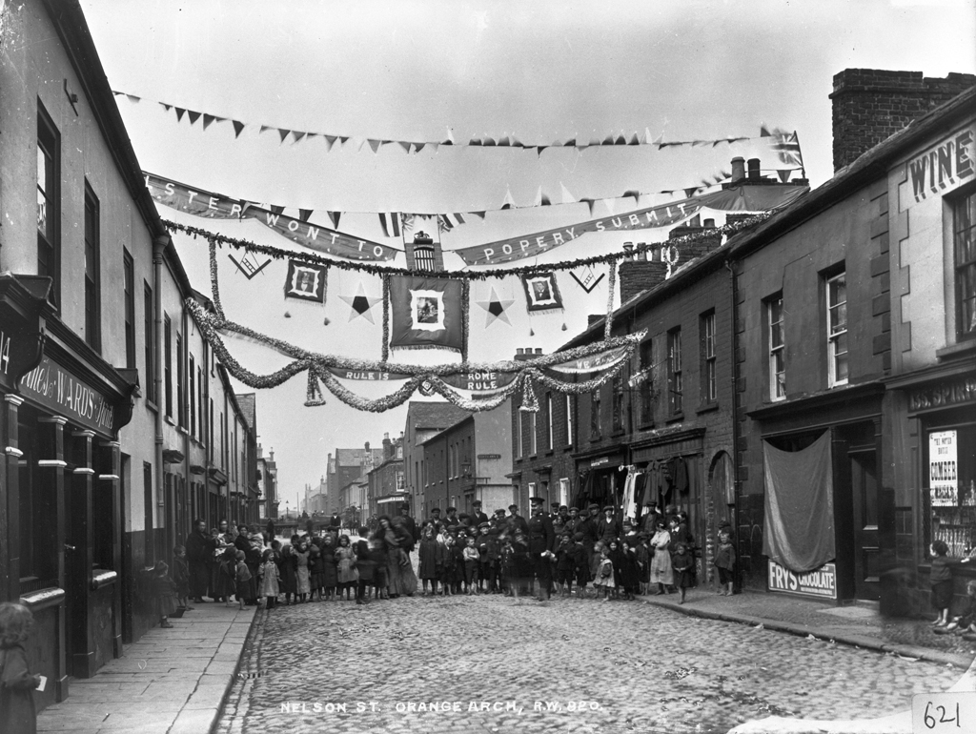

Slide 7
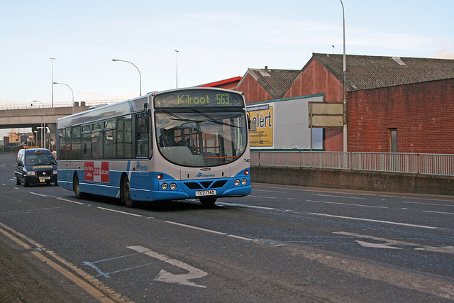

Slide 8
A labour intensive sector
Belfast dockers enjoy a work break

Slide 9
Containerisation
Spot the docker

Slide 10
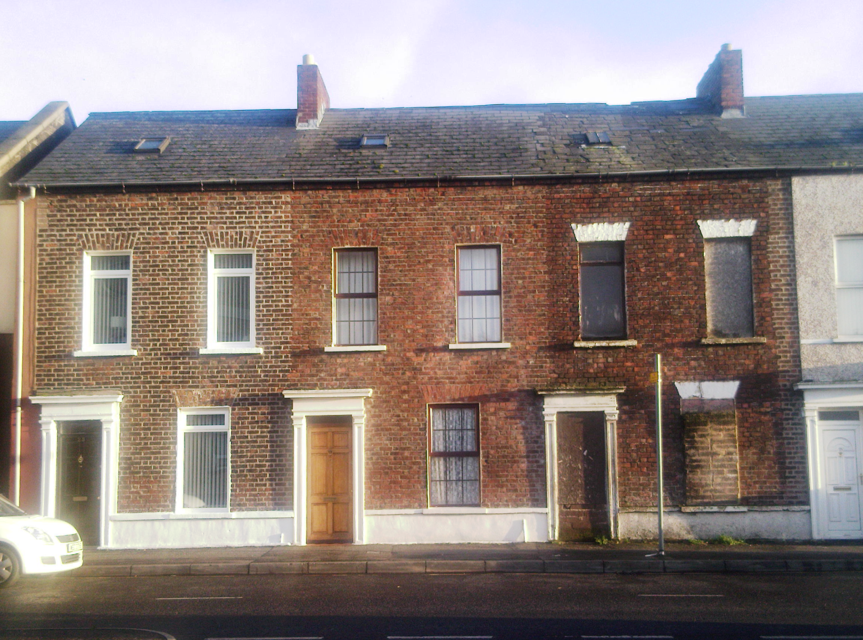

Slide 11
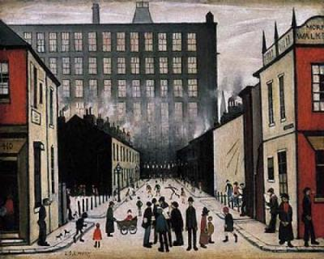

Slide 12
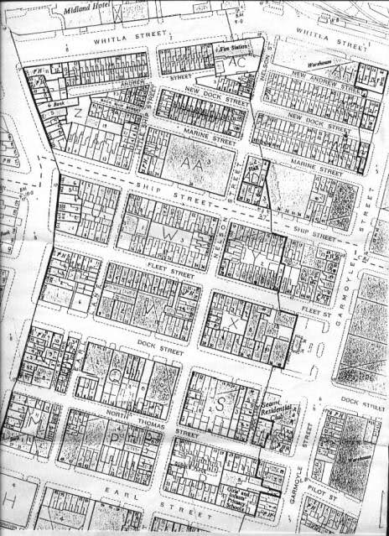

Slide 13
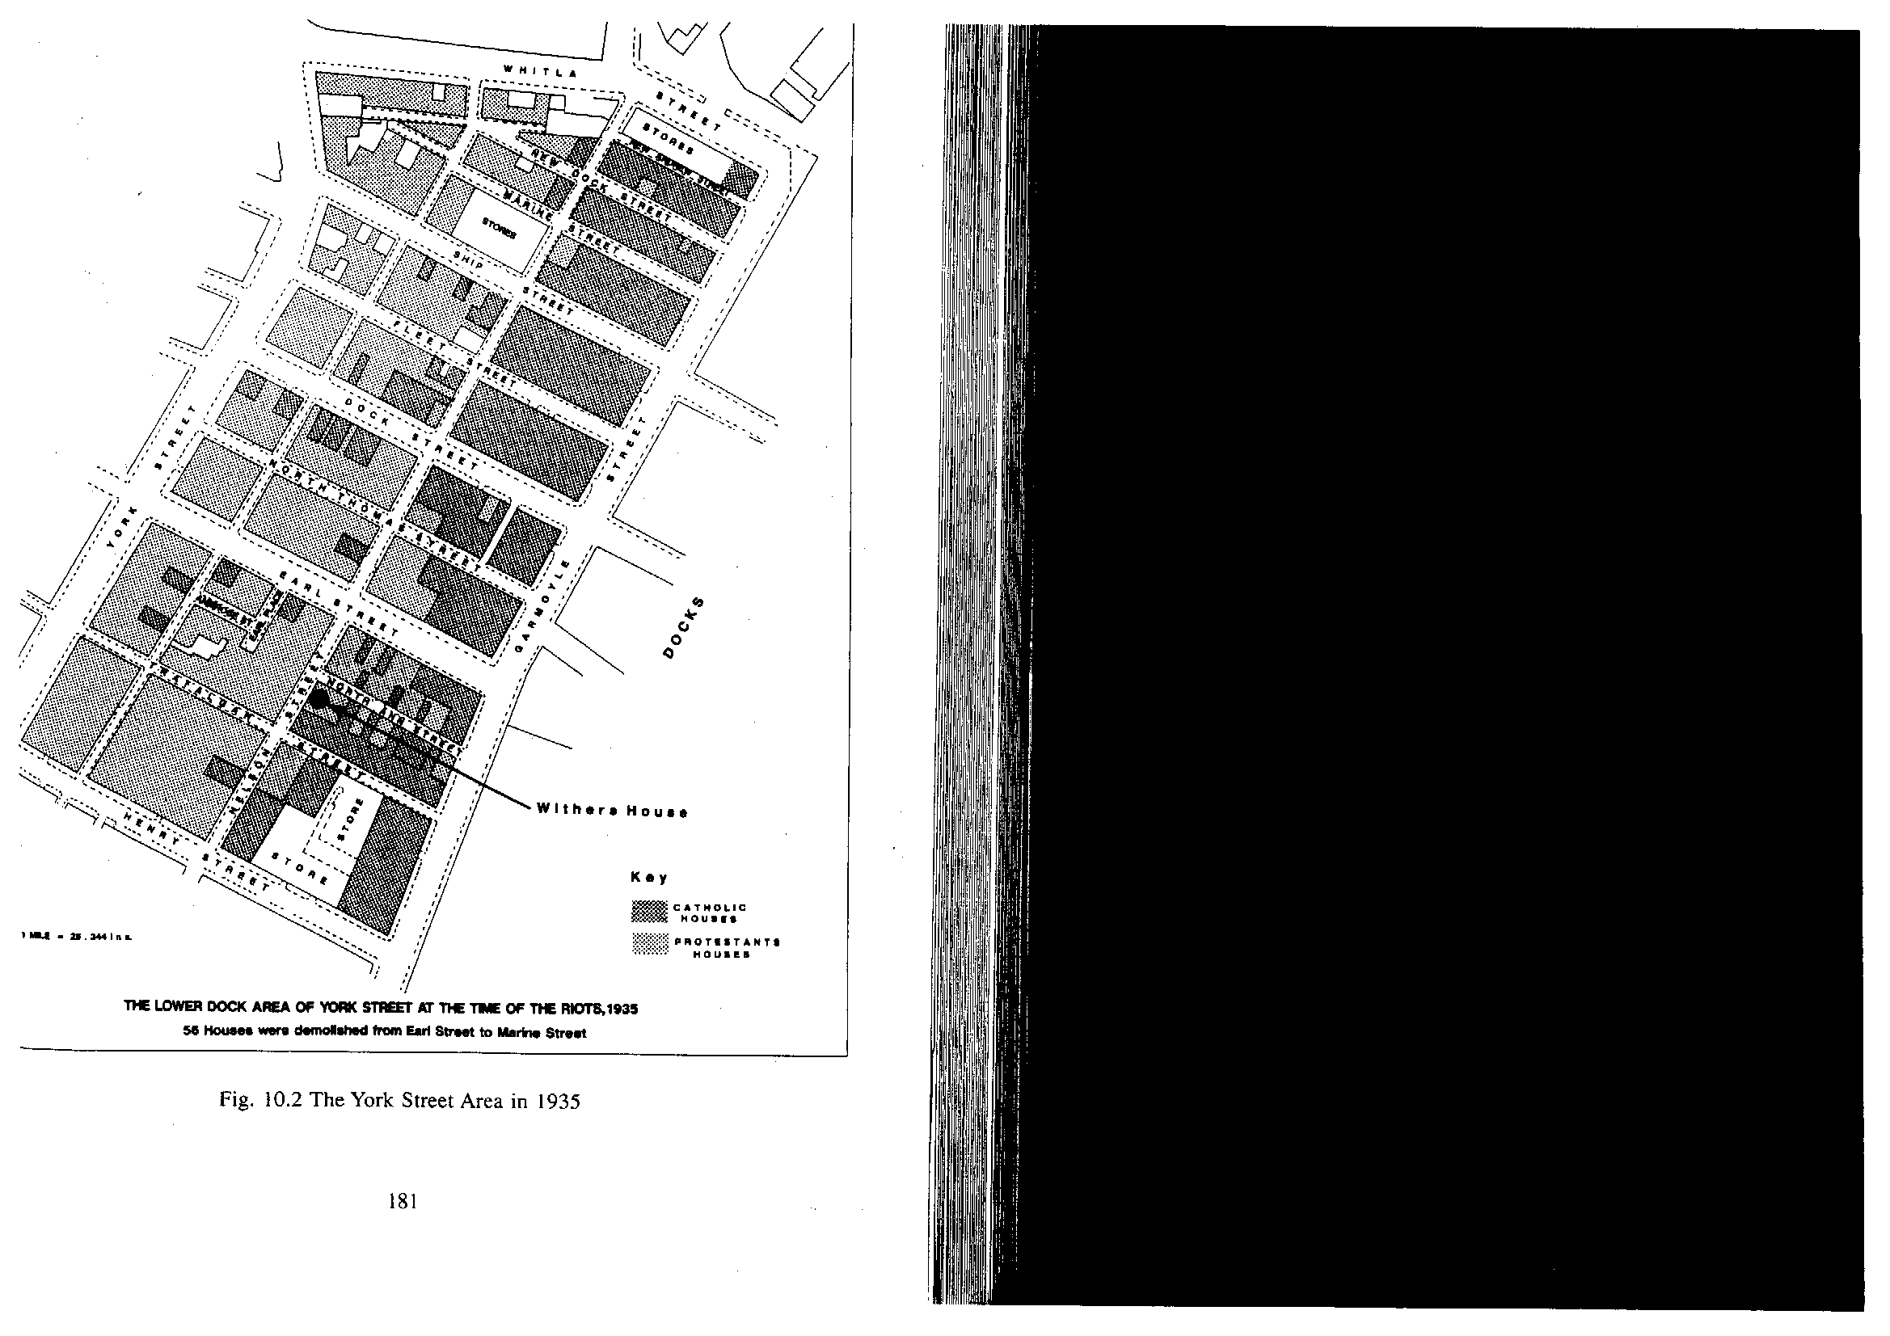

Slide 14
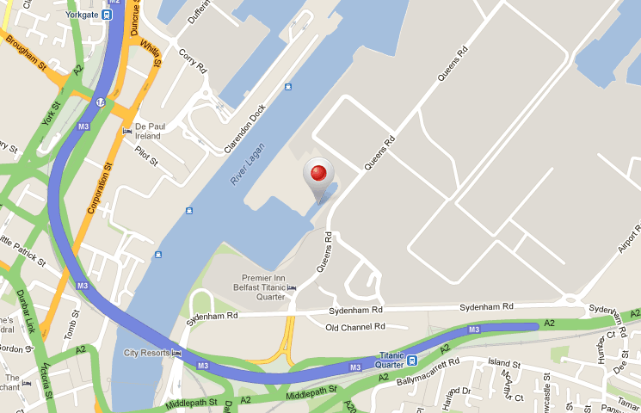

Slide 15
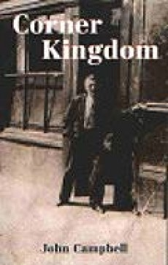
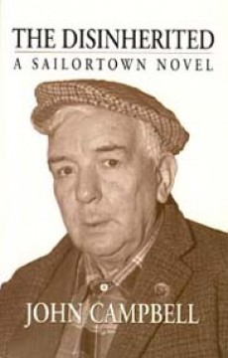
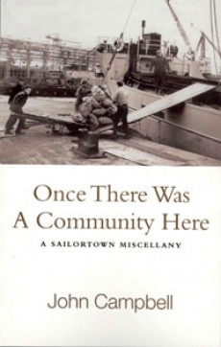

Slide 16
I thought about all the many houses of Sailortown, and felt sad at the slow destruction of a neighbourhood and community. A community of good people, mostly quiet and peaceful, patiently living out their existence never asking for more than three score and ten, always making the best of what life threw at them. Households where the doors were never closed, and one was always made welcome. Welcome to share in all the little things that meant so much – the births, the deaths, the childhood days, the school years, and the times of tears and laughter, the times of departures and homecomings.

Slide 17
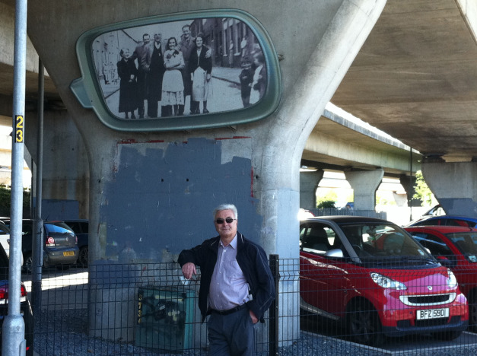

Slide 18
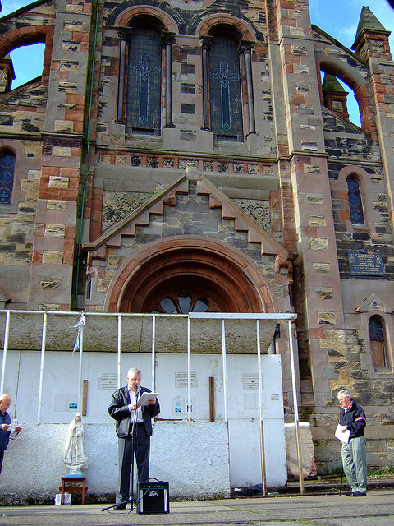

Slide 19
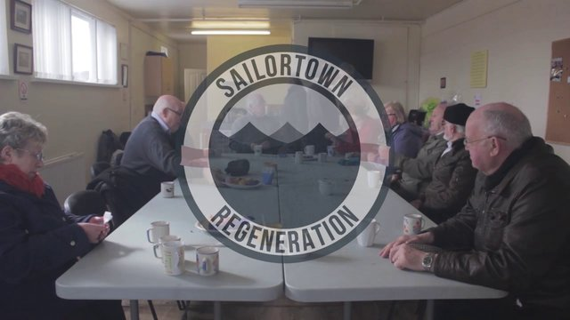

Slide 20
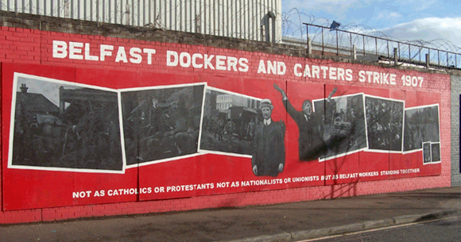

Slide 21
Anna Bryson
Memories of RC/Prot relations prior to 1969 are filtered thru prism of the Troubles
Protestants were generally less likely to reference the sectarian divide when discussing the period
Ps were also more likely to view the period before 1969 as a ‘golden age’
RCs often opened their accounts with reference to discrimination against them or their community in the post-war era
RCs were more likely to locate any ‘golden age’ reference to the WW2 years

Slide 22
But one thing I do remember, I happened to be down Liam McMahon's one night and I think it was Stanley Goodall was in the bar. It was one of them families, you know what I mean? I think a couple of them had married Catholics and turned Catholic but Stanley was still the Protestant guy. And some guy happened to say something of a sectarian nature to him. And three of the dockers got your man and literally - and I mean literally - head first threw him into Garmoyle Street, to the middle of the road. Told him if he ever came back again they would kick him up and down, and that is a fact. Now that is the way I could describe Sailortown in the small instance that happened - the bar. We had no time for that sort of craic.
John Clancy

Slide 23
And that was a great day because there was - there was - everybody got buns and everybody got cakes and there was lemonade and there was - I’m sure there was more Catholic children outside the door than there was Protestant ones, ya know what I mean? That sorta thing.
Marie O’Hara on the local Orange Lodge Master being collected from his house

Slide 24
we had a lot in common it was called poverty, y’know? We were that poor we used to get parcels from the third world and after a while you get fed up of eating bananas.
John Clancy on common economic problems

Slide 25
Funny enough I don’t remember any crimes. There could have been maybe men coming out of the pub and getting drunk and having a fight or something but I don’t remember any crimes down at it at all, so I don’t. I don’t remember.
Kathleen Mahon

Slide 26
John Clancy reading ‘Sailortown’

Slide 27
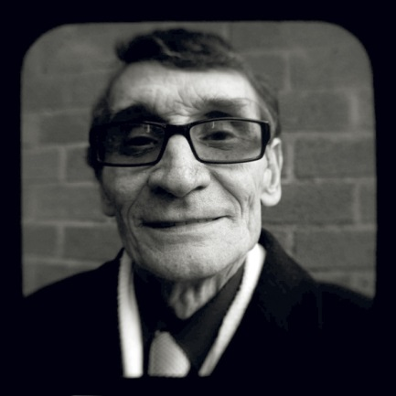
In Sailorstown was some good men
and many a punch-up we had then,
but we’d all finish friends again,
in Sailorstown.
In Sailorstown the drink was good
and many men used it for food.
It put them in the fighting mood,
in Sailorstown.

Slide 28
Titanic Museum, Belfast
Some forms of nostalgia become heritage

Slide 29
…it was of the Titanic going out of Belfast, fantastic colours, dynamic grasp of the moment. But there’s something in the mural that everybody had ignored in talking about Titanic and remembering it. It shows a truck…shows you on the mural the dockers land the bags…and that’s what’s been missing. The Titanic has ignored docks. The Titanic festival, the Titanic money, the Titanic image, the movement called ‘The Titanic’ has not recognised the docks.
[Liam McBrinn on a Frank Quigley mural]

Slide 30
The Holylands

Slide 31
Social change in the holylands
Social mobility
Demographic population shifts
The Troubles
The availability of new suburban Protestant enclaves
In the longer term, the expansion of HE student numbers
Belfast’s bohemia?

Slide 32
Ann Gorman navigates the ‘sectarian’ issue

Slide 33
Liz Smyth on changing demographics

Slide 34
Conclusions
Move beyond simple uses of nostalgia
Simple
Reflective
Interpretative
Belfast working class testimony is conflicted
Individual memory must be framed within communal narratives
Struggle to place their lives with conflict of grand narratives of various Troubles and their legacies
Sectarianism
Deindustrialisation
Urban redevelopment

