Slide 1
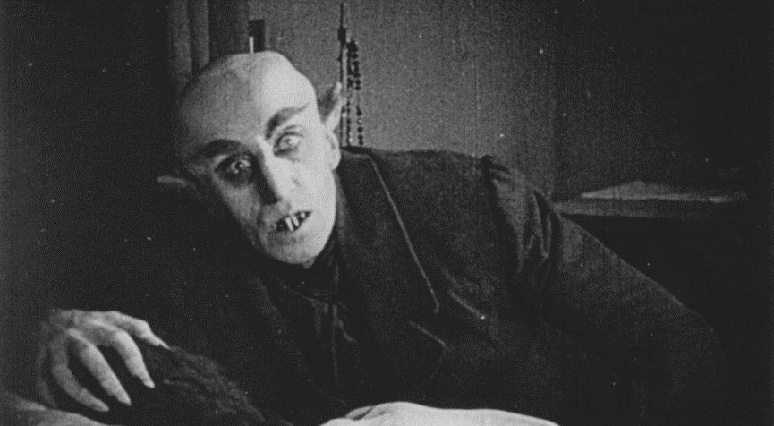
The Gothic

Slide 2
Gothic [OED]
A. adj. 1. a. Of, pertaining to, or concerned with the Goths or their language.
3. a. Belonging to, or characteristic of, the Middle Ages; medieval, ‘romantic’, as opposed to classical. In early use chiefly with reprobation: belonging to the ‘dark ages’.
b. A term for the style of architecture prevalent in Western Europe from the twelfth to the sixteenth century, of which the chief characteristic is the pointed arch. Applied also to buildings, architectural details, and ornamentation.
d. Gothic Revival n. the reintroduction of a Gothic style of architecture towards the middle of the 19th cent.
4. barbarous, rude, uncouth, unpolished, in bad taste. Of temper: Savage.
5. a. Writing and Printing. Used for some kind of written character.
b. In England, the name of the type commonly used for printing German, as distinguished from roman and italic characters.
B. n. That which is Gothic.
The Gothic language.
A Gothic building.
Gothic architecture or ornamentation.
Draft additions December 2007
Of or designating a genre of fiction characterized by suspenseful, sensational plots involving supernatural or macabre elements and often (esp, in early use) having a medieval theme or setting.

Slide 3
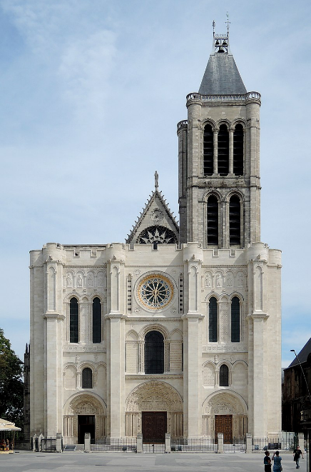
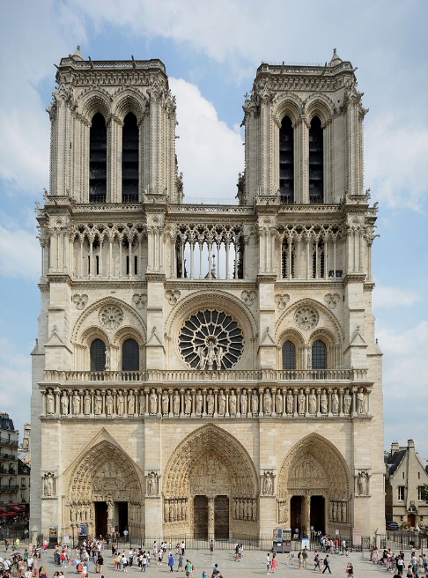
Basilica of Saint Denis, completed 1144
Notre Dame de Paris, begun c. 1200

Slide 4
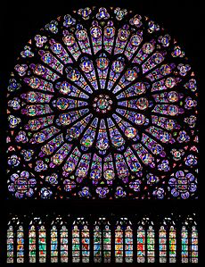
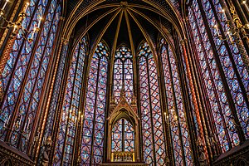
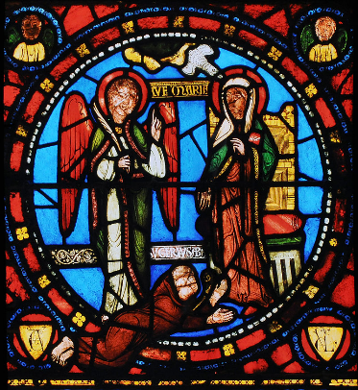

Slide 5
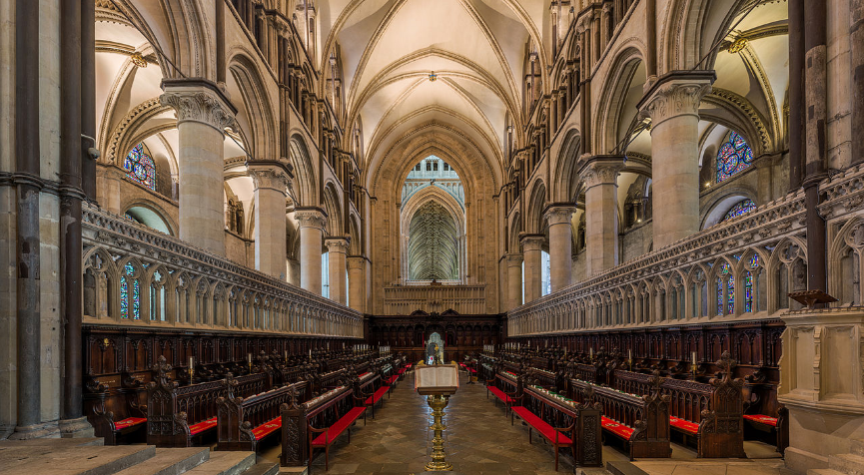

Slide 6
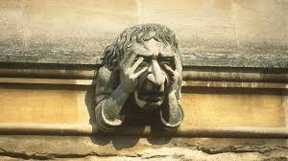
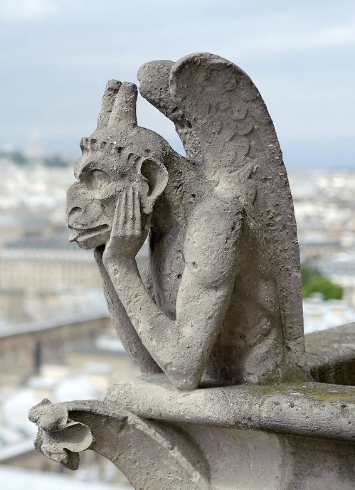
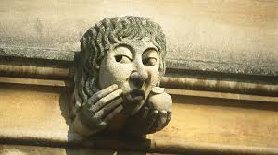
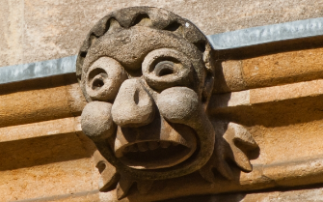

Slide 7
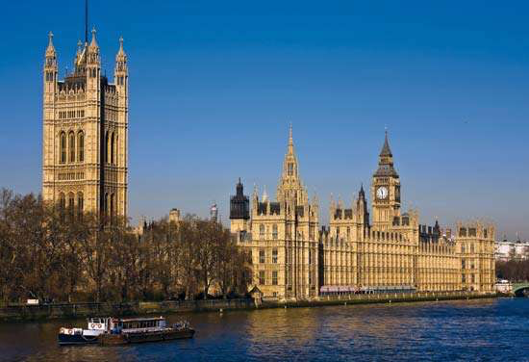
The Victorian Gothic Revival

Slide 8
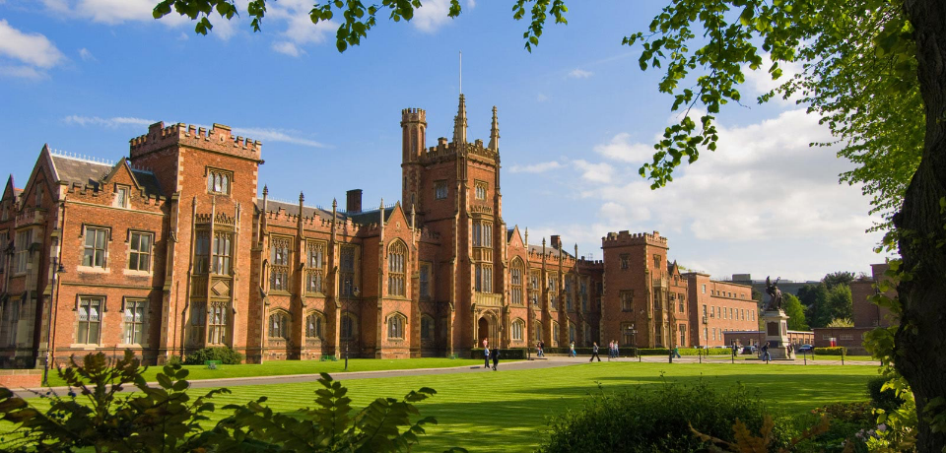

Slide 9
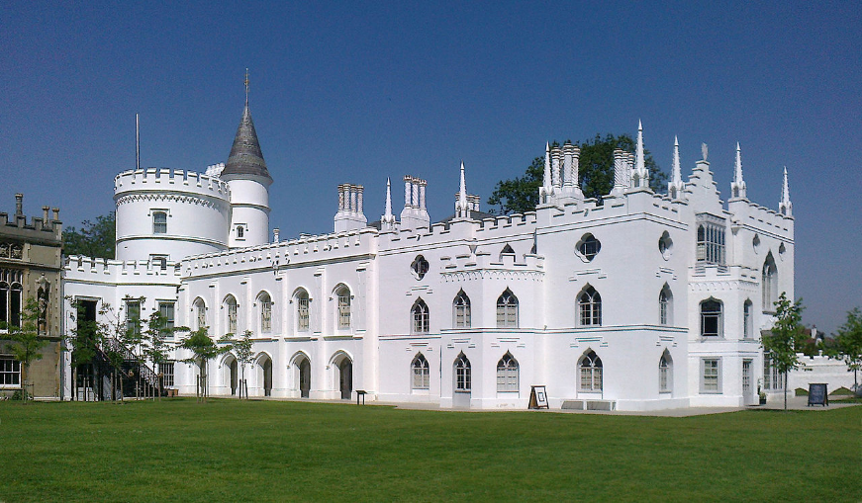
The Gothic Revival … Strawberry Hill, 1749
https://www.youtube.com/watch?v=dry7CPCRzEY

Slide 10
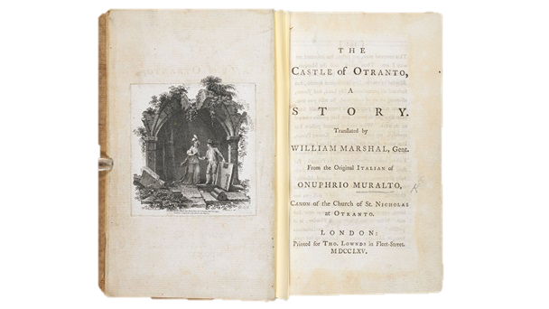
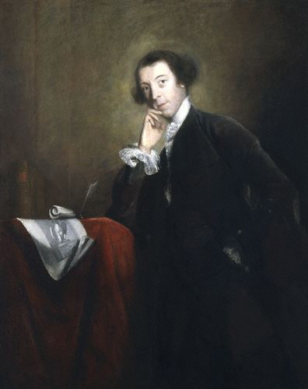
Horace Walpole (1717-1797)
The Castle of Otranto Translated by William Marshal, Gent. From the Original Italian of Onuphrio Muralto, Canon of the Church of St Nicholas at Otranto.

Slide 11
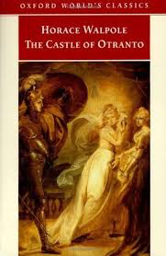
Preface to the first edition of The Castle of Otranto (1764)
The following work was found in the library of an ancient Catholic family in the north of England. It was printed at Naples, in the black letter, in the year 1529. How much sooner it was written does not appear. The principal incidents are such as were believed in the darkest ages of Christianity; but the language and conduct have nothing that savours of barbarism. The style is the purest Italian.

Slide 12
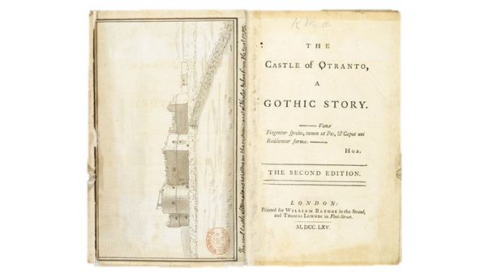
second edition
… it is fit that he should ask pardon of his readers for having offered his work to them under the borrowed personage of a translator. As diffidence of his own abilities and the novelty of the attempt, were the sole inducements to assume the disguise, he flatters himself he shall appear excusable. […] It was an attempt to blend the two kinds of romance, the ancient and the modern. In the former, all was imagination and improbability: in the latter, nature is always intended to be, and sometimes has been, copied with success. Invention has not been wanting; but the great resources of fancy have been dammed up, by a strict adherence to common life.
‘It engages our attention here, makes some of us cry a little, and all in general afraid to go to bed o’nights.’ --Thomas Gray

Slide 13
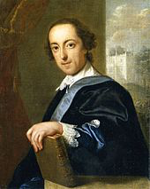
Origins of Otranto …
I had time to write but a short note with The Castle of Otranto, as your messenger called on me at four o’clock as I was going to dine abroad. Your partiality to me and Strawberry have I hope inclined you to excuse the wildness of the story. You will even have found some traits to put you in mind of this place. When you read of the picture quitting its panel, did not you recollect the portrait of Lord Falkland all in white in my gallery? Shall I even confess to you what was the origin of the romance? I waked one morning in the beginning of last June from a dream, of which all I could recover was, that I had thought myself in an ancient castle (a very natural dream for a head filled like mine with gothic story) and that on the uppermost bannister of a great staircase I saw a gigantic hand in armour. In the evening I sat down and began to write, without knowing in the least what I intended to say or relate…I was glad to think of anything rather than politics.
--Letter to Cole, Saturday 9 March 1765. The Yale edition of Horace Walpole’s Correspondence ed. W.S.Lewis et al. (New Haven, 1937-1983) [online] available at: <http://walpole.library.yale.edu/collections/digital-collections/horace-walpole-correspondence> [accessed: 18 Jan 2019] i, 88
Notes:
--turn away from politics and emergence of subconscious fears and desires

Slide 14
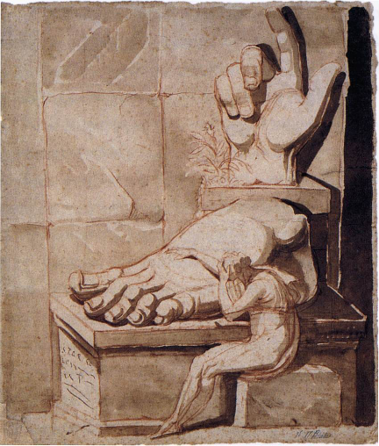
Gothic tropes in The Castle of Otranto
Medievalism (castle, archaic language, etc)
Powerful male villain
Damsel in distress
Inheritance, succession, bloodlines
Hidden identities
Doubles
Manuscripts, documents, editors
Portraits that come to life
Supernatural incidents
Servants
Notes:
Otranto is enormously successful and popular; gothic takes off as a genre

Slide 15
Definitions of the Gothic
The gothic novel, or in an alternative term, gothic romance, is a type of prose fiction inaugurated by Horace Walpole’s The Castle of Otranto – A Gothic Story [1764] – the subtitle denotes its setting in the Middle Ages – and flourished through the early nineteenth century. Some writers followed Walpole’s example by setting their stories in the medieval period; others set them in a Catholic country, especially Italy or Spain. The locale was often a gloomy castle furnished with dungeons, subterranean passages and sliding panels; the typical story focused on the sufferings imposed on an innocent heroine by a cruel and lustful villain, and made bountiful use of ghosts, mysterious disappearances, and other sensational and supernatural occurrences [...] The principal aim of such novels was to evoke chilling horror by exploiting mystery and a variety of horrors...the best opened up to fiction the realm of the irrational and of the perverse impulses and nightmarish terrors that lie beneath the orderly surface of the civilised mind [...] The term ‘Gothic’ has also been extended to a type of fiction which lacks the exotic setting of the earlier romances, but develops a brooding atmosphere of gloom and terror, represents events that are uncanny, or macabre, or melodramatically violent, and often deals with aberrant psychological states.
M.H. Abrams, A Glossary of Literary Terms, 8th ed. (London: Wadsworth, 2004), pp. 137-8.

Slide 16
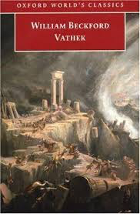
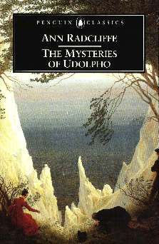
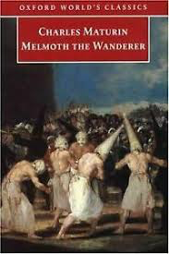
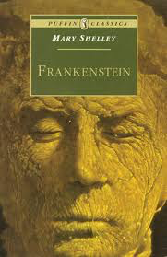
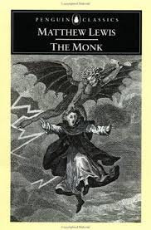
Charles Robert Maturin
Melmoth the Wanderer (1820)

Slide 17
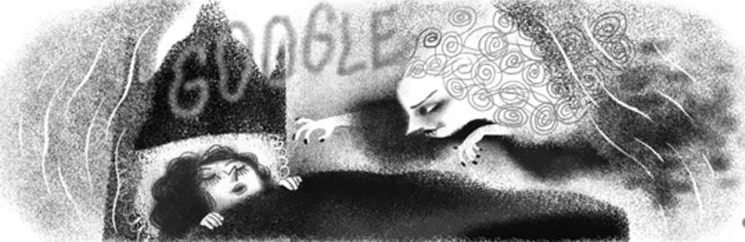
Irish Gothic?

Slide 18
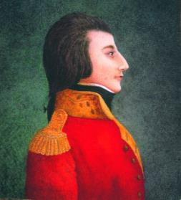
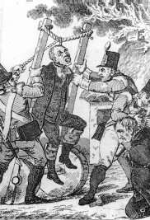
The Temple of your liberties is filled with buyers and sellers, with money changers and thieves, with placemen and pensioners; these unclean and ominous harpies, gorged with the public spoil, and sucking still, like insatiable vampires, the last drainings of the vital blood of their country.
--Theobald Wolfe Tone, ‘An address to the people of Ireland on the present important crisis’ (1796)
Before 1798, the Irish Gothic was close to the English Gothic in terms of its dual interests in early British and Irish history […] and in ghosts and sensational terrors […] But it also resembled North American Gothic in that it seemed to press the reader in the direction of rather generalised allegorical readings which emphasised the resemblance between the oppressed virtue of the characters and the fate of the nation. After 1798, the terrors of the Gothic became much more explicitly related to those of contemporary life in Ireland, and the realism became much more horrific and dangerous than previous fantasy literature had suggested…
--Siobhán Kilfeather, ‘The Gothic Novel’.
Notes:
--already a kind of ‘otherness’ in how Ireland is perceived, in its representation by (usually) English writers (Spenser, Fynes Moryson, or way back to Giraldus Cambrensis in the Middle Ages)–

Slide 19
Irish literary Gothic?
* Whereas the origins of English Gothicism are diverse and obscure—involving the sensibility of a remarkable individual like Walpole, the larger development of literary romanticism, and the growth of aesthetics through the study of concepts such as ‘the sublime’ – Irish gothic fiction is remarkably explicit in the way it demonstrates its attachment to history and politics [. . .] At the risk of paradox, it has to be said that while Irish gothic writing does not amount to a tradition, it is a distinctly protestant tradition. Maturin, Maxwell, the Owenson sisters, Sheridan Le Fanu and Charles Lever, Bram Stoker and Oscar Wilde, Yeats, Synge, and Elizabeth Bowen were all attached to some degree to the (once) Established Church of Ireland. Maturin and Maxwell were ordained ministers of the Church; Le Fanu was the son of a dean, and even Yeats was the grandson of a clerical home. However, only the earliest of these writers (Maturin) could be described as in any sense a conscientious believer in the orthodoxies of the reformed church, and progressive distance from belief is a more important feature of their background than credal allegiance. Irish gothic in this sense is a distinctive version of a wider Victorian crisis of Christian belief.
W.J. McCormack, ‘Irish Gothic and After (1820–1945)’, p. 837.

Slide 20
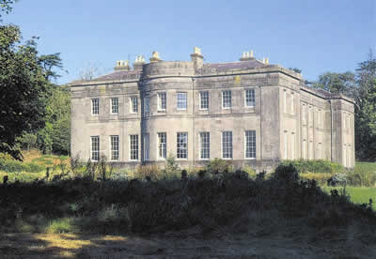
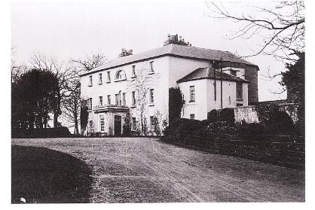
* Thus, a ‘colonial’ history, Protestantism, and the fear of marginalisation – rather than marginalisation itself – are central features of the Irish Gothic tradition. The demonisation of both Catholics in general, and Catholicism as a theological and social system, is also central to the Irish Gothic: its monsters are invariably Catholic or crypto-Catholic, the clearest example of which is the anti-Catholic manual that is Maturin’s Melmoth the Wanderer in which the Catholic Church is depicted as a cornucopia of perverts, control freaks, Satanists, and power-hungry sadists.
--Jarlath Killeen, ‘Irish Gothic: A Theoretical Introduction’.
Notes:
What do you think of this concept of Irish Gothic?
Anyone see any problems with it? What or who does it leave out? Genre, gender etc
Mangan, Griffin, Carleton, Banims … gothic so pervasive that critics such as Richard Haslam have suggested we should be discussing a gothic mo

Slide 21
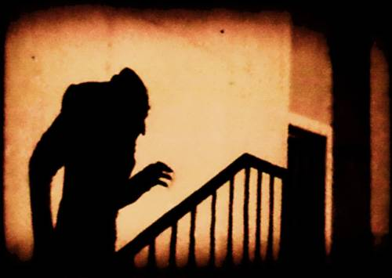
Irish Gothic
Sheridan Le Fanu, Carmilla (1871/2)

Slide 22
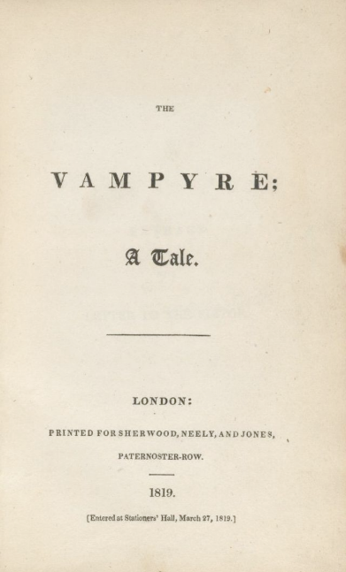
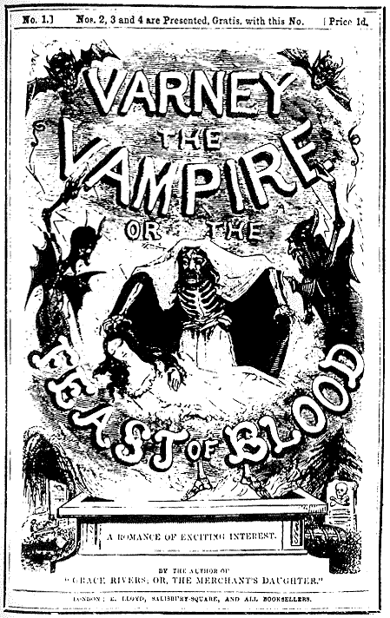
Varney the Vampire; or, the Feast of Blood, attrib. to James Malcolm Rhymer, ser. 1845-7
John Polidori, The Vampyre (1819)

Slide 23
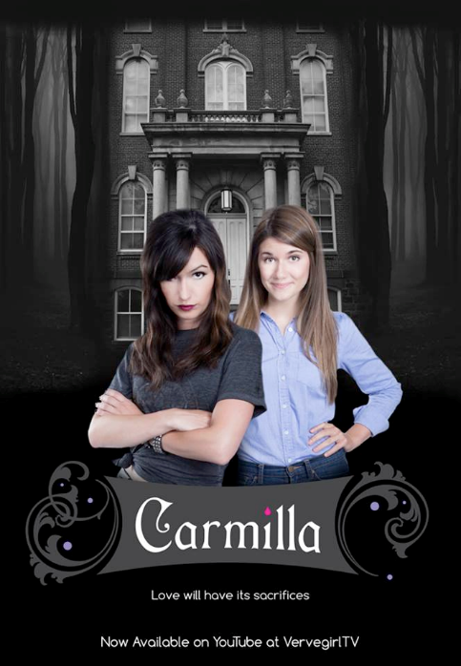
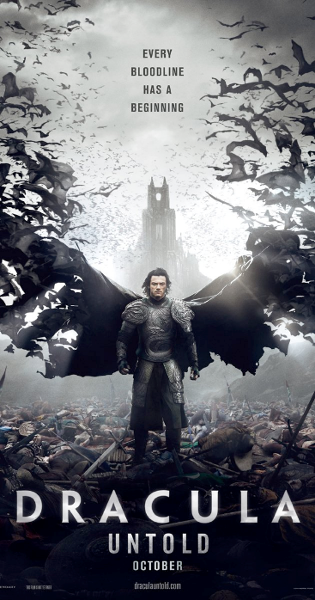

Slide 24
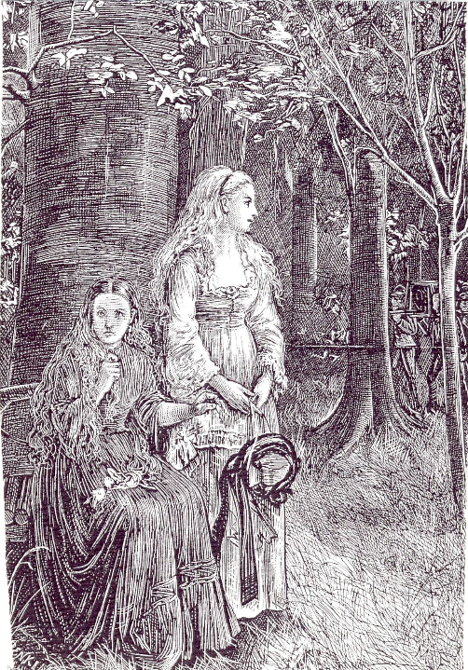
“Besides, how can you tell me that your religion and mine are the same; your forms wound me and I hate funerals. What a fuss! […] Her face underwent a change that alarmed and even terrified me for a moment. It darkened and became horribly livid; her teeth and hands were clenched, and she frowned and compressed her lips, while she stared down upon the ground at her feet, and trembled all over with a continued shudder as irrepressible as ague. (Le Fanu 31-2)
Engraving of ‘Carmilla’; The Dark Blue, December 1871

Slide 25
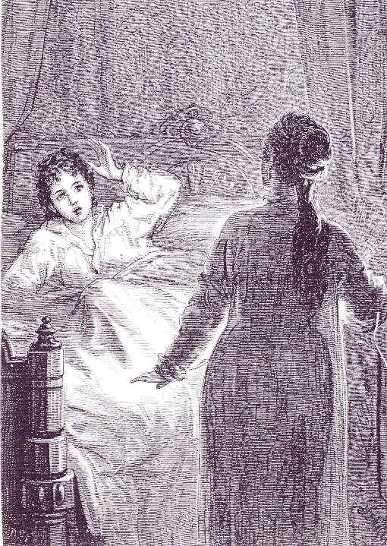
I am going to tell you now about a dream that led immediately to an odd discovery. One night, instead of the voice I was accustomed to hear in the dark, I heard one, sweet and tender, and at the same time terrible, which said, “Your mother warns you to beware of the assassin.” At the same time a light unexpectedly sprang up, and I saw Carmilla, standing, near the foot of my bed, in her white night-dress, bathed, from her chin to her feet, in one great stain of blood.’ (Le Fanu 52)
Engraving of ‘Carmilla’; The Dark Blue, February 1872

Slide 26
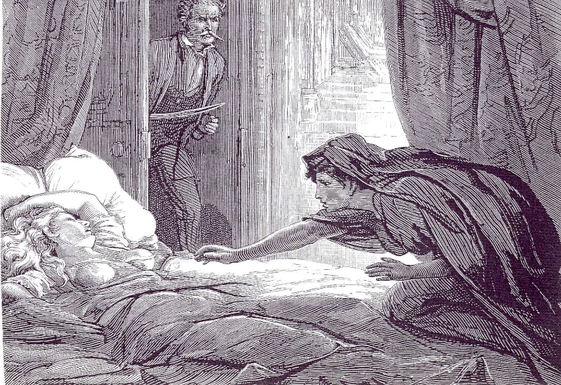
Engraving of “Carmilla”; The Dark Blue, March 1872
“…I saw a large black object, very ill-defined, crawl, as it seemed to me, over the foot of the bed, and swiftly spread itself up to the poor girl’s throat, where it swelled, in a moment, into a great, palpitating mass. For a few moments I had stood petrified. I now sprang forward, with my sword in my hand.” (Le Fanu 87)

Slide 27
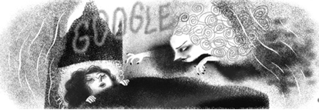

Slide 28
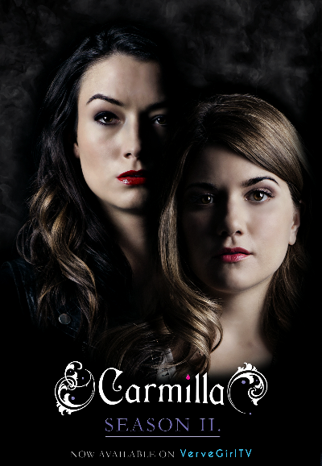
The prettiest creature I ever saw: Carmilla
I wonder whether you feel as strangely drawn towards me as I do to you; I have never had a friend--shall I find one now?" She sighed, and her fine dark eyes gazed passionately on me.
Now the truth is, I felt rather unaccountably towards the beautiful stranger. I did feel, as she said, "drawn towards her," but there was also something of repulsion. In this ambiguous feeling, however, the sense of attraction immensely prevailed. She interested and won me; she was so beautiful and so indescribably engaging. (Le Fanu 24-5)

Slide 29
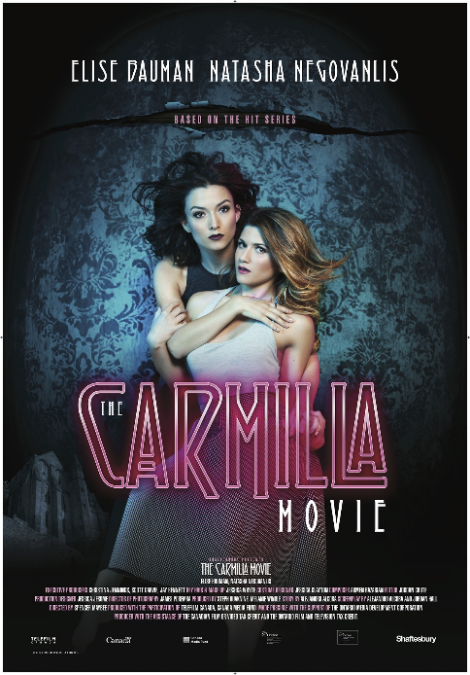
And when she had spoken such a rhapsody, she would press me more closely in her trembling embrace, and her lips in soft kisses gently glow upon my cheek. Her agitations and her language were unintelligible to me. From these foolish embraces, which were not of very frequent occurrence, I must allow, I used to wish to extricate myself; but my energies seemed to fail me. Her murmured words sounded like a lullaby in my ear, and soothed my resistance into a trance, from which I only seemed to recover myself when she withdrew her arms.
In these mysterious moods I did not like her. I experienced a strange tumultuous excitement that was pleasurable, ever and anon, mingled with a vague sense of fear and disgust. I had no distinct thoughts about her while such scenes lasted, but I was conscious of a love growing into adoration, and also of abhorrence. This I know is paradox, but I can make no other attempt to explain the feeling. (Le Fanu 29)

Slide 30
“I am descended from the Karnsteins; that is, mamma was.”
"Ah!" said the lady, languidly, "so am I, I think, a very long descent, very ancient. Are there any Karnsteins living now?”
"None who bear the name, I believe. The family were ruined, I believe, in some civil wars, long ago, but the ruins of the castle are only about three miles away.”
"How interesting!" she said, languidly. "But see what beautiful moonlight!” (Le Fanu 40)

Slide 31
Here then, were all the admitted signs and proofs of vampirism. The body, therefore, in accordance with the ancient practice, was raised, and a sharp stake driven through the heart of the vampire, who uttered a piercing shriek at the moment, in all respects such as might escape from a living person in the last agony. Then the head was struck off, and a torrent of blood flowed from the severed neck. The body and head was next placed on a pile of wood, and reduced to ashes, which were thrown upon the river and borne away, and that territory has never since been plagued by the visits of a vampire. (Le Fanu 92)

Slide 32
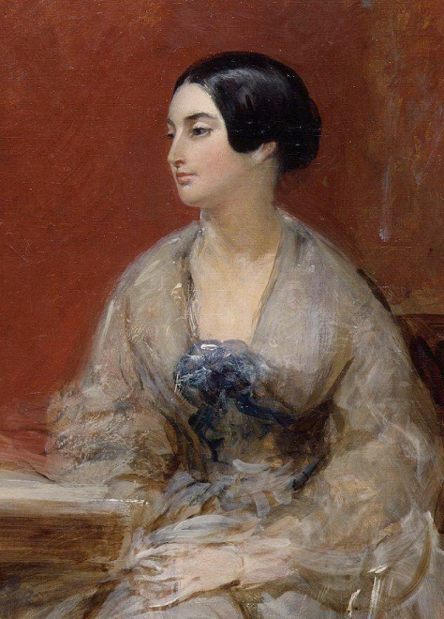
Caroline Norton (née Sheridan) 1808-1877
Separation of Mother and Child by the Laws of Custody of Infants Considered (1837)
A plain letter to the Lord chancellor on the Infant Custody Bill (1839)
English laws for women in the nineteenth century (1854)

Slide 33
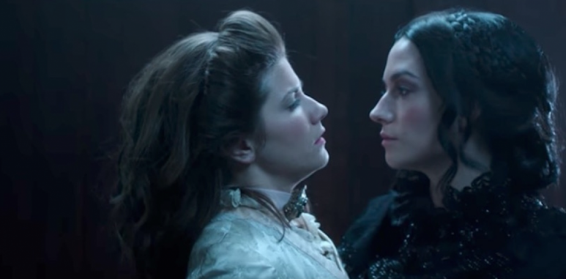
I had read in old storybooks of such things. What if a boyish lover had found his way into the house, and sought to prosecute his suit in masquerade, with the assistance of a clever old adventuress. But there were many things against this hypothesis, highly interesting as it was to my vanity. (Le Fanu 30)

Slide 34

… and to this hour the image of Carmilla returns to memory with ambiguous alternations--sometimes the playful, languid, beautiful girl; sometimes the writhing fiend I saw in the ruined church; and often from a reverie I have started, fancying I heard the light step of Carmilla at the drawing room door. (Le Fanu 96)

Slide 35
Although men as well as women suffer from repression in ‘Carmilla’, Le Fanu chooses female protagonists because he agrees with clear-sighted Victorians that women in particular is stunted emotionally. ‘Carmilla’ is part of that High Victorian self-examination which called into question literary and social conventions and the moral orthodoxies underlying them […] Social theorists as well as novelists realized that orthodox attitudes toward sexual purity had caused a dangerous split between conscious and unconscious […] The more we deny the existence of passions, the more we can control those passions only by repressing them. Le Fanu’s point in ‘Carmilla’ is not that Laura necessarily succumb to her lesbian tendencies, but that she succeed in knowing herself. Laura is unnamed for forty pages, is never given a last name, and is not located specifically in time because she is everyperson—all men and women in every era who overdevelop the conscious. She remains a powerful figure for readers today because the cultural threat which she personifies is ever present. (Veeder 198-9)

Slide 36
Gothic displacement
In Styria, we, though by no means magnificent people, inhabit a castle, or schloss. A small income, in that part of the world, goes a great way. Eight or nine hundred a year does wonders. Scantily enough ours would have answered among wealthy people at home. My father is English, and I bear an English name, although I never saw England. But here, in this lonely and primitive place, where everything is so marvelously cheap, I really don't see how ever so much more money would at all materially add to our comforts, or even luxuries. (Le Fanu 4)
…a ruined village with its quaint little church, now roofless, in the aisle of which are the moldering tombs of the proud family of Karnstein, now extinct, who once owned the equally desolate chateau which, in the thick of the forest, overlooks the silent ruins of the town. (Le Fanu 5)

Slide 37
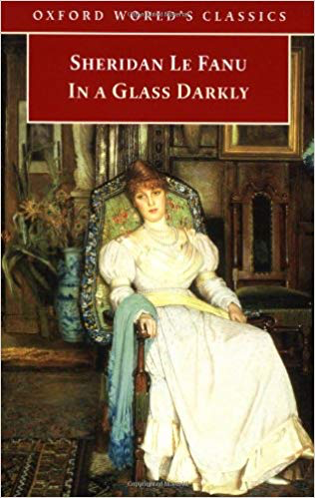
Carmilla is a native of the terrain she haunts. She is one of the ancient lords of the land, whose descendants, reduced to peasant/tenant status, often haunted the Anglo-Irish estates confiscated from their ancestors which they considered rightfully their own. Carmilla threatens the new English landowners with death, with a kind of demonic possession, sexually with a kind of double miscegenation – basic fears among the Anglo-Irish gentry as they saw their control of Ireland slipping away[…] In Ireland, as in the vampire legend’s basic element, the past survives to torment the present. (Robert Tracy, intro. to Le Fanu, In A Glass Darkly, pp. xxvi-xxvii)

Slide 38
Critical definitions of Irish Gothic
At the risk of paradox, it has to be said that while Irish gothic writing does not amount to a tradition, it is a distinctly Protestant tradition. (W. J. McCormack)
[Irish gothic] leads from Maturin and Le Fanu to Bram Stoker and Elizabeth Bowen and Yeats – marginalized Protestants all, often living in England, but regretting Ireland, stemming from families with strong clerical and professional colorations, whose occult preoccupations surely mirror a sense of displacement, a loss of social and psychological integration, and an escapism motivated by threat of takeover by the Catholic middle classes [...] (Roy Foster)

Slide 39
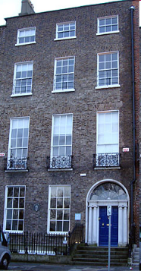
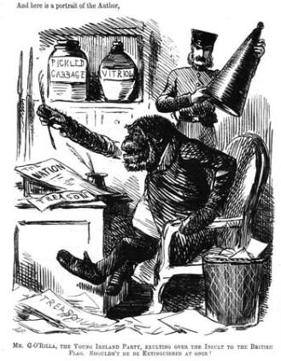
Irish Context: 1814-73
‘all rests upon a quaking bog…’
(qtd in McCormack 219)
Catholic Emancipation
1831-8 The Tithe War
1845-49 The Great Famine
1848 Young Ireland rebellion
IRB and the Fenian Brotherhood
1867 Fenian Rising; Manchester Martyrs; Clerkenwell explosion
Irish Church Disestablishment Act (abolished tithes)
1870 Isaac Butt founds the Home Government Association (later the Home Rule League)
The soil of Ireland, at present in possession of an oligarchy, belongs to us, the Irish people and to us it must be restored. We declare also in favour of absolute liberty of conscience and the separation of Church and State. We intend no war against the people of England; our war is against the aristocratic locusts, whether English or Irish, who have eaten the verdure of our fields. (Lee 56)

Slide 40
