Slide 1
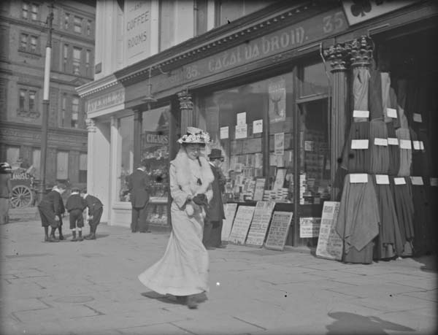
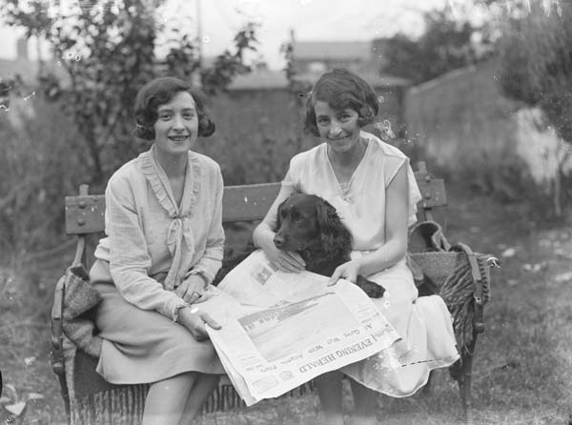
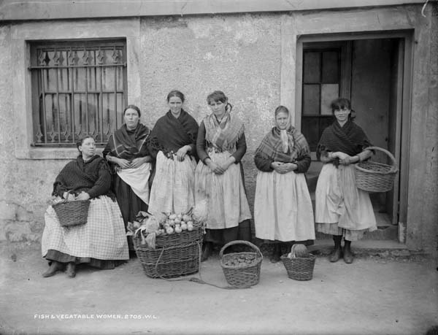
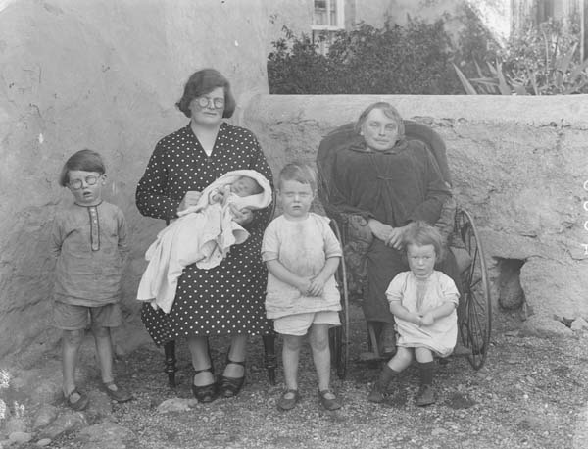
Sources for the study of modern Irish women’s history
Dr Elaine Farrell
e.farrell@qub.ac.uk

Slide 2
Today’s class
1
Overview
Education
Suffrage
Sexuality
2
3
4

Slide 3
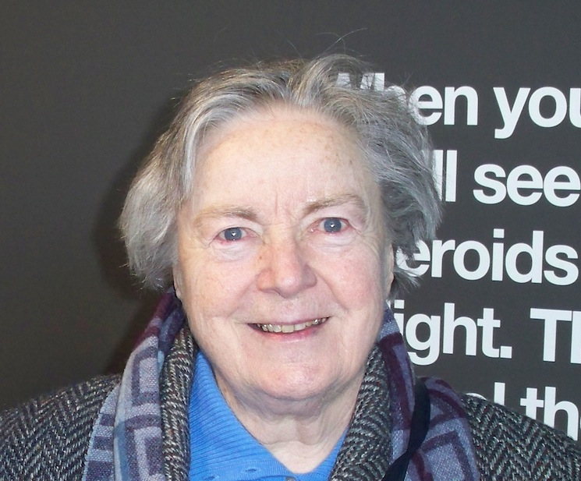
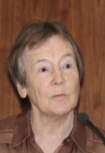
http://womenshistoryassociation.com/

Slide 4
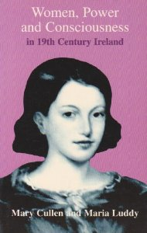
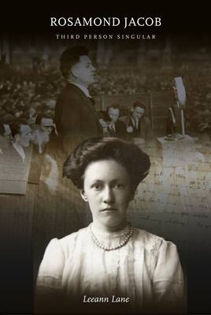
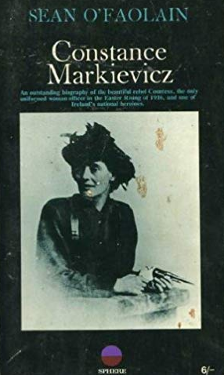
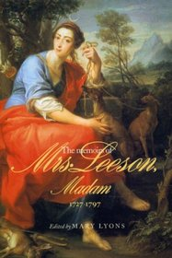
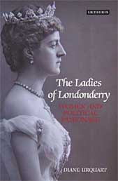
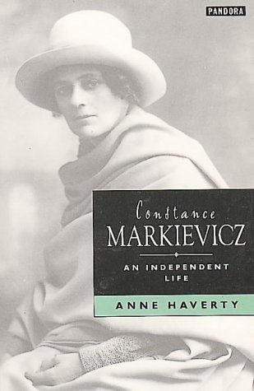
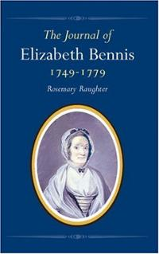

Slide 5
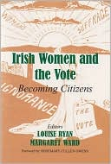
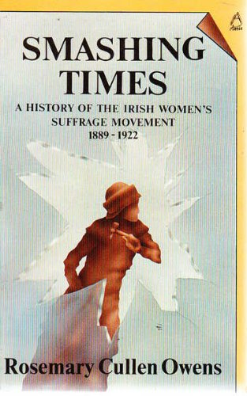
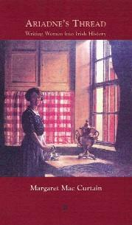
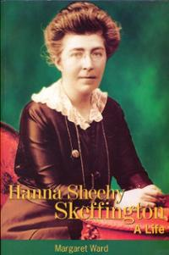
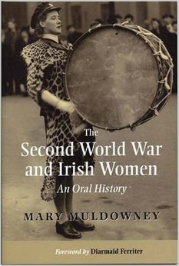
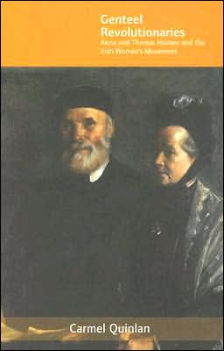
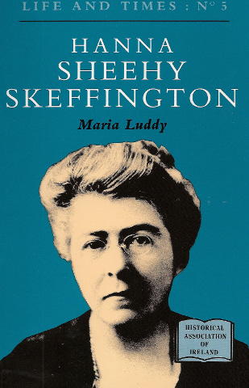
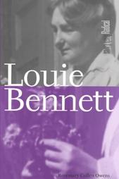

Slide 6
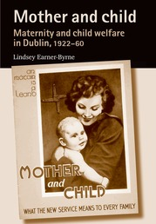
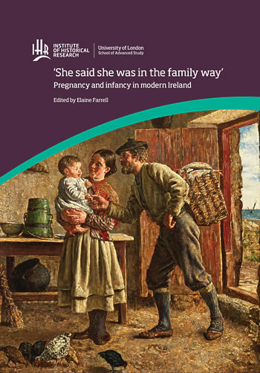
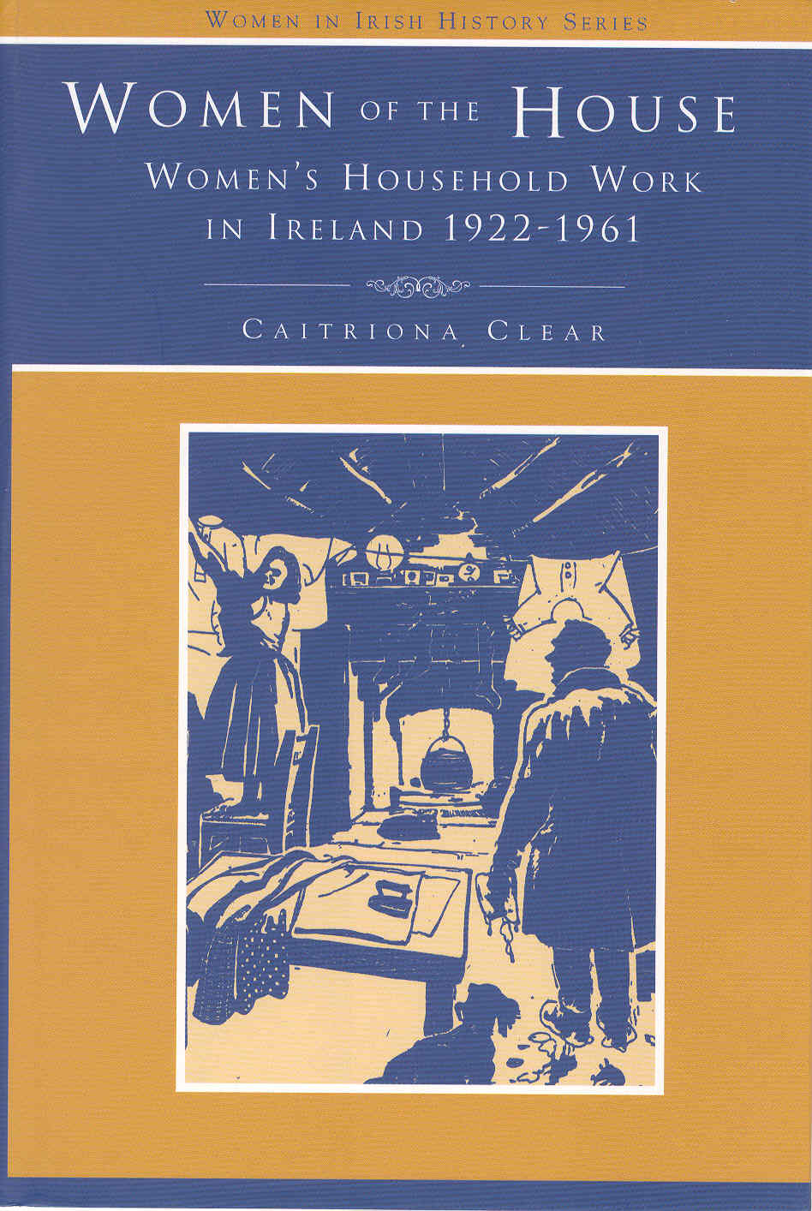

Slide 7
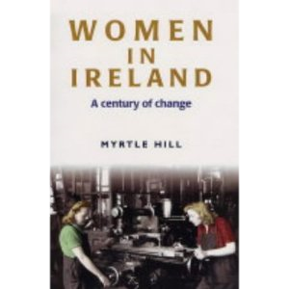
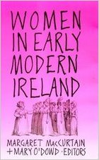
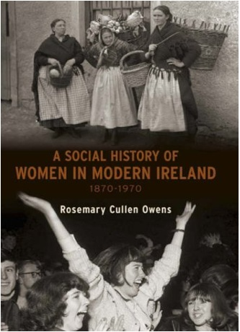
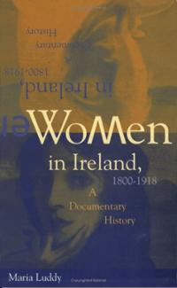
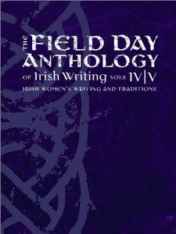
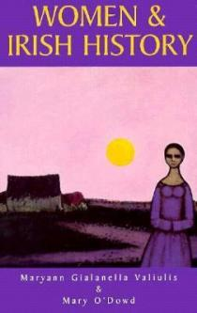

Slide 8
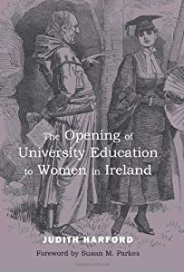
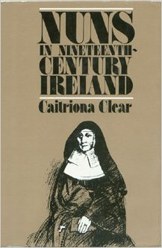
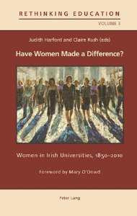
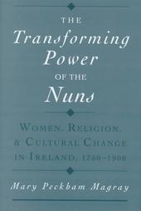
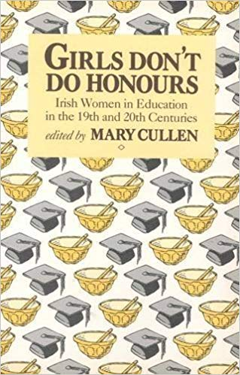

Slide 9
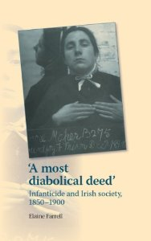
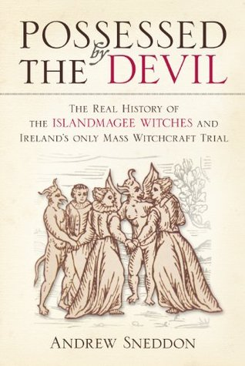
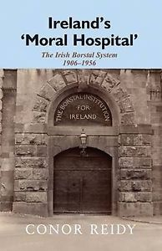
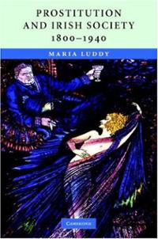

Slide 10
Education

Slide 11
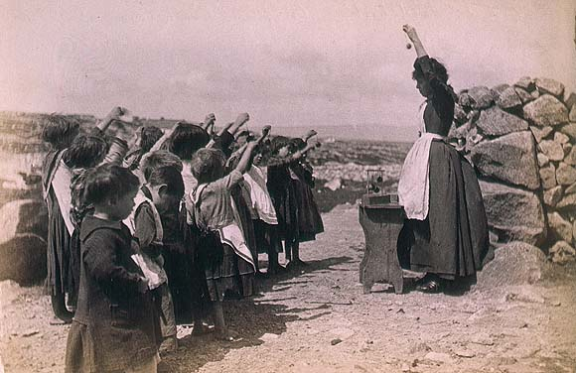
Primary education
‘It was only in the larger towns that any means of educating the poor existed, other than that afforded by the “Hedge schoolmasters,” a class of men themselves little above actual beggary, who wandered about the country, imparting their own scanty knowledge to the children of those who would supply them with food and afford them a lodging...No wonder that a hundred years ago few of the lower orders could read and fewer write.’
LOMBE ATTHILL

Slide 13
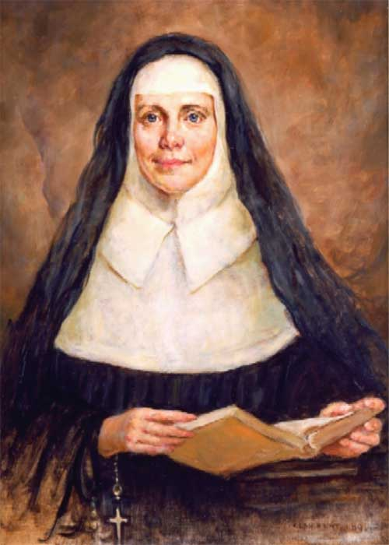
Catherine McAuley

Slide 14
Secondary education
1878, Intermediate Education (Ireland)

Slide 15
‘We are told that women don’t need a high education; their hearts are of more consequence than their minds. We are told that even if they should have a high education, it ought to be different from that of men, because their work in life will be different ... And we are told that it is very presumptuous for them to wish for any good thing they have not got already.’
ISABELLA TOD (1875)
University education
Higher education institutions for women
Queen’s Institute Dublin 1861
Alexandra College Dublin 1866
Belfast Ladies’ Institute 1867
Governess Association of Ireland 1869

Slide 16
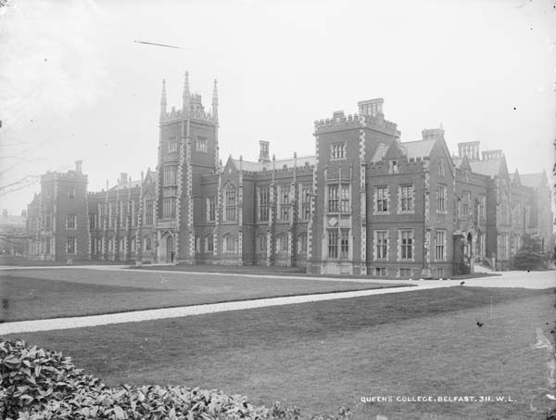
1879, Universities Education (Ireland) Act

Slide 17
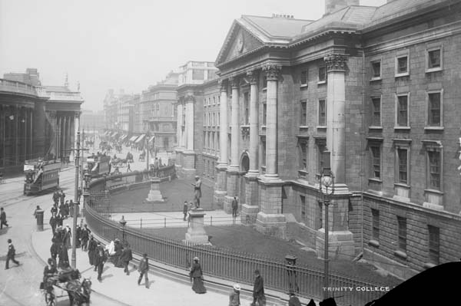
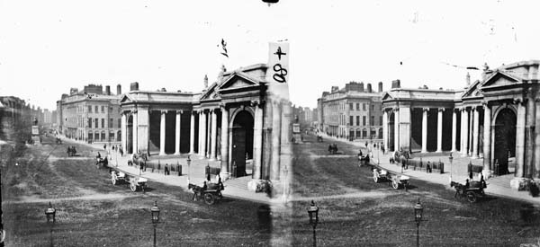
Trinity College, Dublin
‘Over my dead body, will women enter this College’
GEORGE SALMON, 1904

Slide 18
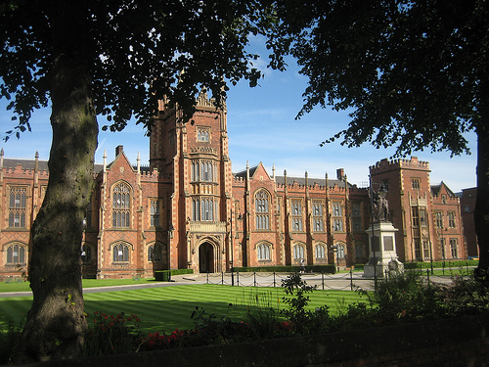

Slide 19
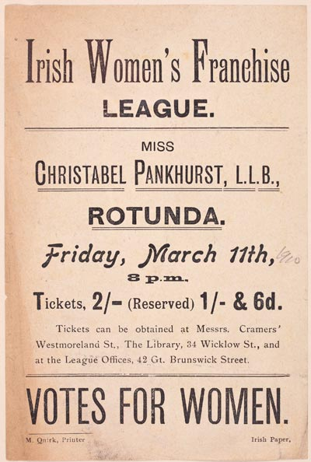
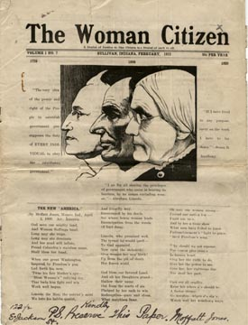
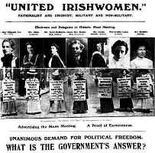
Suffrage

Slide 20
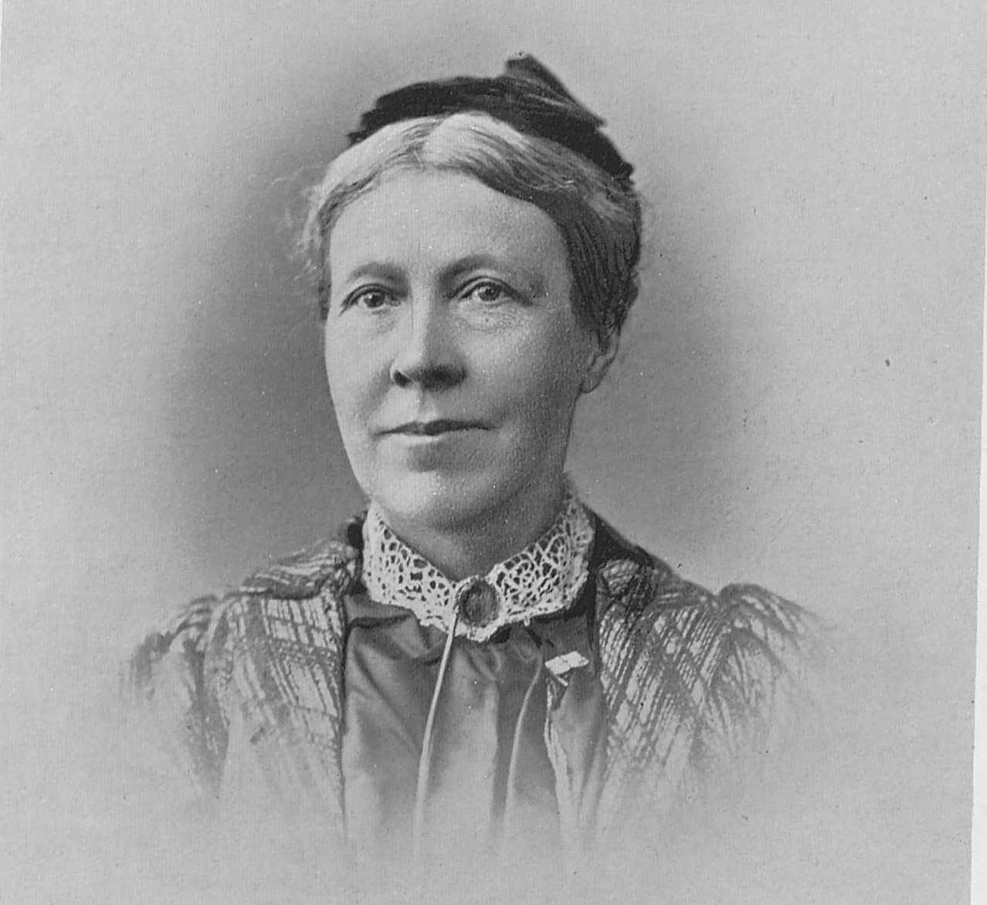
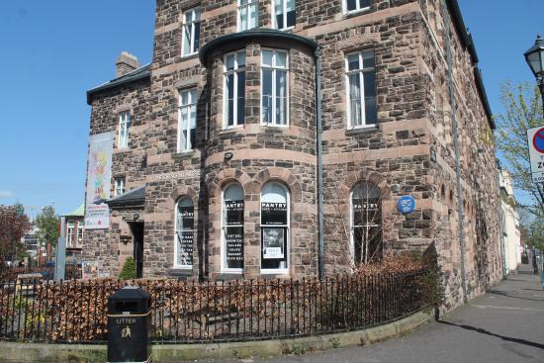

Slide 21
‘… is not easy to keep our temper when we see the most illiterate labourer, with no two ideas in his head, exercising the very important function of self-government while educated women capable in every way of giving a rational vote are still debarred.’
Organisation | Year
Women’s Suffrage Committee (Barbara Leigh Smith Bodichon) | 1865
Manchester Suffrage Committee | 1867
London National Society for Women’s Suffrage (Helen Taylor) | 1867
Edinburgh National Society for Women’s Suffrage | 1867
North of Ireland Society for Women’s Suffrage (Isabella Tod) | 1871
Dublin Women’s Suffrage Association (Anna Haslam) | 1876

Slide 22
Radicalisation

Slide 23
Women’s Social and Political Union, 1903
Christabel Pankhurst
Emmeline Pankhurst
Sylvia Pankhurst

Slide 24
Irish Women’s Franchise League (1908)

Slide 25
Opposition

Slide 29
Personally I am dead against Forcible Feeding which always ends with the release of the prisoner long before her time. I want to keep these ladies under lock and key for five years and I am quite willing to feed them with Priests Champagne and Michaelmas Geese all the time, if it can be done but ... these wretched hags ... are obstinate to the point of death.
AUGUSTINE BIRRELL

Slide 32
WW1

Slide 33
Representation of the People Act, February 1918
Householders/wives of householders
graduate of a British university
owned property worth £5 annually

