Slide 1
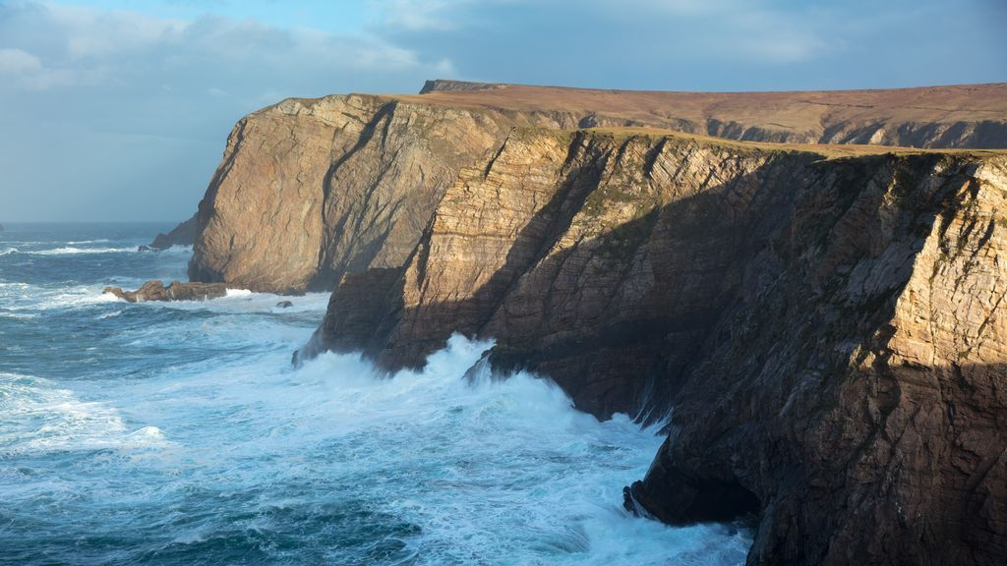
Seamus Heaney
and his poetry
Patrick Macfarlane

Slide 2
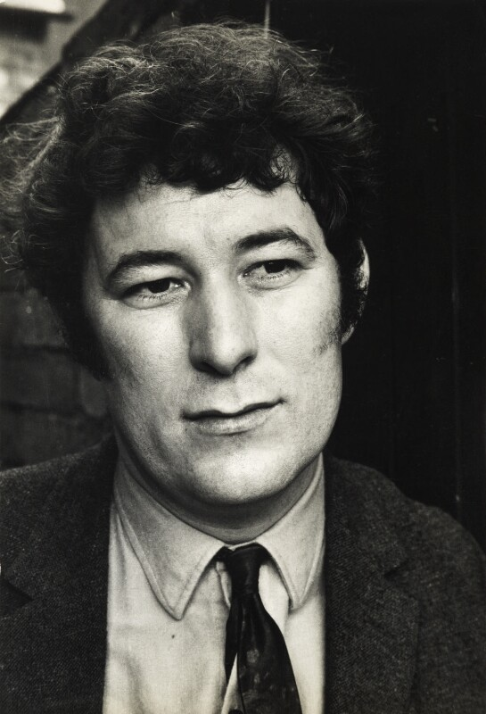
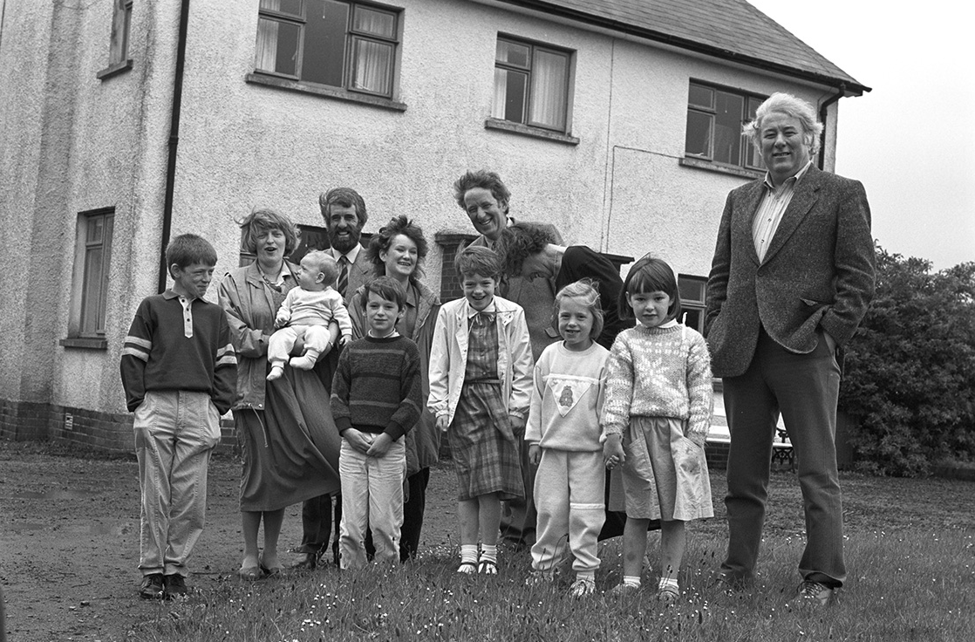
Heaney, early 1970s
Heaney with two brothers and their wives and children, Bellaghy, c. 1980

Slide 3
North
I returned to a long strand,
the hammered shod of a bay,
and found only the secular
powers of the Atlantic thundering.
I faced the unmagical
invitations of Iceland,
the pathetic colonies
of Greenland, and suddenly
those fabulous raiders,
those lying in Orkney and Dublin
measured against
their long swords rusting,
those in the solid
belly of stone ships,
those hacked and glinting
in the gravel of thawed streams
were ocean-deafened voices
warning me, lifted again
in violence and epiphany.
The longship’s swimming tongue
was buoyant with hindsight—
it said Thor’s hammer swung
to geography and trade,
thick-witted couplings and revenges,
the hatreds and behindbacks
of the althing, lies and women,
exhaustions nominated peace,
memory incubating the spilled blood.
It said, ‘Lie down
in the word-hoard, burrow
the coil and gleam
of your furrowed brain.
Compose in darkness.
Expect aurora borealis
in the long foray
but no cascade of light.
Keep your eye clear
as the bleb of the icicle,
trust the feel of what nubbed treasure
your hands have known.’

Slide 4
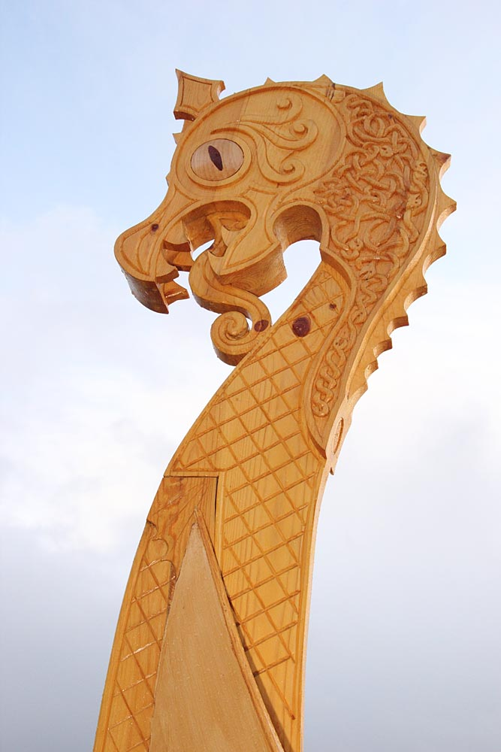
‘The longship’s swimming tongue’

Slide 5
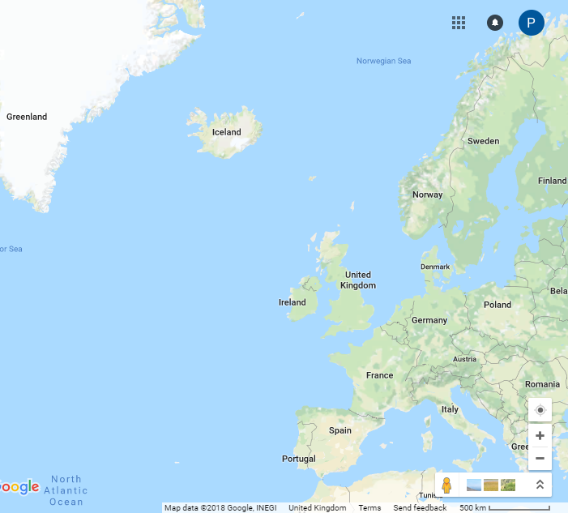
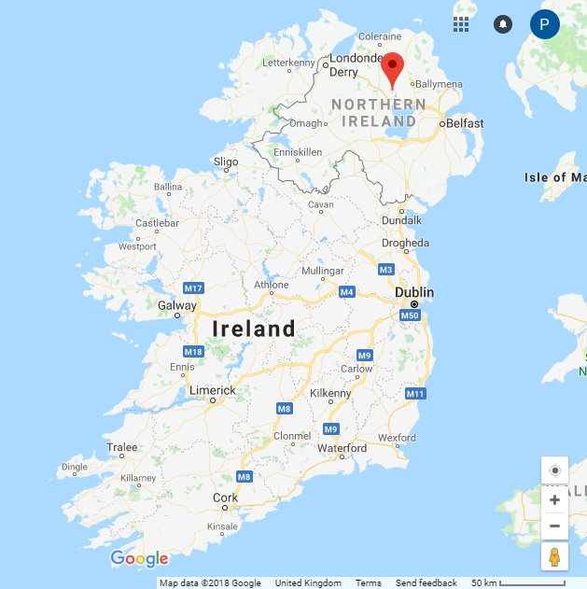
‘North’

Slide 6
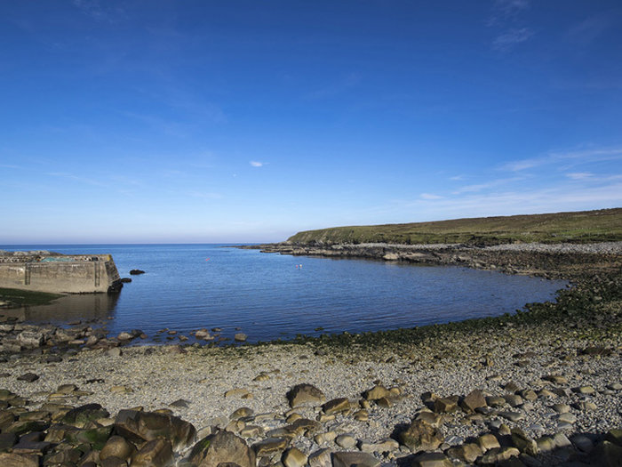
‘The hammered shod of a bay’

Slide 7
North
I returned to a long strand,
the hammered shod of a bay,
and found only the secular
powers of the Atlantic thundering.
I faced the unmagical
invitations of Iceland,
the pathetic colonies
of Greenland, and suddenly
those fabulous raiders,
those lying in Orkney and Dublin
measured against
their long swords rusting,
those in the solid
belly of stone ships,
those hacked and glinting
in the gravel of thawed streams
were ocean-deafened voices
warning me, lifted again
in violence and epiphany.
The longship’s swimming tongue
was buoyant with hindsight—
it said Thor’s hammer swung
to geography and trade,
thick-witted couplings and revenges,
the hatreds and behindbacks
of the althing, lies and women,
exhaustions nominated peace,
memory incubating the spilled blood.
It said, ‘Lie down
in the word-hoard, burrow
the coil and gleam
of your furrowed brain.
Compose in darkness.
Expect aurora borealis
in the long foray
but no cascade of light.
Keep your eye clear
as the bleb of the icicle,
trust the feel of what nubbed treasure
your hands have known.’
the hatreds and behindbacks
of the althing, lies and women,
exhaustions nominated peace,
memory incubating the spilled blood.

Slide 8
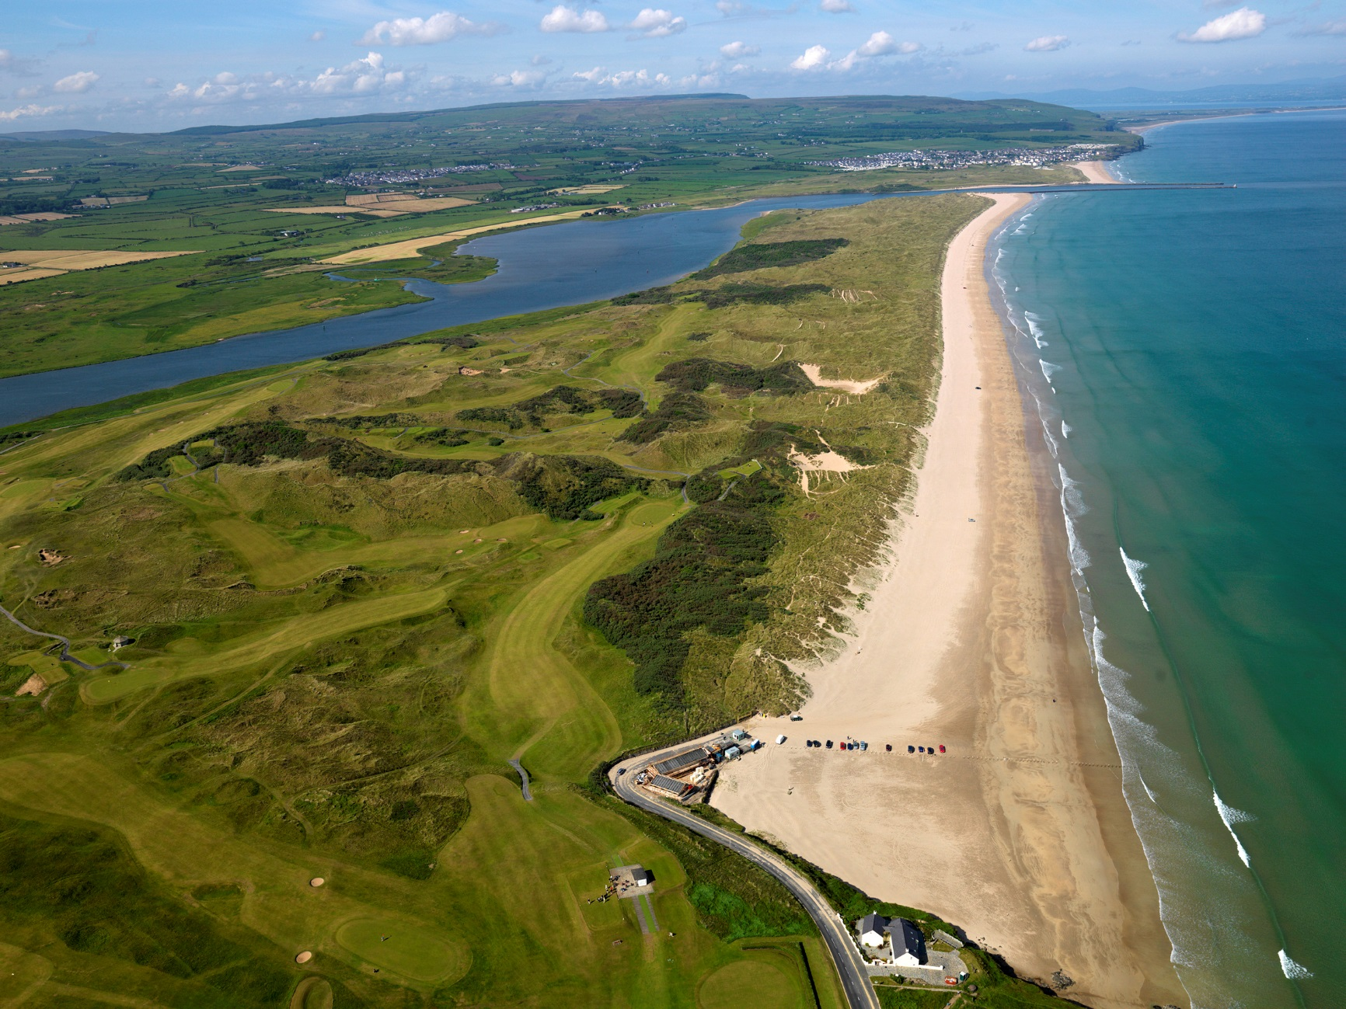
‘I returned to a long strand’

Slide 9
Belderg ‘They just kept turning up
And were thought of as foreign’ -
One-eyed and benign,
They lie about his house,
Quernstones out of a bog.
To lift the lid of the peat
And find this pupil dreaming
Of neolithic wheat!
When he stripped off blanket bog
The soft-piled centuries
Fell open like a glib:
There were the first plough-marks,
The stone-age fields, the tomb
Corbelled, turfed and chambered,
Floored with dry-turf-coomb.
A landscape fossilized,
Its stone-wall patternings Repeated before our eyes
In the stone walls of Mayo.
Before I turned to go
He talked about persistence,
A congruence of lives,
How, stubbed and cleared of stones,
His home accrued growth rings Of iron, flint and bronze.
So I talked of Mossbawn,
A bogland name. ‘But moss?’
He crossed my old home’s music
With older strains of Norse.
I told how its foundation
Was mutable as sound
And how I could derive
A forked root from that ground,
Make bawn an English fort,
A planter’s walled-in mound,
Or else find sanctuary
And think of it as Irish,
Persistent if outworn.
‘But the Norse ring on your tree?’
I passed through the eye of the quern,
Grist to an ancient mill,
And in my mind’s eye saw
A world-tree of balanced stones,
Querns piled like vertebrae,
The marrow crushed to grounds.

Slide 10
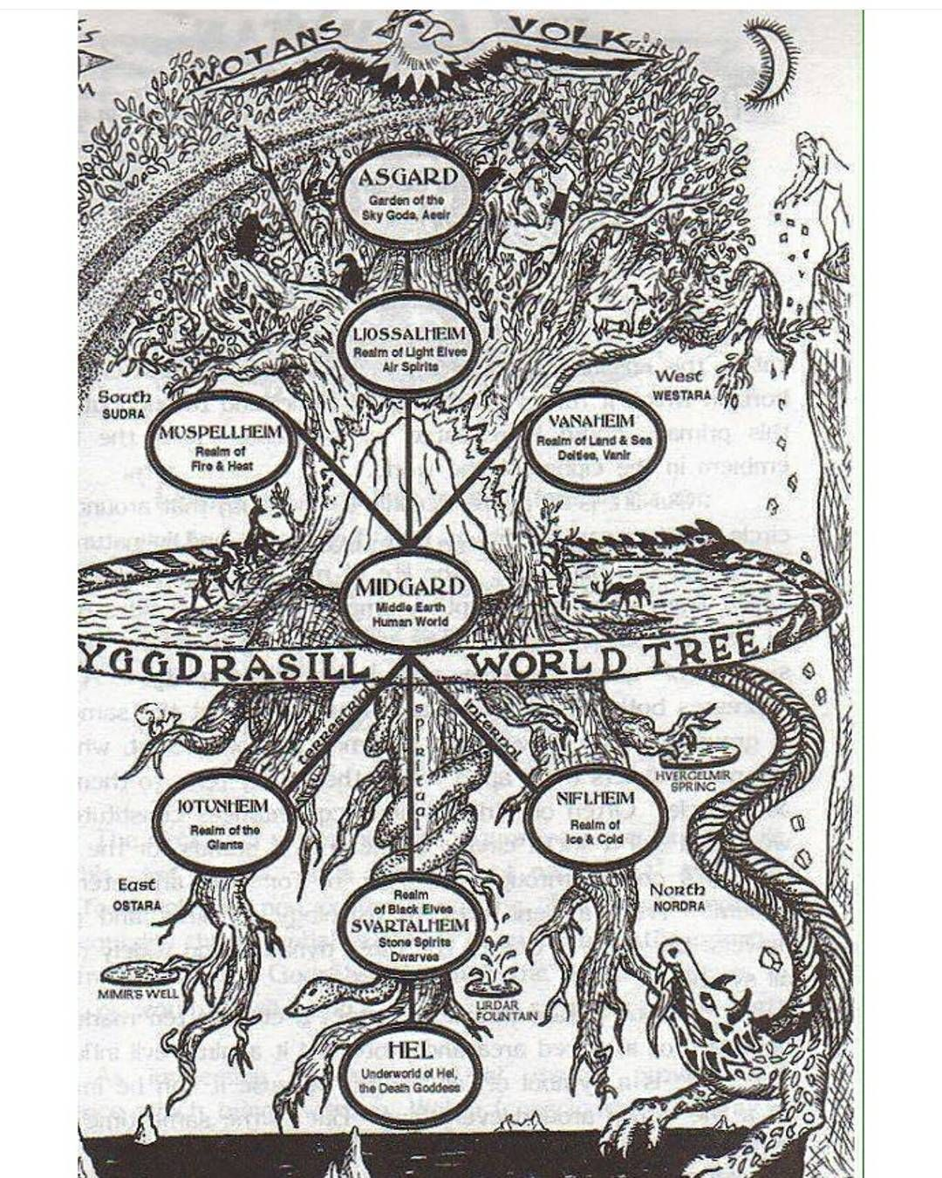
‘A world-tree’

Slide 11
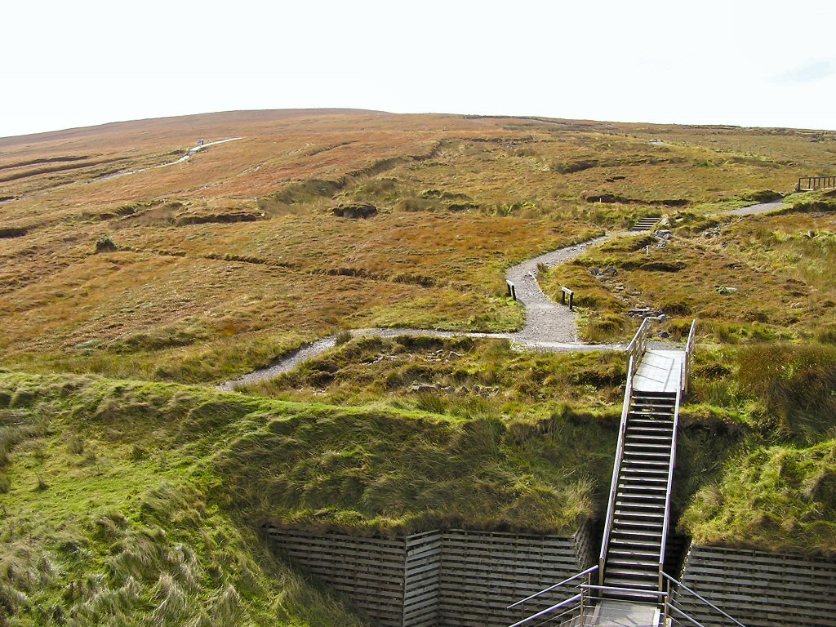
‘Blanket bog’

Slide 12
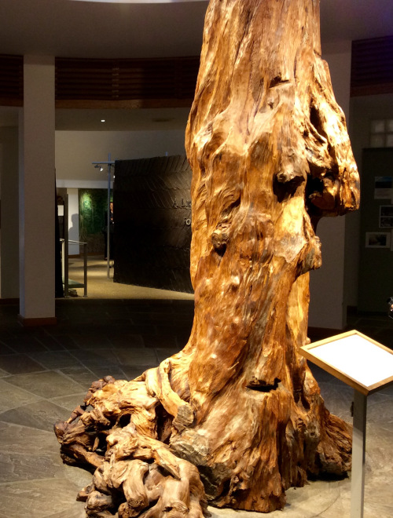
‘A forked root from that ground’

Slide 13
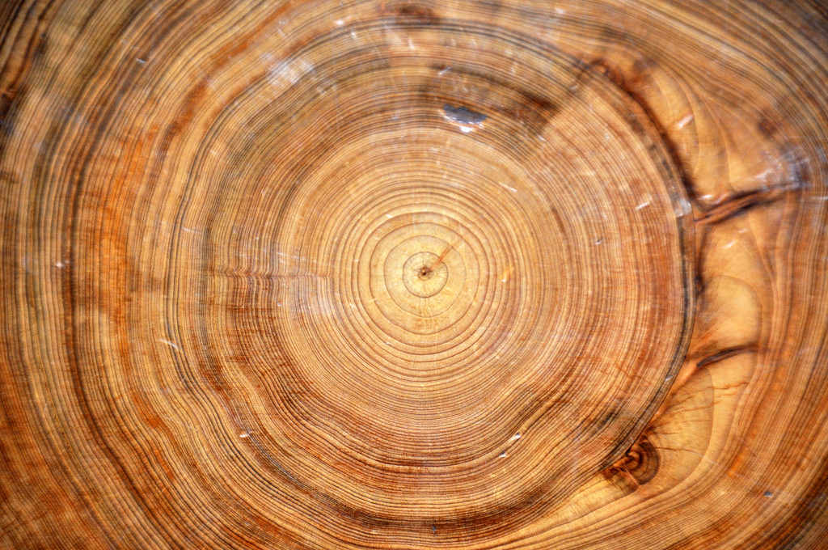
‘His home accrued growth rings’

Slide 14
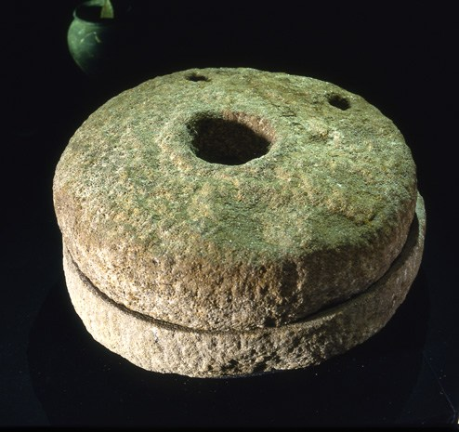
‘Quernstones out of a bog’

Slide 15
moss bán
moss bawn

Slide 16
Bogland
for T. P. Flanagan We have no prairies To slice a big sun at evening— Everywhere the eye concedes to Encroaching horizon, Is wooed into the cyclops’ eye Of a tarn. Our unfenced country Is bog that keeps crusting Between the sights of the sun. They’ve taken the skeleton Of the Great Irish Elk Out of the peat, set it up An astounding crate full of air.
Butter sunk under More than a hundred years Was recovered salty and white. The ground itself is kind, black butter Melting and opening underfoot, Missing its last definition By millions of years. They’ll never dig coal here, Only the waterlogged trunks Of great firs, soft as pulp. Our pioneers keep striking Inwards and downwards, Every layer they strip Seems camped on before. The bogholes might be Atlantic seepage. The wet centre is bottomless.

Slide 17
Mossbawn: Two Poems in Dedication
for Mary Heaney
I. Sunlight
There was a sunlit absence. The helmeted pump in the yard heated its iron, water honeyed
in the slung bucket
and the sun stood like a griddle cooling
against the wall
of each long afternoon. So, her hands scuffled over the bakeboard,
the reddening stove
sent its plaque of heat
against her where she stood in a floury apron by the window.
Now she dusts the board with a goose’s wing, now sits, broad-lapped, with whitened nails
and measling shins:
here is a space again, the scone rising
to the tick of two clocks.
And here is love
like a tinsmith’s scoop
sunk past its gleam in the meal-bin.

Slide 18
II. The Seed Cutters
They seem hundreds of years away. Breughel, You’ll know them if I can get them true. They kneel under the hedge in a half-circle Behind a windbreak wind is breaking through. They are the seed cutters. The tuck and frill Of leaf-sprout is on the seed potatoes Buried under that straw. With time to kill, They are taking their time. Each sharp knife goes Lazily halving each root that falls apart In the palm of the hand: a milky gleam, And, at the centre, a dark watermark. O calendar customs! Under the broom Yellowing over them, compose the frieze With all of us there, our anonymities.

Slide 19
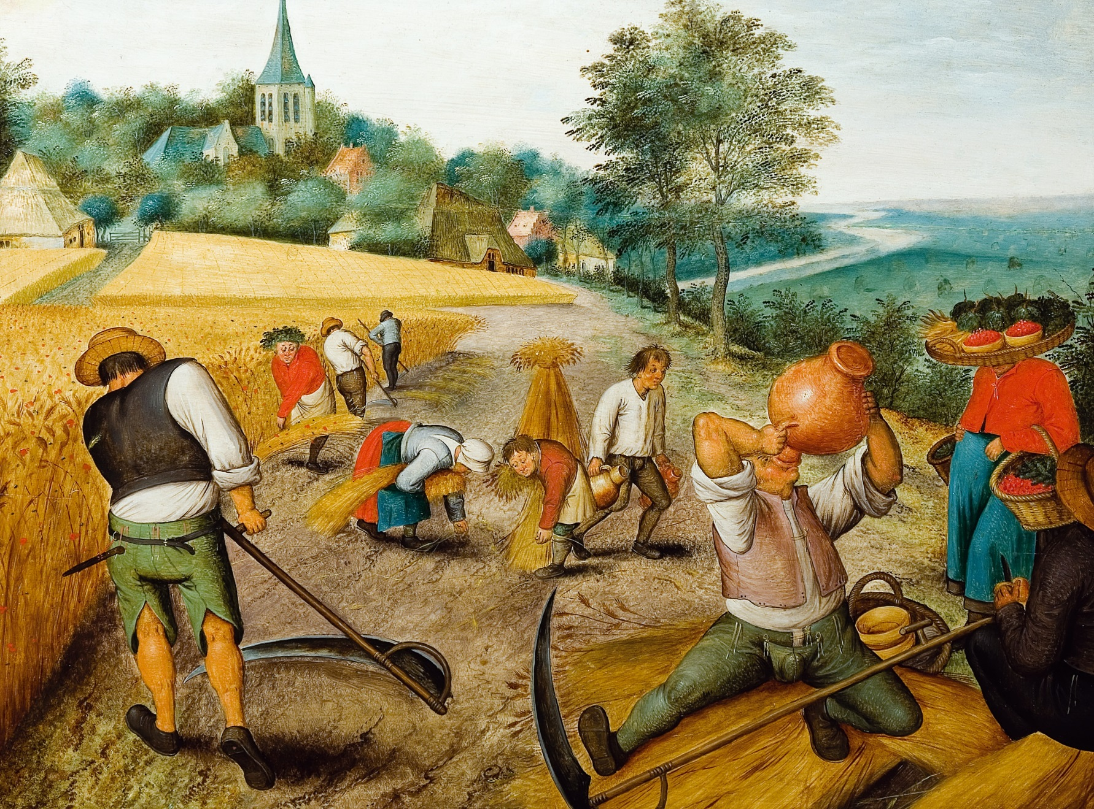
‘Oh, calendar customs!’

Slide 20
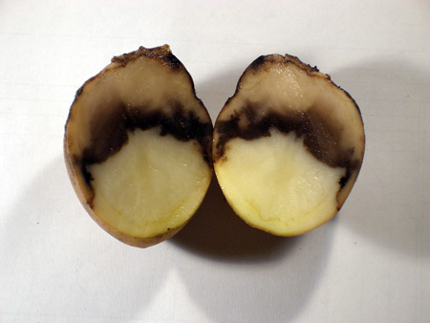
‘A dark watermark’

