Slide 1
INTRODUCTION TO THE LANGUAGES OF IRELAND
Professor Mícheál Ó Mainnín
Irish (School of Arts, English & Languages, QUB)
m.omainnin@qub.ac.uk

Slide 2
Hungarian
English
Lithuanian
Polish
Languages of Ireland
Irish
Ulster Scots
French
Portuguese
Norse
Russian
Chinese

Slide 3
Fáilte
go hOllscoil na Banríona, Béal Feirste!
Welcome to Queen’s University, Belfast!

Slide 4
SAYING HELLO IN IRISH!
Goidé mar atá tú/sibh?
Cén chaoi a bhfuil tú/sibh?
Conas atá tú/sibh?

Slide 5
FIRST IMPRESSIONS!
Familiarity? Any words you have heard before? ‘Fáilte’?
Connections (Language Family)? Similarity to English, Spanish etc.?
Sounds and Orthography (spelling conventions)?
Variety of Forms (region)?

Slide 6
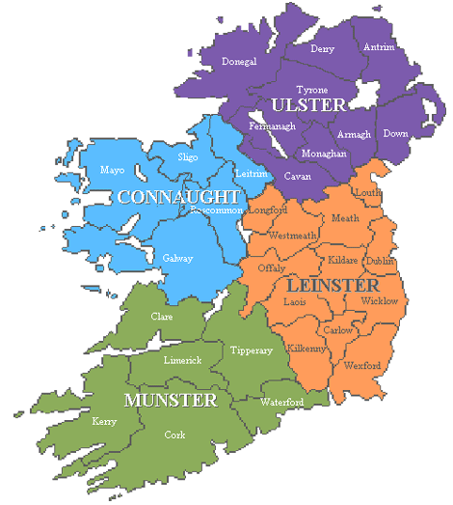

Slide 7
CONTEMPORARY DIALECTS OF IRISH
Goidé mar atá tú/sibh? ULSTER
Cén chaoi a bhfuil tú/sibh? CONNAUGHT/CONNACHT
Conas atá tú/sibh? MUNSTER

Slide 8
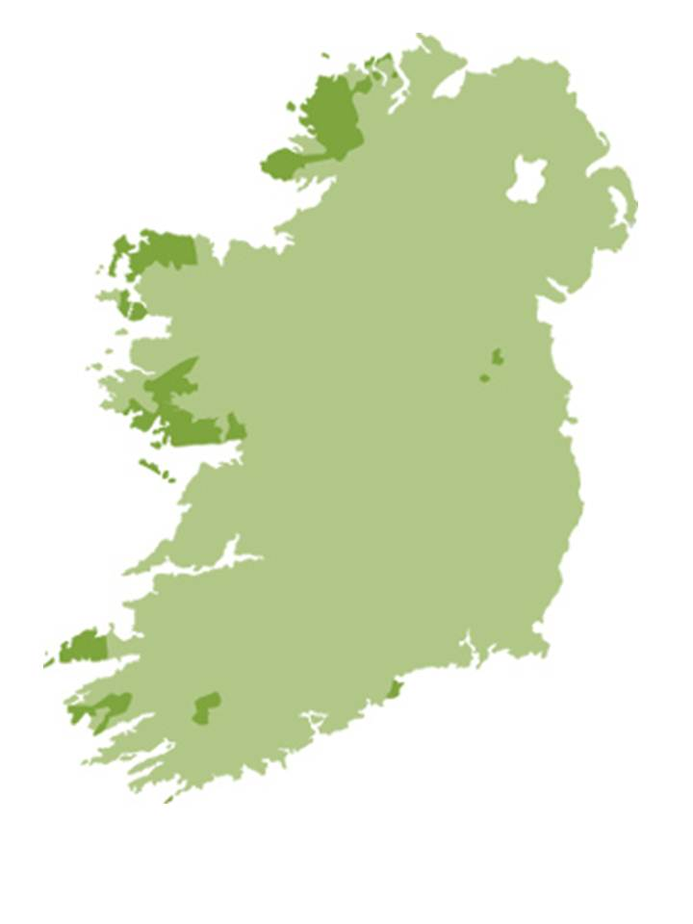
GAELTACHT: IRISH-SPEAKING DISTRICTS
traditional speakers: unbroken chain of transmission across the generations
to note:
1. geographical distribution
2. fragmentation
similarities with Scotland and Wales
Notes:
Outside education system: 3,382 fewer than 2011.

Slide 9
IRISH SPEAKERS: IRISH REPUBLIC
Census 2016:
  Total population: 4.4 million
  39.8% (1.76 million) able to speak Irish
  [however, majority could claim some knowledge of Irish as it is a compulsory subject at school]
  4.2% (73,803) speak Irish daily outside of the education system
  Gaeltacht population: 96,090
  63,664 (66.3%): ability to speak Irish
  32% speak Irish daily outside the education system.

Slide 10
IRISH SPEAKERS: NORTHERN IRELAND
Census 2011:
  104,943 (6.05%) can speak the language to varying degrees
  184,898 (10.65%) claim some knowledge of Irish
  4,130 (0.2%) use Irish as their main home language
  N.B. two important factors:
  1. no traditional Gaeltacht areas in Northern Ireland
  2. Irish not compulsory anywhere in the education system

Slide 11
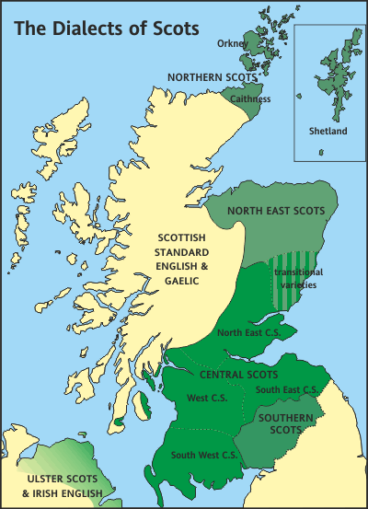
LANGUAGES OF SCOTLAND
Scotland’s linguistic heritage: more complicated than Ireland
two major indigenous languages since the 14th century: Scottish Gaelic (Highlands) and Scots (Lowlands)
as in Ireland, both under pressure from English since the 17th century

Slide 12
ULSTER SCOTS
Scots first introduced into Ulster with the Plantation of Ulster (1609)
speakers of Scottish Gaelic also settled here but blended into Irish or Lowland Scots populations
core areas of Scottish settlement: speakers from Lowland Scotland outnumbered English settlers in ratio of 5/6: 1
core areas in Antrim, Down, Donegal

Slide 13
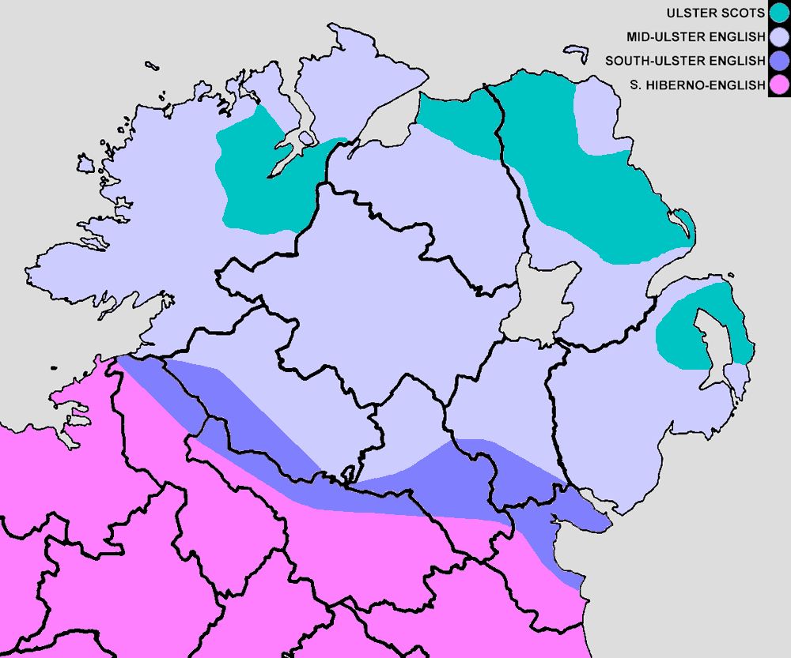

Slide 14
ULSTER SCOTS SPEAKERS
Census 2011:
  16,373 (0.9%) can speak, read, write and understand Ulster Scots
  140,204 (8.1%) claim some ability in Ulster Scots
  N.B. this does not include one of the core areas:
  Donegal is in the Irish Republic
  how many with some ability in Ulster Scots? (This information was not sought in the 2016 census.)

Slide 15
IRISH AND ULSTER SCOTS: SHARED CONTEXTS?
both minoritised languages in contemporary Ireland
spoken in both the Irish Republic and NI (but Ulster Scots confined to northern part of the island)
both have some support from the Irish & UK governments (but in different ways and to different extents)
both spoken by Protestants and Catholics, Unionists and Nationalists, and non-aligned people in NI to varying degrees (but Irish championed by Nationalist parties and Ulster Scots by Unionist parties)

Slide 16
LANGUAGES AND IDENTITY
  entwined with identity and politics
  extremely complicated historically
  Protestant reformation (mid-16th century) and the Plantation of Ulster (1603)
  languages embroiled in religious and political differences in Ireland
  prejudice against languages other than English

Slide 17
KING HENRY VIII TO THE TOWN OF GALWAY, 1536
‘that every inhabitant…endeavour themselves to speak English… and especially that you, and every [one] of you, do put forth your child to school, to learn to speak English, and that you fail not to fulfil this our commandment… and… avoid our indignation and high displeasure.’

Slide 18
EDMUND SPENSER, THE QUEEN’S POET
Nine Years’ War (1593-1601)
highpoint of conflict, leading to defeat of the Irish by the forces of Queen Elizabeth I and the destruction of ‘Gaelic Ireland’
greater polarisation and hardening of attitudes
Spenser, ‘A View of the Present State of Ireland’, 1596:
‘the speech being Irish, the heart must needs be Irish’

Slide 19
DECLINE OF THE IRISH LANGUAGE
major period of decline, 1609-1893
disproportionate effect of Great Famine (1845-49) on Irish-speaking communities
famine hit poorer communities in the west most strongly; these were also the most strongly Irish-speaking
psychological as well as numerical damage: Irish as the ‘language of poverty’; English as the ‘language of progress’ and of the NEW WORLD
internalised prejudice against the Irish language among the Irish themselves

Slide 20
IRELAND AT PARTITION
Partition of the Island in 1921:
Irish Free State (26 counties) & Northern Ireland (6 counties)
  state of the language in 1921: language close to death
  attempts at cultural revival since 1880s: Gaelic Athletic Association 1884; Conradh na Gaeilge/Gaelic League 1893
  efforts to restore/revitalise Irish as a spoken and national language
  differences and tensions between cultural nationalists (e.g. Douglas Hyde) and nationalist separatists (e.g. Patrick Pearse)
  alienation of Northern Unionists

Slide 21
REPUBLIC OF IRELAND
Irish Free State (1922)
became the Irish Republic (officially in 1949)
new constitution in 1937 enacted by Taoiseach, Éamon de Valera
major impact on language status and government policy

Slide 22
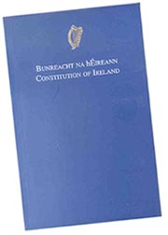
THE IRISH CONSTITUTION 1937
Article 8:
the Irish language as the national language is the first official language.
the English language is recognised as a second official language.
provision may… be made by law for the exclusive use of either of the said languages for any one or more official purposes, either throughout the State or in any part thereof.

Slide 23
IMPACT ON GOVERNMENT POLICY
1st official language, alongside English.
  Both languages have equal status
  In law, Irish takes precedence. So if there is a discrepancy between the two language versions of a law, it is the Irish version that is deemed to be ‘right’.
compulsory in education from 5 years of age to final state examinations (with some exemptions)
necessary to have a certain level of the Ianguage to work in some areas of the civil service
Notes:
Exemptions: outside of RoI up to 11
Learning disability which impedes mother tongue acquisition
Pupils from abroad with no knowledge of English

Slide 24
OFFICIAL LANGUAGES ACT (2003)
Act established in Republic of Ireland to promote the use of Irish in the State
right to use either of the official languages in the Houses of Parliament (the Oireachtas)
  all debates and proceedings of the Houses shall be published in each of the official languages
right to use either of the official languages in court
    no one should be disadvantaged by their language of choice
  duty of public bodies to use the official languages in communications with the public (oral and written)
    if a member of the public contacts a public body in one language, they should respond in the same language
Notes:
Contributions made by a person in either of the languages may be published only in that language
Failure to comply with Act: €2,000 fine and/or max 6 months imprisonment

Slide 25
OFFICIAL LANGUAGES ACT (CONTINUED)
establishment of Oifig an Choimisinéara Teanga (Office of the Language Commissioner)
  To monitor compliance of the Act by public bodies
  To investigate any failures by a public body to comply with the Act
  To provide assistance and advice to the public regarding rights, and to public bodies regarding obligations, as set out in the Act

Slide 26
IRISH AND THE LANGUAGE OF GOVERNMENT
Uachtarán na hÉireann (President); Áras an Uachtaráin
Oireachtas (Legislature): Dáil Éireann and Seanad Éireann
Teachta Dála (T.D.) (‘member of parliament’)
Taoiseach (‘leader, chief’) > Prime Minister
Tánaiste (‘second-in-rank’) > Deputy Prime Minister
Ceann Comhairle (Speaker of the Assembly)

Slide 27
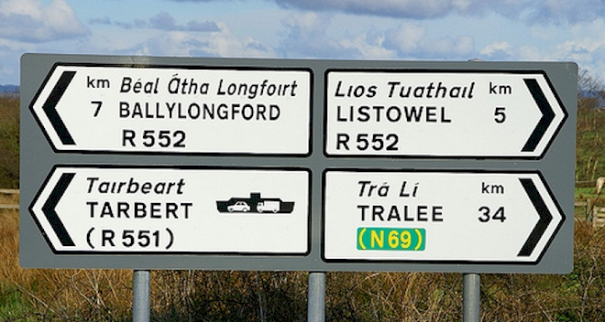
IRISH IN THE PUBLIC SPACE

Slide 28
NORTHERN IRELAND
  divisive/contested status of languages
  no state support for Irish (or Ulster Scots) in 1921
  Irish language as ‘foreign’, ‘threat’ etc.
  Ulster Scots did not exist as a term until 1980s
  contested status of Ulster Scots: language or dialect?

Slide 29
LEGISLATIVE BACKGROUND IN NORTHERN IRELAND
need for support of linguistic diversity first articulated:
Good Friday/Belfast Agreement (1998)

Slide 30
BELFAST AGREEMENT
‘All participants recognise the importance of respect, understanding and tolerance in relation to linguistic diversity, including in NI, the Irish language, Ulster-Scots and the languages of the various ethnic communities, all of which are part of the cultural wealth of the island of Ireland.’

Slide 31
EUROPEAN CHARTER FOR REGIONAL OR MINORITY LANGUAGES (1992)
Belfast Agreement alludes specifically to the European Charter for Regional or Minority Languages & consideration then being given by UK to signing it (which it did 3 years later (2001))
Agreement echoes language of the Charter, including taking ‘resolute action to promote’ the Irish language specifically

Slide 32
DISTINCT NUANCING
Charter speaks, on only a couple of occasions, of making commitments ‘as far as this is reasonably possible’
among its ‘objectives and principles’, stresses that ‘the adoption of special measures in favour of regional or minority languages… is not considered to be an act of discrimination against the users of more widely-used languages’

Slide 33
COMMUNITY SENSITIVITIES
British Government to pursue commitments ‘where appropriate & where people so desire it’
Agreement encouraged new Assembly to sustain these ‘in a way which takes account of the desires and sensitivities of the community’
NI Problem: fractured community and conflicting perceptions of identity
recognition of both Irish and Ulster-Scots in the Belfast Agreement has not solved this problem

Slide 34
ST ANDREWS AGREEMENT (2006)
‘The Government will introduce an Irish Language Act reflecting on the experience of Wales and Ireland and work with the incoming Executive to enhance and protect the development of the Irish language’
‘The Government firmly believes in the need to enhance and develop the Ulster Scots language, heritage and culture and will support the incoming Executive in taking this forward.’

Slide 35
ST ANDREWS AGREEMENT ACT 2006
‘The Executive Committee shall adopt a strategy setting out how it proposes to enhance and protect the development of the Irish language.’
‘The Executive Committee shall adopt a strategy setting out how it proposes to enhance and develop the Ulster Scots language, heritage and culture.’

Slide 36
CONTROVERSY OVER IRISH LANGUAGE ACT
commitment by British Government to an Irish Language Act in the St Andrews Agreement NOT given legislative effect in the St Andrews Act
language legislation devolved to the NI Assembly and Executive: requires cross-party support which has not been forthcoming
collapse of Northern Ireland Assembly in January 2017
failure to restore Stormont; a crucial element of this has hinged on the failure to agree an Irish Language Act

Slide 37
CURRENT POSITION IN NORTHERN IRELAND
no language legislation in NI
this distinguishes it from rest of UK and Ireland
strategies for Irish and Ulster Scots, 2015-35
these are being implemented by the Department for Communities (previously known as the Department of Culture, Arts & Leisure) but progress is being impeded by lack of government at Stormont

Slide 38
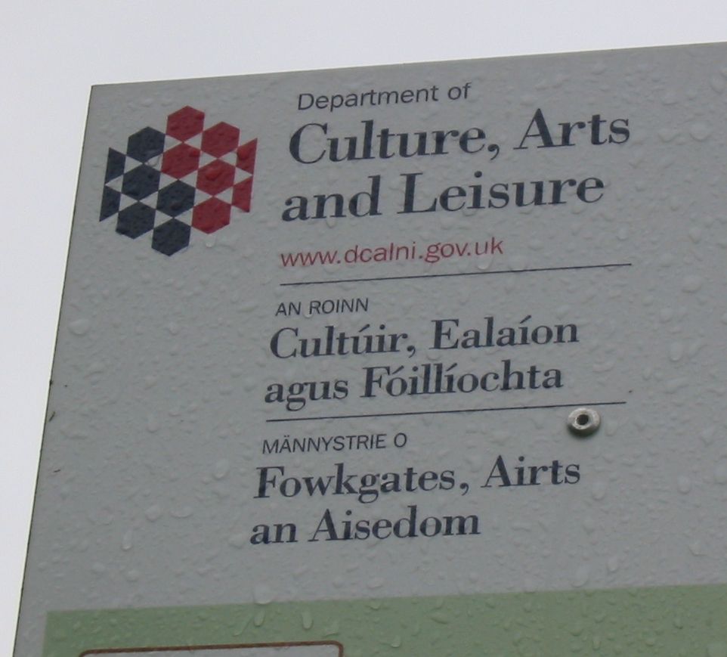
TRILINGUAL SIGNAGE

Slide 39
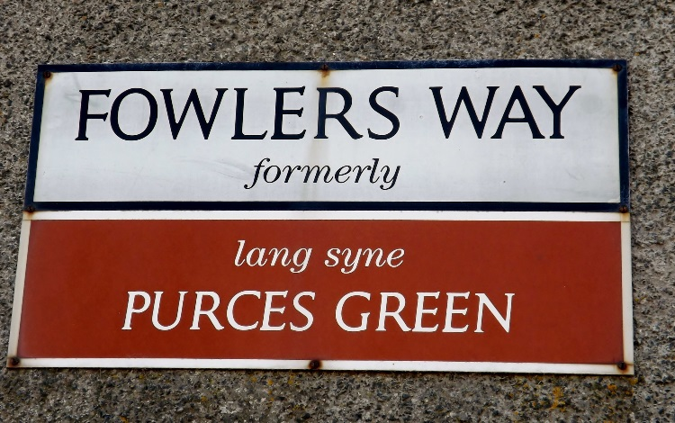
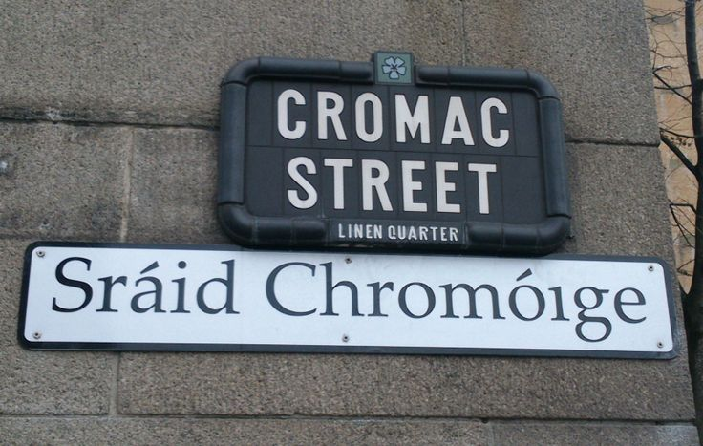
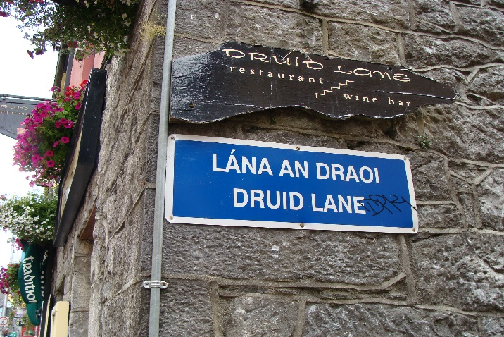
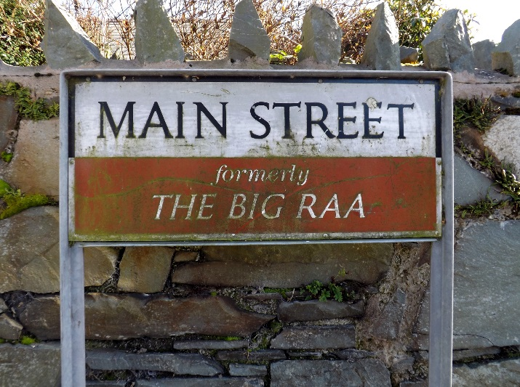
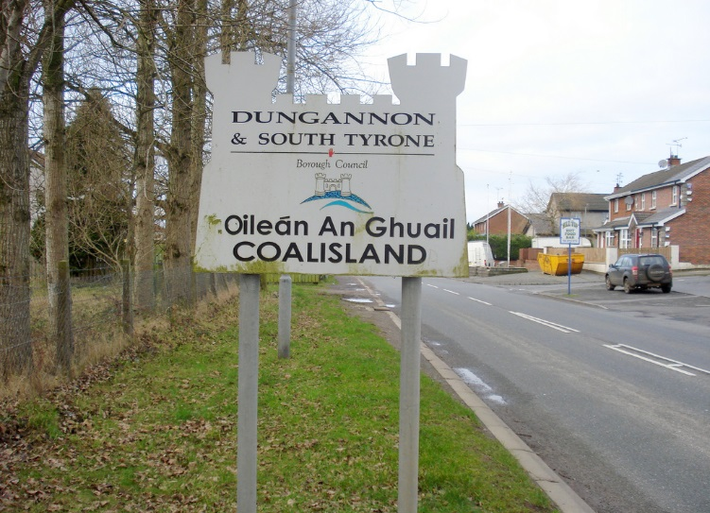
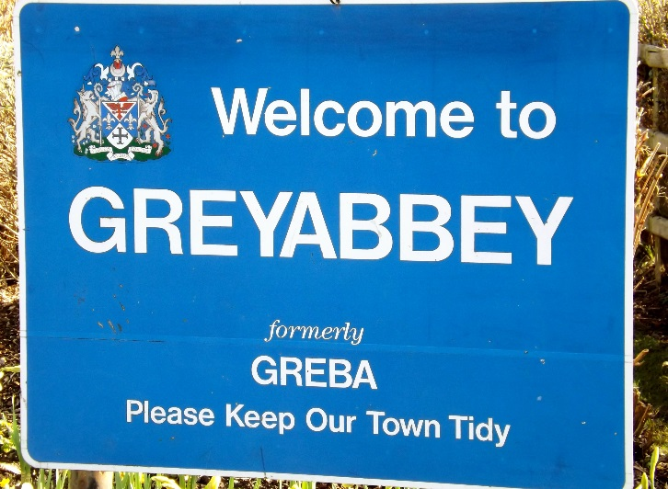
BILINGUAL STREET SIGNS

Slide 40
‘NEW SPEAKERS’ AND BELFAST GAELTACHT QUARTER
Belfast quarters, e.g. Titanic Quarter, Queen’s Quarter
West Belfast Task Force proposal (2002): designation of an area in West Belfast as a Gaeltacht area
based on numbers and prominence of ‘new’ speakers of Irish
plan for Gaeltacht Quarter adopted by government (DCAL)
capital investment in infrastructure: community centres, sports facilities and purpose-built premises for radio station

Slide 41
SHARED HERITAGE
The languages of Ulster placenames: Irish, English, Scots
only one contested place-name: Ir. Doire > Derry (> Londonderry)
Irish: Béal Feirste (Belfast), Seanchill (Shankill), Tuath na bhFál (Falls)
Scottish: Sandyknowes, Caldhame, Balmoral
English: Brookeborough; Cookstown

Slide 42
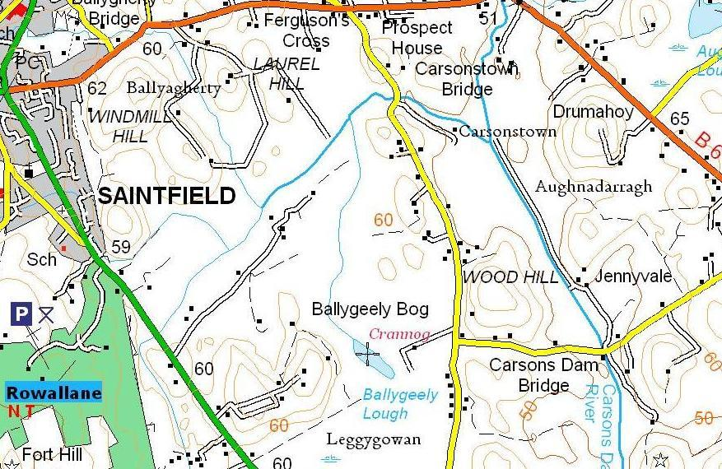

Slide 43
SOME CONCLUSIONS
Irish and Ulster Scots are endangered languages; declining numbers of native speakers, despite varying degrees of government support
both have left their mark on English as we speak it and on our cultural environment (e.g. place-names); but influence of Ulster Scots is confined to the north of Ireland
Irish has a ‘new speaker’ population, particularly in urban areas, facilitated by Irish-medium education. There is considerable vigour in some associated developments, e.g. Irish-medium television, online platforms etc.
in NI, language continues to be a divisive issue

Slide 44
SOME RESOURCES
https://www.uni-due.de/DI/
https://www.bbc.co.uk/iplayer/episode/b09g3ll5/languages-of-ulster-series-1-episode-1
http://ulsterscotsacademy.com
https://www.cso.ie/en/releasesandpublications/ep/p-cp10esil/p10esil/
http://www.placenamesni.org/
http://meits.org/
Nic Pháidín & Ó Cearnaigh, A New View of the Irish Language (2008)

