Slide 1
EARLY BELFAST AND ITS HERITAGE

Slide 2
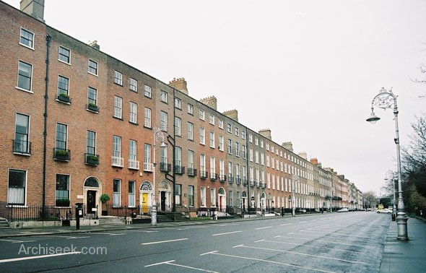
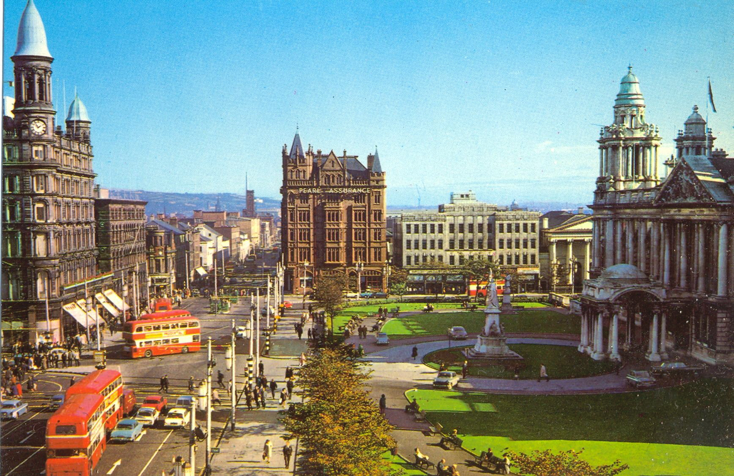
Belfast is not Dublin

Slide 3
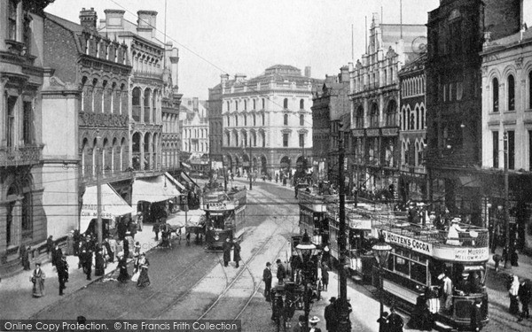
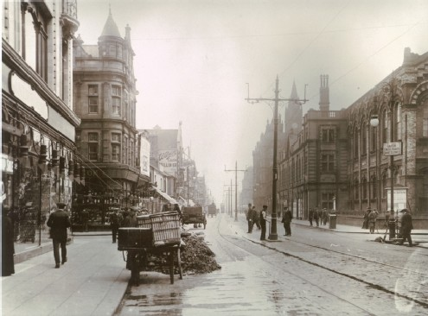
A Victorian Provincial City

Slide 4
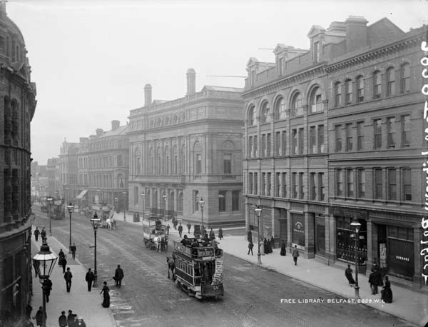
Royal Avenue 1880-1

Slide 5
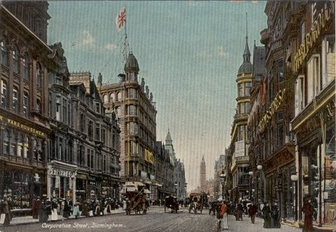
Corporation Street, Birmingham

Slide 6
A Victorian City
1821 37,000
1831 53,000
1841 75,000
1851 98,000
1861 119,000
1871 174,000
1881 208,000
1891 256,000
1901 349,000
2017 585,000

Slide 7
A Town Without a History?
“... before the union, Belfast was a village; now it ranks with the cities of the earth. Before the union it had a few coasting craft, and a few American and West Indian ships – and that open bay, which now embraces the navies of every land, was but a desert of useless water. The centre of our town was studded with thatched cottages, where now stands one of the fairest temples to the genius of industry and commerce. Our merchants, then unknown, are now welcomed in every land ... In one word more I have done with my argument. Look at Belfast, and be a Repealer – if you can. “
Rev. Henry Cooke, 1841

Slide 8
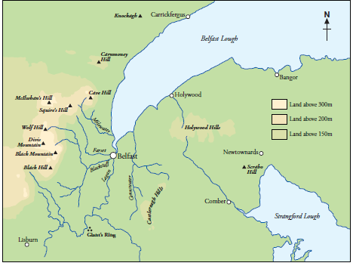
The Physical Setting

Slide 9
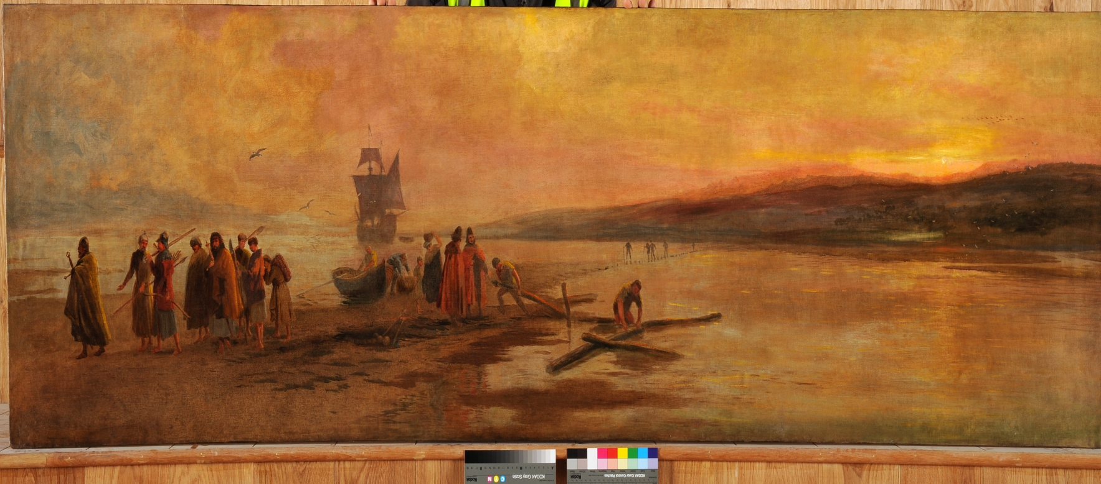
The Mouth of the Sandbank

Slide 10
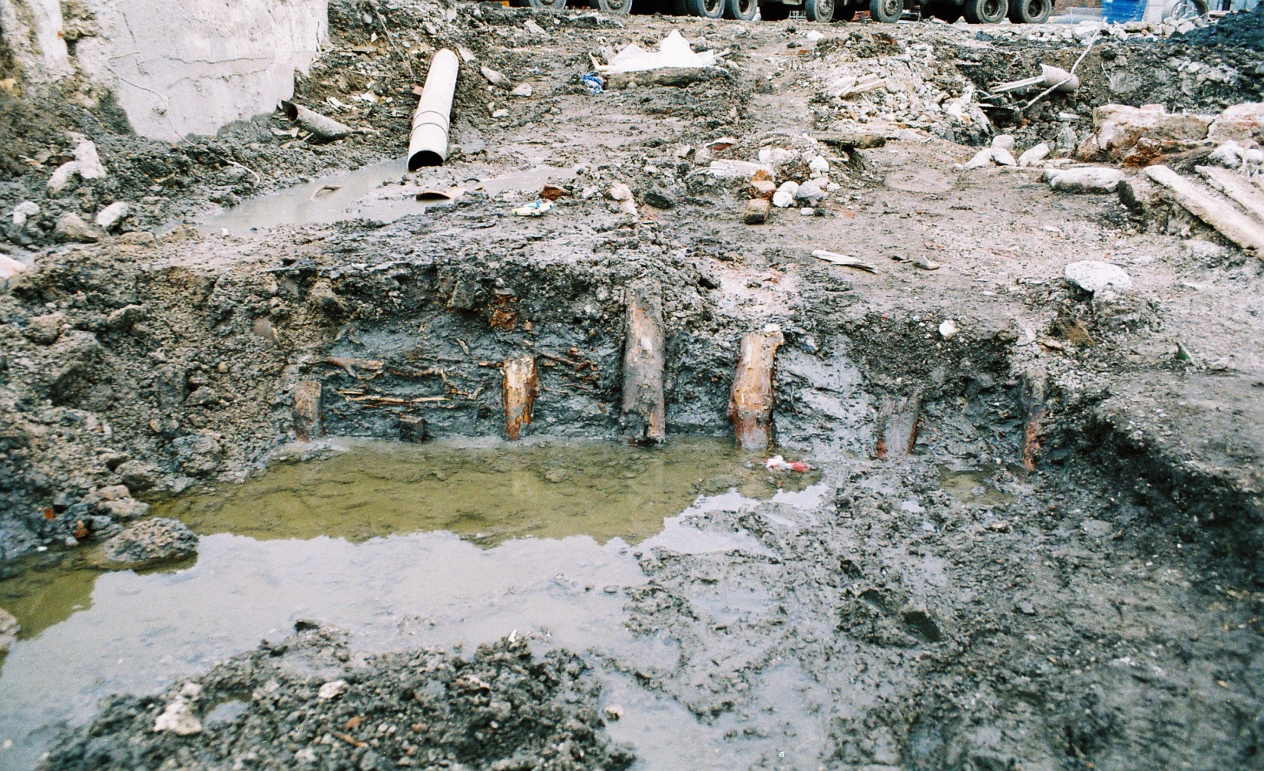
Victoria Square Excavations

Slide 11
Medieval Belfast
1262 The Castle of the Ford
1333 Watermill, castle, town
15th c. A tower house of the Clandeboye O’Neill

Slide 12
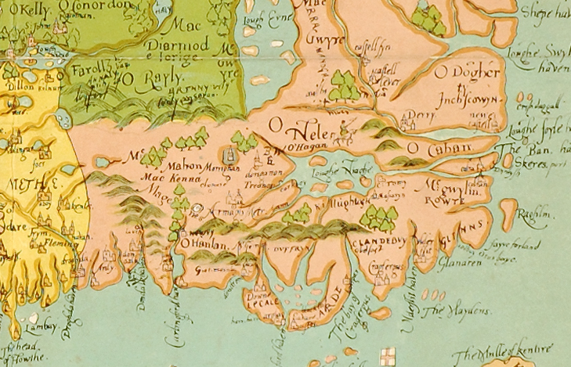
North East Ulster 1567

Slide 13
Plantation Town

Slide 14
Thomas Phillips, 1685

Slide 15
The Plantation Town
A satellite of Carrickfergus
Population (1640) – 400-500.
Population (1660) – 589
‘A barbarous nook in Ireland’ (Milton)

Slide 16
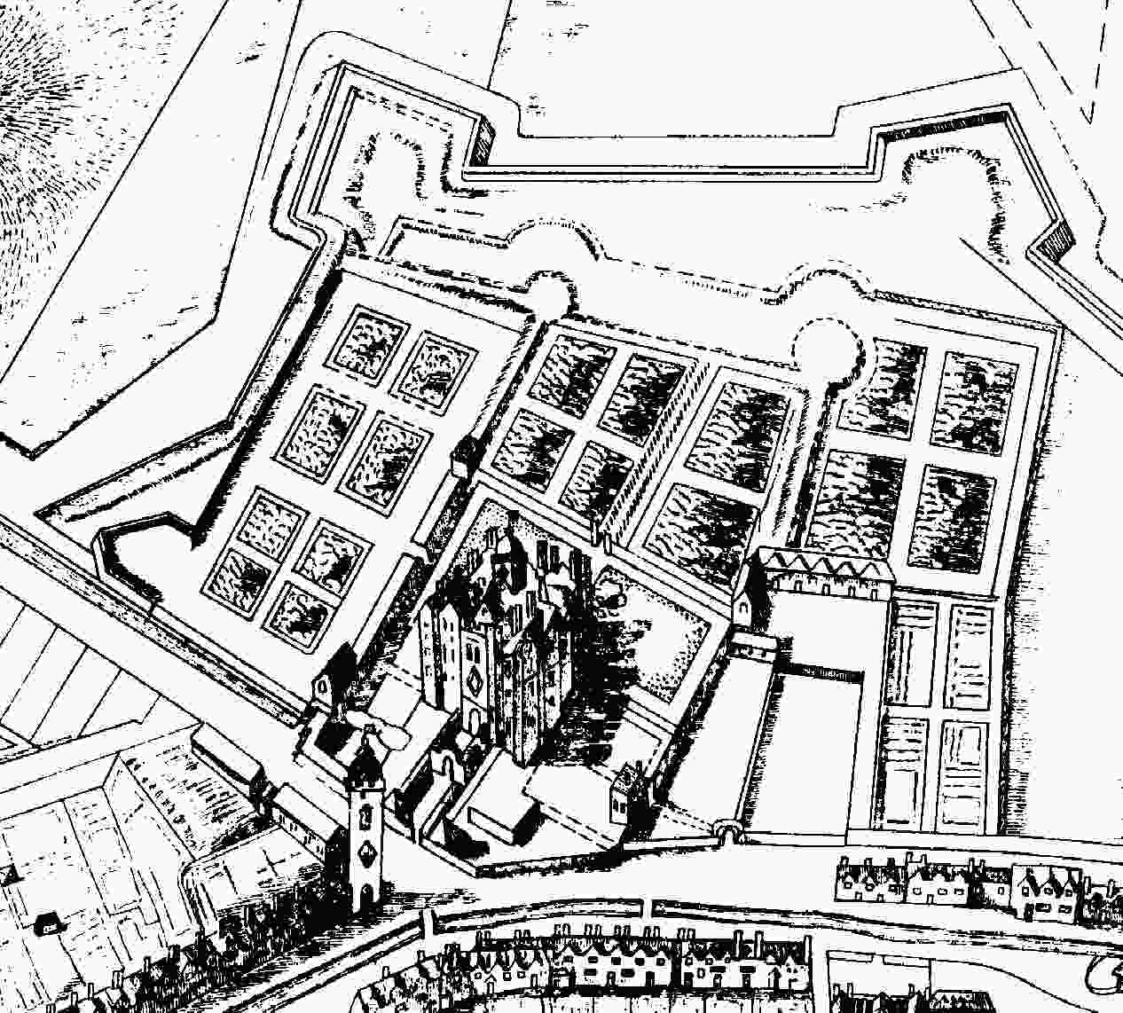
Thomas Phillips, 1685

Slide 17
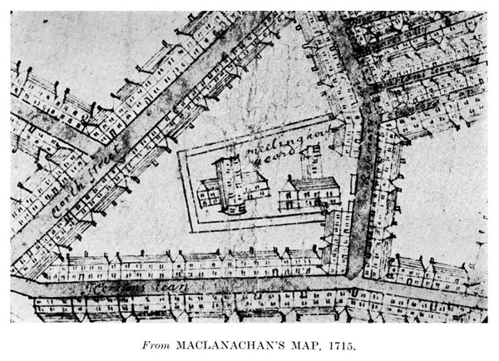
John MacLanachan 1715

Slide 18
Belfast c.1725
Population 8,000
Third busiest port
Sixth largest town

Slide 19
Atlantic Port 1660 -
The rise of the Atlantic economy
Provisions – beef, pork, butter
Linen cloth and yarn
Flaxseed as a return cargo
Emigrants
Significance of the Lagan corridor

Slide 20
The Physical Setting

Slide 21
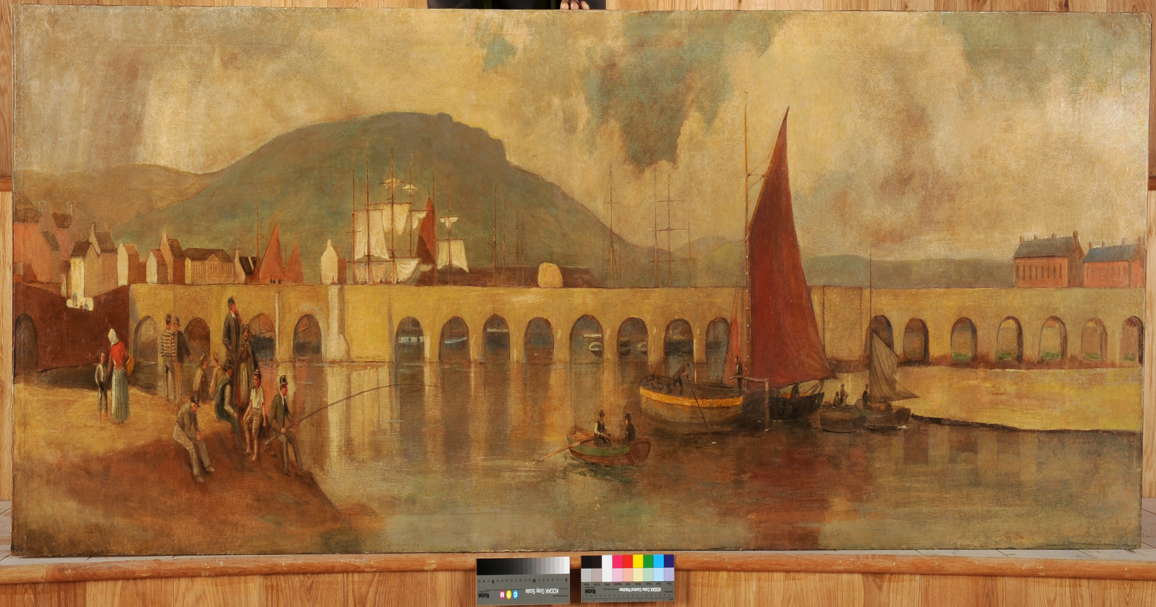
The Long Bridge (1680s)

Slide 22
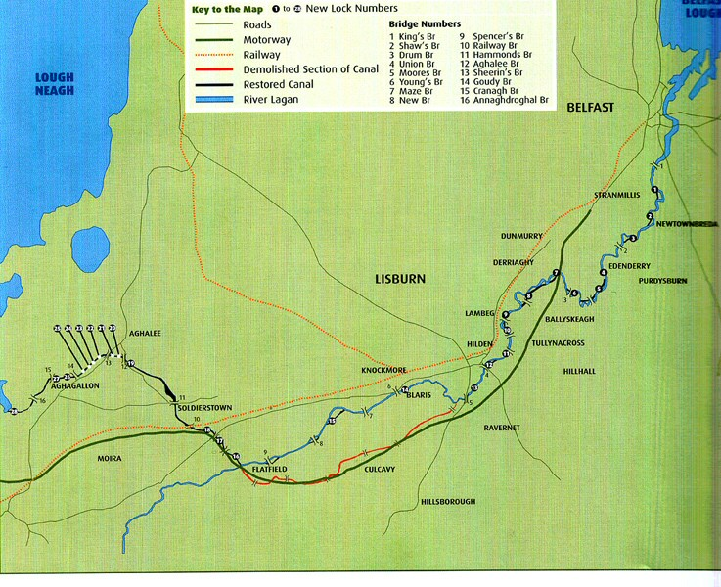
Lagan Navigation

Slide 23
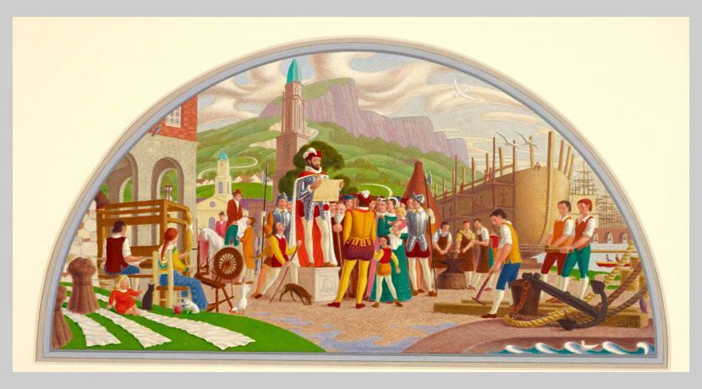
Chichester/Donegall

Slide 24
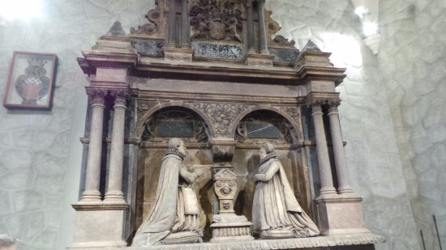
Sir Arthur Chichester 1563-1625

Slide 25
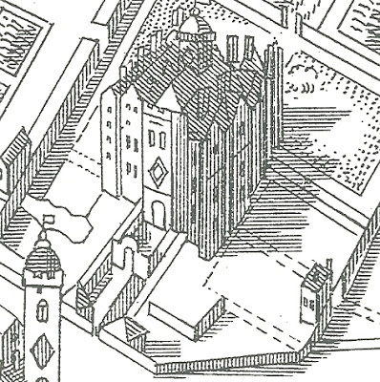
Belfast Castle 1685

Slide 26
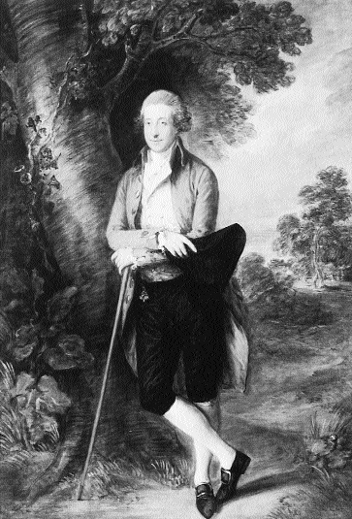
1st Marquess of Donegall 1739-99

Slide 27
Urban improvement
New building leases
High Street, Castle Place, Waring Street
New streets
North Street, Donegall Street, Donegall Place
Economic development
Linen Hall, Lagan Navigation
Amenities
Market, Exchange/Assembly Rooms, parish church

Slide 28
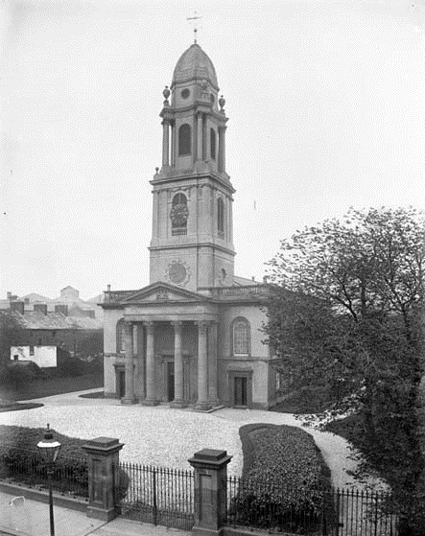
St Ann’s Church

Slide 29
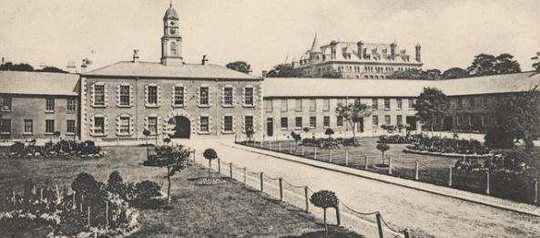
White Linen Hall

Slide 30
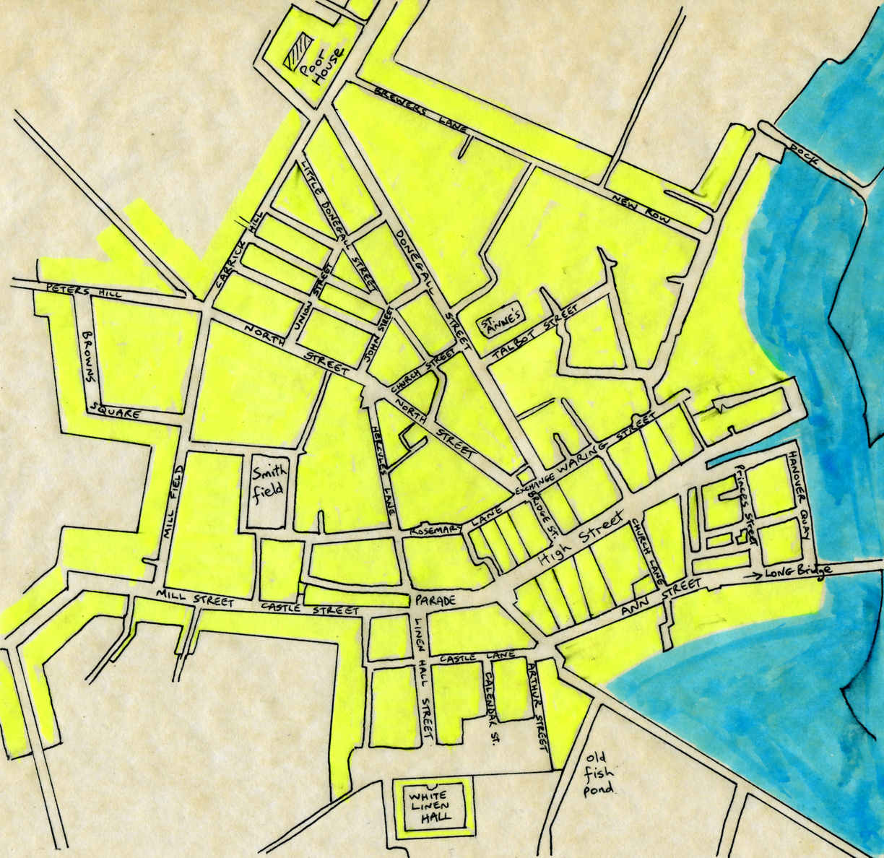
Belfast 1791

Slide 31
Before the urban doughnut
‘ ... The town of Belfast consists of one long broad street, and of several lanes in which the inferior people live...’
Bishop Richard Pocock, 1752

Slide 32
Belfast and the urban renaissance
Theatre, coffee houses
Belfast Newsletter 1737
Education
Belfast Academy
Belfast Academical Institution 1814
Clubs and societies
“The Athens of the North”

Slide 33
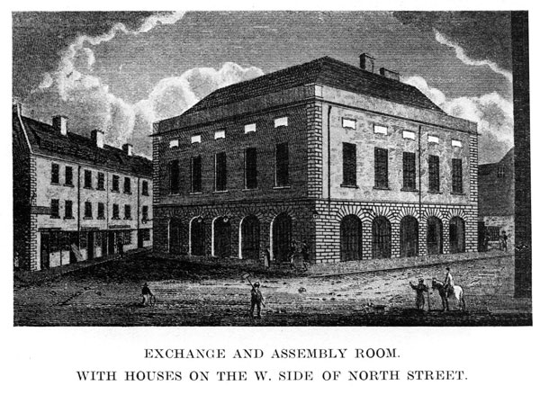
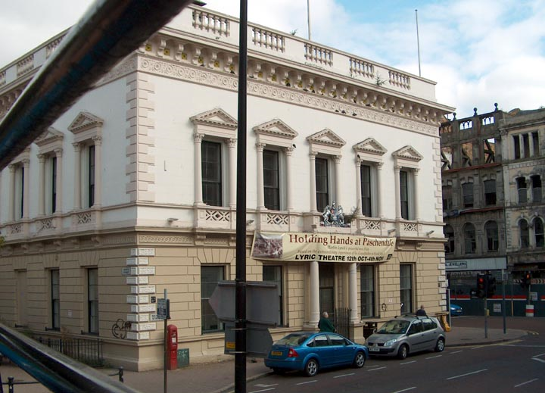
Exchange and Assembly Rooms 1769-76

Slide 34
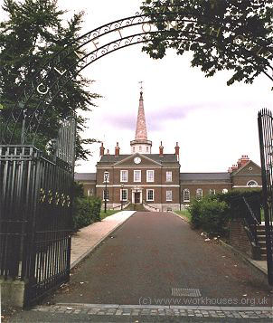
Civic Virtue and Corporate Effort: Clifton House 1771-4

Slide 35
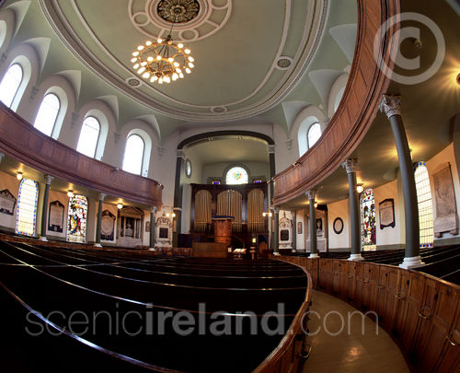
Rosemary Street First Presbyterian 1781-3

Slide 36
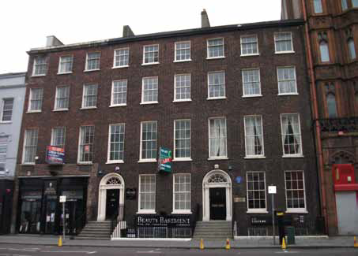
The Georgian Town

