Slide 1
Women and the Public Sphere in Ireland c. 1770s - 1918

Slide 2
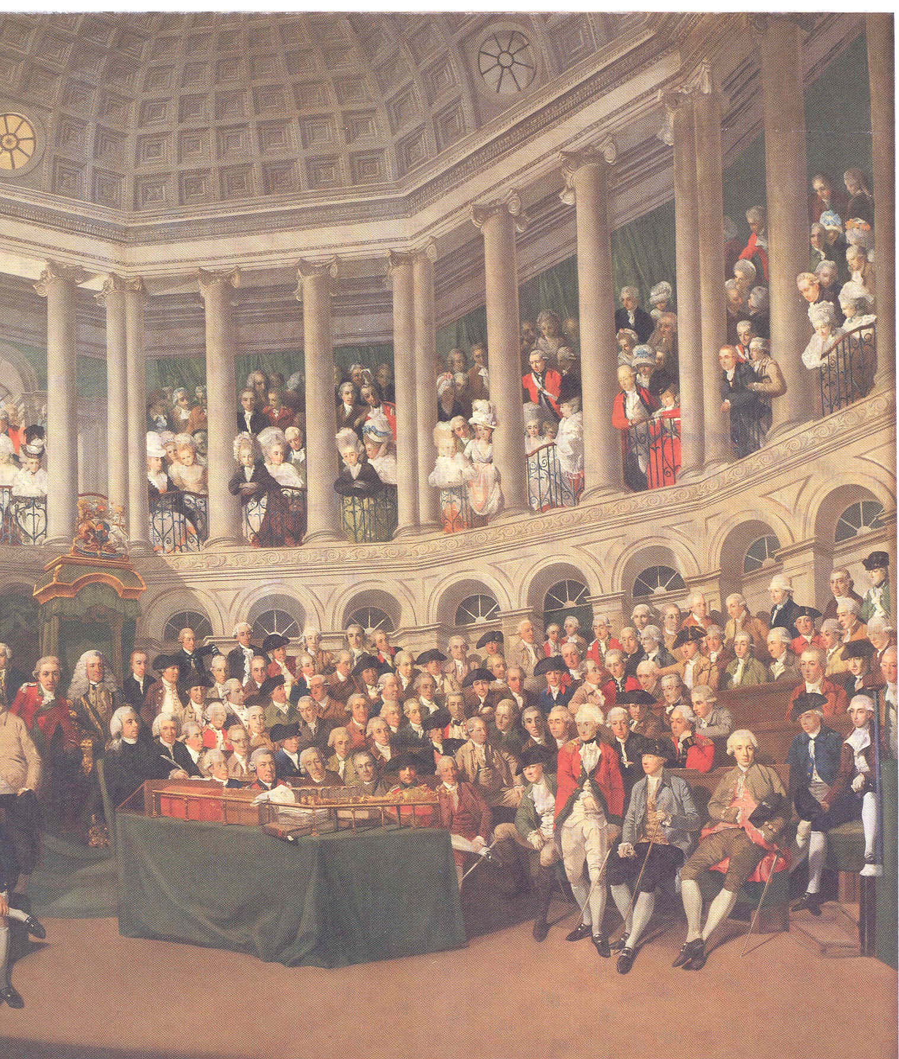
Irish Parliament 1780

Slide 3
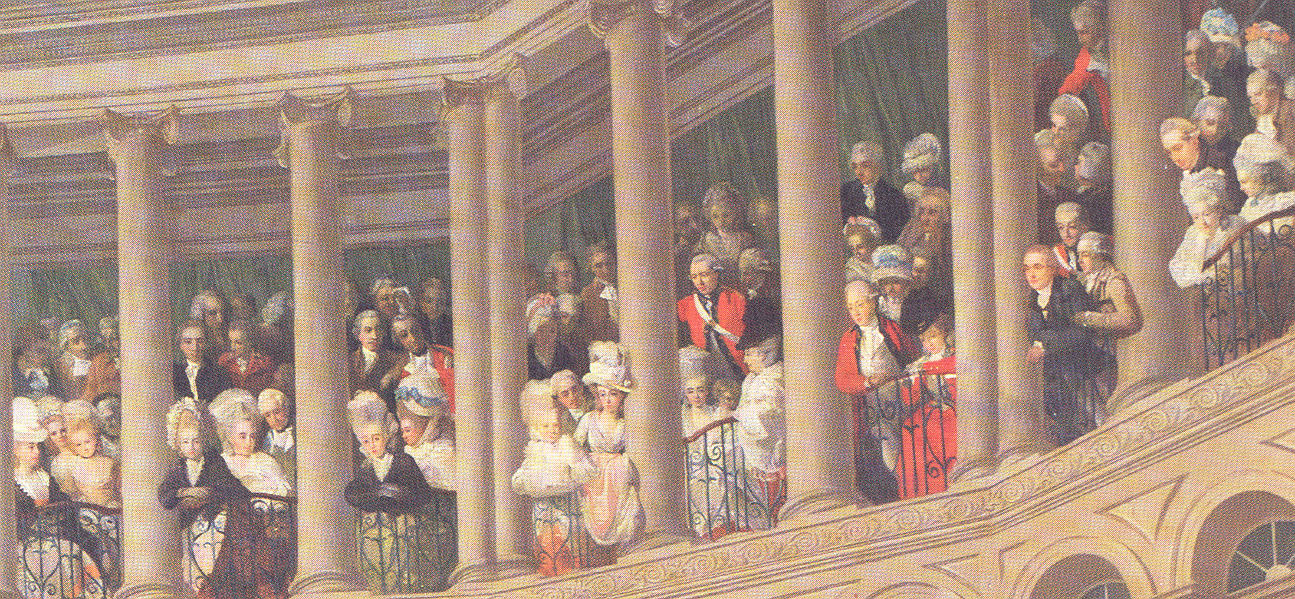
The front row of gallery reserved for women

Slide 4
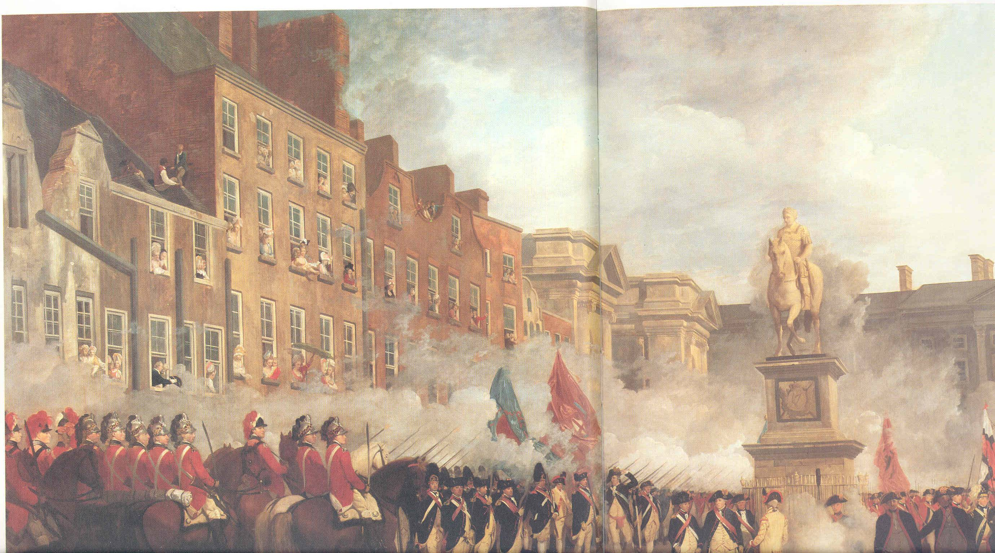
Irish Volunteers:
Local Militia During American Revolution
Evolved into Political Movement
More Independence for Irish Parliament
Women Supporters
Volunteer Military Review, College Green, Dublin 1781

Slide 5
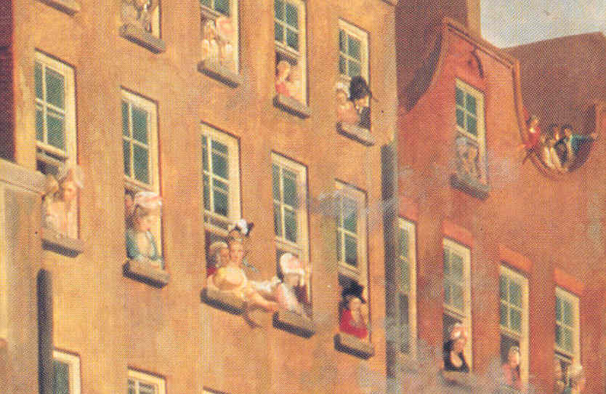

Slide 6
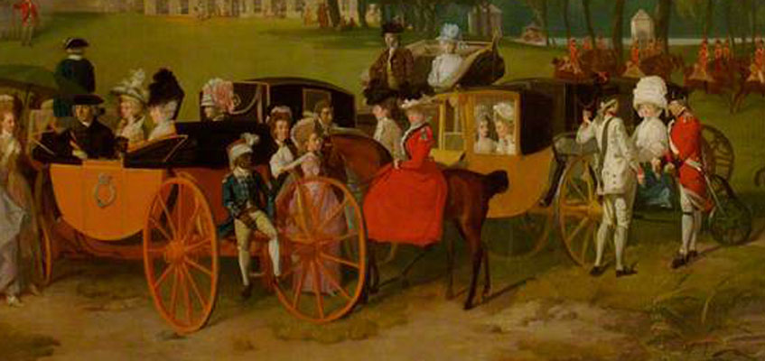
Women in Volunteer Uniform (Fashion or Political Statement)

Slide 7
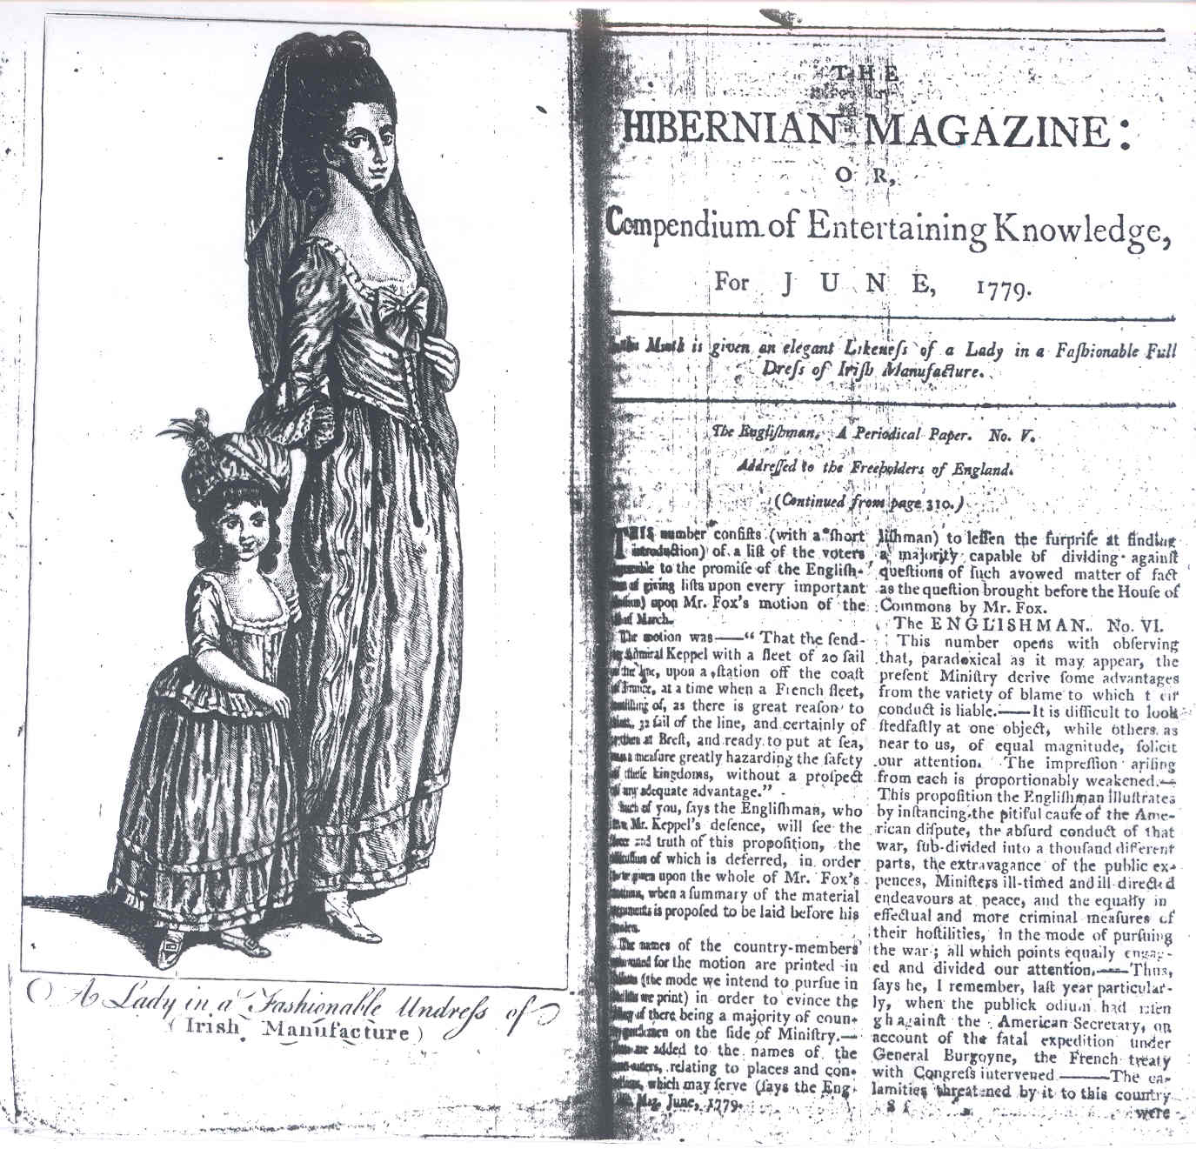
Volunteers: Improve Irish Economy
Buy Irish
Political Power of Women as Consumers
Newspaper Appeals to Wealthy Irish Women to Buy Irish Cloth

Slide 8
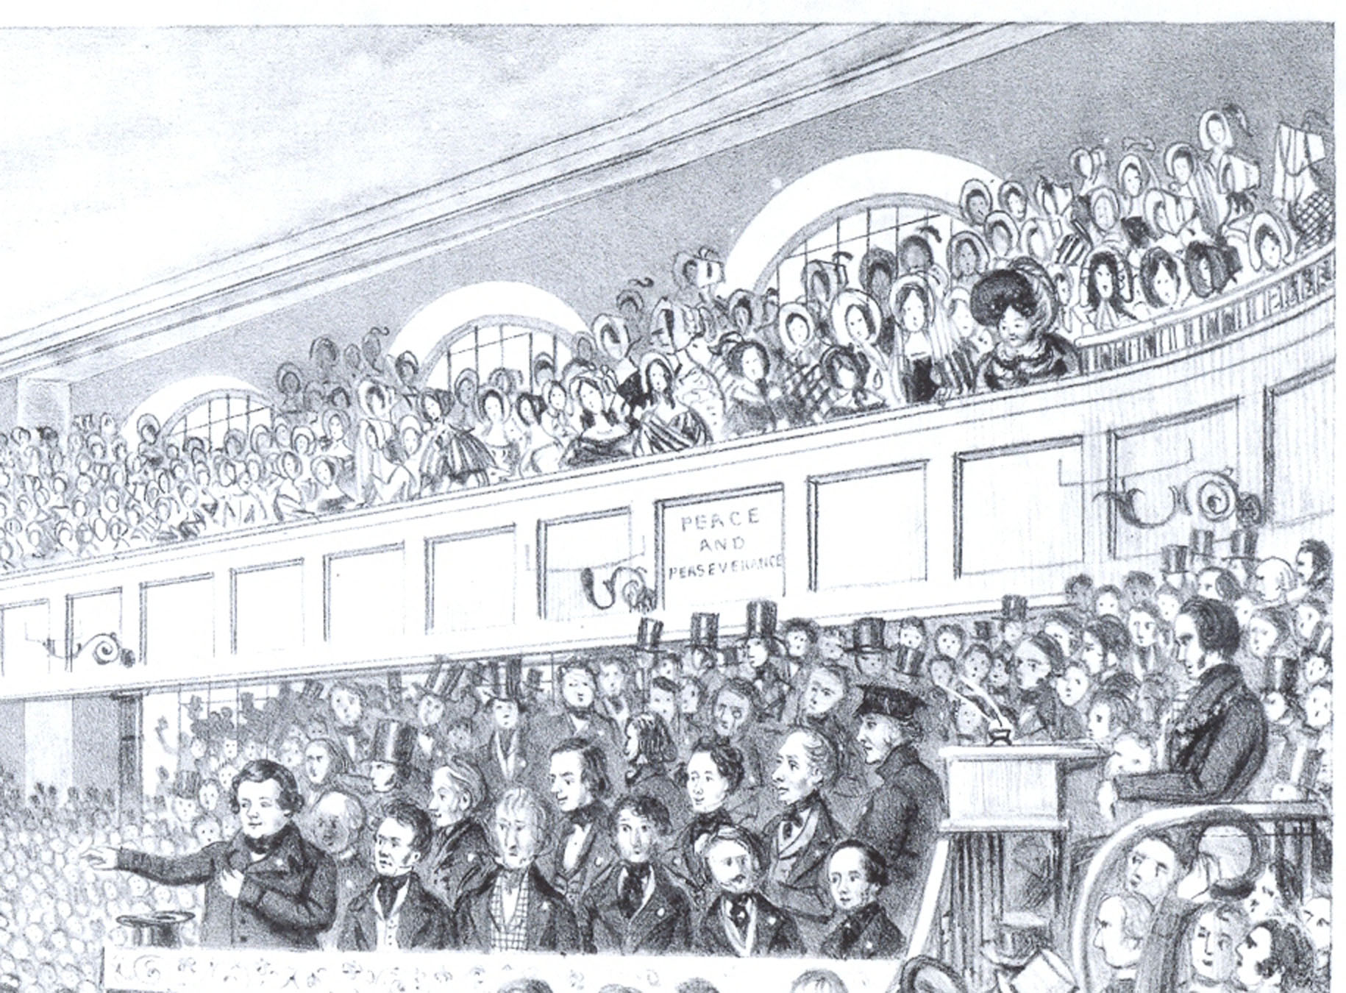
Daniel O’Connell’s Political Movement:
1820s-1840s
Mobilised Mass Movement
Women Very Involved
Gallery: Female Space

Slide 9
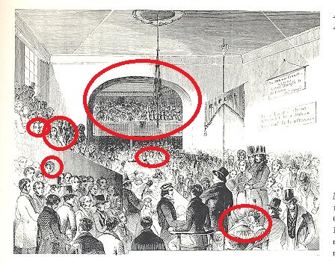
Repeal Association Meeting, Dublin 1843: Women Members
Women sat in the gallery and in the main chamber at a meeting of the Repeal Association in Dublin in 1844 (Illustrated London News)
Notes:
Women’s membership depended on how much money they raised
£2
£1
Women who contributed money –
The Pilot
10s or more

Slide 10
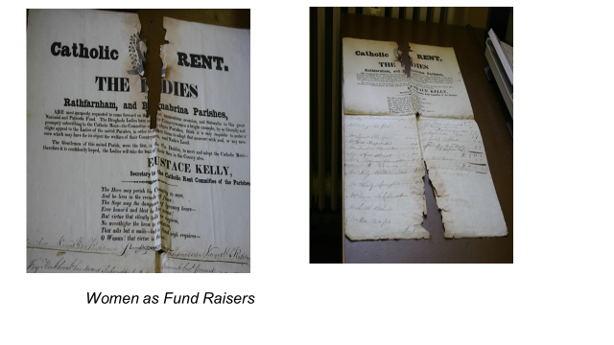

Slide 11
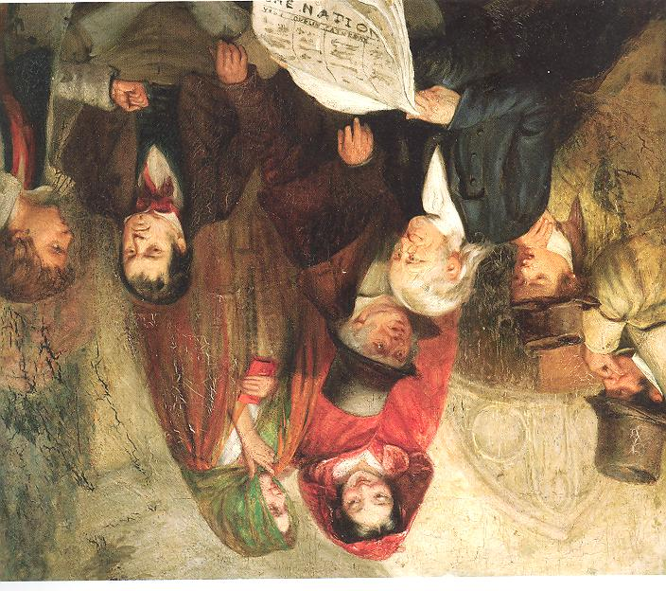
Women’s Limited role in Nationalist Movement 1840s-1880s
Write Political Verse
Raise Funds for Prisoners
Safe Houses
Female Role

Slide 12
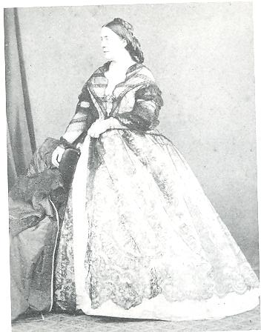
Ladies’ Land League in USA in the 1880s
President: Delia Parnell
Women Addressed Public Meetings in US
Raised Funds for Irish Tenants
1881: Charles Stewart Parnell and Michael Davitt arrested
Ladies’ Land League Founded in Ireland

Slide 13
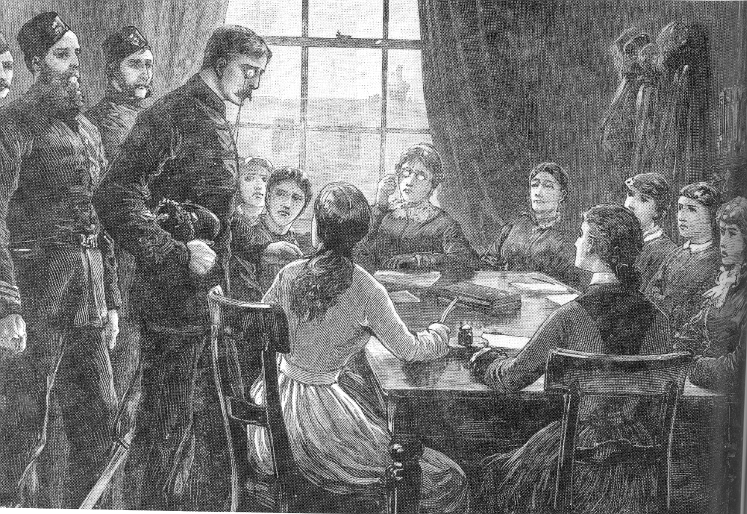
Ladies’ Land League Meeting

Slide 14
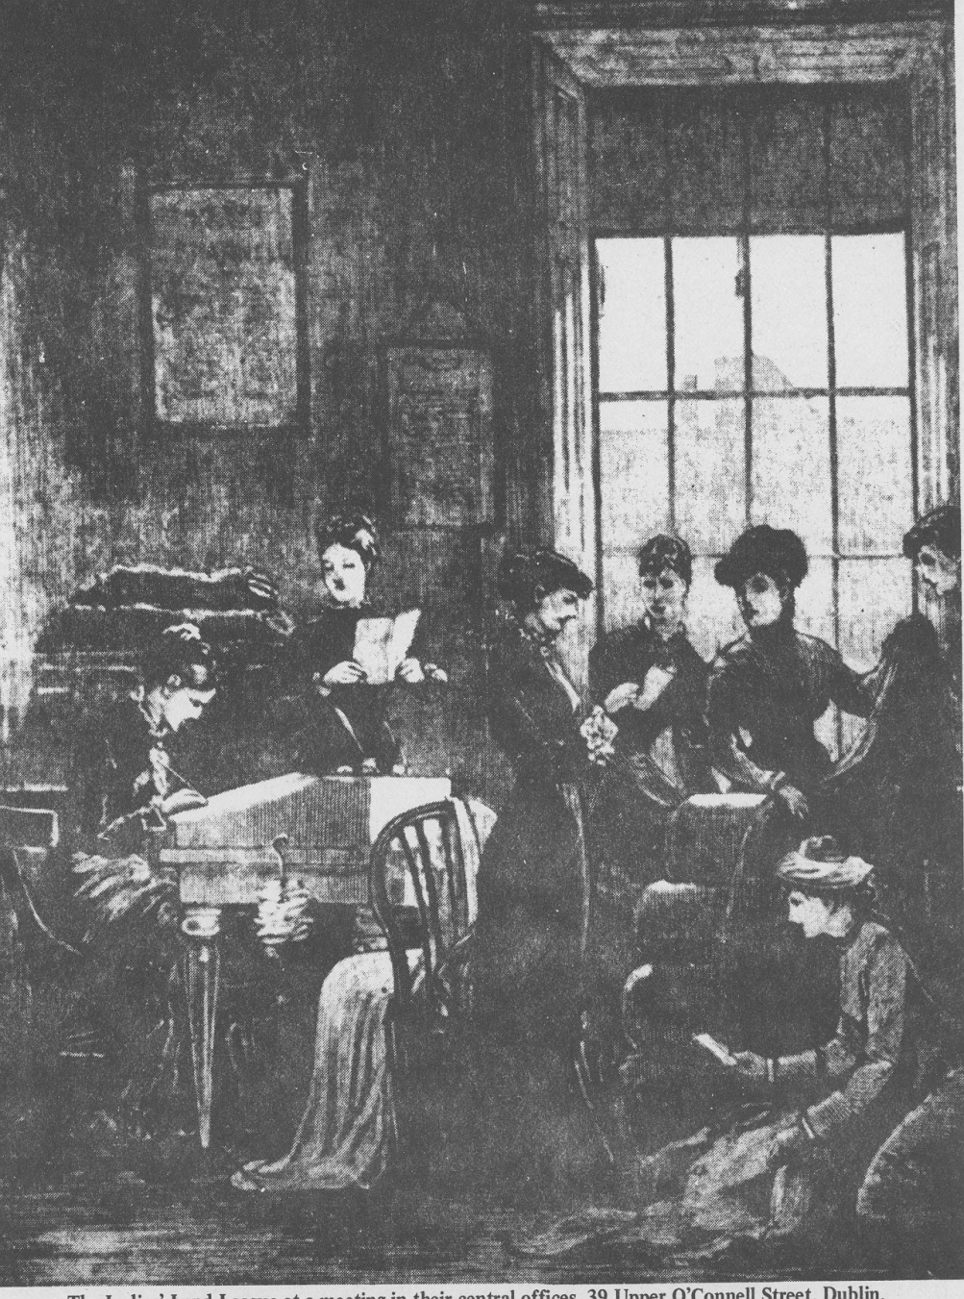
Ladies’ Land League

Slide 15
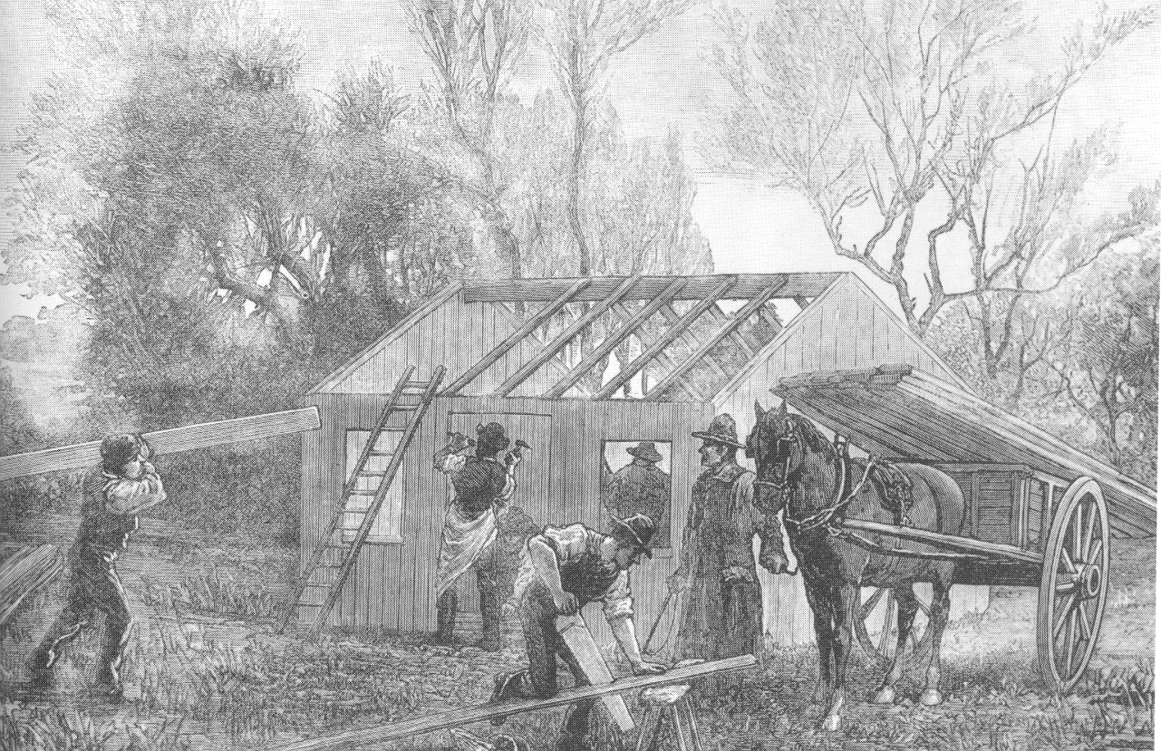
House Built with Ladies’ Land League Funds
Organisation Closed When Men Released from Prison

Slide 16
Home Rule Campaign Led by Charles Stewart Parnell and John Redmond
Opposed by Unionists in North and South
Ulster Unionist Council Formed to Coordinate Opposition
Ulster Women’s Unionist Council Founded 1911
(largest political organisation of women in Ireland)

Slide 17
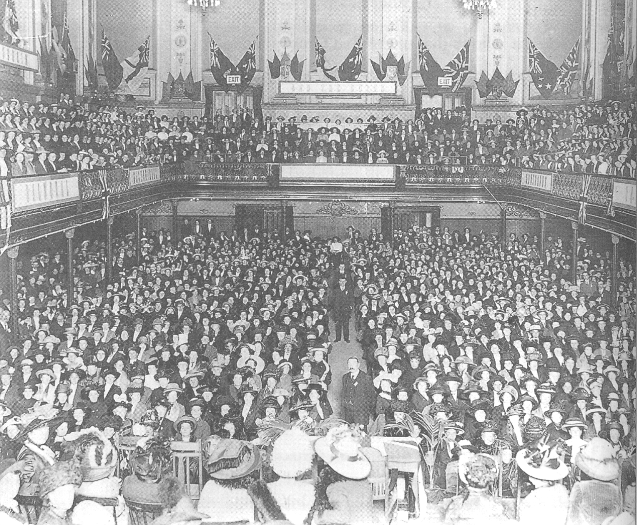
Meeting of Ulster Women’s Unionist Council, 1912

Slide 18
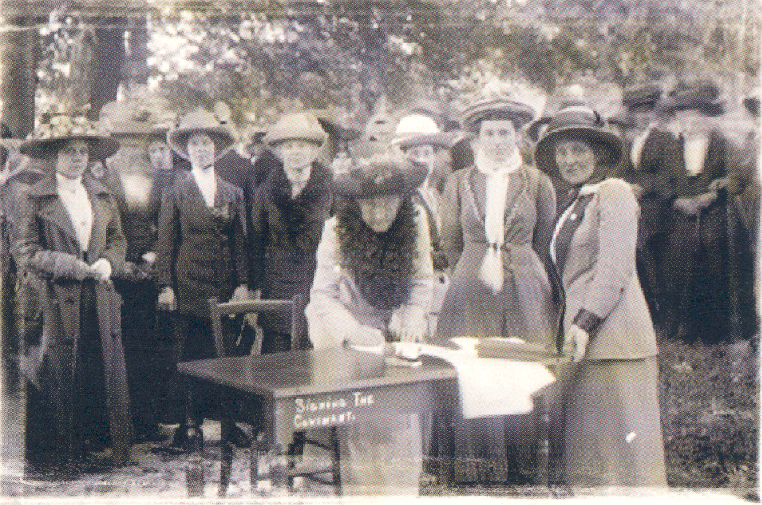
Ulster Day
28 September 1912
234,46 Women
216,206 Men

Slide 19
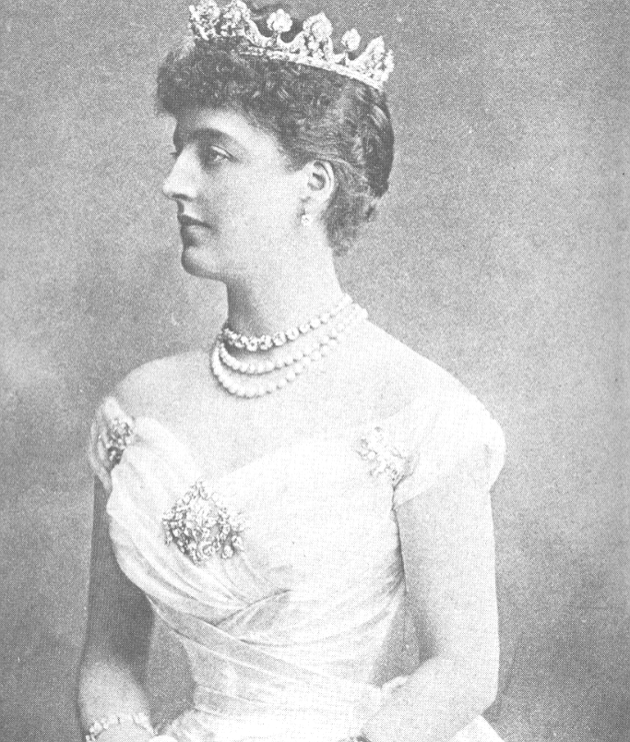
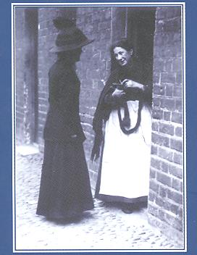
Aristocratic Women Acted As Leaders of Local UWUC Associations
Working Class Women Also Involved
Belfast Mill Workers

Slide 20
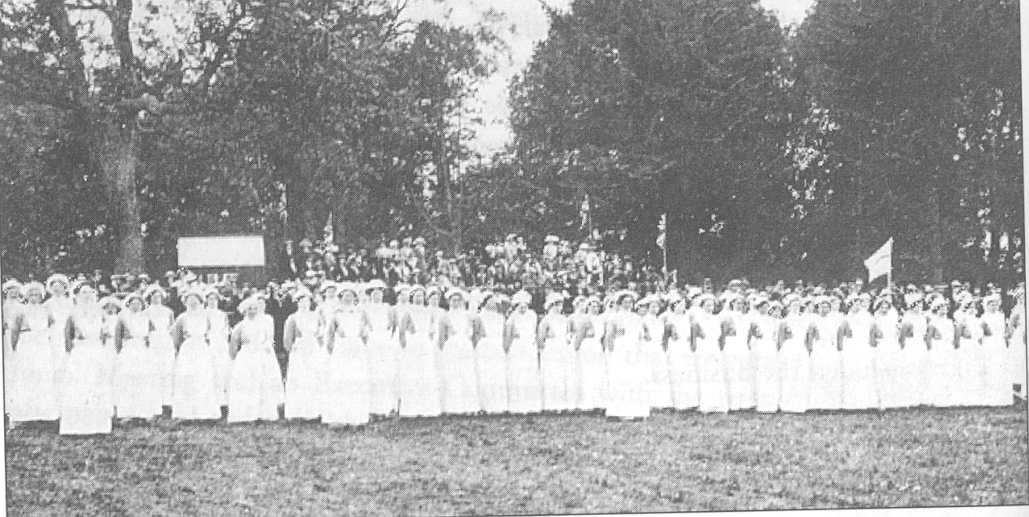
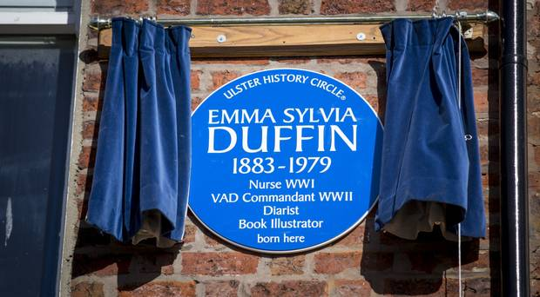
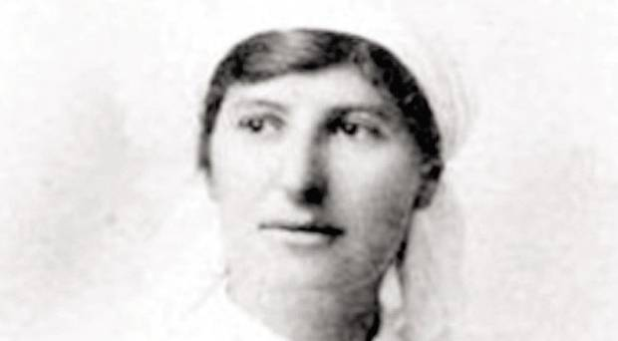
World War I (1914-1918)
War Work of UWUC
Funded and trained nurses

Slide 21
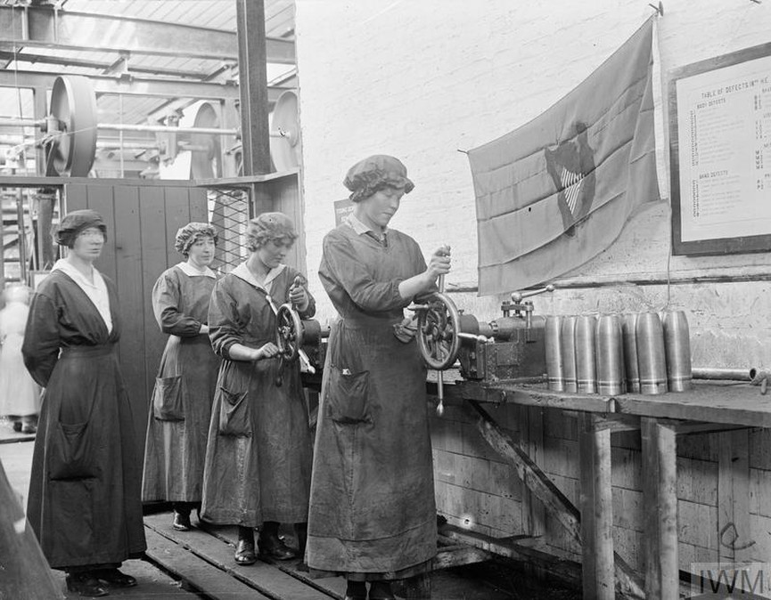
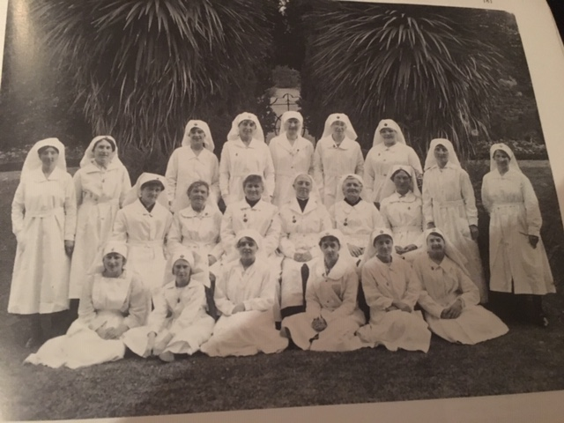
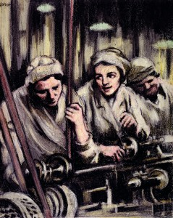
World War I (1914-1918)
War Effort in Ireland
Factories Producing Ammunition
Linen Cloth for Aeroplanes
Volunteer Organisations (nurses; collecting moss (Antiseptic))

Slide 22
Other Forms of Political Engagement
Campaigns Led by Women from 1880s for Women’s Rights in Politics, Property Rights and Education
Involvement with Church as Nuns

Slide 23
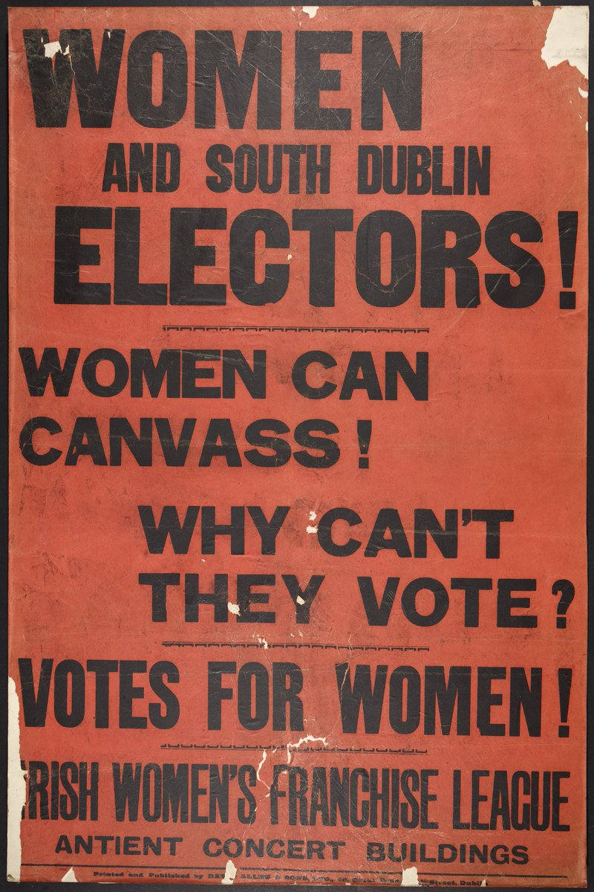
Women’s Associations Formed to Canvas for Parliamentary Candidates
Unionist Parties’ Women’s Groups
Legacy of Ladies Land League
Irish MPs Did Not Want To Form Another Women’s Association

Slide 24
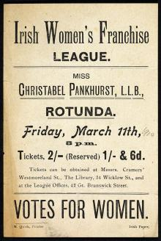
Suffrage
Different Groups Formed to Support Suffrage Movement
Influenced by growing militancy in British suffrage movement

Slide 25
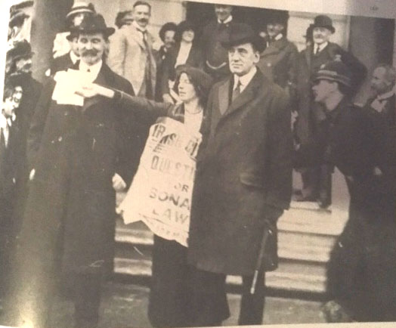
Adopt Tactics of English Movement

Slide 26
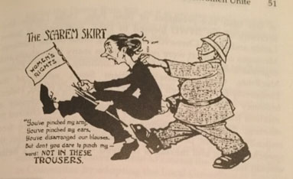
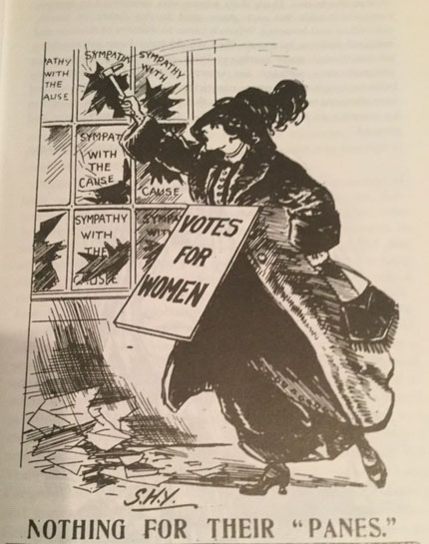
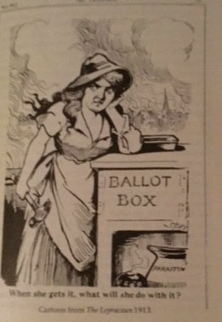
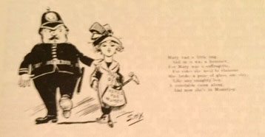
Hostility to the Irish Women’s Franchise League

Slide 27
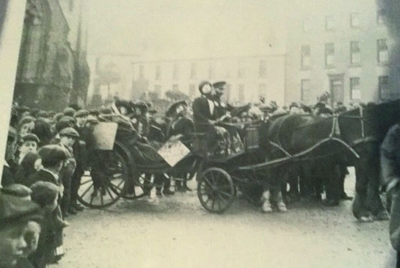
‘unwomanly’ and ‘unsexed’
Strabane, Co Tyrone c. 1910

Slide 28
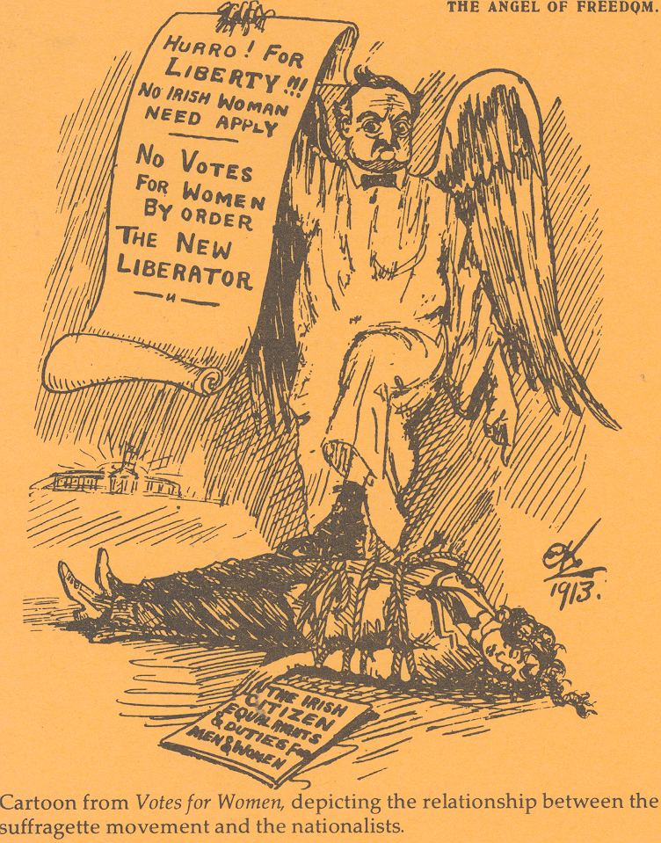
Hostility of Irish Parliamentary Party: Distraction from Home Rule Debate
Women Over 30 Granted Vote in 1918

Slide 29
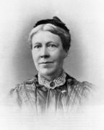
Example of Woman Campaigner (involved in different campaigns)
Isabella Tod (1836-1896)
Campaigned for:
Admission of Women to Queen’s University (1880s, 1890s)
Married Women’s Property Act 1880s
Women’s Suffrage (1870s-1890s)
Founded Liberal Women's Unionist Association

Slide 30
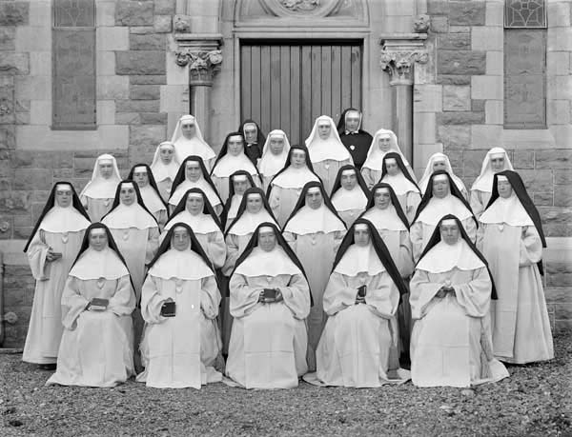
Increase in Infrastructure of Catholic Church In Post-Famine Ireland
Increase in Number of Priests
Increase in Number of Nuns
1800: 120
1850: 1500
1870: 3700
1900: 8000

Slide 31
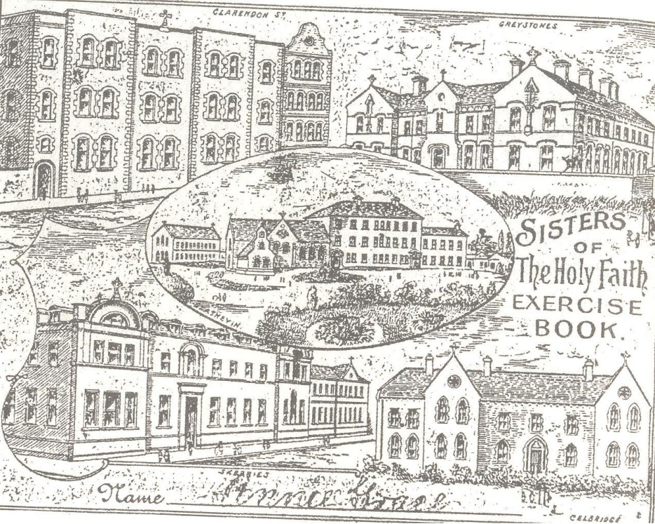
Physical Presence of Convent Buildings in Town Landscape: Buildings Funded by Catholic Merchant Families in Towns

Slide 32
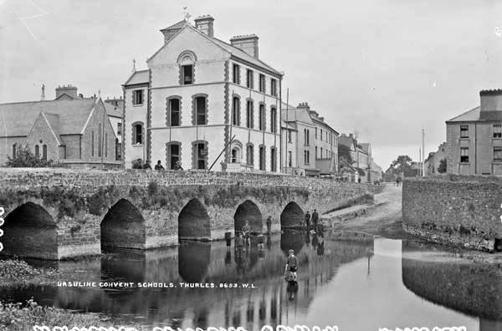
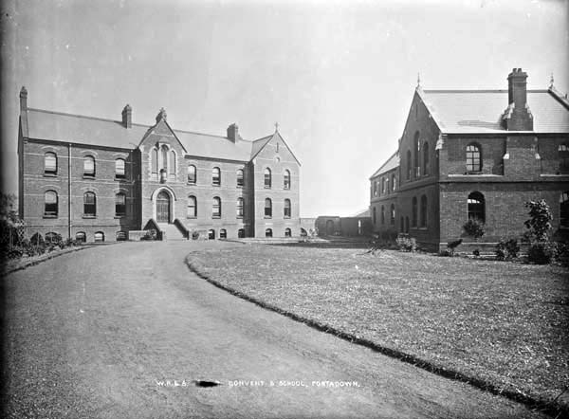
Ursuline Convent, Thurles, Co Tipperary
Convent Buildings, Portadown

Slide 33
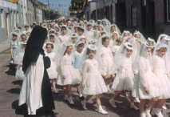
Devotional Revolution: Romanisation of Irish Church Practices after 1850
Nuns Essential for Spread
Cultural Power of Nuns
Spreading Middle Class Values Through Schools (embourgeoisement of Irish society)

