Slide 1
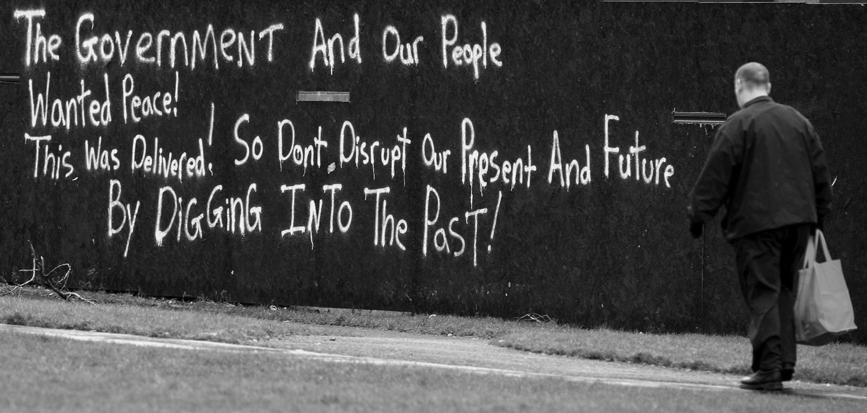
Irish studies summer school
RepresenTING THE TROUBLES IN museums
17 JULY 2019
DR MATTHEW JACKSON

Slide 2
AGENDA
Context – conflicting narratives of conflict
National Museum representation
Community displays
State display
Stalled Maze/Long Kesh proposals

Slide 3
1. CONFLICTING NARRATIVES OF CONFLICT
Contested past;
Commemorative vacuum – war by another means?;
Political articulation of narratives;
Unresolved past – problematic legacy issues;
‘Struggle over memory’
‘the complex negotiations and interventions that nudged the peace process forward faced resolutely away from attempting to confront or understand the past and towards the fantasy of a clean slate through vague but uplifting and often ingenious linguistic formulations that allowed all sides to feel good and claim victory…’
Tom Dunne, "Commemorations and 'Shared History': A different role for historians?" in History Ireland, no. 1 (2013), p. 11.

Slide 4
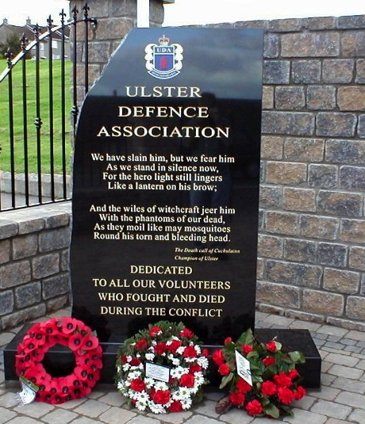
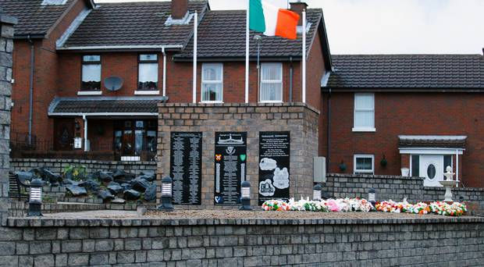

Slide 5
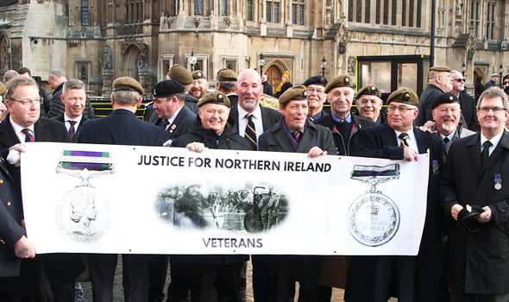
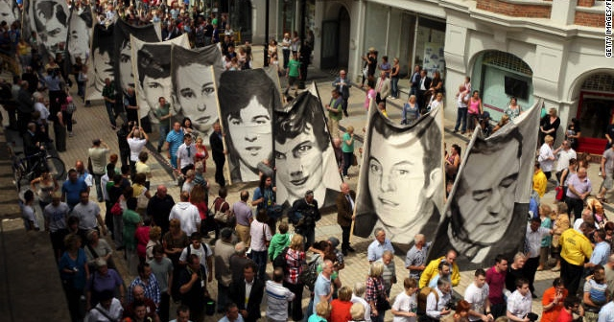

Slide 6
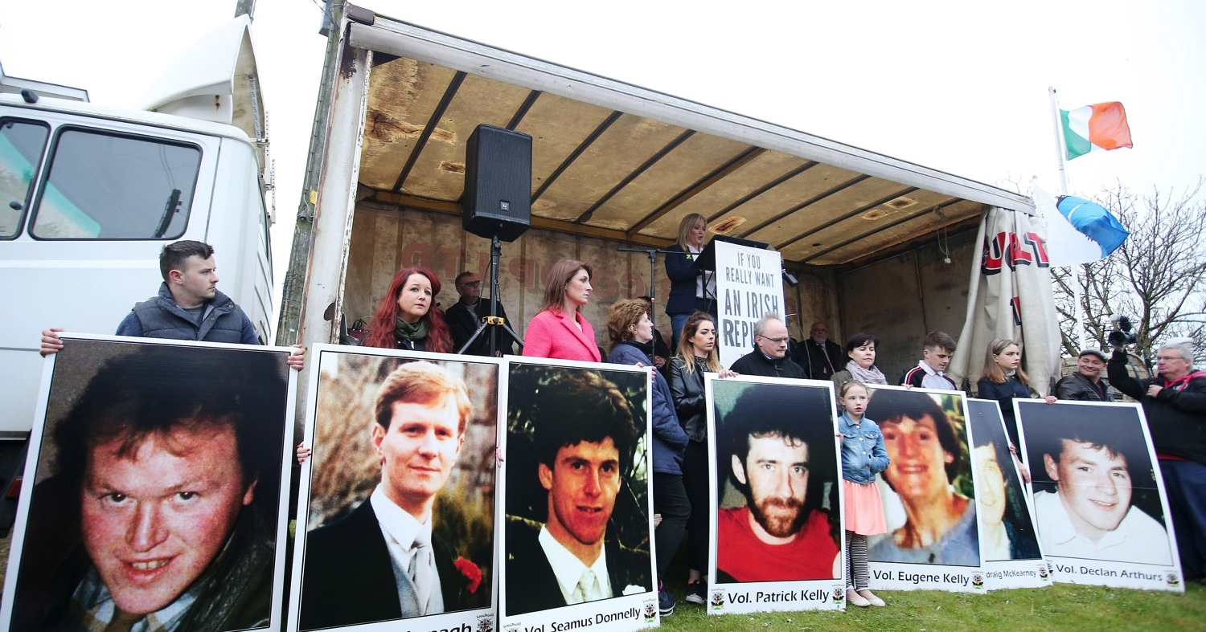
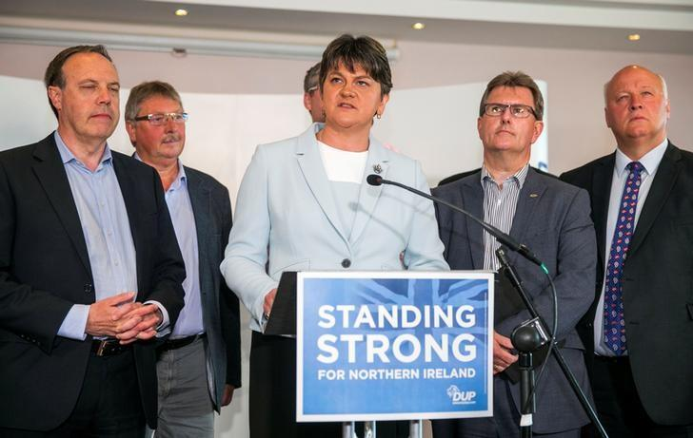

Slide 7
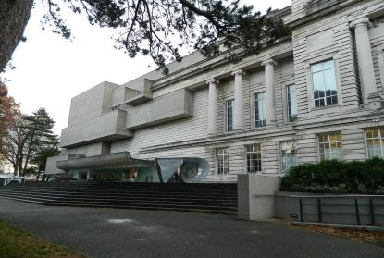
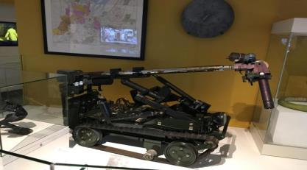
2. NATIONAL MUSEUM REPRESENTATION
The troubles and beyond exhibition (Ulster museum)
NI’s most prestigious history museum
NMNI - a non-departmental public body and is therefore:
  - Bound with NI Museums Policy
  - Charged with representing all communities in NI

Slide 8
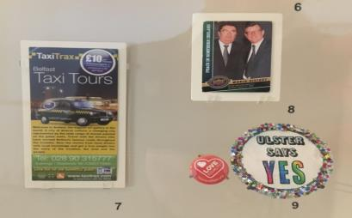
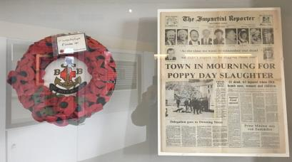
Troubles and Beyond exhibition opened in 2018
Chronological interpretation (1970s, 80s etc.)
Result of three year project ‘Collecting the Troubles and Beyond’
Challenging perspectives exist alongside one another

Slide 9
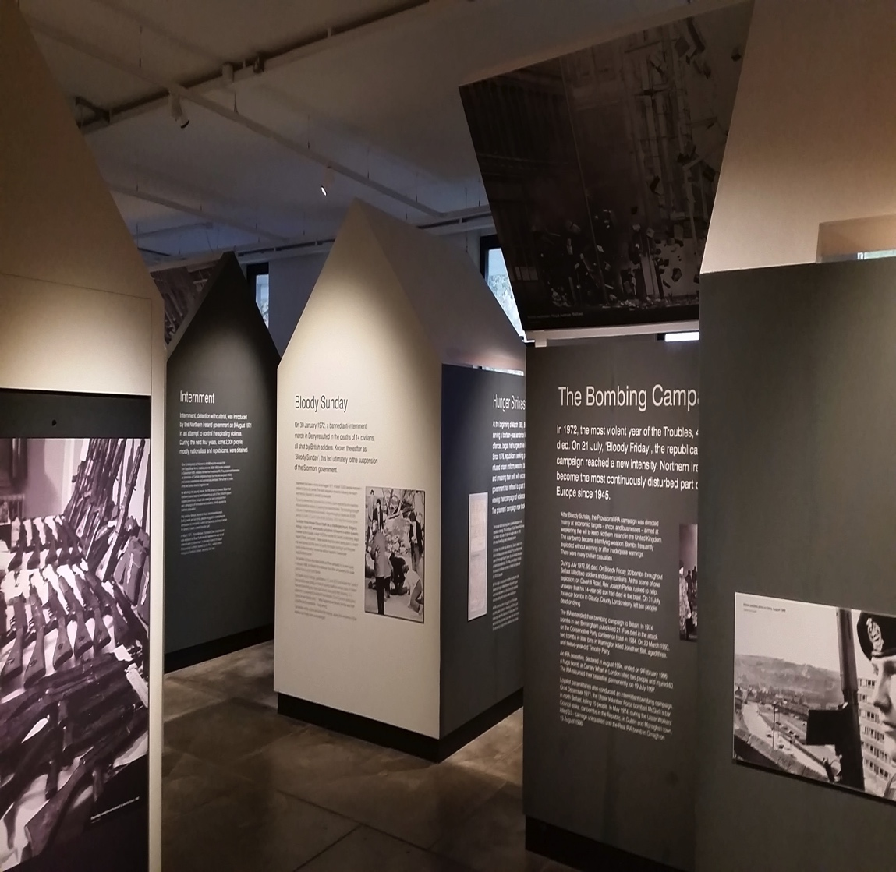
Replaced ‘The Troubles gallery’
Opened in 2009 – first permanent exhibition of the Troubles as a whole
Impartial + neutral reading
Reflective of tensions around confronting the past
Heavily at odds with contested nature of the Troubles and wider political/social/cultural landscape

Slide 10
3. COMMUNITY REPRESENTATIONS
Republican and loyalist interpretations
Seen as authentic / ‘real’ due to proximity to conflict-related incidents
Unapologetic
Non-sanitised
Subject to criticism of glorifying violence / retraumatising victims
‘Same acts of history viewed through different lenses’

Slide 11
Reflective of community + often personal experiences of conflict
Personnel involved include relatives of victims, ex-combatants, ex-prisoners, political representatives + community activists
Constructions of historical ‘Others’ (perceived enemies/aggressors/perpetrators of violence)
Projections of victimhood
Legitimisation of violence
Relationship with conflict tourism industry or ‘Troubles Tourism’

Slide 12
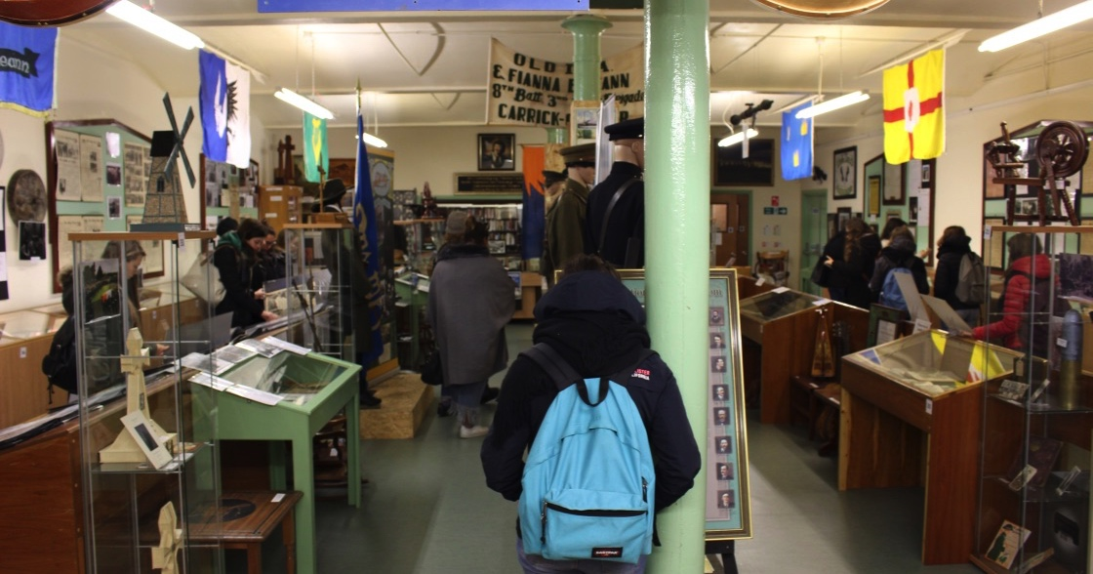
IRISH REPUBLICAN HISTORY MUSEUM
Presents the ‘various phases of the struggle for Irish freedom.’
Located off the Falls Road in West Belfast
Preferred reading of oppression and heroic struggle
Funded by private donors and donations by visitors
Dedicated to Eileen Hickey (imprisoned IRA ‘volunteer’)
Staffed by former prisoner

Slide 13
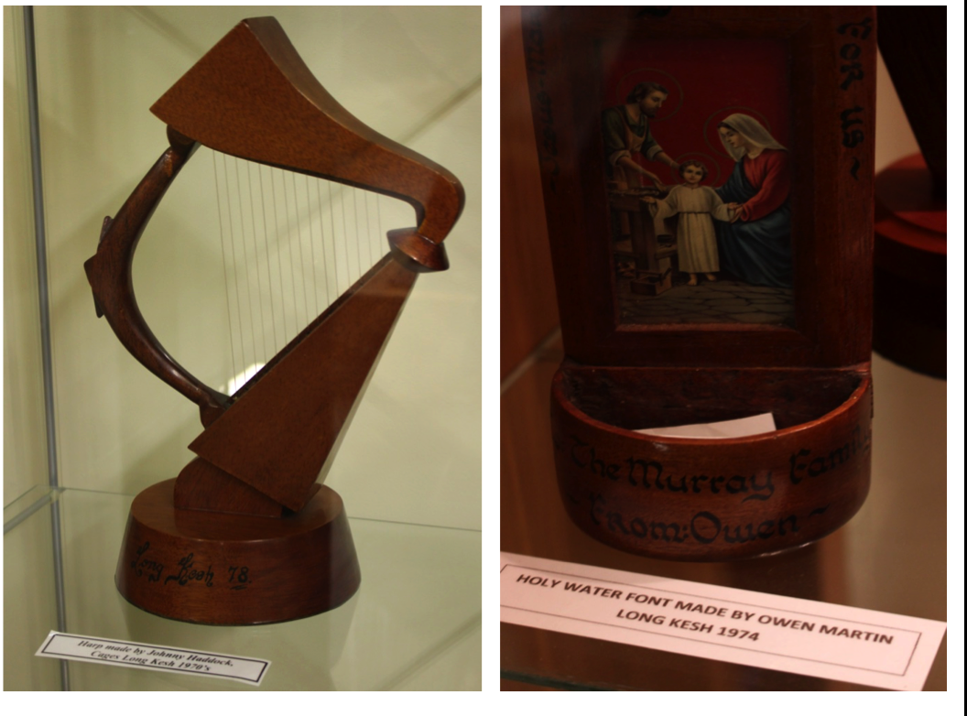
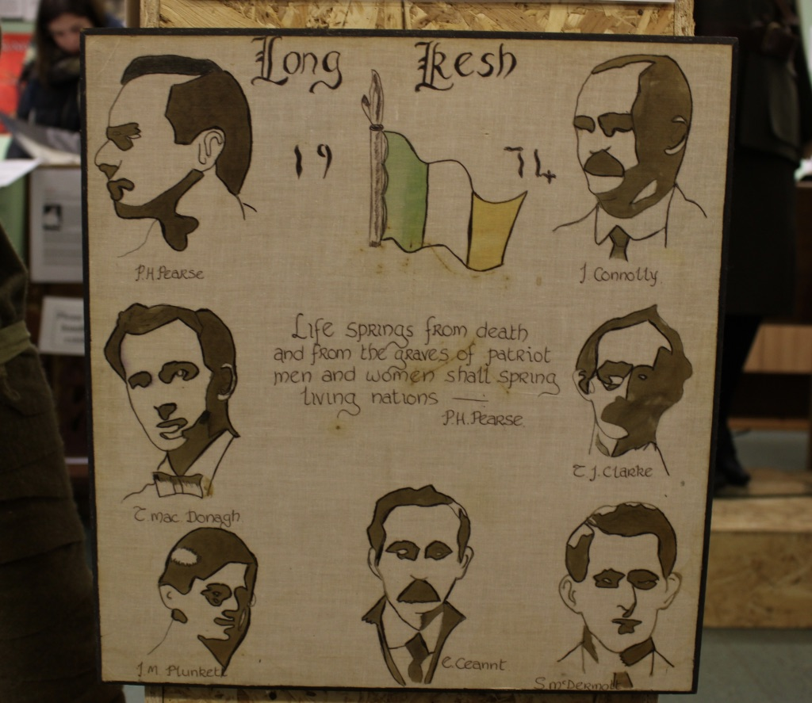
Prison handicrafts
Produced by republican prisoners
Display indicates:
commemoration/memorialization of those who produced them
continuity of struggle and sacrifice along with a fictive kinship across both time and space

Slide 14
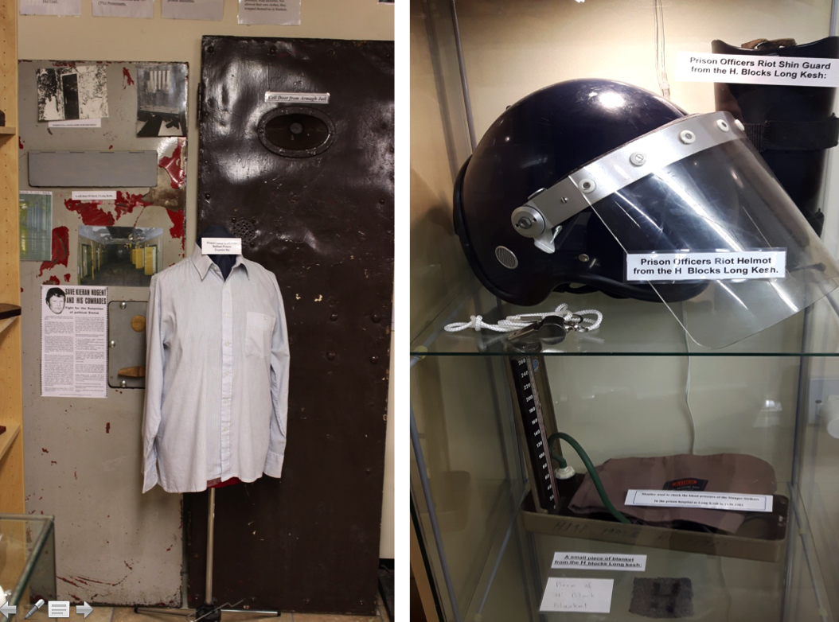
Infrastructural remnants and objects from Maze/Long Kesh Prison
Illustrate the centrality of prison experience
Ensure that messages around imprisonment, struggle and sacrifice endure
Contrast with ‘official’ polices of eradicating built heritage of Troubles

Slide 15
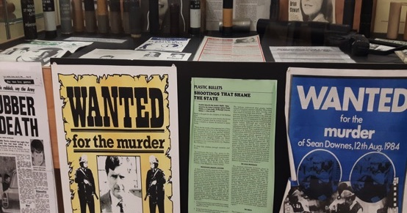
Display of rubber/plastic bullets
The use of rubber/plastic bullets by security forces remains deeply contested and controversial
Ongoing investigations into these killings (legacy issue)

Slide 16
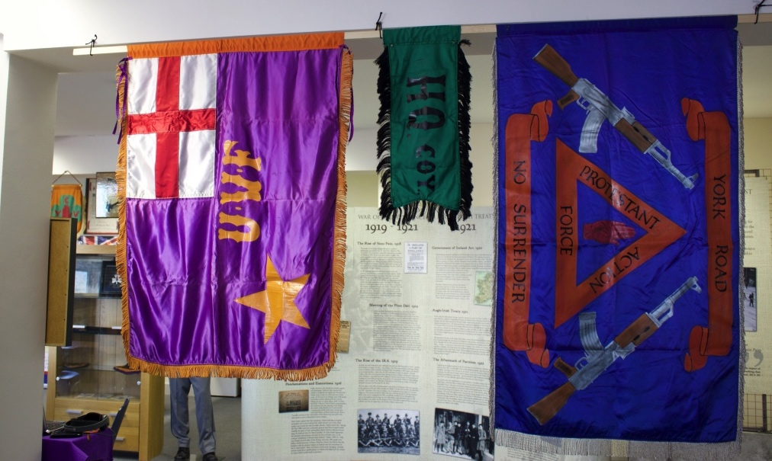
ACTION FOR COMMUNITY TRANSFORMATION (ACT)
MUSEUM - OUR JOURNEY—OUR NARRATIVE
Displays the major political developments which led to the creation of the Northern Ireland state, the social and political unrest that followed and the events which secured peace in NI
Located on Shankill Road
Preferred reading – loyalist combatants/prisoners were ordinary human beings + not criminals
Funded through peace organizations and grants
Staffed by a former prisoner

Slide 17
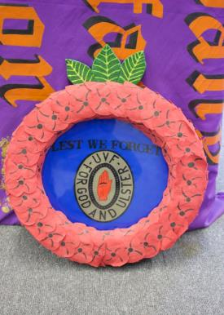
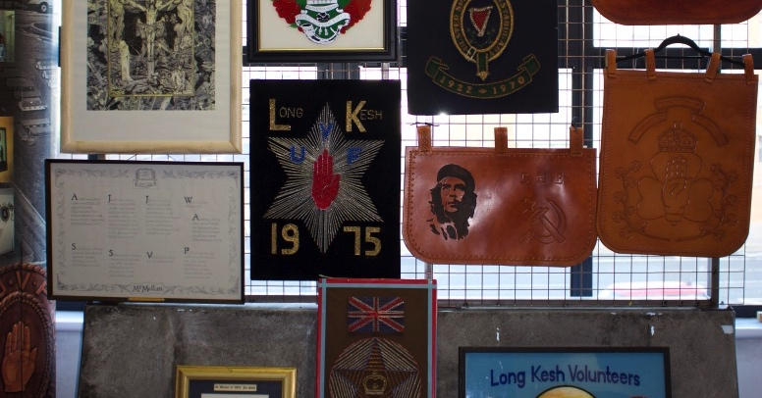
Prison handicrafts
Like republican museum, highlighting centrality of prison experience + commemoration/memorialization of those who produced them
Troubles part of a wider historical narrative that includes sacrifice of Ulstermen in World War I

Slide 18
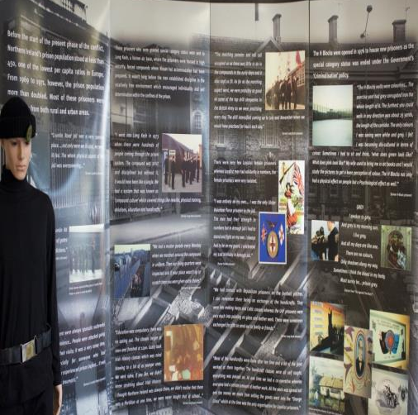
Exhibition text used to ‘humanize’ loyalist ex-combatants
“…the men who went to prison weren’t monsters who had no feelings or emotions…they are ordinary caring citizens.” (ex-prisoner)
“I was entirely on my own…I was the only Ulster Volunteer Force prisoner in the jail. The men had their strength in numbers but in Armagh jail I had to stand and flight on my own. I always had to be on my guard. I celebrated my 21st birthday in Armagh jail.” (ex-prisoner)

Slide 19
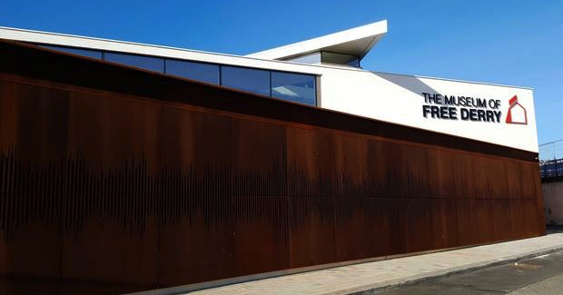
MUSEUM OF FREE DERRY
Established in order to tell the story of what happened in the city during the period 1968 – 1972.
Located in Bogside area of Derry City.
Preferred reading of victimhood + communal resistance
Majority publically funded (sets it apart from other non-state actor exhibitions)
Many of the staff lost loved ones on Bloody Sunday

Slide 20
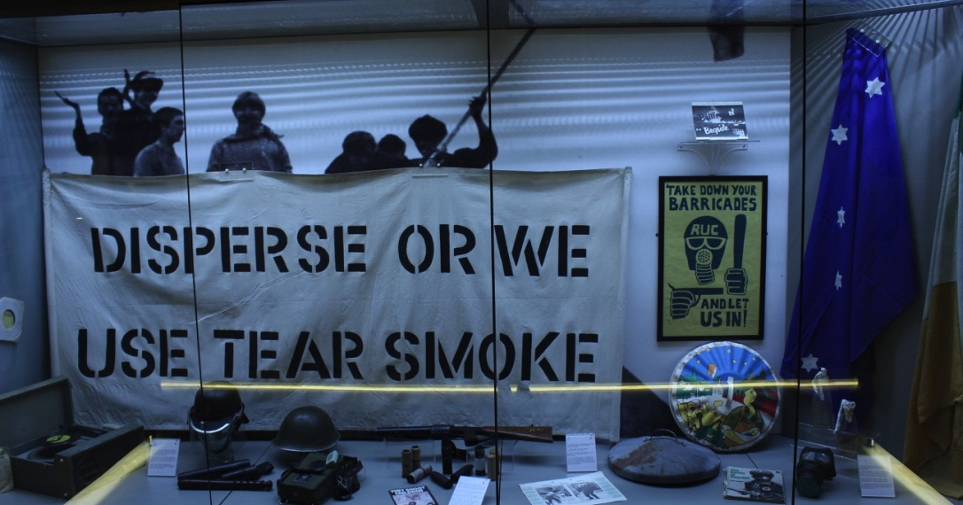
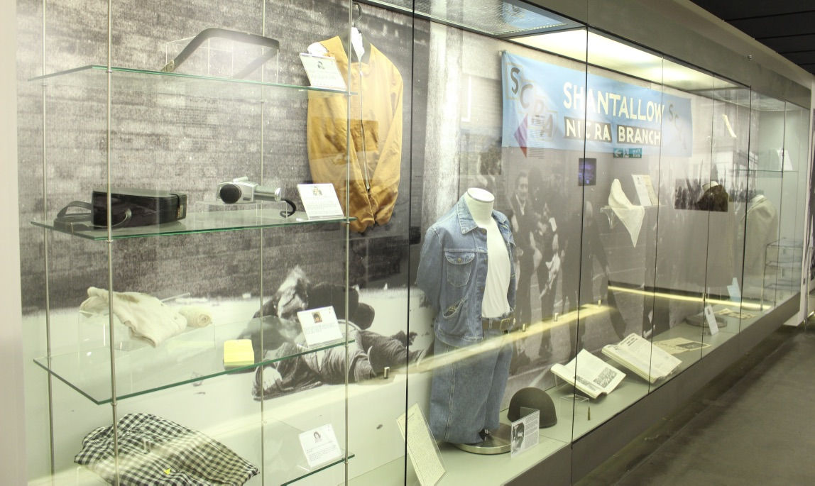
Rubber bullet gun, rubber/plastic bullets, CS gas etc.
Used present the RUC and the British Army as an oppressive force
Petrol bombs
Presenting protesters as heroic defenders of an embattled community
Personal belongings of Bloody Sunday victims
Communicate the ‘murderous kind of day it was’ (Michael Kelly – museum staff member)
Elicit empathy + identification with victims

Slide 21
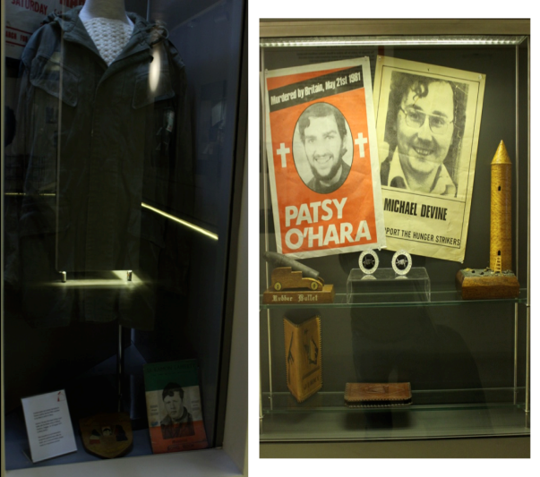
Commemoration/memorialization of republicans
Left – Combat jacket and jumper of Eamon Lafferty (PIRA ‘volunteer’) + commemorative plague
Right – Posters of Patsy O’Hara and Michael Devine (PIRA ‘volunteers’ + hunger strikers)

Slide 22
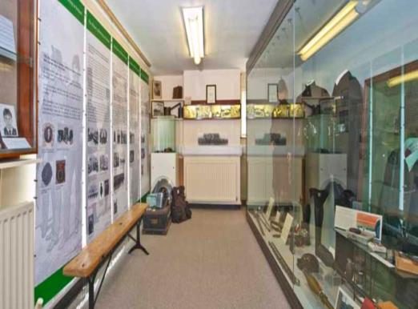
4. State displays
POLICE SERVICE MUSEUM
Located inside Castlereagh Police Station, the fortified headquarters of the PSNI in east Belfast
Preferred reading – RUC as having acted as an honest broker between two warring tribes
Administered by the PSNI
Debate over a new museum

Slide 23
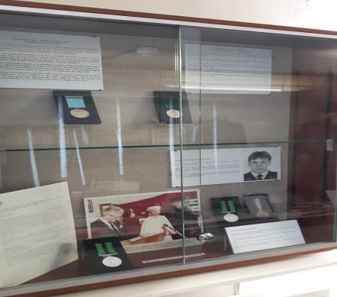
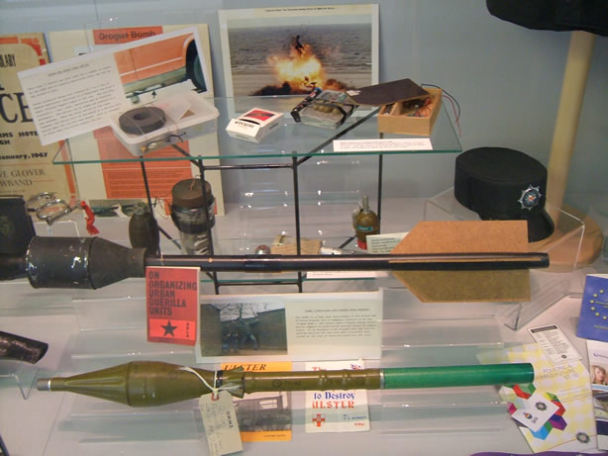
‘terrorist weapons used against the police over the years’ (PSNI)
Memorialization of RUC officers who lost their lives during the Troubles

Slide 24
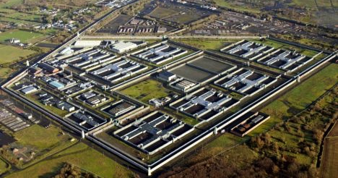
5. No ‘troubles Museum’ in NI
- MAZE/long kesh site proposal
Held over 10,000 republican and loyalist prisoners during conflict
Closely allied to republication narratives of the conflict
Closed in 2000 + majority of structure demolished

Slide 25
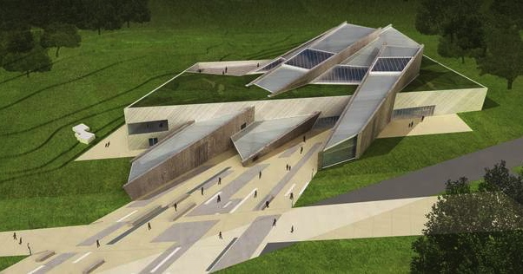
2010 – announcement of plans to build a Conflict Transformation Center
Initially received cross-party support, particularly between the DUP and Sinn Féin
Design by Daniel Libeskind + £18 million in EU funding
2013 – proposals collapsed
2019 – plans indefinitely ‘set aside’

Slide 26
Conclusion
Deeply contested past and fragmented commemorative landscape
Exhibitions displaying the Troubles attempting to:
  Tell ‘our’ story as experienced by ‘us’ or ‘our community’
  Represent the whole conflict in ways that allow visitors to draw own conclusions
Continuing conversation around the place, role and purpose of museums displaying the Troubles in NI

Slide 27
DISCUSSION & QUESTIONS
mjackson17@qub.ac.uk

