Slide 1
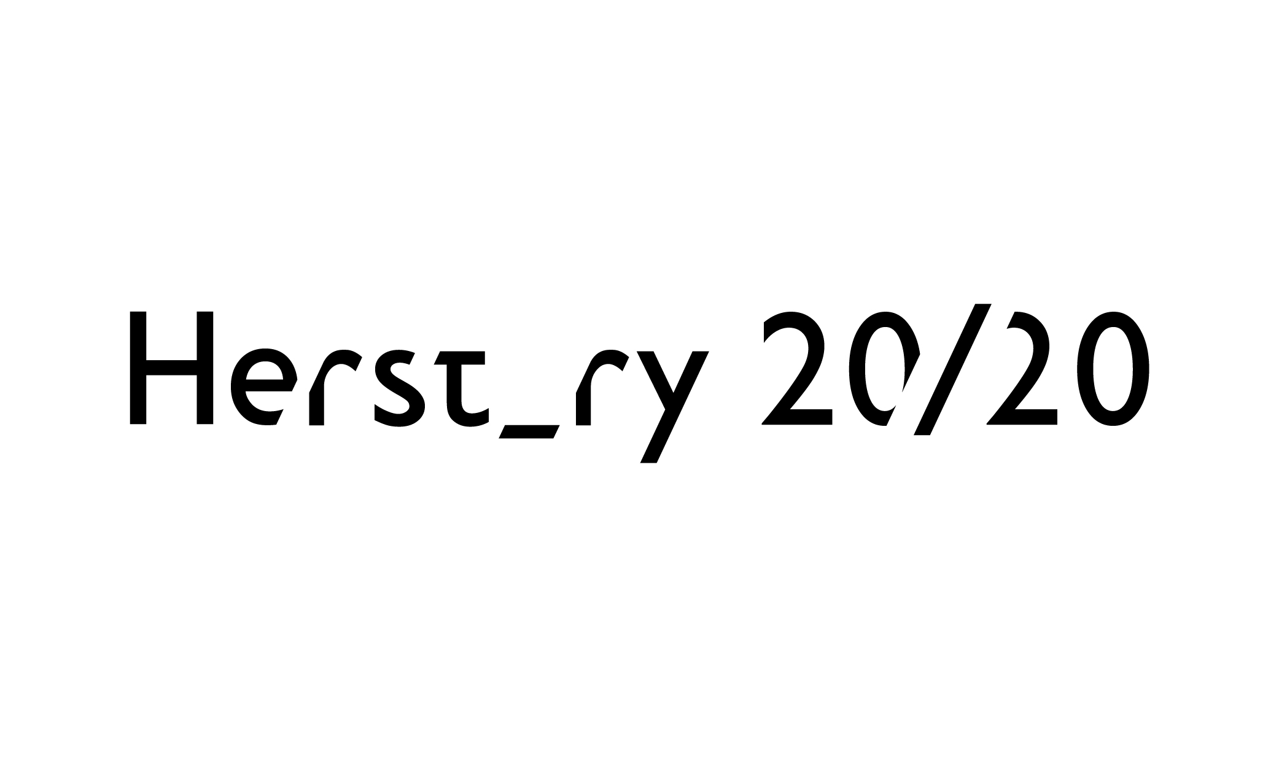
Queen’s Gender Initiative
WOMEN IN QUEEN’S PORTRAITS
#HerstoryRTE

Slide 2
Professor Elizabeth Meehan Artist: john kindness
Queen’s Gender Initiative
WOMEN IN QUEEN’S PORTRAITS
#HerstoryRTE

Slide 3
Mrs Brenda McLaughlin Pro Chancellor Artist: Comhghall Casey
Queen’s Gender Initiative
WOMEN IN QUEEN’S PORTRAITS
#HerstoryRTE

Slide 4
Professor Dame Ingrid Allen Artist: Tom Hallifax
Queen’s Gender Initiative
WOMEN IN QUEEN’S PORTRAITS
#HerstoryRTE

Slide 5
Professor Jean Orr Artist: Benita Stoney
Queen’s Gender Initiative
WOMEN IN QUEEN’S PORTRAITS
#HerstoryRTE

Slide 6
Professor Margaret Mullett Artist: Stephen Johnston
Queen’s Gender Initiative
WOMEN IN QUEEN’S PORTRAITS
#HerstoryRTE

Slide 7
Baroness May Blood Artist: Nicola Russell
Queen’s Gender Initiative
WOMEN IN QUEEN’S PORTRAITS
#HerstoryRTE

Slide 8
Professor Mary McAleese Artist: Carol Graham
Queen’s Gender Initiative
WOMEN IN QUEEN’S PORTRAITS
#HerstoryRTE

Slide 9
Professor Mollie McGeown Artist: Laurence Coulter
Queen’s Gender Initiative
WOMEN IN QUEEN’S PORTRAITS
#HerstoryRTE

Slide 10
Professor Edna Longley Artist: Jeffrey Morgan
Queen’s Gender Initiative
WOMEN IN QUEEN’S PORTRAITS
#HerstoryRTE

Slide 11
Professor Ruth Lynden-bell Artist: Jennifer Trouton
Queen’s Gender Initiative
WOMEN IN QUEEN’S PORTRAITS
#HerstoryRTE

Slide 12
“Out of the Shadows” commissioned (2000) Council Chamber, Queen’s University Belfast Artist: Michelle Rogers
#HerstoryRTE

