Slide 1
Year 3 GP Tutor Update
Dr Louise Sands
Year 3 2023/24
Notes:
Introduce ourselves and work contexts and why we love GP!

Slide 2
Need to know
Add your name and cypher code to the chat with your practice code to ensure SUMDE payment
Session is informal
Add questions/comments in chat
Feel free to interrupt to ask questions
Sharing the expertise of the group
Aim to finish by 4pm
Notes:
Familiar faces; introduce 2 Gp fellows

Slide 3
Objectives for this session
Share feedback from 22-23
Overview of Year 3 GP placement
Virtual Primary Care (VPC)
Assessment completion
Ideas for managing 6 students in practice

Slide 4
What did the students say? feedback highlights year 3 2022-23.docx

Slide 5
What “stood out” for students?
A lot of patients present with non-specific symptoms so for a GP to be able to quickly hone onto a couple of possible diagnoses is a brilliant skill.
How enthusiastic and welcoming the staff were
Getting an inside look into the running of a GP surgery and getting a feel for how GPs operate in their day to day was very interesting

Slide 6
What “stood out” for students?
GP - incredibly supportive, sensitive to my learning needs, fantastic teacher
The group discussions we had with our GP at the start and the end of the day to reflect on what we had learned.
interesting to look through patient electronic notes to understand the complexity of their situations

Slide 7
What “stood out” for students?
The extent to which social issues impact upon a patient's physical and mental health, and how it is part of a GPs job to understand and address this
The resilience of patients and how many complex co-morbidities patients in primary care can have
How to treat the patient rather than the condition(s)
How to hold a normal conversation with patient and not follow a scripted questionnaire in my mind

Slide 8
What did the students not enjoy?
Time spent at home preparing talk on pre-arranged topic
Too much time given to patient notes review for CBD
Travel time to the surgery

Slide 9
What did GP Tutors think?
Students well prepared, enthusiastic and engaged very well.
Excellent student presentations.
Students enjoyed taking unfiltered histories and presenting them.
Students have been motivated and have enjoyed practice time.
Students had improved awareness of role of GP and introduction to members of MDT.

Slide 10
What did GP Tutors want to know?
What ground rules the students have been given
How much clinical skills we should be teaching the students
More structured guidance on what is expected
More information on what I need to complete in the logbook
How to facilitate a small group.
What other tutors do/how they manage sessions

Slide 11
Aims of Year 3 GP Placement
For students to understand the structure, principles and practice of GP work, and how primary care is different from secondary care
For students to understand patients and their illnesses within all their complexity and social and cultural contexts

Slide 12
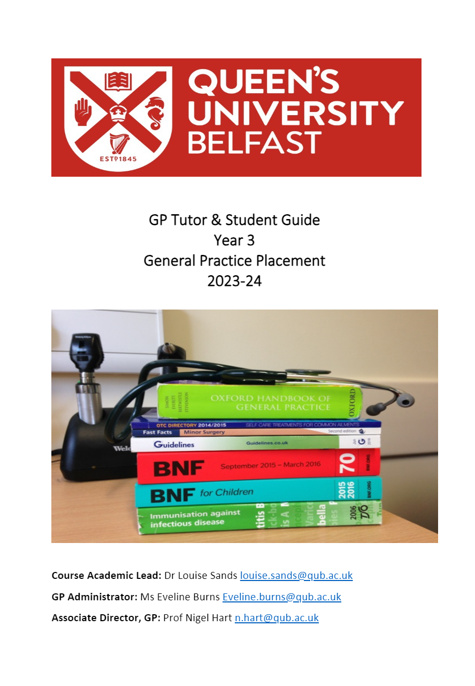
What you (and the students) need to know
GP Tutor and student guide available on the QUBGP web
https://www.qub.ac.uk/sites/qubgp/Curriculum/Year3GP/

Slide 13
https://www.rcgp.org.uk/getmedia/074af536-aaae-4eef-95cb-63ee18e96fda/learning-general-practice.pdf

Slide 14
Learning Objective Person-centred Care
The generalist clinical method
Holistic care (the biopsychosocial model)
The doctor-patient relationship
Long term conditions

Slide 15
Learning Objective Population Centred Care
Preventing disease and promoting health
Information technology
Teamwork and leadership
Medical ethics

Slide 16
Learning Objectives Effective Delivery of Care

Slide 17
What experience have these students had in GP in years 1+2?
Family medicine year 1 -ZOOM
Family medicine year 2 –F2F/remote
Clinical skills experience – F2F/remote

Slide 18
Year 3 GP placement
6 Wednesday mornings in your practice
Intro session week 1 LIC
via ZOOM- QUB
Review session week 14 LIC
via ZOOM - QUB
6 students per group
Students working in pairs or greater

Slide 19
Intro Session- what’s included?
Housekeeping
MyProgress
Meet the MDT
What to expect in GP
EPA/CBD/VPC

Slide 20
GP Practice- Email to students?
Time to be there
Practice location
Parking,bus,train
Who to meet

Slide 21
What will they do on GP placement?
Hot seating
Case Based Discussion
Virtual Primary Care
…and lots more!

Slide 22
Clinical Consultation
Home Visit
Telephone call
Face to Face

Slide 23
Remote consulting
Accuryx
Telephone

Slide 24
Sample timetable

Slide 25
Any thoughts?

Slide 26
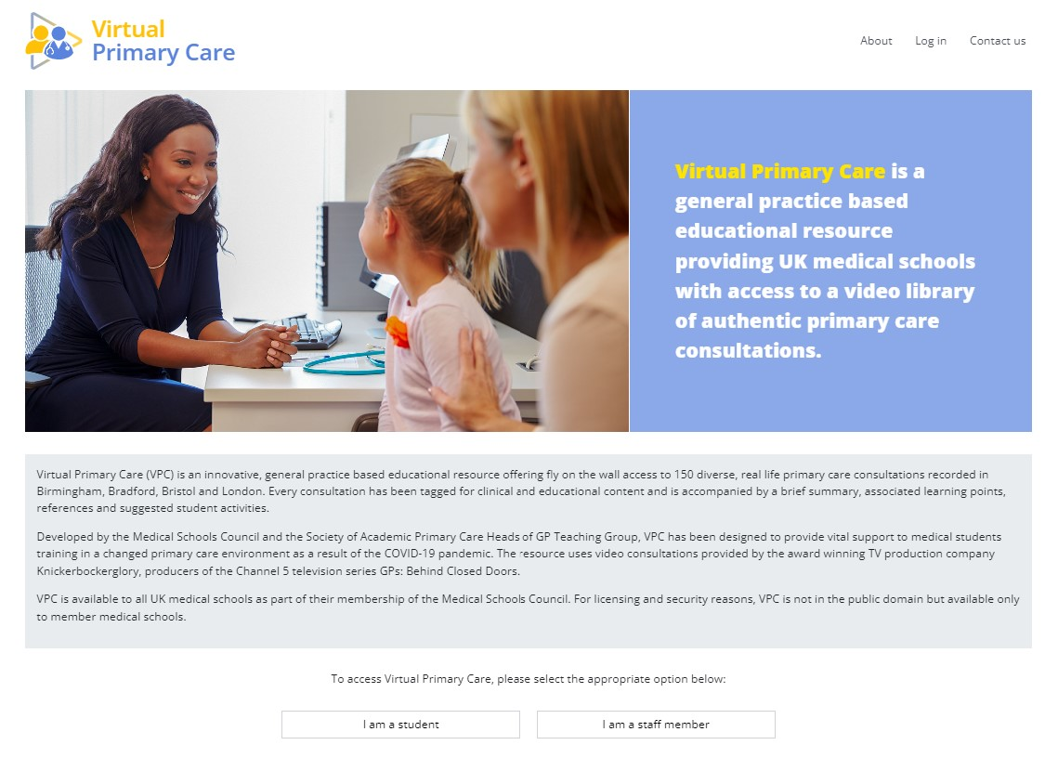
Virtual Primary Care
https://vpc.medicalschoolscouncil.org.uk/
Video tutorial
https://youtu.be/QaZSHEaRJz8?si=xqBiuAQREeVAwhuP

Slide 27
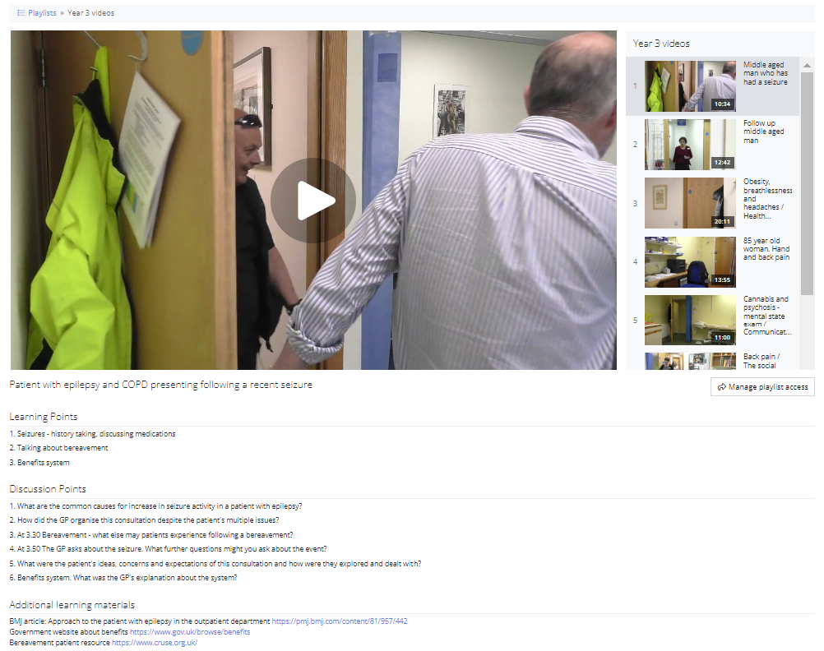
Virtual Primary Care - How best to use on GP placement?

Slide 28
Any thoughts?

Slide 29
Students and Home Visits

Slide 30
Home Visiting
Seek patient verbal consent in advance of the home visit
Agree time of visit and check who else will be in the home at the time/any animals?
Students should complete a home visit in a minimum of two
Check if students have their own transport or if it is within easy walking distance or can be accessed by public transport
Discuss specific tasks for home consultation

Slide 31
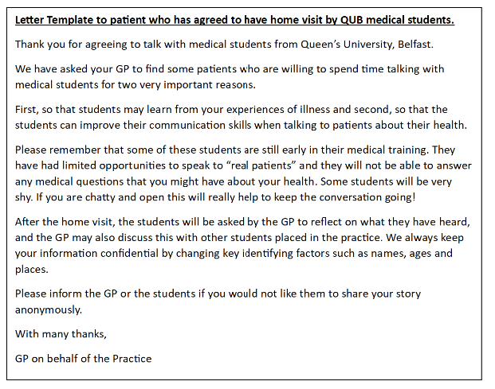
Home Visiting

Slide 32
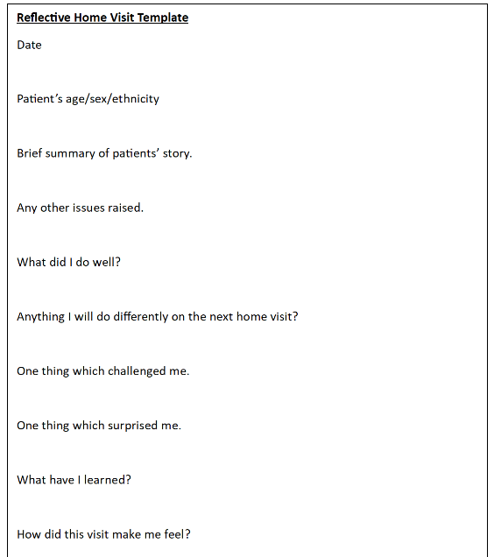
Home Visiting

Slide 33
Any thoughts?

Slide 34
MyProgress Video guide for Tutors

Slide 35
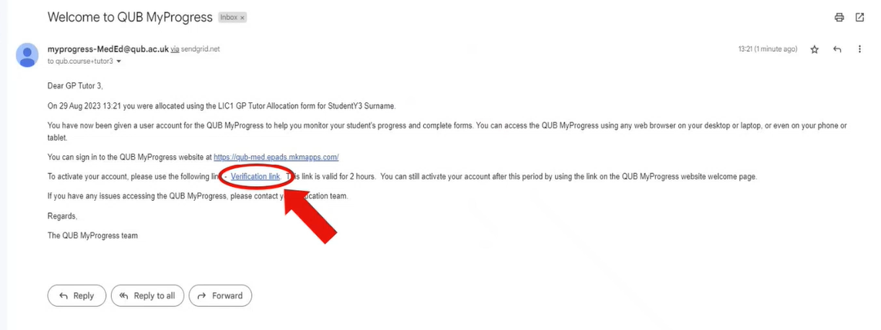
MyProgress

Slide 36
MyProgress https://qub-med.epads.mkmapps.com/#/

Slide 37
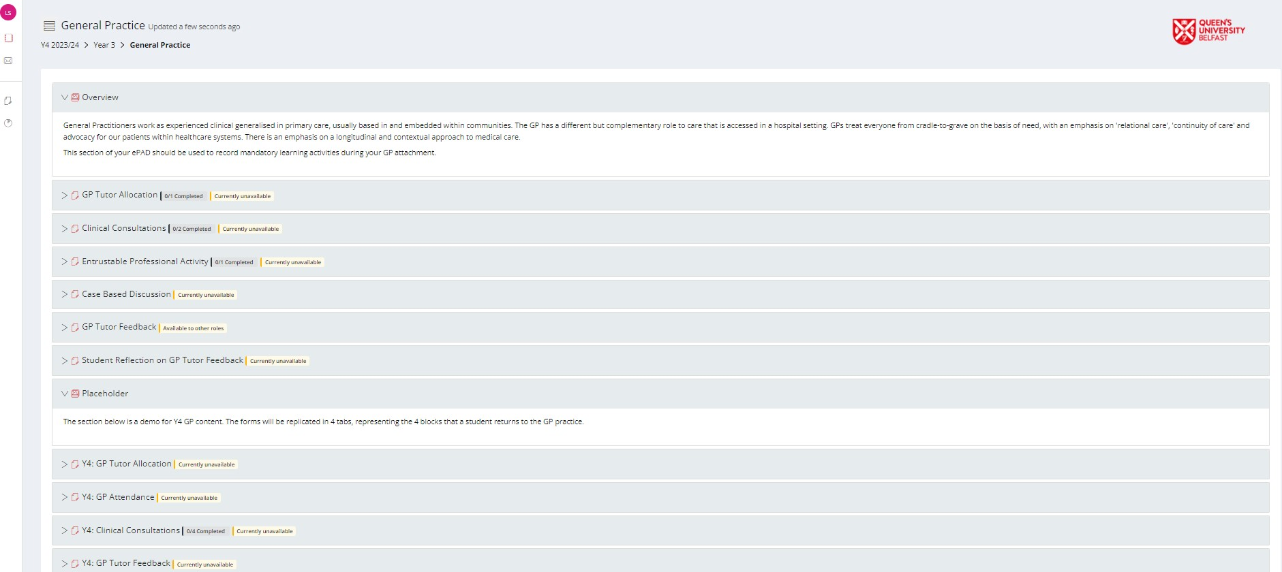
MyProgress Overview

Slide 38
What do they need to complete?
It is the student’s responsibility to ensure that all required elements of MyProgress are completed.
You must complete the GP Tutor Feedback at the end of the 6 week placement.

Slide 39
What must each student complete?
Clinical Consultations – 2 needed
Case-based Discussion (CBD) - 1 needed
Entrustable Professional Activity (EPA) – student self-rates at start and at some later point in placement
Student Reflection on GP Tutor Feedback (student completes after GP sign off)

Slide 40
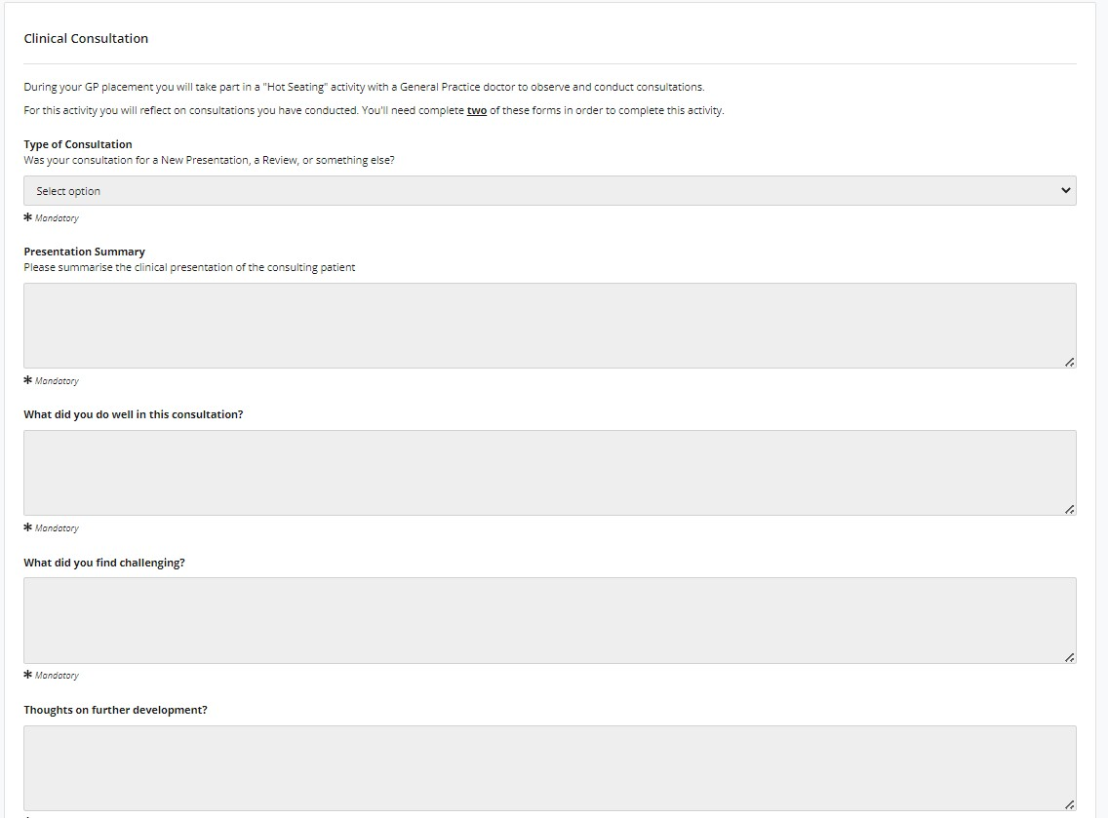
Clinical Consultations x2

Slide 41
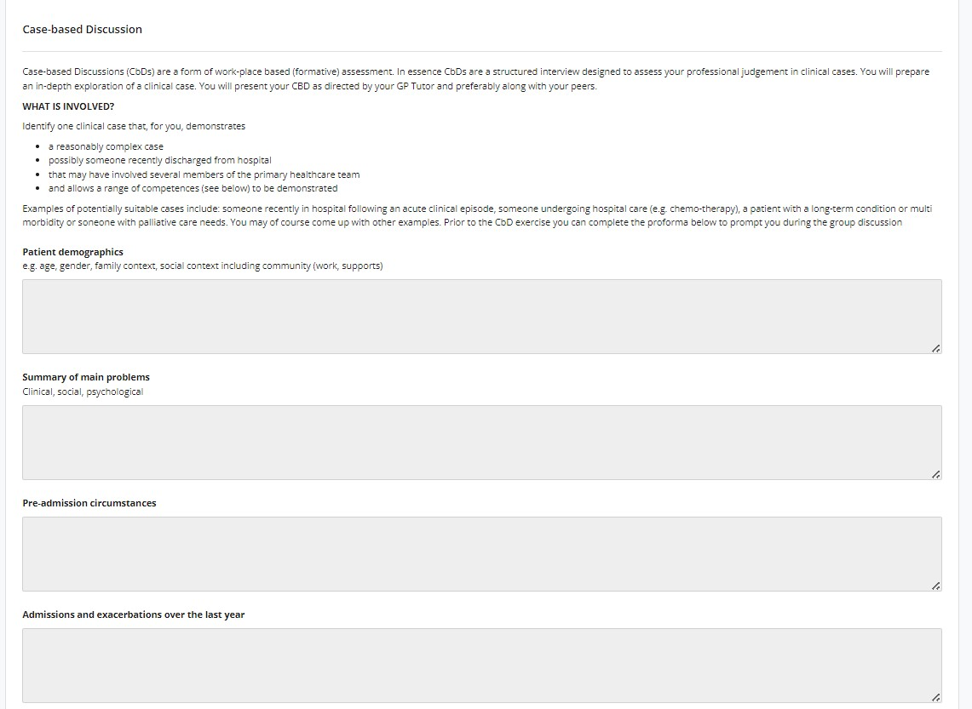
Case based Discussion x1

Slide 42
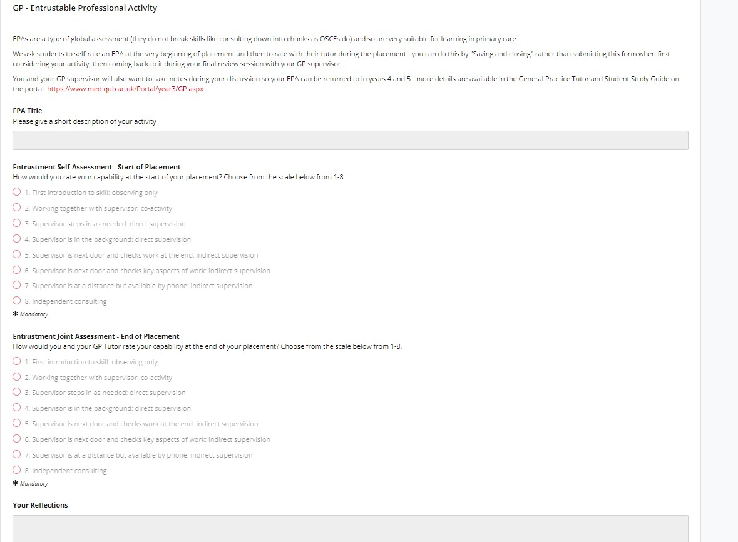
Entrustable Professional Activity (EPA)

Slide 43
Entrustable Professional Activity (EPA) Scale
1 First introduction to skill: observing only
2 Working together with supervisor: co-activity
3 Supervisor steps in as needed: direct supervision
4 Supervisor is in the background: direct supervision
5 Supervisor is next door and checks work at the end: indirect supervision
6 Supervisor is next door and checks key aspects of work: indirect supervision
7 Supervisor is at a distance but available by phone: indirect supervision
8 Independent consulting

Slide 44
What does GP Tutor complete?

Slide 45
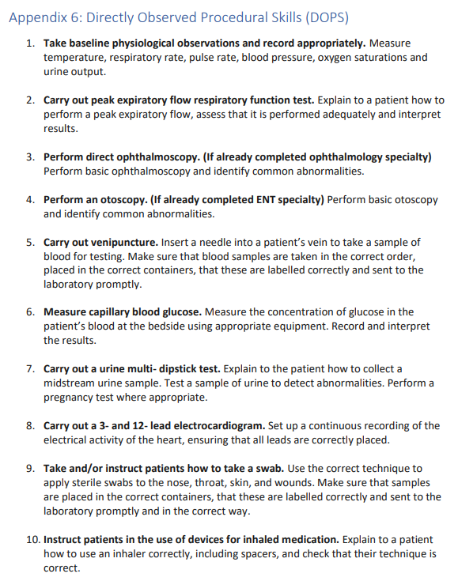
Optional DOPS activities

Slide 46
Any questions?

Slide 47
You are the experts!
What activities work well – How can we share as a group?
Are there other learning opportunities in the locality that you can use?
“Spread the word!”
Sharing feedback between semester 1 and 2

Slide 48
Thank you for your support of our QUB students

Slide 49
Dingbats
Can you re-arrange the following medical anagrams:
Luscious Bert _______________________
(Clue: infectious disease)
Irish tart ___________________________
(Clue: chronic condition)
Tibia tonics __________________________
(Clue: prescription only)
Aorta clamp __________________________
(Clue: Think OTC)

Slide 50
Dingbats
Can you re-arrange the following medical anagrams:
Luscious Bert _______________________ TUBERCULOSIS
(Clue: infectious disease)
Irish tart ___________________________ ARTHRITIS
(Clue: chronic condition)
Tibia tonics __________________________ ANTIBIOTICS
(Clue: prescription only)
Aorta clamp __________________________ PARACETAMOL
(Clue: Think OTC)

